Slide 1
public class Hello
{
public static void main(String[] args)
{
Scanner input = new Scanner(System.in);
System.out.println("What is you name?");
String name = input.nextLine();
System.out.println("Hello " + name);
}
}
INTRODUCTION TO PROGRAMMING
TCP 2017
Prof: Ian Glow
Deck 3 – Input and History

Slide 2
First Thing Lets Recap Yesterday
int, double, boolean, char are all types
if, while, for, do are control statements
Scope means { } that control when local variables are destroyed
Comparison operators compare values and produce a boolean
Boolean logic is used in control statements
Scanner objects read input

Slide 3
How Do we Get Input?
System.in (aka use a scanner)
Files
Command Line Arguments
Net
GUI

Slide 4
Arrays
Arrays are a block of memory with slots to put variables in
int[] myArray = new int[3]; //Create an array of ints with 3 slots
myArray[0] = 10; //arrays start at the 0 index
myArray[1] = 100;
myArray[2] = 1000;
for(int i = 0; i < myArray.length; i++)
{
System.out.println(myArray[i]);
}

Slide 5
Arrays – Looping over them backwards
Arrays can be traversed in many ways
int[] myArray = new int[4]; //Create an array of ints with 4 slots
myArray[0] = 1; //arrays start at the 0 index
myArray[1] = 2;
myArray[2] = 4;
myArray[3] = 8;
for(int i = myArray.length - 1; i >= 0; i--)
{
System.out.println(myArray[i]);
}

Slide 6
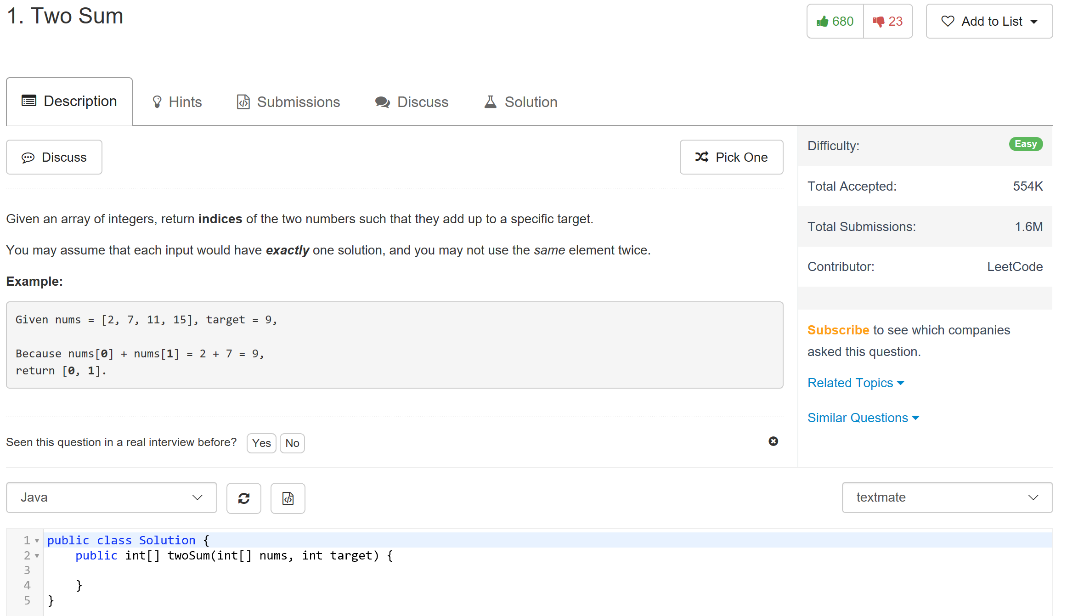
Warm Up
https://leetcode.com/problems/two-sum/#/description

Slide 7
SCANNER
Scanner is an object that lets you get input from the command line.
Example:
Scanner input = new Scanner(System.in);
System.out.println("Enter a number: ");
int num = input.nextInt();
System.out.println("Ohh " + num + " squared is: " + (num * num));

Slide 8
SCANNER Initialization
Scanner is an object, so you have to create one using the new keyword and pass in the stream you want to read from into the constructor function.
Scanner input = new Scanner(System.in);
Type Variable name new constructor function for scanner
//System.in is the console input stream
//System.out is the console output stream

Slide 9
SCANNER Object
After you create a Scanner object and assign it to a variable, you can then use methods on it to get values from the System.in stream.
Scanner input = new Scanner(System.in);
String name = input.nextLine();
int age = input.nextInt();
double heightInM = input.nextDouble();

Slide 10
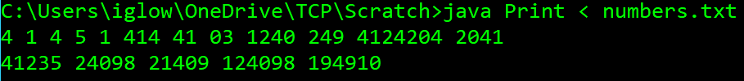
Piping Input
We will get to how to read files directly in java, but you can also ‘pipe’ a file’s contents into System.in using < in the command prompt.
import java.util.Scanner; public class Print
{
public static void main(String[] args)
{
Scanner in = new Scanner(System.in);
while(in.hasNext())
System.out.println(in.nextLine());
}
}

Slide 11
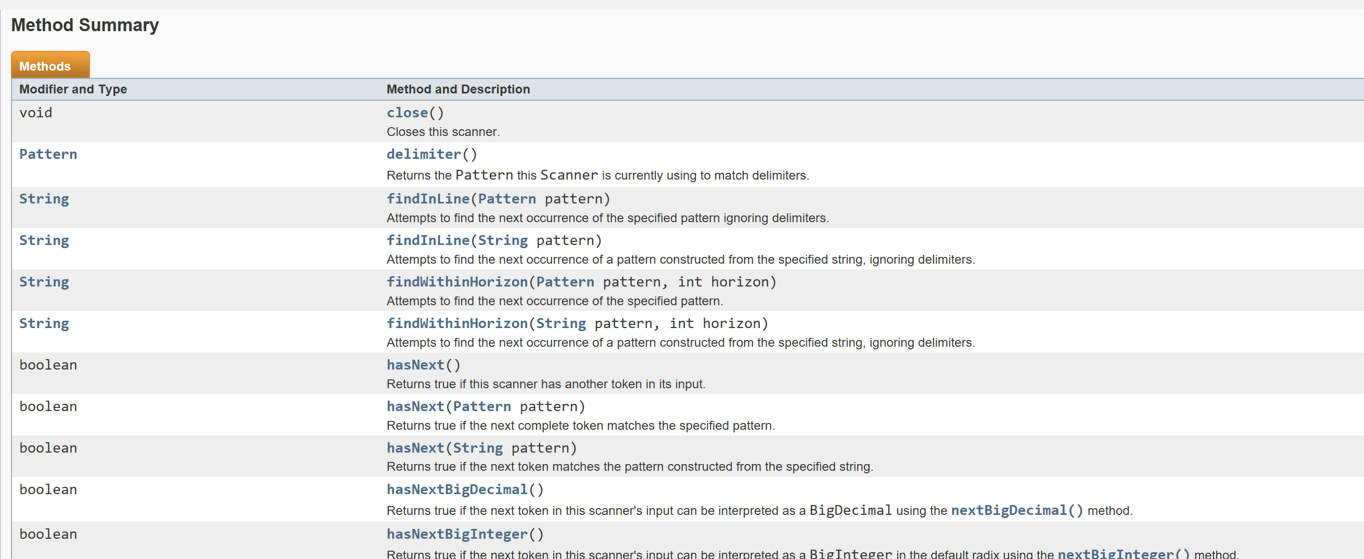
SCANNER Documentation
https://docs.oracle.com/javase/7/docs/api/java/util/Scanner.html

Slide 12
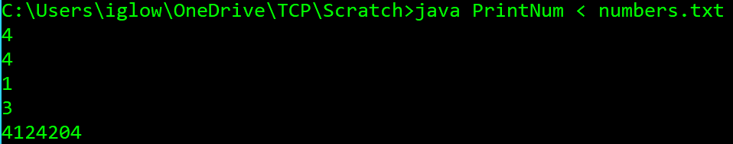
Piping Input – Finding Numbers
import java.util.Scanner;
public class PrintNum
{
public static void main(String[] args)
{
Scanner in = new Scanner(System.in);
while(in.hasNext())
{
//hasNextInt() looks ahead to see if there is an int coming up
if(in.hasNextInt())
System.out.println(in.nextInt());
in.next(); //Gets rid of chars that aren't ints
}
}
}

Slide 13
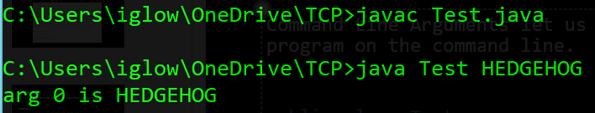
Command-Line Arguments
Command-line arguments let us pass in an array of strings when we execute a program on the command line.
public class Test
{
public static void main(String[] args)
{
if(args.length > 0)
{
System.out.println("arg 0 is " + args[0]);
}
}
}

Slide 14
Command-Line Argument Example
What if we wanted to create a program that takes two integers on the command line and then finds the greatest common factor?
Hmm, we need a way to turn a String into an int.

Slide 15
String Parsing
We can use the Integer class to turn a String into an int, and the Double class to turn a String into a double. //Notice the caps
String str = "10";
int x = Integer.parseInt(str); //x is now 10
String str2 = "9.99";
double y = Double.parseDouble(str2); //y is now 9.99

Slide 16
GCF Command Line Example – Planning (Pseudocode)
Get values from command line and turn to ints
Find smaller value
Divide the integers using bigger and bigger numbers (but equal to or less than the smaller integer), until you find the biggest one that divides both (without remainders).
Lets try!

Slide 17
GCF Command Line Example
To run: java GCF 126 27 Result: 9
public static void main(String[] args)
{
int x = Integer.parseInt(args[0]);
int y = Integer.parseInt(args[1]);
int smaller;
if(x > y) //If there is only one statement after a control statment you dont need {}
smaller = y;
else
smaller = x;
int gcf = 1;
for(int i = 2; i <= smaller; i++)
{
if(x % i == 0 && y % i == 0)
gcf = i;
}
System.out.println(gcf);
}

Slide 18
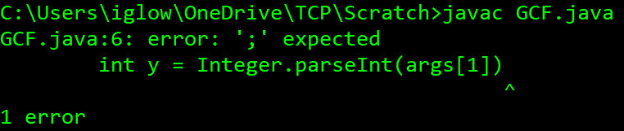
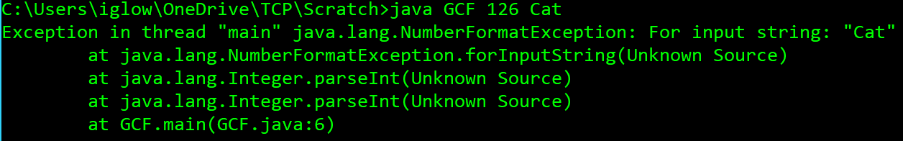
A Brief Note on Errors
There are three categories of errors:
Compile Time Errors:
Run Time Errors (Exception and Logic):
Logic Errors

Slide 19
Strings
Strings are actually objects like the scanner class, so they have methods that you can call on them, and on the inside of the class they are represented by a char[]
char[] cArray = new char[3];
cArray[0] = 'H';
cArray[1] = 'i';
cArray[2] = '!';
//You can directly call the String constructor function
String str = new String(cArray);
System.out.println(str); //Outputs: Hi!
System.out.println(str.charAt(1)); //Outputs: i

Slide 20
String Java Doc
https://docs.oracle.com/javase/7/docs/api/java/lang/String.html
String str = "Cashew Crunch"; //a literal
String str2 = new String(); //create an empty string
System.out.println(str.length()); //13
System.out.println(str2.isEmpty()); //true
System.out.println(str.equals(str2)); //false
System.out.println(str2.equals("")); //true
System.out.println(str.substring(7)); //Crunch
System.out.println(str.substring(4,7)); //ew
System.out.println(str + "!"); //Cashew Crunch!
System.out.println(str.concat("!")); //Cashew Crunch!
System.out.println(str.contains("run")); //Cashew Crunch!
System.out.println(str.toUpperCase()); //CASHEW CRUNCH!

Slide 21

String +=
x += y; → x = x + y; → x = x.concat(y);
public class abc
{
public static void main(String[] args)
{
//Maybe useful for hw4…
String str = new String();
for(char c = 'a'; c < 'z'; c++)
str += c;
System.out.println(str);
}
}

Slide 22
In Class Assignment TIME – Reverse a String
Very common interview question, with many ways to do it. You guys have 10 minutes and get extra credit for solving it!
Description:
Take a String as a command-line argument, then print a reversed version of it.
Example:
java reverse ilikerobots → stoborekili
Hints: use charAt() to get a char at a position in a string, length() to get its length(), += it incrementally build a string, and look at a reverse for loop.

Slide 23

The World Before Computers
Computers were people who just did math in bulk. Programmers were mathematicians who come up with the algorithm that the computers would follow.

Slide 24
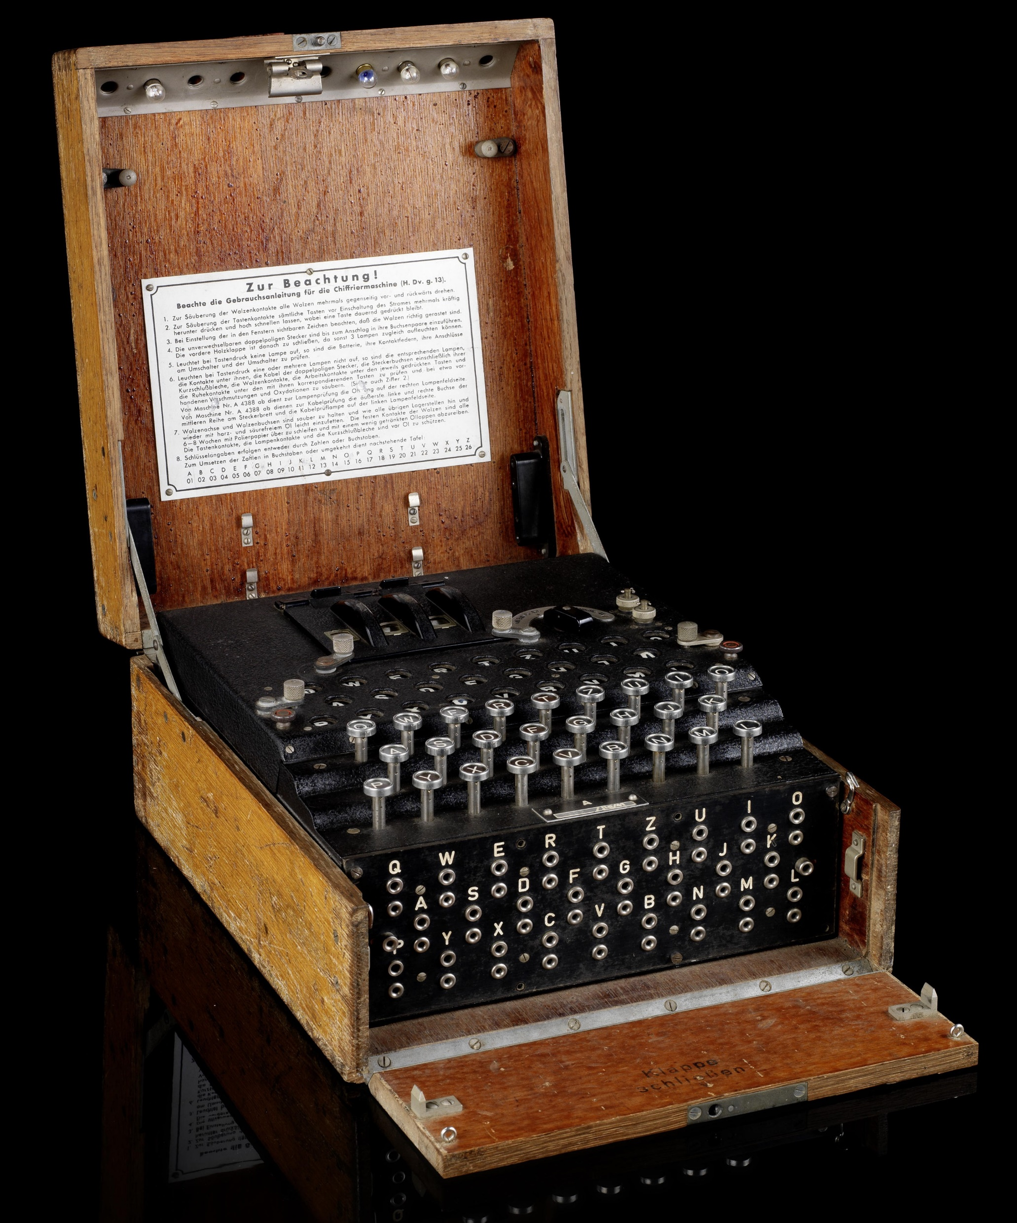
Before Any Programming
Digital circuits were originally used without general-purpose processing. They took information in and used circuits to directly produce output.

Slide 25
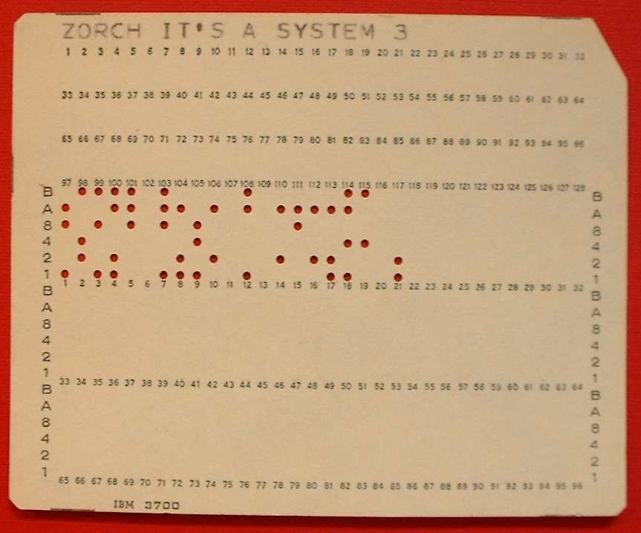
Before Any Programming – Pt2
Then we got general-purpose computing that was used for basic tasks but the ‘program’ was switches and dials, and eventually punch cards that translated to raw machine code in binary.

Slide 26
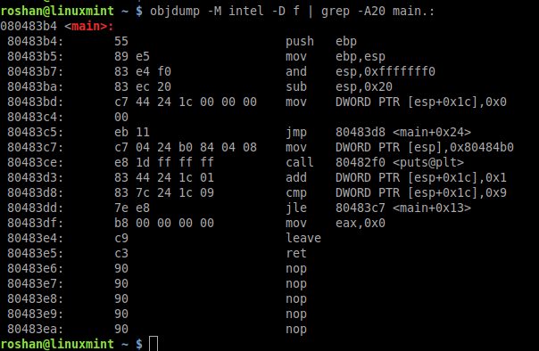
Assembly Language
Assembly language lets you write machine code one to one using words instead of binary //hex
https://gamedev.stackexchange.com/questions/6145/what-programming-language-was-super-mario-bros-written-in

Slide 27
GP Programing Language
Then we got Fortran and Lisp
Then we got C
Then we got Java, C#, and C++
Then we got Java Script

Slide 28
Videos
The Past of Computer Science:
https://www.youtube.com/watch?v=uoDdqYOwpR8
The future of Computer Science:
https://youtu.be/YX40hbAHx3s?list=FLRD1yjMFV9Klg23wB5wh4Ng

Slide 29
Java Basics
Java is both a compiled language and an interpreted language.
You write a .java file in the java programming language.
You compile it with javac and produce a .class file in java bytecode
When you run the program with java it is loaded into a Java Virtual Machine (the JVM) that then interprets the bytecode and on the fly translates the bytecode into machine code your CPU (central processing unit) can understand

Slide 30
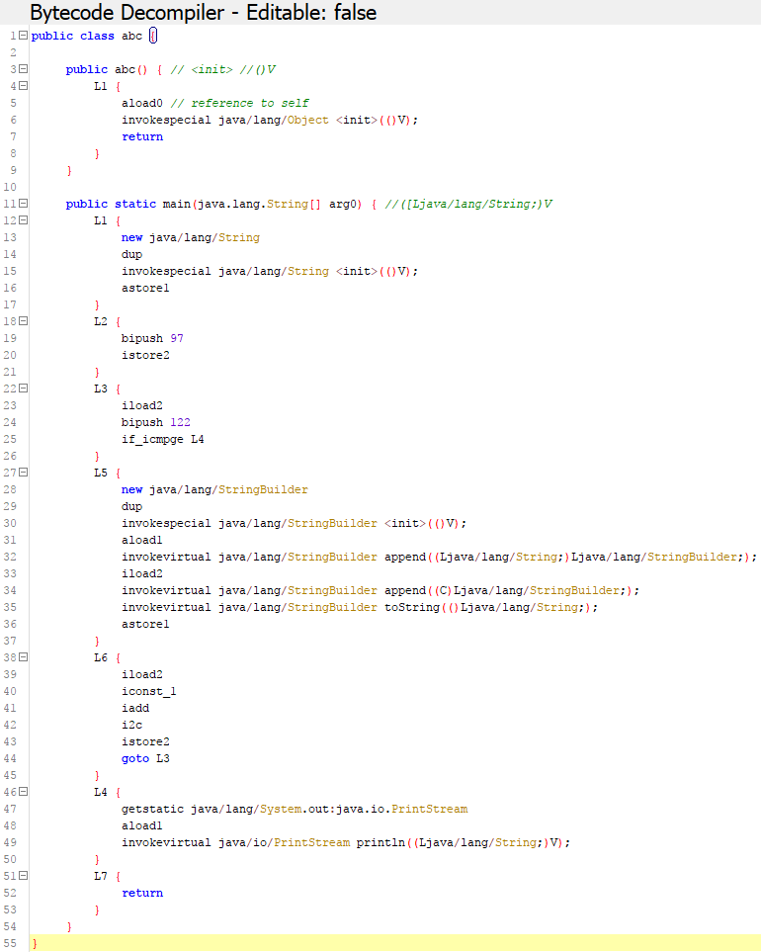
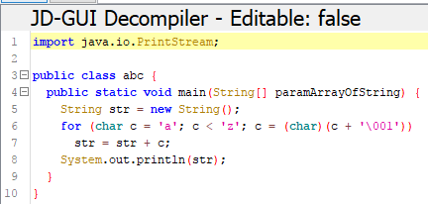
Java Basics - Decompiling
public class abc
{
public static void main(String[] args)
{
String myString = new String();
for(char letter = 'a'; letter < 'z'; letter++)
myString += letter;
System.out.println(myString);
}
}

Slide 31
Java Portability
You can wrap a collection of .class files into a single .jar file
.jar files can be made so they are executed on click
.jar files can then be wrapped in apps or a .exe

Slide 32
Java Strengths
Really common and good introductory language
Same basic syntax as Javascript, C++, C#
Lots of libraries and systems that use it
“Write once, run anywhere”
“Enterprise strength”

Slide 33
Java Weaknesses
You can ‘decompile’ the source code
Not super performant
Hard to write low level code
Very verbose

Slide 34
Where is java used Most often?
Android
Web (eBay and things)
Games
Databases
Management software

Slide 35
HW3
‘HW3 – Summation’ is on Moodle.
Due tomorrow!

