Slide 1
public class Bubble
{
public static int[] bubbleSort(int[] arr)
{
for(int i = 0; i < arr.length; i++)
{
for(int j = 0; j < arr.length - 1; jA++)
{
if(arr[j] > arr[j+1]) //swap
{
int temp = arr[j];
arr[j] = arr[j+1];
arr[j+1] = temp;
}
}
} return arr;
}
}
INTRODUCTION TO PROGRAMMING
TCP 2017
Prof: Ian Glow
Deck 6 – Sorting and Search

Slide 2
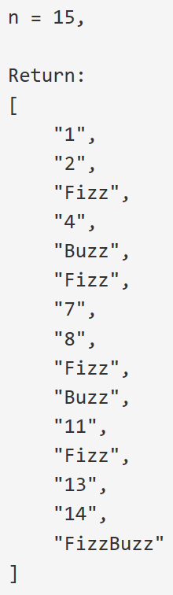
Warm Up
Write a program that outputs the string representation of numbers from 1 to n.
But for multiples of three it should output “Fizz” instead of the number and for the multiples of five output “Buzz”. For numbers which are multiples of both three and five output “FizzBuzz”.
https://leetcode.com/problems/fizz-buzz/description/

Slide 3
Arrays Have Some Problems…
Arrays are fixed size, and cannot be resized.
int[] vals = new int[3];
for(int i = 0; i < 4; i++)
{
vals[i] = i; //ERROR WHEN i = 3
}

Slide 4
Our own Solution…
public static void main(String[] args)
{
int[] vals = new int[0];
for(int i = 0; i < 4; i++)
vals = addToEndOfArray(vals, i);
}
public static int[] addToEndOfArray(int[] array, int value)
{
int[] toRet = new int[array.length + 1];
for(int i = 0; i < array.length; i++)
toRet[i] = array[i];
toRet[array.length] = value;
return toRet;
}
..but it’s bad. Everytime we add 1 thing we have to copy everything!

Slide 5

How do we fix this???

Slide 6
We Don’t! We let someone Else do it! – ArrayList
import java.utils.*; //We have to import ArrayList
public class ArrayListTest
{
public static void main(String[] args)
{
//In the <> we put the type we want for our elements.
//It has to be a class such as Point or Lion,
//so we use the class version of int (Integer).
ArrayList<Integer> arr = new ArrayList<Integer>();
for(int i = 0; i < 4; i++)
arr.add(i);
System.out.println(arr);
}
}

Slide 7
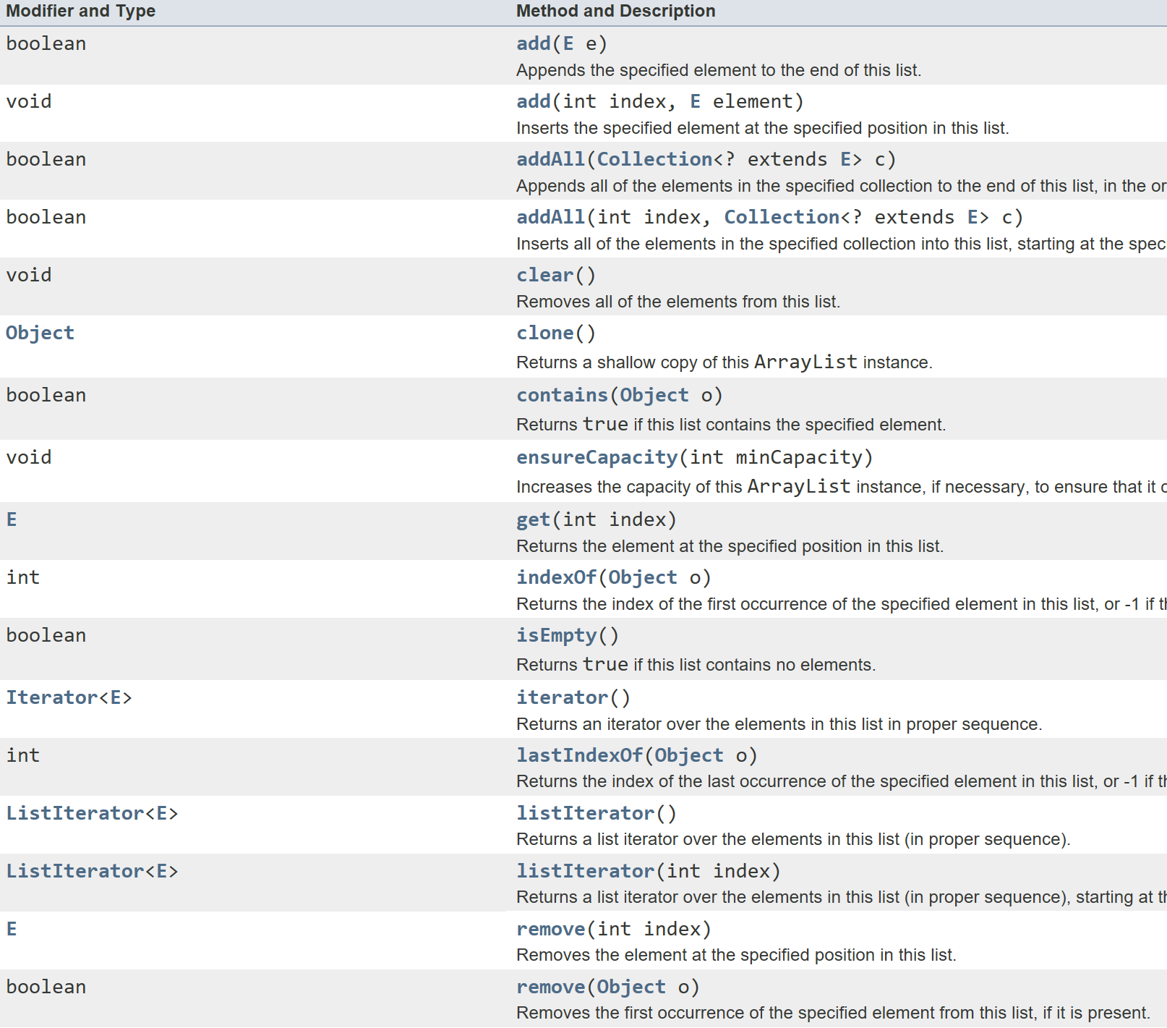
ArrayList Java Doc
http://docs.oracle.com/javase/7/docs/api/java/util/ArrayList.html

Slide 8
Let’s solve the most common CS Problem - Sorting
You are given an array of numbers in some order and you want to reorder it in an ascending or descending order.
Why?
With a sorted list you can:
Find Min or Max instantly
Can find median
Can use binary search
Etc…

Slide 9
Sorting Algorithms
Slow ~N^2 comparisons: //N being the # of items in array
Bubble Sort
Selection Sort
Insertion Sort
Fast ~N * log(N) comparisons:
Merge Sort
Heap Sort
https://en.wikipedia.org/wiki/Sorting_algorithm#Popular_sorting_algorithms

Slide 10
Bubble Sort – N^2
The largest values bubble to the end at each pass, so in N passes the list is sorted.
public static int[] bubbleSort(int[] arr){
for(int i = 0; i < arr.length; i++){
for(int j = 0; j < arr.length - 1; j++){
if(arr[j] > arr[j+1]) //swap
{
int temp = arr[j];
arr[j] = arr[j+1];
arr[j+1] = temp;
}
}
}
}

Slide 11
Selection Sort – N^2
Find the smallest and swap it to the start of the list. Repeat N times.
public static int[] selectionSort(int[] arr)
{
for(int i = 0; i < arr.length; i++)
{
int smallestIndex = i;
for(int j = i + 1; j < arr.length; j++)
{
if(arr[j] < arr[smallestIndex])
smallestIndex = j;
}
//Swap
int temp = arr[i];
arr[i] = arr[smallestIndex];
arr[smallestIndex] = temp;
}
return arr;
}

Slide 12
Insertion Sort – N^2
For each value in the original list, put it in the right spot in a new list.
public static ArrayList<Integer> insertionSort(ArrayList<Integer> arr){
ArrayList<Integer> result = new ArrayList<Integer>();
for(int i = 0; i < arr.size(); i++)
{
int cur = arr.get(i);
if(result.size() == 0 || result.get(result.size() - 1) < cur){
result.add(cur);
}
else
{
for(int j = 0; j < result.size(); j++)//Place it in the right spot
{
if(result.get(j) > cur)
{
result.add(j, cur);
break;
}
}
}
}
return result;
}

Slide 13
Merge Sort – N log n
Split items into two halves
Sort each half recursively
Combine both halves //N comparisons

Slide 14
Merge Sort – N log n
public static ArrayList<Integer> mergeSort(ArrayList<Integer> array)
{
int n = array.size();
if(n <= 1)
return array;
ArrayList<Integer> left = mergeSort(new ArrayList<Integer>(array.subList(0, n/2)));
ArrayList<Integer> right = mergeSort(new ArrayList<Integer>(array.subList(n/2, n)));
ArrayList<Integer> result = new ArrayList<Integer>();
while(left.size() > 0 || right.size() > 0)
{
if(left.size() == 0 || (right.size() > 0 && right.get(0) < left.get(0)))
{
result.add(right.get(0));
right.remove(0);
}
else
{
result.add(left.get(0));
left.remove(0);
}
}
return result;
}

Slide 15
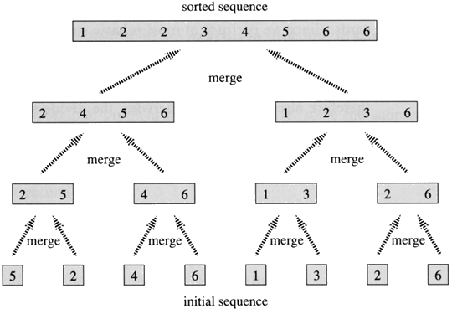
Merge Sort – N log n

Slide 16
Now Let’s RACE!
-Teams of 2
-Race to see who can sort a deck of cards fastest.
-Cannot use any knowledge not gained from a direct comparison.
-You can only flip two cards face up, look at them, make a decision, then flip them both face down (at a time).
Winning team gets a prize!

Slide 17
How Does Google maps Work?
It’s called pathfinding!

Slide 18
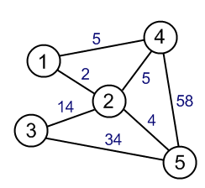
Other Places we Use pathfinding:
Anywhere you have a graph with nodes and edges!
Video Games
Travel and Business
Computer Networking
AI Planning

Slide 19
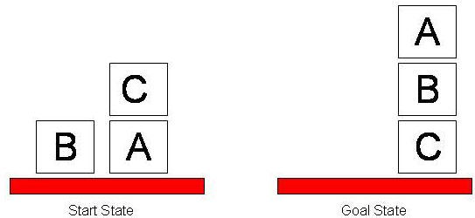
Decision Spaces:
Anywhere you have a graph with nodes and edges!

Slide 20
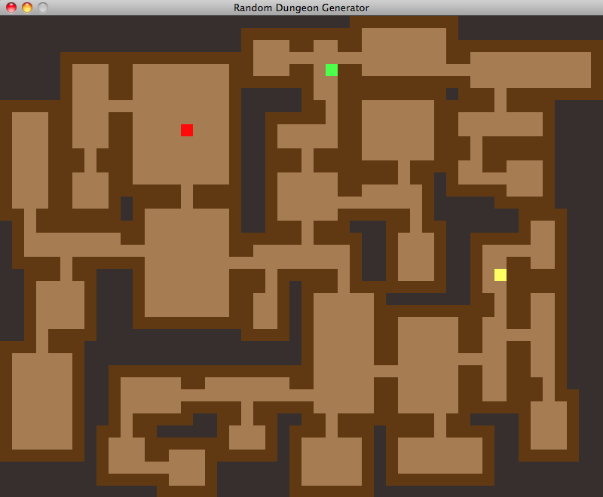
Ohh No!! you need to escape a maze!
You are trapped and your friend is injured!
You need to find your way to the exit, call 911, and give them the info on the shortest path to your friend.
(This is what google does)

Slide 21
Simplest Algorithm: Depth First Search
Keep going through the 1st door you see until you come to a dead end.
Backtrack until there is a door you haven’t tried and then continue the algorithm from there.
Properties:
-Is guaranteed to find the exit (if a path exists).
-The path you eventually find to the exit is not guaranteed to be the shortest.

Slide 22
Ohh No!! you need to escape a maze! – DFS Drawing
Doors are edges
Rooms are nodes

Slide 23
Algorithm: BreaDth First Search
Only go to the rooms one room away from your friend and look for the exit. Then go to rooms two away from your friend… then three away… etc…
Properties:
-Is guaranteed to find the exit (if a path exists).
-The path you eventually find to the exit is guaranteed to be the shortest in terms of the number of rooms visited.

Slide 24
Ohh No you need to escape a maze! – BFS Drawing

Slide 25
Dijkstra's algorithm
Visit the room that is the closest to your friend but you haven’t already visited. Keep a list of all the doors and the rooms they connect to so you can always find the smallest and update values for new rooms you find.
https://en.wikipedia.org/wiki/Dijkstra%27s_algorithm
Properties:
-Is guaranteed to find the exit (if a path exists).
-The path you eventually find to the exit is guaranteed to be the shortest in terms of the distance traveled.

Slide 26
Dijkstra's algorithm Drawing

Slide 27
Greedy algorithm
Head straight toward where you think the exit is based of some guess (called a heuristic). If you get stuck backtrack to a door you haven’t tried.
Properties:
-Is guaranteed to find the exit (if a path exists).
-Is really fast in simple mazes, slow in complex mazes.
-The path you eventually find to the exit is not guaranteed to be the shortest in any way.

Slide 28
Greedy Search algorithm Drawing

Slide 29
A* algorithm
Visit a room that is close to your friend that you haven’t visited, but is going in the direction you think the exit is. The distance from your friend matters more (or is equivalent) to your guess on the exit (the heuristic) in your decision making
Properties:
-Is guaranteed to find the exit (if a path exists).
-Is really fast almost always.
-The path you eventually find to the exit is guaranteed to be the shortest in terms of the distance traveled.

Slide 30
A* Search algorithm Drawing

Slide 31
A* is the winner!
Lets Visualize:
https://github.com/kevinwang1975/PathFinder
More A* Info:
http://theory.stanford.edu/~amitp/GameProgramming/AStarComparison.html

Slide 32
Pathfinding Recap
Pathfinding can be used anywhere you can represent nodes and edges.
Algorithms:
Ones that don’t pay attention to edge weight:
Depth First Search – super simple algorithm
Breadth First Search – finds quickest in terms of rooms (nodes)
Ones that do pay attention to edge weight:
Dijkstra’s – a lot of work but finds the correct path
Greedy – pretty simple but doesn’t always find the best path
A* – the champ if you have a heuristic

Slide 33
HW6 – Sorting Cards
On Moodle
Due tomorrow!

