Slide 1
public class LineTester
{
public static void main(String[] args)
{
Scanner scan = new Scanner(System.in);
System.out.println("Enter number of points:");
int n = scan.nextInt();
Point[] points = new Point[n];
System.out.println("Enter each x and y:");
for(int i = 0; i < n; i++)
points[i] = new Point(scan.nextDouble(), scan.nextDouble());
Line line = new Line(points);
System.out.println(line.toString());
while(true)
{
System.out.println("Enter x for prediction:");
double x = scan.nextDouble();
System.out.println("At x = " + x + ", y = " + line.getYAt(x));
}
}
}
Deck 7 – Artificial Intelligence
INTRODUCTION TO PROGRAMMING
TCP 2017
Prof: Ian Glow

Slide 2
What is AI?
Artificial intelligence (AI) is the intelligence exhibited by machines or software. It is also the name of the academic field of study which studies how to create computers and computer software that are capable of intelligent behavior.

Slide 3
Examples of AI?
-NPCs in video games
-Self-driving cars
-Corporate planning systems
-Doctor replacers
Anything that a human can do, but a computer is doing it is “Artificial Intelligence”

Slide 4
Pong AI
https://scratch.mit.edu/projects/24201698/
AI ideas:
-Move randomly
-Move toward ball y
-Predict the future
-Hybrid
When creating an AI you have to think:
-What actions can it take?
-How smart do I want it to be?
-How expensive can it be?

Slide 5
Chess AI
The Shannon number, named after Claude Shannon, is a conservative lower bound (not an estimate) of the game-tree complexity of chess of 10¹²⁰, based on an average of about 10³ possibilities for a pair of moves consisting of a move for White followed by one for Black, and a typical game lasting about 40 such pairs of moves
https://www.youtube.com/watch?v=kdJnrrZeng0
AI for some problems is reallllly hard…
//Now Watson is a doctor and AlphaGo will take over the world

Slide 6
A Bucket of AIs
https://aiexperiments.withgoogle.com/

Slide 7
What is Machine Learning?
Machine learning is the subfield of computer science that, according to Arthur Samuel in 1959, gives "computers the ability to learn without being explicitly programmed." Evolved from the study of pattern recognition and computational learning theory in artificial intelligence, machine learning explores the study and construction of algorithms that can learn from and make predictions on data – such algorithms overcome following strictly static program instructions by making data-driven predictions or decisions, through building a model from sample inputs.

Slide 8
What is Machine Learning?
Machine learning is when programs learn
AI is when a program does something “intelligent”

Slide 9
Basic Machine Learning – Linear Regression
Predict a future value based on previous points on a 2d plot.
Ie: If we have points (0,10), (1, 12), (2,14), we can create the line y = 2x + 10 and then we can predict that at x = 10,
y would be around 210
Only useful for linearly correlated values.

Slide 10
Basic Machine Learning – Linear Regression
public class LineTester
{
public static void main(String[] args)
{
Scanner scan = new Scanner(System.in);
System.out.println("Enter number of points:");
int n = scan.nextInt();
Point[] points = new Point[n];
System.out.println("Enter each x and y:");
for(int i = 0; i < n; i++)
points[i] = new Point(scan.nextDouble(), scan.nextDouble());
Line line = new Line(points);
System.out.println(line.toString());
while(true)
{
System.out.println("Enter x for prediction:");
double x = scan.nextDouble();
System.out.println("At x = " + x + ", y = " + line.getYAt(x));
}
}
}

Slide 11
Basic Machine Learning – Linear Regression
public class Line
{
public double slope;
public double intercept;
//Linear Regression
public Line(Point[] points)
{
int n = points.length;
Point avarage = Point.midpoint(points);
// http://algs4.cs.princeton.edu/14analysis/LinearRegression.java.html
double xxbar = 0.0, yybar = 0.0, xybar = 0.0;
for (int i = 0; i < n; i++) {
xxbar += (points[i].x - avarage.x) * (points[i].x - avarage.x);
yybar += (points[i].y - avarage.y) * (points[i].y - avarage.y);
xybar += (points[i].x - avarage.x) * (points[i].y - avarage.y);
}
slope = xybar / xxbar;
intercept = avarage.y - slope * avarage.x;
}
public double getYAt(double x)
{
return x * slope + intercept;
}
}

Slide 12
Basic Machine Learning – Linear Regression
We can use this in a lot of places in real life:
https://teslanomics.co/what-is-the-lifespan-of-a-tesla-battery-and-how-long-will-it-last
There are many forms of regression: quadratic, cubic, multidirectional, etc…

Slide 13
Machine Learning – Neural Network
Replicate a complicated function by training a fake brain with a lot of inputs and expected outputs. You choose the structure, inputs, outputs, and activation function. Backpropagation algorithm repeatedly “trains” the weights on edges to minimize the error.
Input
Input
Input
Input Layer
Perceptron
Perceptron
Perceptron
Activation Function
1.0
0.0
Perceptron
Perceptron
Output
Hidden Layer
0.0 0.5 1.0
Output Layer
Perceptron
Perceptron
Perceptron
Input
Output
Output
Output

Slide 14
Example Neural Network - OR
Activation Function
1.0
0.0
Input A
Input B
Input Layer
Perceptron
Perceptron
0.0 0.5 1.0
A | B | Output
0 | 0 | 0
0 | 1 | 1
1 | 0 | 1
1 | 1 | 1
1.0
1.0
Perceptron
Output Layer
Output
Function is basically:
if(A + B > 0.5) return 1;
Else return 0;

Slide 15
Example Neural Network - AND
Activation Function
1.0
0.0
Input A
Input B
Input Layer
Perceptron
Perceptron
0.0 0.5 1.0
A | B | Output
0 | 0 | 0
0 | 1 | 0
1 | 0 | 0
1 | 1 | 1
0.3
0.3
Perceptron
Output Layer
Output
Function is basically:
if(0.3A + 0.3B > 0.5) return 1;
else return 0;

Slide 16
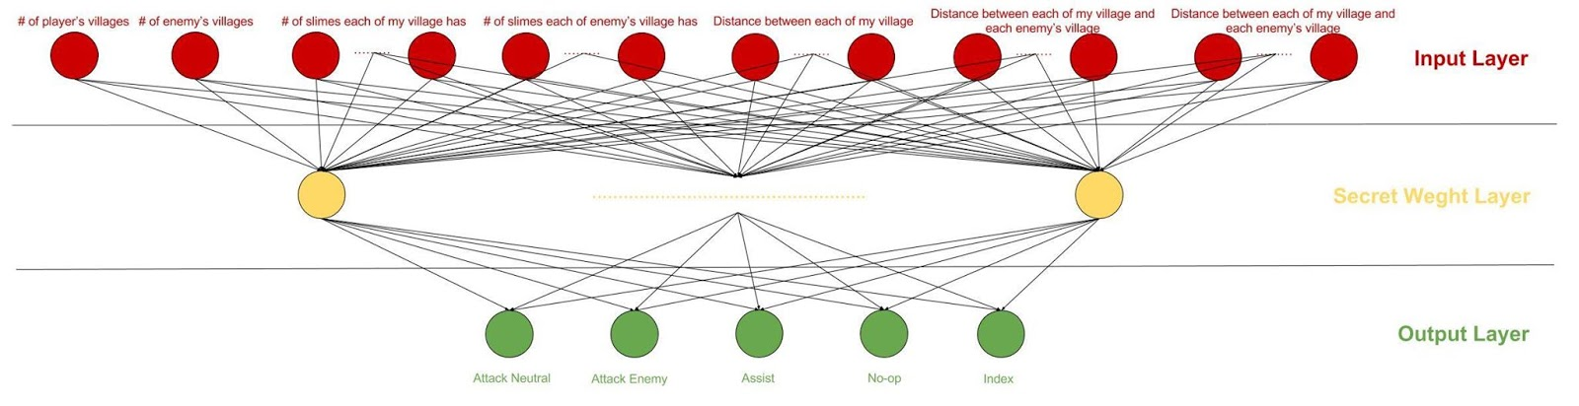
Machine Learning – Neural Network

Slide 17
Machine Learning – Neural Network
They are everywhere!
-Self-Driving
-Games
-Image Recognition
-Speech Synthesis
More…

Slide 18
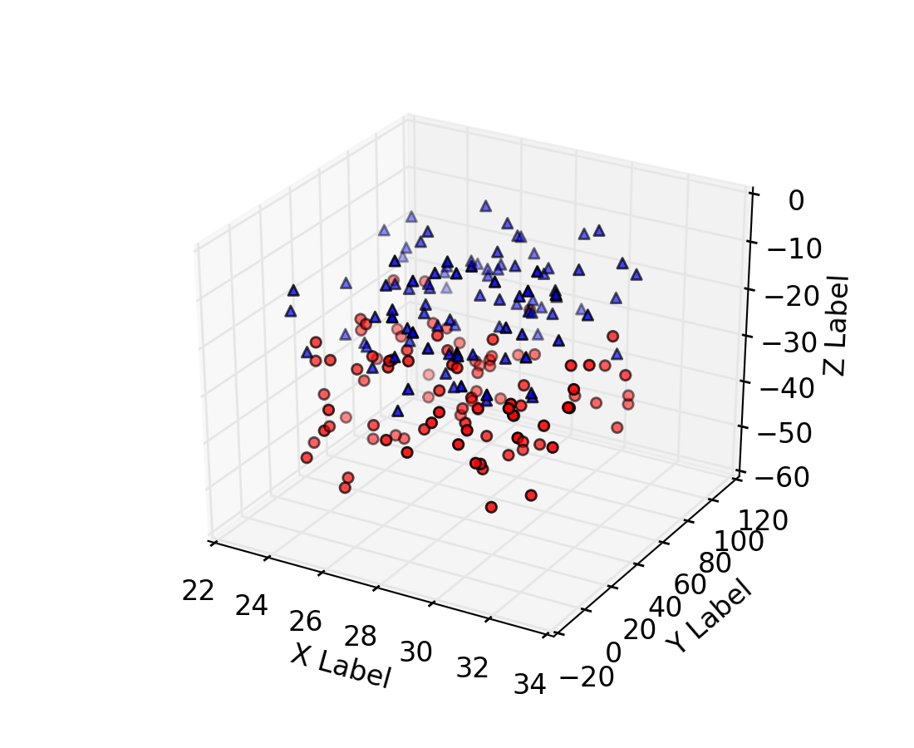
Machine Learning – K-Nearest Learning
Look for the closest points in multi-dimensional space and then make a decision based on them

Slide 19
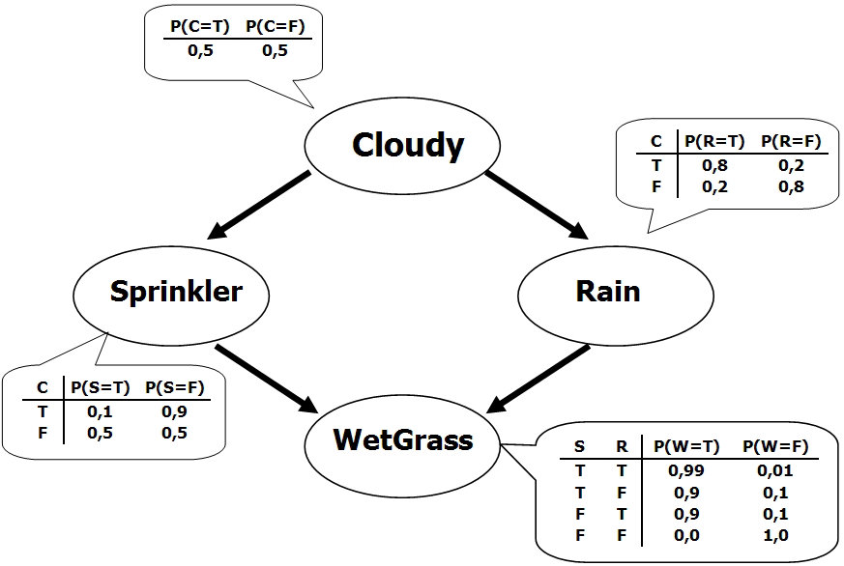
Machine Learning – Bayesian Network
A giant learned conditional probability. E.g., “given that the email has this word, what's the probability it’s spam?”

Slide 20
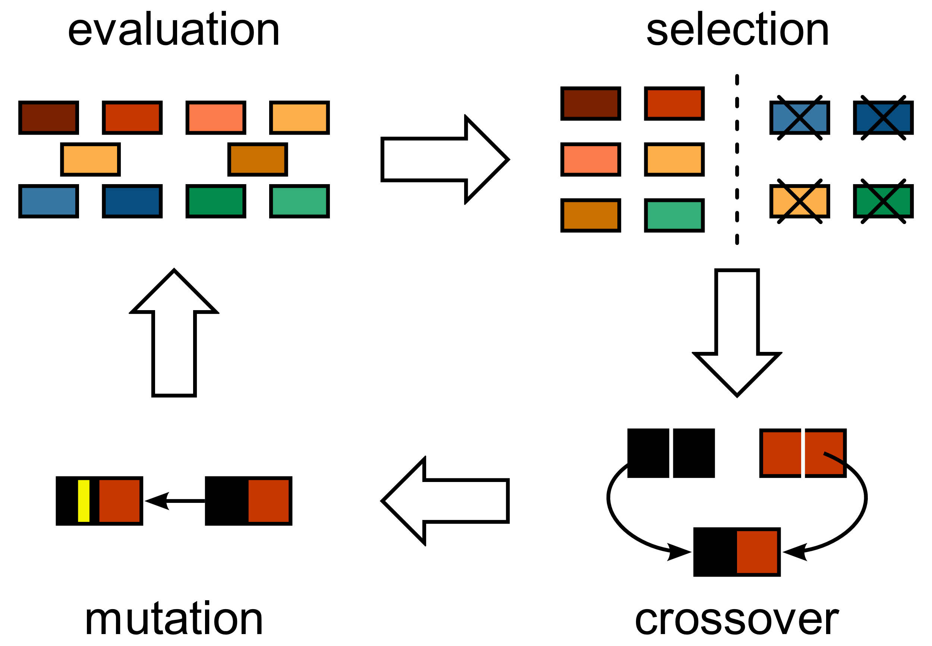
Genetic Algorithms – p1
Create random answers, then judge them using a
fitness function. Only let the best survive. Breed new answers from previous good answers, apply mutations then loop.

Slide 21
Genetic Algorithms – p2
Mutation – necessary to get traits not in any original individual
Crossover – let traits try working together and drive us to our goal

Slide 22
Genetic Algorithms – Initial Population
public static Species generateRandomPop()
{
String genes = "";
int length = (int)(Math.random() * 10 + 1);
for(int i = 0; i < length; ++i)
{
genes += (char)(Math.random() * 26 + 'A');
}
return new Species(genes);
}

Slide 23
Genetic Algorithms – Fitness
public int getFitness(String goal)
{
//http://www.programcreek.com/2013/12/edit-distance-in-java/
String word1 = genes;
String word2 = goal;
int len1 = word1.length();
int len2 = word2.length();
// len1+1, len2+1, because finally return dp[len1][len2]
int[][] dp = new int[len1 + 1][len2 + 1];
for (int i = 0; i <= len1; i++) {
dp[i][0] = i;
}
for (int j = 0; j <= len2; j++) {
dp[0][j] = j;
} // ………………………………………………………………………, etc.

Slide 24
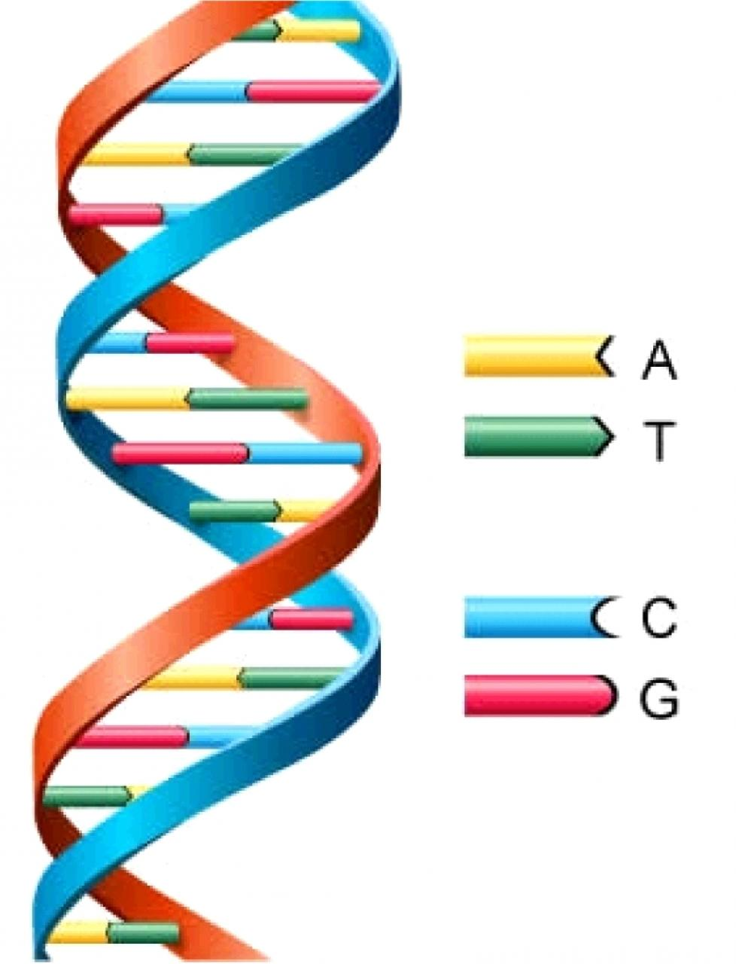
Genetic Algorithms – Mutation
public void pointMutation()
{
fitness = -1;
char[] c = genes.toCharArray();
int point = (char)(Math.random() * c.length);
char change = (char)(Math.random() * 26 + 'A');
c[point] = change;
genes = new String(c);
}
public void additionMutation()
{
fitness = -1;
genes += (char)(Math.random() * 26 + 'A');
}
public void deletionMutation()
{
fitness = -1;
if(genes.length() > 1)
genes = genes.substring(0, genes.length() - 1);
}

Slide 25

Genetic Algorithms – Crossover
//Two children!
public Species[] breed(Species other)
{
Species[] children = new Species[2];
children[0] = new Species(genes.substring(0, genes.length() / 2) + other.genes.substring(other.genes.length() / 2));
children[1] = new Species(other.genes.substring(0, other.genes.length() / 2) + genes.substring(genes.length() / 2));
return children;
}

Slide 26
Genetic Algorithms + Neural Nets = Amazing
Mar I/O:
https://www.youtube.com/watch?v=qv6UVOQ0F44

Slide 27
Machine Learning Magic
Music:
https://www.youtube.com/watch?v=j60J1cGINX4
Dota 2:
https://www.youtube.com/watch?v=92tn67YDXg0&feature=youtu.be&t=9m33s
Art:
https://www.fastcodesign.com/3048274/heres-what-googles-trippy-deep-dream-ai-does-to-a-video-selfie

Slide 28
The Danger
http://www.cgpgrey.com/blog/humans-need-not-apply

Slide 29
A Solution
https://www.youtube.com/watch?v=OEkT14RBzDI&t=1s
Musk, Zuckerberg, Gates…

Slide 30
Let’s try another Programming Language!
Clojure, a Lisp-based dialect that outputs java bytecode so it can be used anywhere Java can be used.
-It is a functional programming language and you can pass functions
-It has no loops
-You cannot modify a variable after creating it //or you shouldn’t
-It is not object-based
You can launch an online version here: http://www.tryclj.com/

Slide 31
Clojure - Basic Syntax
(Function arg0 arg1 arg2)
Example:
(* 4 6)
(+ 1 2 3 4)
(/ 20 4)
(* 4 (- 10 3))
() ← function calls always return a value, i.e. everything is an expression

Slide 32
Clojure – Creating a Function Syntax
(defn name [arg0 arg1 arg2] (body))
Examples:
(defn dub [x] (* x x))
(defn factorial [x]
(if (= x 1)
1
(factorial (- x 1))))

Slide 33
Clojure – Useful functions
(print "Woot")
; Group statements together with do
(do
(print "Hello")
"World") ; => "World" (prints "Hello")
(if false "a" "b") ; => "b"
(if false "a") ; => nil

Slide 34
In-Class Clojure Assignments
Create a function that outputs the midpoint of two pairs of x and y.

Slide 35
Clojure – Infinite Ranges
; A sequence need only provide an entry when it is accessed.
; So because sequences can be lazy -- they can define infinite series:
(range 4) ; => (0 1 2 3)
(range) ; => (0 1 2 3 4 ...) (an infinite series)
(take 4 (range)) ; (0 1 2 3)
((take 10 (cycle [4 5 6]))) ; (4 5 6 4 5 6 4 5 6 4)

Slide 36
Clojure – Map and Filter
; map takes a function and a sequence and applies the function to each
; member in the sequence
(map #(* % 2) (range 1 10))) ; (2 4 6 8 10 12 14 16 18)
(filter #(= (mod % 4) 0) (range 20)) ; (0 4 8 12 16)

Slide 37
In Class Clojure Assignments
Do fizz buzz in Clojure!
https://leetcode.com/problems/fizz-buzz/description/

Slide 38
Clojure – LEARN MORE!
The main website:
https://clojure.org/
A great free online book on Clojure:
https://www.braveclojure.com/
A quick overview of all of Clojure:
https://learnxinyminutes.com/docs/clojure/

Slide 39
HW7 – Evolution
On Moodle
Due tomorrow!

