Slide 1

Deck 8 – Game Development
INTRODUCTION TO PROGRAMMING
TCP 2017
Prof: Ian Glow

Slide 2
What is a Video Game?
A video game is an interactable simulation of a universe
Traditionally there are systems:
Rendering
Physics
Networking
And there are actors:
Players
NPCs
That have components and behaviors:
Colliders
AI Controllers

Slide 3
The Basic Game Loop
Start Game
While(true):
Get Input
Update Game World
Produce Output

Slide 4
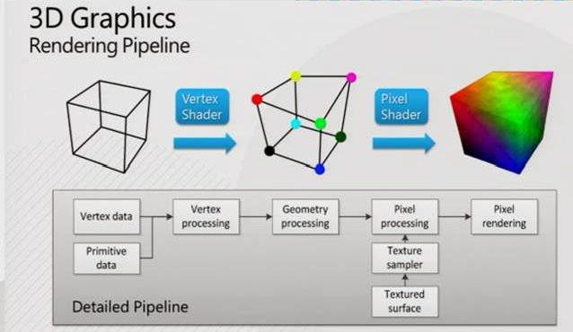
Graphics?
https://en.wikipedia.org/wiki/Graphics_pipeline

Slide 5
How do we get Something to show on a screen?
We first have a game object with a location (a 2d or 3d point also known as a vector).
This game object is made out of triangles, with each triangle having three vertices (which have relative vectors to the objects location)
We then use a vertex shader to transform each vertex into its position on the actual screen
We then fill in the new screen space triangles with textures and color using a pixel shader
//A shader is a tiny massively-parallel program run on a GPU

Slide 6
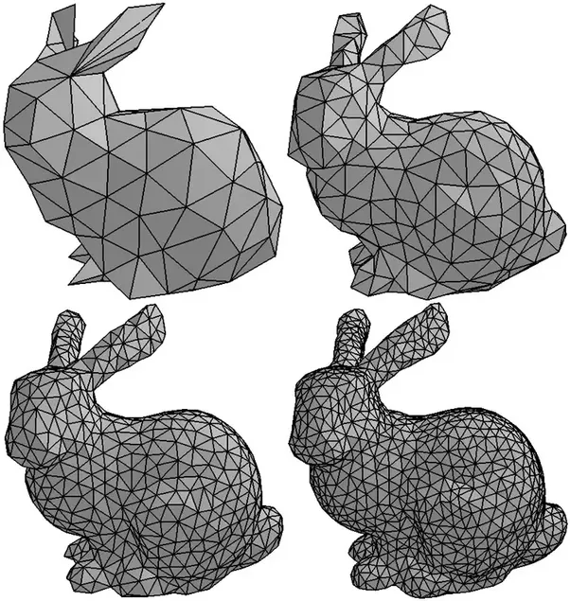
Meshes

Slide 7
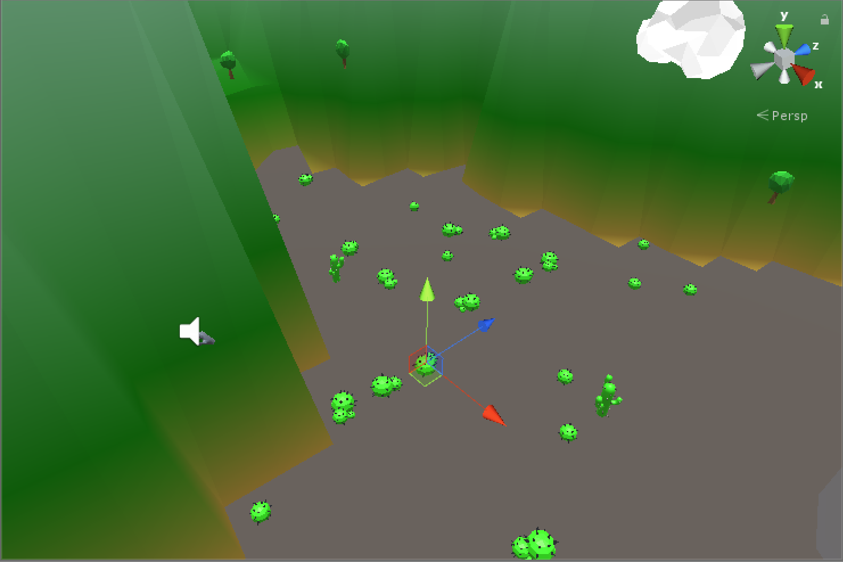
World Space
An object’s location in the real world

Slide 8
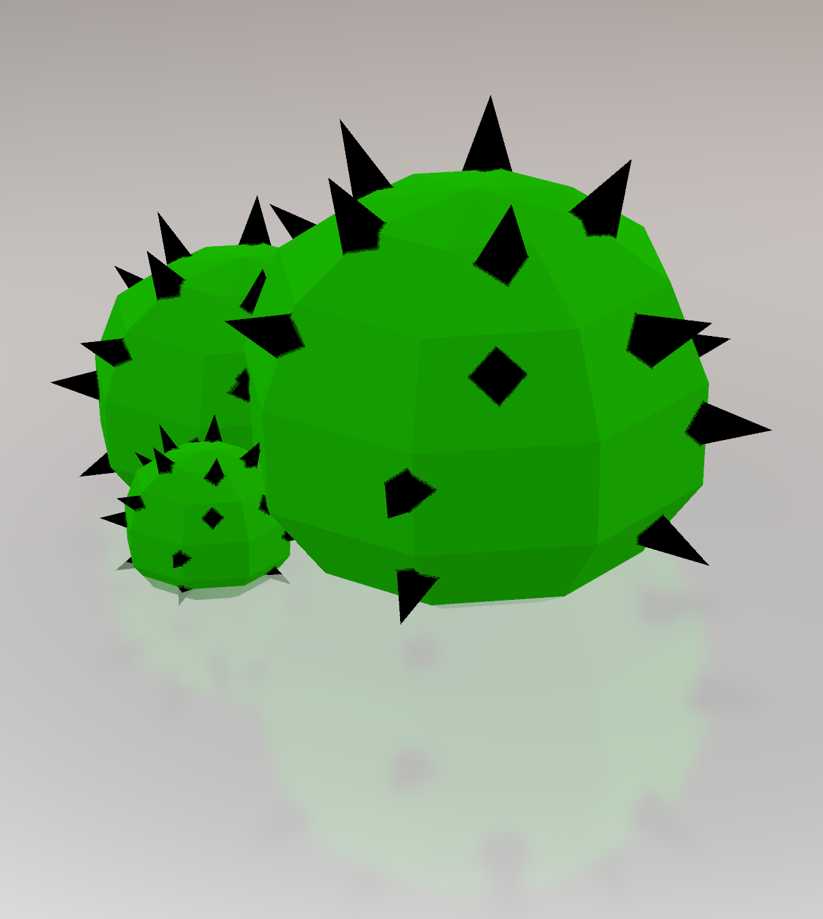
Object Space
Location of vertexes relative to the center of the object

Slide 9
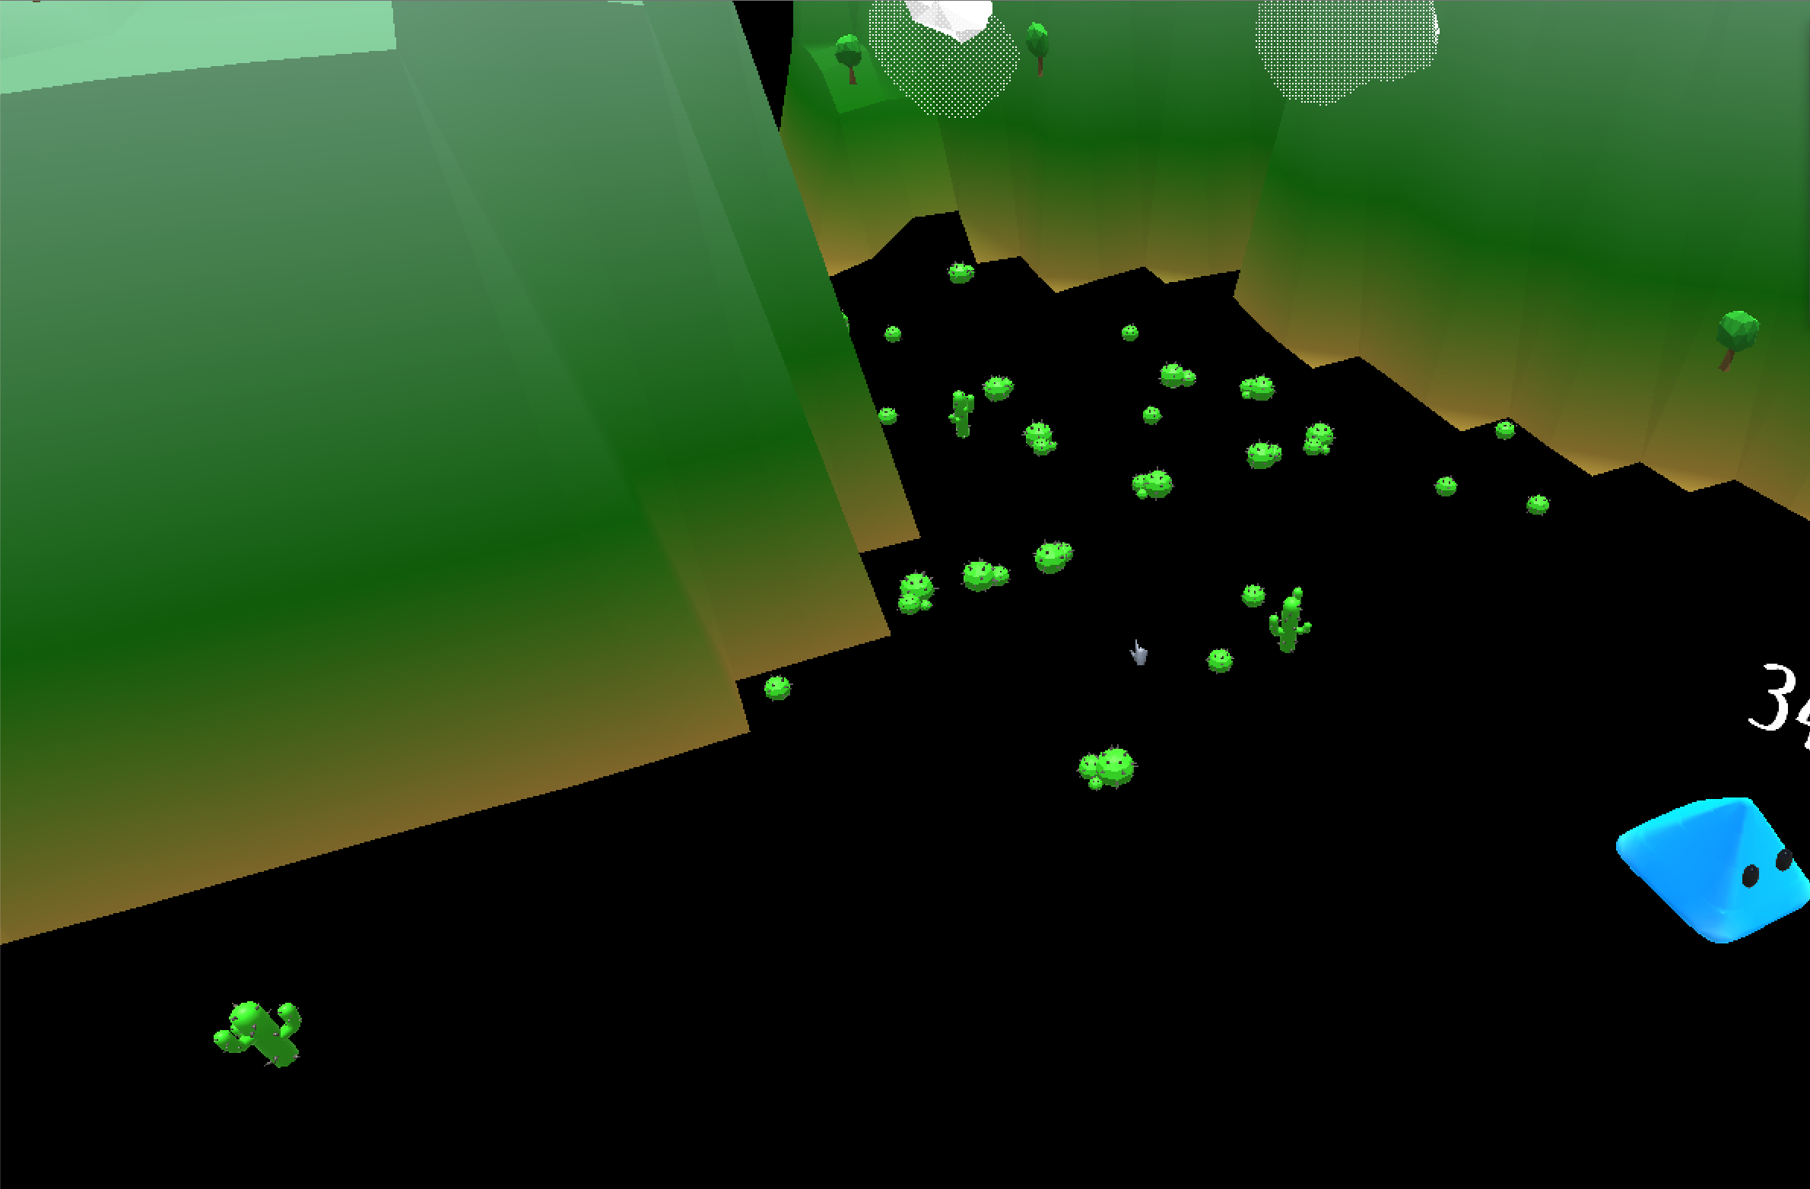
Screen Space
Location of vertices when shown on the screen

Slide 10
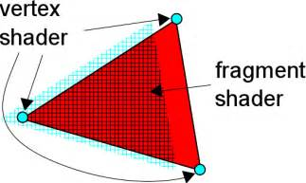
ShaDers
Shaders are tiny
programs executed
in parallel by the GPU.
DirectX or OpenGL
vertex shader - transform each vertex into its position on the actual screen
pixel shader (fragment shader) – color in the pixels on the screen

Slide 11
A vertex Shader
struct VertexToPixel
{
float4 Position : POSITION;
float4 Color : COLOR0;
float4 Position3D : TEXCOORD0;
};
float4x4 xViewProjection;
VertexToPixel SimplestVertexShader( float4 inPos : POSITION, float4 inColor : COLOR0)
{
VertexToPixel Output = (VertexToPixel)0;
Output.Position = mul(inPos, xViewProjection);
Output.Color.rgb = inPos.yxz;
Output.Position3D = inPos;
return Output;
}

Slide 12
A Pixel Shader
struct VertexToPixel
{
float4 Position : POSITION;
float4 Color : COLOR0;
float4 Position3D : TEXCOORD0;
};
struct PixelToFrame
{
float4 Color : COLOR0;
};
PixelToFrame OurFirstPixelShader(VertexToPixel PSIn)
{
PixelToFrame Output = (PixelToFrame)0;
Output.Color.rgb = PSIn.Position3D.yxz;
return Output;
}

Slide 13
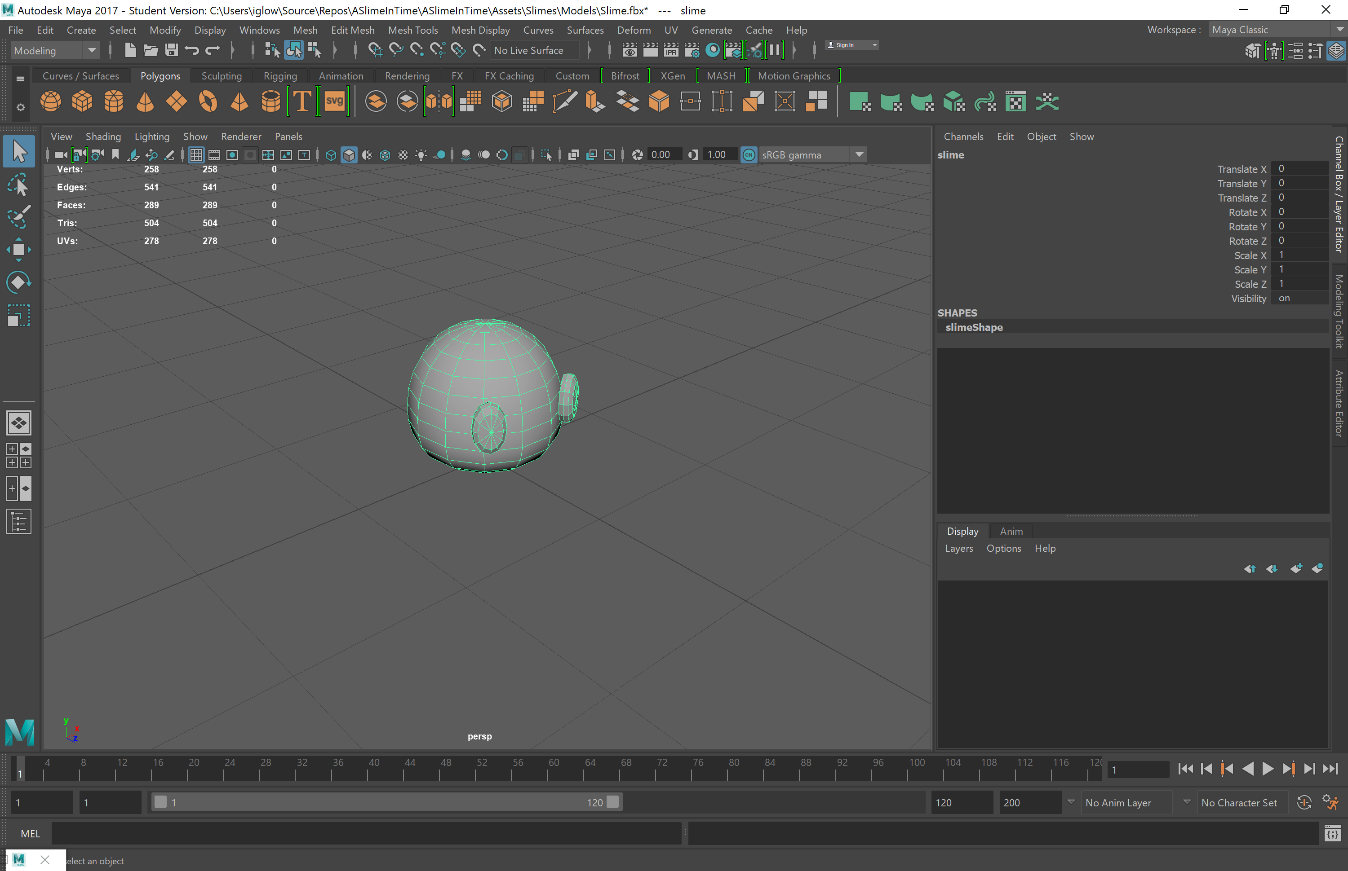
Making Models – Use Maya

Slide 14
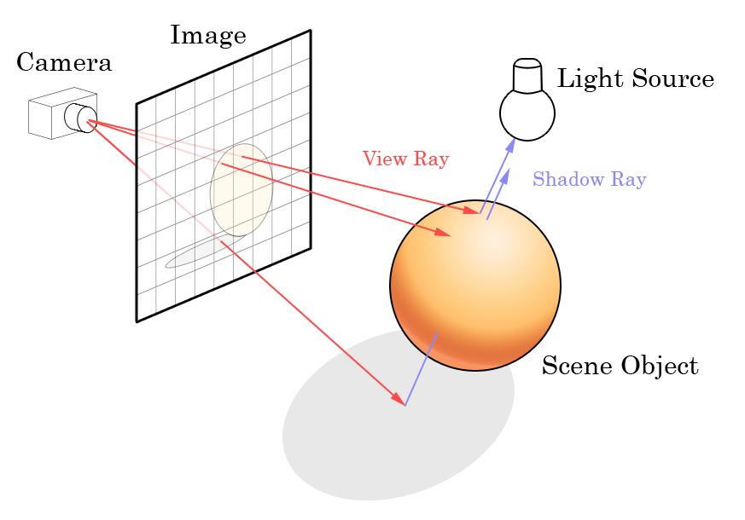
Raytracing
https://youtu.be/frLwRLS_ZR0

Slide 15
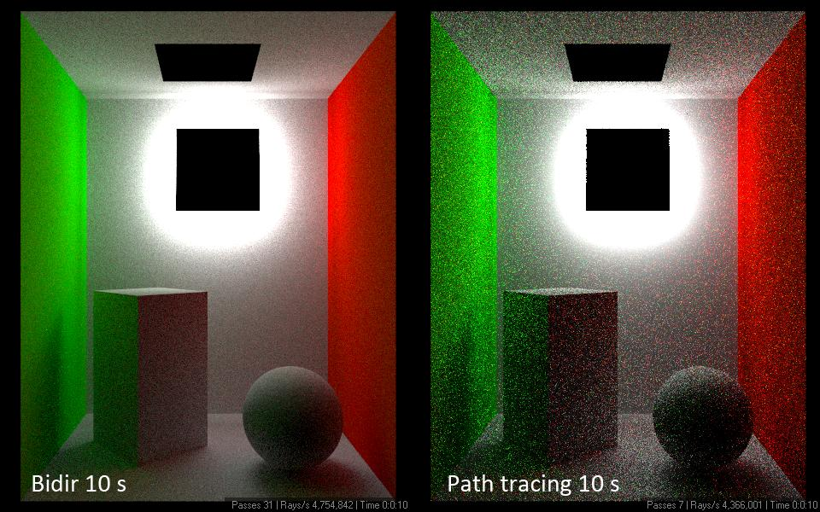
Path tracing
https://www.youtube.com/watch?v=pXZ33YoKu9w

Slide 16
What is a game engine?
A game engine is a software framework designed for the creation and development of video games. Developers use them to create games for consoles, mobile devices and personal computers. The core functionality typically provided by a game engine includes a rendering engine ("renderer") for 2D or 3D graphics, a physics engine or collision detection (and collision response), sound, scripting, animation, artificial intelligence, networking, streaming, memory management, threading, localization support, scene graph, and may include video support for cinematics.

Slide 17
Game Engines
Unity – C#, Easy to use, free
Unreal – C++ , Super powerful, free
LibGdx – Java, Open Source
Game Maker – Custom, CRAZY EASY
Or
Make Your own!

Slide 18
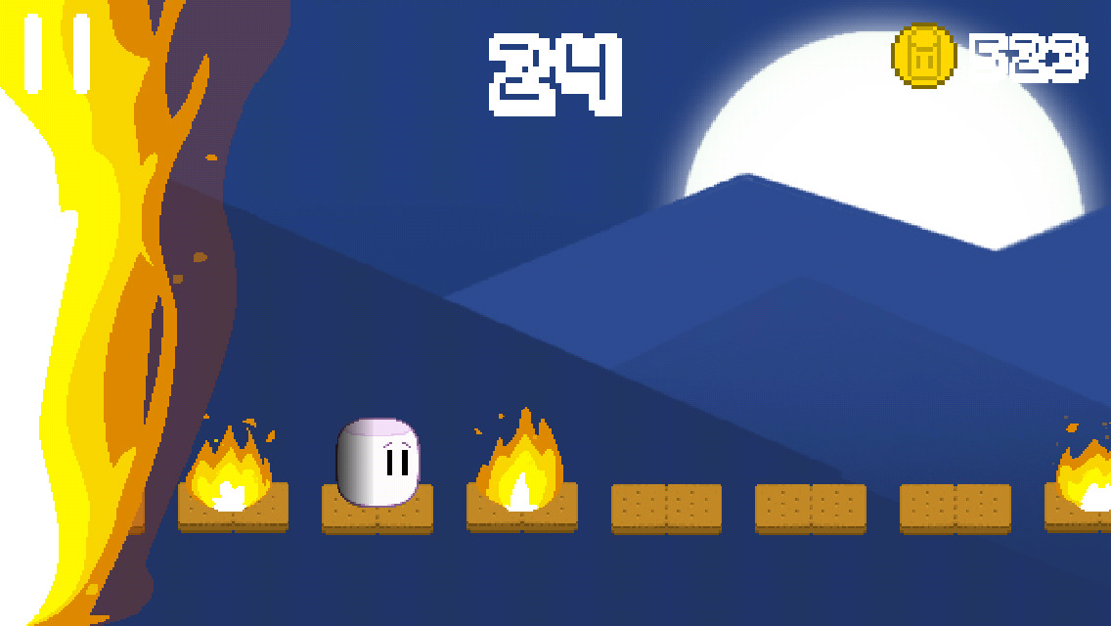
Let’s Make Pong in Java using Lib GDX!
http://libgdx.badlogicgames.com/

Slide 19
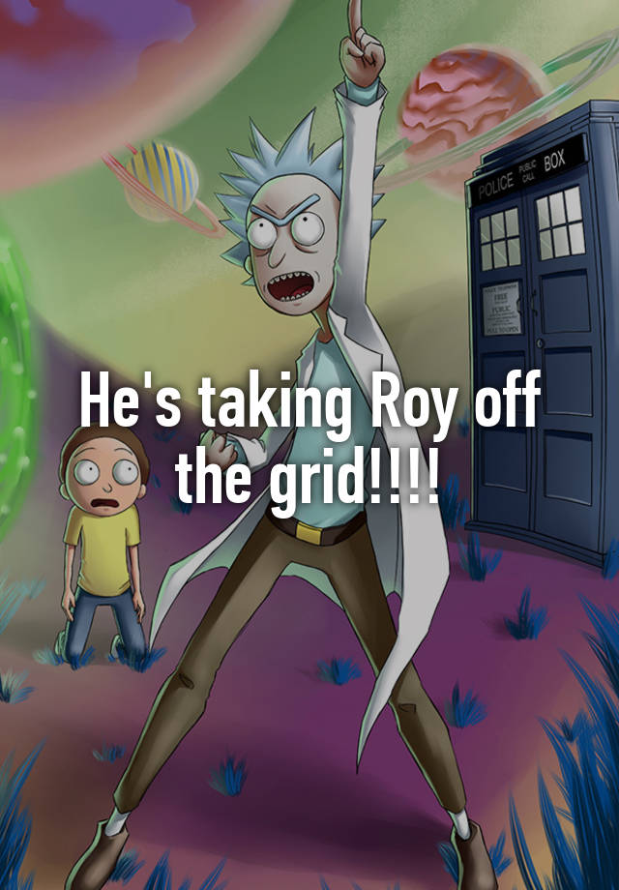
ALL a Game Is, Is A Universe with fabric of code
Carl Sagan, Man and His Ignorance:
https://youtu.be/Qfm0GCvsIVA?list=FLRD1yjMFV9Klg23wB5wh4Ng

Slide 20
HW7 Evolution (Extra Credit)
Due tonight!
Project 1 – TCP Dungeon
On Moodle
Due Tuesday!
Project 2 – Invasion
On Moodle
Due Wednesday!

