Slide 1

CampusLoop
Campus Lost and Found Management System
Presented by
M. Mokshitha - 24KB105AC
U. Guru Nikitha - 24KB1A05LV
K. Leelavathi - 24KB1A05T8
M. Hasini - 24KB1A05Z8
III BTECH |CSE - D | NBKR INSTITUTE OF SCIENCE AND TECHNOLOGY
Notes:
Introduce the project and the team. Replace the name and roll number placeholders in the table.

Slide 2




Introduction
Students sometimes lose their belongings on campus.
Finding them is hard when there is no common place to report them.
Report.
Search.
Recover.
CampusLoop is a web application to report and find lost items.
It provides a single platform to manage lost and found items.
Notes:
Explain in your own words how students lose things on campus and why a single platform helps.

Slide 3




Problem Statement
Scattered information
Lost-item news spreads through word of mouth and separate groups.
No common place
Students may not know where to check for missing belongings.
Hard to verify
It is difficult to confirm an item belongs to the person claiming it.
One system helps
A common system makes the whole process easier.
Notes:
Today information is scattered across groups and word of mouth. A common system fixes that.

Slide 4
Objectives
1
Provide a common platform for lost and found items
2
Let users report lost or found belongings with full details
3
Make it easy to search and filter reported items
4
Update an item's status once it has been recovered
5
Keep all item details organized in a database
Notes:
Walk through the five objectives briefly.

Slide 5






Technologies Used
FRONTEND
BACKEND
DATABASE
React JS
Node.js and Express JS
TiDB Cloud
Creates the user interface.
Handles server operations.
MySQL-compatible database. Stores user and report details.
IMAGE STORAGE
COMMUNICATION
DEPLOYMENT
Cloudinary
REST APIs
GitHub Pages and Render
Stores uploaded item images.
Connects frontend and backend.
Frontend: GitHub Pages. Backend: Render.
Notes:
Frontend: React JS. Backend: Node.js with Express JS. Database: TiDB Cloud (MySQL-compatible). Images are stored in Cloudinary. REST APIs connect the frontend and backend. Frontend hosting: GitHub Pages. Backend hosting: Render.

Slide 6
System Architecture
CampusLoop follows a three-tier architecture.
PRESENTATION LAYER
Student and Admin Interface
React JS
REST API communication between the frontend and backend
APPLICATION LAYER
Business Logic and API Handling
Node.js + Express.js
DATA LAYER
Database for users, reports, messages and notifications
TiDB Cloud
IMAGE STORAGE
Used separately to store uploaded item images
Cloudinary
Notes:
Three tiers: presentation layer (React JS), application layer (Node.js + Express.js) and data layer (TiDB Cloud). REST APIs carry communication between the frontend and backend. The backend handles business logic and stores data in TiDB Cloud; uploaded item images go to Cloudinary.

Slide 7
Main Modules
1
Student Module
2
Lost and Found Module
Student registration and login.
Profile management.
Browse and search reports.
Manage personal reports.
Submit lost and found reports.
Upload item images.
Edit, renew and delete reports.
Track report status.
3
Admin Module
4
Communication Module
Admin login.
View and manage reports.
Manage registered users.
View dashboard statistics.
Notifications.
Private messaging.
Message replies.
Report progress updates.
Notes:
Walk through the four modules: Student, Lost and Found, Admin, and Communication.

Slide 8
Database Design
Main Database Tables
Database Operations
Table | Purpose
Users | Stores student and administrator account information
Items | Stores lost and found item details
Messages | Stores communication between users
Notifications | Stores notifications for users
Create – Store new user accounts and item reports.
Read – Retrieve reports, user details and messages.
Update – Modify report details and item status.
Delete – Remove reports when required.
Notes:
Main tables: Users, Items, Messages and Notifications. Operations: create, read, update and delete.

Slide 9
Key Features
User authentication and protected access.
Lost and found item reporting.
Image uploads using Cloudinary.
Search, sorting and filtering.
Quick View and detailed report pages.
Notifications and private messaging.
Report status tracking and expiry management.
Admin dashboard with monthly analytics.
Dark mode and profile management.
Notes:
Walk through the nine key features, from authentication and reporting to messaging, status tracking, the admin dashboard and dark mode.

Slide 10
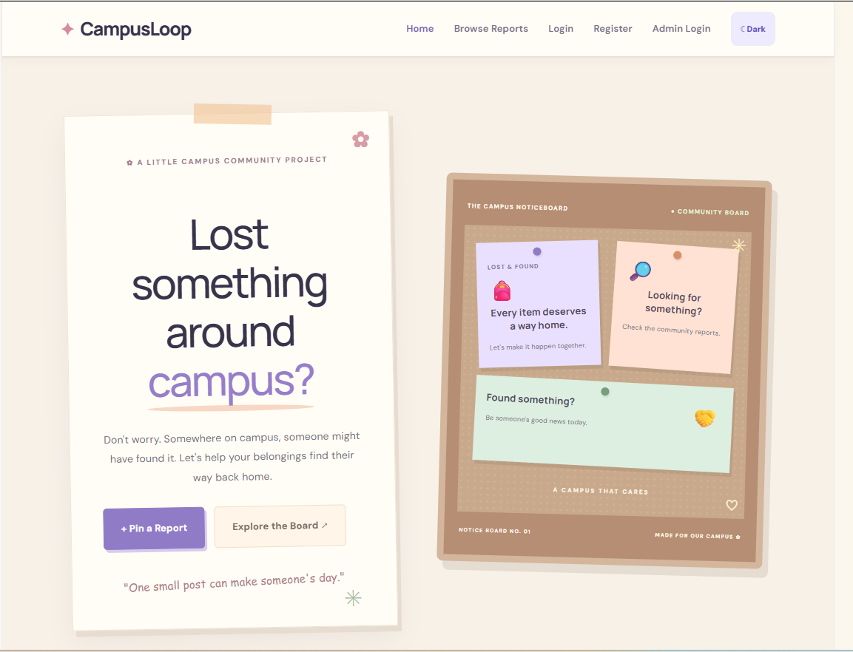
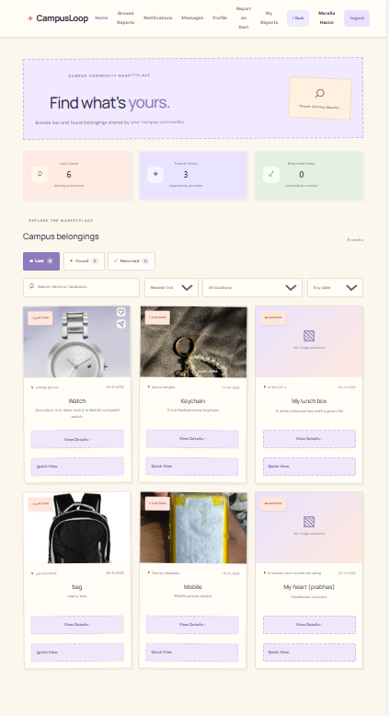
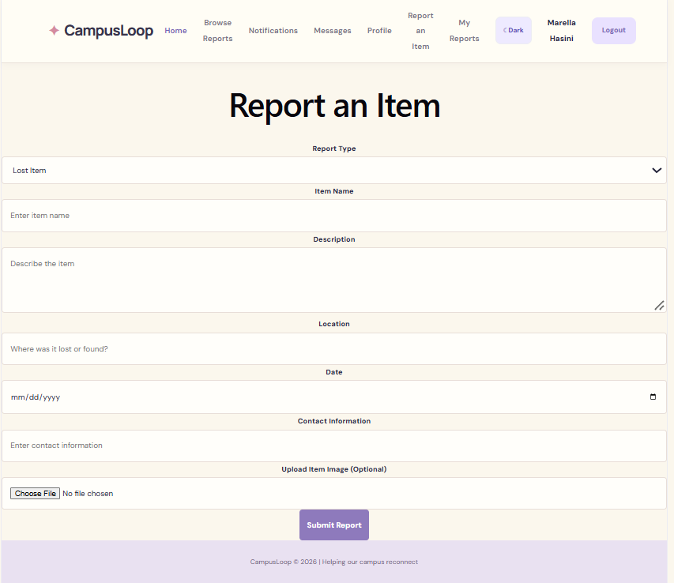
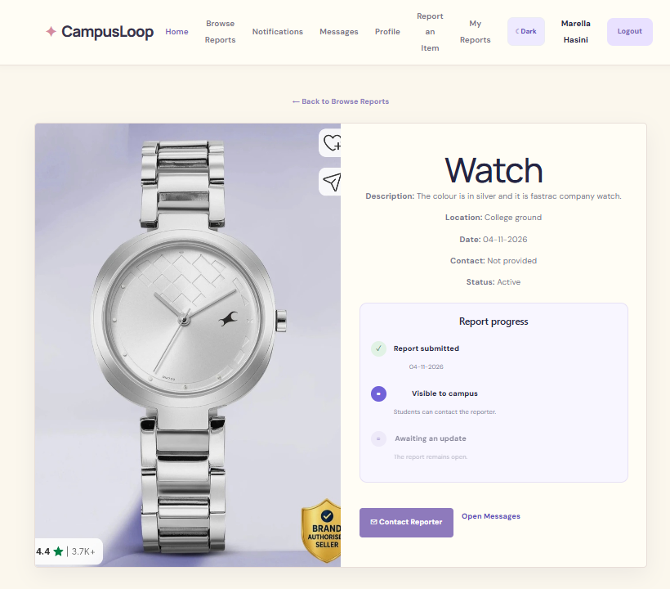
Application Screenshots
1. Home
Main landing page
Add screenshot
2. Browse Reports
View and search reported items
Add screenshot
3. Report an Item
Submit lost or found reports
Add screenshot
4. Report Details
View complete item information
Notes:
Replace each dashed placeholder with a screenshot of the actual running CampusLoop application, then read out the caption beside it.

Slide 11
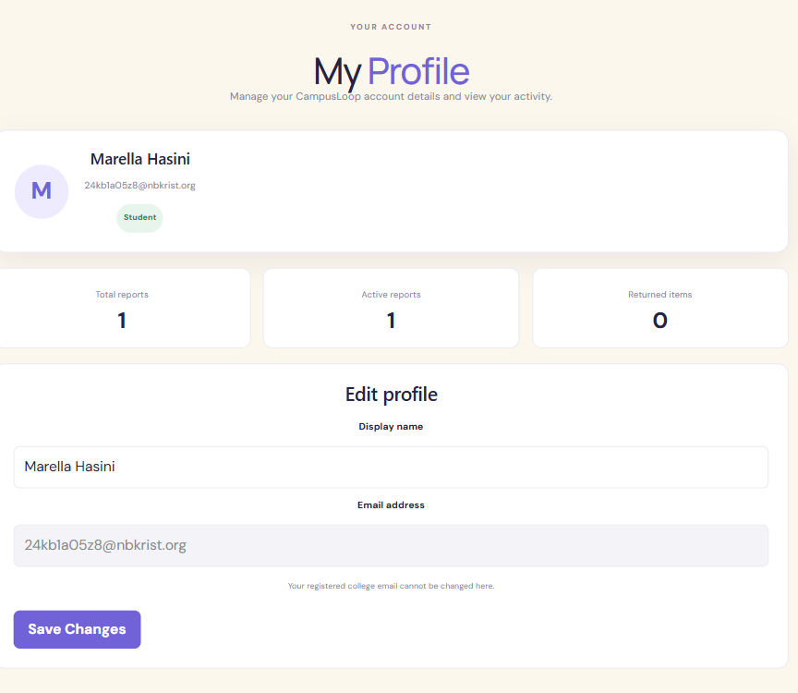
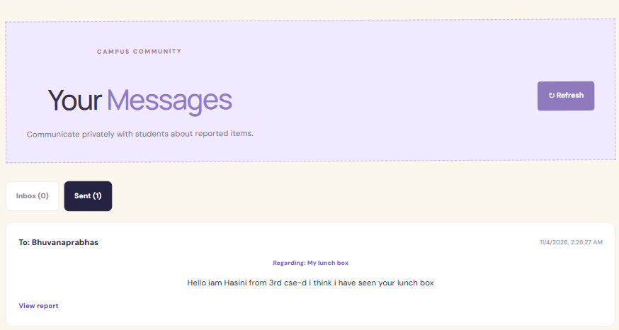
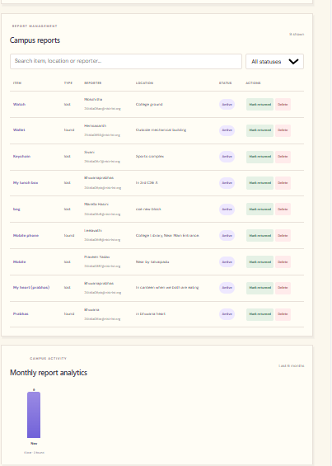
Application Screenshots (continued)
Add screenshot
5. Student Profile
Manage personal profile and reports
Add screenshot
6. Messages
Communicate with other students
Add screenshot
7. Admin Dashboard
Manage reports and monitor activities
Notes:
Replace each dashed placeholder with a screenshot of the actual running CampusLoop application: Student Profile, Messages and Admin Dashboard.

Slide 12
Testing and Results
The main functionalities were tested, and the features worked as expected.
Test Case | Expected Result | Actual Result
Student Registration | Account should be created | As expected
Student Login | User should log in successfully | As expected
Report Submission | Item report should be saved | As expected
Search and Filters | Matching reports should appear | As expected
Image Upload | Image should be uploaded | As expected
Messaging | Users should exchange messages | As expected
Admin Access | Admin dashboard should open | As expected
Status Update | Report status should change | As expected
Testing Environment
Frontend: React JS
Backend: Node.js and Express.js
Database: TiDB Cloud
API Testing: Verified through application requests
Notes:
Eight main functions were tested. Make sure the Actual Result column reflects what your team really observed, and that the testing environment lists your actual deployed database.

Slide 13






Future Enhancements
Mobile application for easier access.
QR code-based item identification.
Email notifications for important updates.
Improved matching suggestions for lost and found items.
Advanced search options.
College identity integration for student verification.
Notes:
Future work: a mobile app, QR code identification, email notifications, better matching suggestions, advanced search, and college identity integration.

Slide 14
Conclusion
CampusLoop provides a centralized platform for managing lost and found items within a college campus.
It makes reporting and searching for missing belongings easier.
It supports communication between students and administrators.
It provides organized report management through an admin dashboard.
It uses React JS, Node.js, Express.js, a MySQL-compatible database and Cloudinary.
Thank You!
Notes:
Summarise and thank the faculty.

