Slide 1
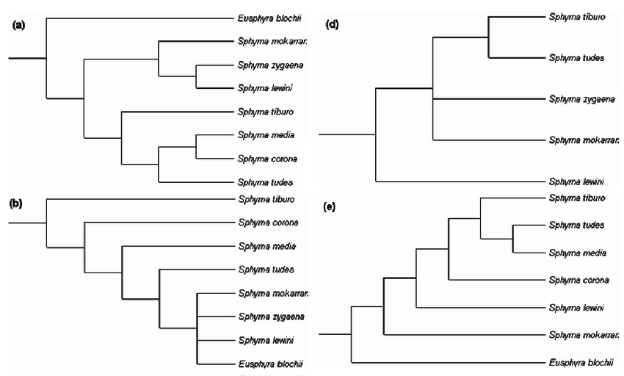
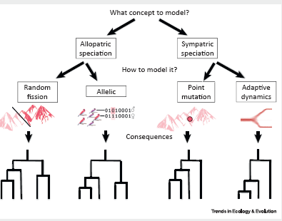
1) Collate simulated phylogenies
2) Characterize tree shape, code by simulation attributes
diversity dependent
diversity independent
point mutation
random fission
Tree shape PCA 2
Tree shape PCA 1
4) What are the most robust signatures of
Diversity dependence
Speciation mode
other…
3a) Which tree shape metrics are most variable?
3b) Which simulation attributes best explain that variation?

