Slide 1
Group 2
Comparison of disparate simulation models reveals the sensitive processes and robust patterns with respect to implementation decisions
Allen, Mikael, Thiago, Odile, Shan, Oskar, Loic, David, Susanne, Juliano, Florian, Pedro, … join us!

Slide 2
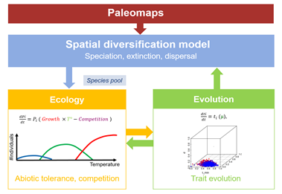
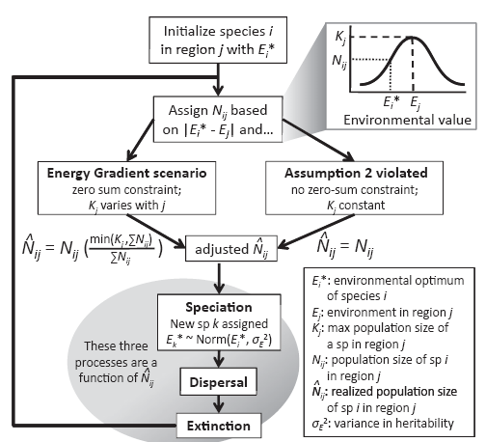
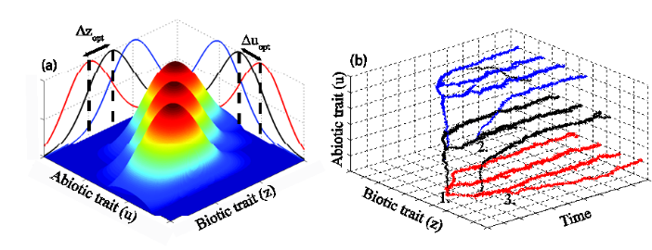
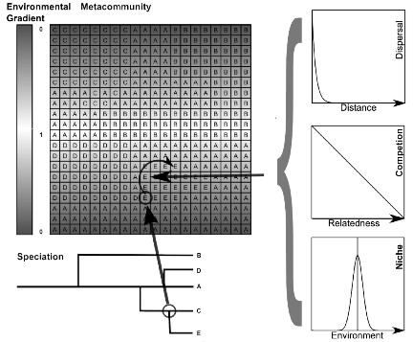
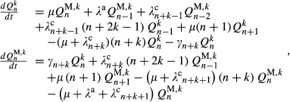
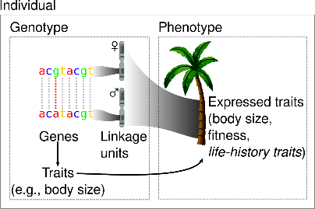
Simulation models
Hagen
Hurlbert-Stegen
Pontarp
Cabral
Hartig
Rangel
DAISIE
Leidinger
Hartig

Slide 3
Variation in patterns due to implementation decisions inhibits the inference of process from pattern

Slide 4
Model 1
Model 2
Model 1 and Model 2 implement the same process differently

Slide 5
Model 1
Model 2
Model 1 and Model 2 implement the same process differently
Metric 1 based on branch lengths is sensitive to this difference
Metric 2 based on topology is robust to this difference

Slide 6
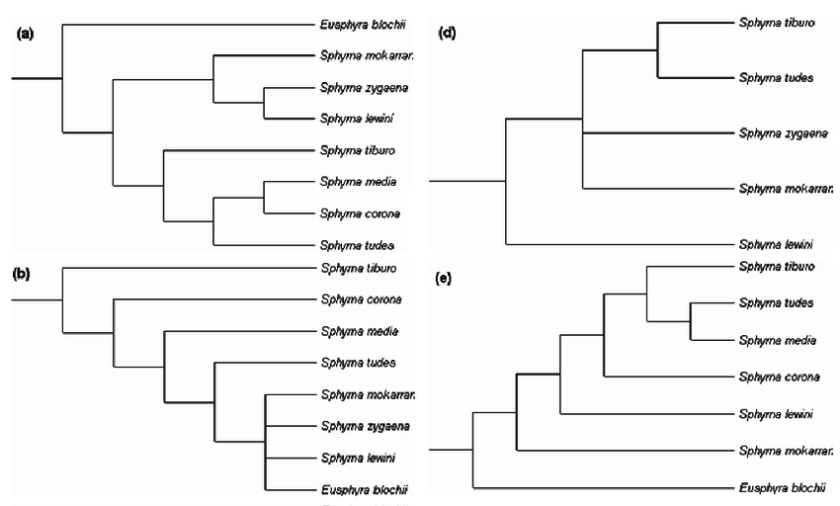
1) Collate simulated phylogenies

Slide 7
1) Collate simulated phylogenies
2) Characterize tree shape, code by simulation attributes
diversity dependent
diversity independent
point mutation
random fission
Tree shape PCA 2
Tree shape PCA 1

Slide 8
1) Collate simulated phylogenies
2) Characterize tree shape, code by simulation attributes
diversity dependent
diversity independent
point mutation
random fission
Tree shape PCA 2
Tree shape PCA 1
3a) Which tree shape metrics are most variable?
3b) Which simulation attributes best explain that variation?

Slide 9
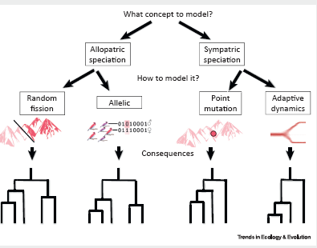
1) Collate simulated phylogenies
2) Characterize tree shape, code by simulation attributes
diversity dependent
diversity independent
point mutation
random fission
Tree shape PCA 2
Tree shape PCA 1
4) What are the most robust signatures of
Diversity dependence
Speciation mode
other…
3a) Which tree shape metrics are most variable?
3b) Which simulation attributes best explain that variation?

Slide 10
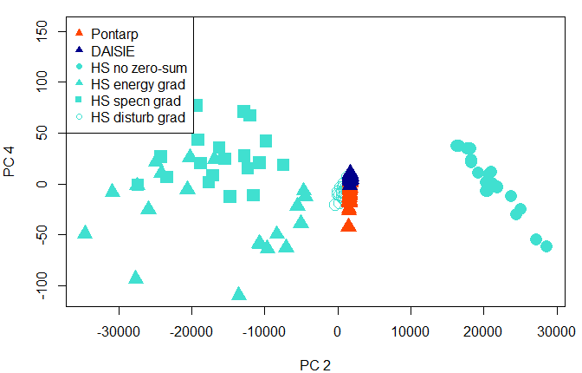
Trees from 3 different simulation families
--upload yours to Github!

Slide 11
Goals for this week
Collate simulation output
trees, but also site x species & traits tables if relevant
Ensure data format standardization

Slide 12
Goals for this week
Collate simulation output
trees, but also site x species & traits tables if relevant
Ensure data format standardization
Identify the big picture processes that may be implemented in different ways
Diversity dependence vs independence
Speciation mode
Others…

Slide 13
Goals for this week
Collate simulation output
trees, but also site x species & traits tables if relevant
Ensure data format standardization
Identify the big picture processes that may be implemented in different ways
Diversity dependence vs independence
Speciation mode
Others…
Identify how to classify/score simulation models to compare implementations
Modeled unit (individuals, populations, species)
Spatial resolution/extent
presence of environmental gradient
Others…

Slide 14
Goals for this week (continued)
Identify summary statistics, metrics and patterns
Phylogenetic patterns
Spatial patterns
BAMM, RPANDA, ClaDS output

