Slide 1
Marketa
Group Members:
Nevil Aghera 92500584012
Jenil Kothiya 92500584026
Avesh Kadari 92500584027
internal Guide :
dr. Ashwin Dobariya
Mca 3a
Group no : 02

Slide 2
1. Introduction to Project Definition
MARKETA is a full-stack, enterprise-grade web application engineered using the MERN Stack (MongoDB, Express.js, React.js, Node.js) that digitizes, streamlines, and automates the complete operational workflow of modern supermarkets and retail grocery stores.
In traditional retail environments, store managers and cashiers heavily rely on manual ledger books, disconnected spreadsheet files, physical receipts, and fragmented desktop software to manage daily business activities. These conventional methods present major operational bottlenecks:
Manual Inventory Errors: Manual stock counting is time-consuming, highly susceptible to human miscalculations, and often leads to unrecorded inventory shrinkages or stockouts during peak business hours.
Complex Supplier & Purchase Management: Tracking vendor purchase orders, payment dues, and stock receipts across multiple suppliers leads to miscommunication and delayed inventory restocking.
Inefficient Checkout & Billing Queue: Manual pricing lookups and slow invoice generation result in long customer waiting times at billing counters.
Lack of Real-Time Financial Visibility: Calculating net profits, gross margins, daily revenue, and tax liabilities manually at the end of each day or month is cumbersome and prone to financial discrepancies.

Slide 3
MARKETA solves these challenges by providing a unified, cloud-ready digital ecosystem.
where all supermarket operations—ranging from product cataloging, supplier management, and POS billing to automated inventory updates, low-stock alert notifications.
Multi-dimensional financial analytics—are managed seamlessly through an intuitive single-window dashboard.
By implementing strict Model-View-Controller (MVC) architectural separation on the backend and component-driven state management on the frontend.
the system provides high throughput, real-time data synchronization, multi-role security (Admin and Manager access controls with pending approval gates), and zero-licensing cost deployment.

Slide 4
2. PREAMBLE
2.1 Synopsis :
MARKETA is a cloud-native Supermarket Management System designed and implemented using the MERN Stack.
The application is built to transition brick-and-mortar retail enterprises into digitally managed, highly efficient smart supermarkets by eliminating manual paper-based processes and fragmented software workflows.
The system empowers supermarket managers, store owners, and cashiers to manage every facet of retail operations from a centralized, web-responsive dashboard. Key operational capabilities include:

Slide 5
Catalog & Category Management: Hierarchical product organization with barcode mapping, unit classification, purchasing cost, and selling price configuration.
Point of Sale (POS) & Billing: High-speed cashier billing terminal supporting item scanning, custom discount calculation, tax processing, receipt printing, and real-time inventory deduction.
Supplier & Purchase Order Tracking: Complete procurement lifecycle tracking from supplier contact management to purchase invoice recording and stock intake auditing.
Automated Stock Monitoring & Alerts: Real-time stock level monitoring that calculates low-stock thresholds (isLowStock) and out-of-stock states (isOutOfStock), automatically triggering high-priority system alerts and notifications.
Customer Profiling & Debt Tracking: Storing customer purchase history, total expenditure, and contact records for personalized customer relationship management.
Financial Reports & Business Intelligence: Interactive graphical analytics powered by Recharts displaying sales trends, revenue performance, profit margins, and inventory asset valuation.
Secure Multi-Role Access Control: Role-based security enforcing strict Admin and Manager permission boundaries, including an automated Admin approval gate for newly registered store managers.

Slide 6
2.2 Problem Statement :
Small to medium-sized supermarkets face severe operational vulnerabilities due to outdated management workflows. The primary problems addressed by MARKETA include:
Inventory Discrepancy & Stockouts: Lack of real-time stock tracking causes unexpected stockouts of high-demand items, resulting in lost revenue and customer dissatisfaction.
Inaccurate Financial Accounting: Manual record-keeping leads to calculation errors when computing gross sales, supplier payables, net profit margins, and discounts.
Security Risks & Unauthorized Access: Traditional desktop systems lack granular audit trails and approval gates, exposing store data to unauthorized edits or unapproved staff actions.
Slow Checkout Processing: Manual product searching during billing increases customer wait times and checkout counter congestion.
Lack of Decision-Making Analytics: Store owners lack visual data insights regarding top-selling products, slow-moving items, and monthly sales trends.

Slide 7
2.3 Objectives of the System :
The overarching objective of the MARKETA Supermarket Management System is to deliver a secure, scalable, and cost-effective digital web platform that automates retail management. Specific technical and business objectives include:
Automate Inventory Lifecycle: Automatically deduct product stock levels immediately upon POS sale completion and update stock levels when new supplier purchases are recorded.
Implement Real-Time Alerting: Trigger automated notifications whenever an item's stock drops below its predefined minimum threshold (minStock), enabling timely replenishment.
Accelerate POS Billing & Invoicing: Provide cashiers with a rapid, intuitive billing interface with discount calculation, tax handling, and instant thermal receipt printing (react-to-print).
Ensure High Security & Access Control: Enforce JWT-based stateless authentication, password encryption (bcrypt.js), role segregation (Admin vs. Manager), and an Admin approval workflow for new registrations.
Deliver Business Intelligence Analytics: Present store owners with interactive charts and reports detailing daily sales, top products, customer expenditure, and category revenue distribution.
Eliminate Software Licensing Costs: Provide an open, self-hostable web architecture that frees small business owners from high recurring SaaS software subscriptions.

Slide 8
2.4 Scope of the System :
A. In-Scope Modules & Features
User Authentication & Admin Approval Gate: Registration, login, profile fetch, JWT token management, and Admin approval panel for pending managers.
Product Catalog & Stock Management: Product creation, image upload via Multer, price setup, barcode assignment, category linking, and stock history tracking.
Category & Supplier Management: Full CRUD operations for product categories and vendor supplier records.
Point of Sale (POS) & Invoice Generation: Cart management, price auto-calculation, custom discounts, invoice auto-numbering (INV-YYYYMMDD-XXXX), and printing.
Customer Management: Recording customer contact info, tracking total visits, and calculating total lifetime spending.
Automated System Notifications: Real-time generation of low_stock and out_of_stock notification logs.
Financial Reports & Dashboard Analytics: Aggregate revenue calculation, profit metrics, and visual Recharts line/bar graphs.

Slide 9
B. Out-of-Scope (Future Boundaries)
Direct hardware-level WebUSB barcode scanner driver compilation (currently uses plug-and-play keyboard emulation).
Multi-store chain inter-branch inventory transfers (currently scoped to single supermarket enterprise).
Direct integrated online payment gateway webhooks (currently supports cash/card POS billing modes).

Slide 10
2.5 Module description :
1. Authentication Module:
Provides secure login and registration for users. It verifies user credentials and ensures that only authorized managers and administrators can access the system.
2. Dashboard Module:
Displays a real-time overview of the supermarket's operations. It summarizes sales, purchases, inventory, profit, and stock alerts for quick decision-making.
3. Product Management Module:
Manages all product-related information, including adding, updating, deleting, and searching products. It helps maintain accurate product records and stock details.
4. Category Management Module:
Organizes products into different categories for better management. It simplifies product classification and improves product searching.

Slide 11
5. Supplier Management Module:
Stores and manages supplier information used for purchasing products. It helps maintain supplier records and simplifies purchase transactions.
6. Customer Management Module:
Maintains customer details and purchase history. It helps the supermarket provide better customer service and track buying patterns.
7. Inventory Management Module:
Monitors and controls product stock levels. It records stock movements and ensures inventory remains accurate through stock adjustments.
8. Purchase Management Module:
Records all purchases made from suppliers and automatically updates inventory. It maintains purchase invoices and purchase history for future reference.
9. Sales Management Module:
Handles customer sales transactions by generating invoices and reducing stock automatically. It ensures accurate billing and maintains complete sales records.

Slide 12
10. Invoice Management Module
Generates and manages purchase and sales invoices with unique invoice numbers. It provides printable invoices and stores invoice history.
11. Stock Alert Module
Continuously monitors inventory levels and identifies products that are low or out of stock. It notifies the manager to reorder products on time.
12. Financial Management Module
Tracks the supermarket's income, expenses, and overall profit. It provides financial summaries that help managers monitor business performance.
13. Reports Module
Generates detailed reports for sales, purchases, inventory, and customers. These reports help analyze business performance and support decision-making.
14. Shop Settings Module
Allows the manager to configure supermarket information such as shop name, GST number, logo, address, and invoice settings. It personalizes the application for the business.

Slide 13
3. REVIEW OF LITERATURE
Study & Analysis of Existing Systems :
A comparative study of current supermarket inventory and POS management solutions was conducted:
Legacy Desktop ERP Systems (e.g., Marg ERP): Standalone desktop software. High license cost, single-terminal restriction, complex UI.
Cloud SaaS Solutions (e.g., Square POS / Odoo): Proprietary SaaS platforms. High recurring monthly fee per terminal, closed architecture.
MARKETA System (Proposed MERN Stack): Open, web-responsive, self-hostable, zero licensing cost, role-gated with real-time stock sync.

Slide 14
Comparative Analysis Matrix :
Comparison Criteria | Legacy Desktop (Marg ERP) | SaaS Cloud POS (Square/Odoo) | MARKETA System (Proposed MERN)
Architecture | Standalone Desktop (C++/VB) | Vendor Cloud SaaS | Full-Stack MERN Web SPA
Cost Model | High One-Time License Fee | Monthly Recurring Subscription | Free & Self-Hostable (Zero License Fee)
Multi-Device Support | Restricted to Single PC | Web / Mobile (Vendor Locked) | Any Browser (Desktop, Tablet, Mobile)
User Role Access | Basic Admin / User Accounts | Fixed Tier Roles | Granular Admin & Manager with Approval Gate
Stock Auto-Deduction | Manual / Batch Processing | Real-Time Sync | Real-Time Auto-Deduction on POS Checkout
Low-Stock Alerting | Static Manual Reports | Email Alerts (Paid Tier) | Automated Real-Time low_stock System Alerts
Receipt Printing | Local Printer Drivers | Proprietary POS Printer | Browser-Native Thermal Printing (react-to-print)

Slide 15
Major Findings & Research Gaps Identified :
High Licensing Burden: Small retail stores cannot sustain high SaaS subscriptions.
Unregulated Manager Onboarding: Legacy systems lack staged approval gates for newly registered staff.
Delayed Stock Auditing: Batch updates cause out-of-stock incidents during peak billing hours.
Complex User Interfaces: Legacy software requires extensive staff training.

Slide 16
4. TECHNICAL DESCRIPTION
4.1 Hardware Requirement
This section specifies the empirical technical requirements verified directly from the MARKETA codebase (React 19.2.7, Vite 8.1.1, React-to-Print 3.3.0, Recharts 3.10.1, Axios 1.18.1, Inter Google Font, and responsive CSS layout engines) needed to open, run, and operate the web application on a user terminal.
Table 4.1 Hardware Requirement
Hardware Component | Minimum System Requirement | Recommended System Requirement
Device Category | Desktop PC, Laptop, POS Terminal, or Tablet | Desktop PC or Dedicated POS Touch Terminal
Processor (CPU) | Dual-Core 1.6 GHz (Intel / AMD / ARM) | Intel Core i3 / AMD Ryzen 3 (Quad-Core 2.0 GHz+)
System Memory (RAM) | 2 GB DDR3 | 4 GB DDR4 or higher
Storage / Disk Space | 500 MB free space | 2 GB free SSD storage
Display Resolution | 1024 × 768 pixels | 1920 × 1080 pixels (Full HD)
Barcode Scanner | Optional (Manual search supported) | Handheld USB / Wireless 1D/2D Laser Barcode Scanner
Receipt Printer | Standard PDF Printer | 80mm Thermal Receipt Printer (ESC/POS compatible)

Slide 17
4.2 Software Requirement
Based on codebase analysis of ES2022+ ECMAScript syntax, HTML5 Canvas/SVG, Web Storage APIs, and CSS variable dependencies:
Table 4.2 Software Requirement
Software Component | Verified Technical Specification
Supported Operating Systems | Windows 10/11, macOS 10.15+, Ubuntu Linux 20.04+, Android 10+ (Tablets), iOS/iPadOS 14+
Recommended Web Browser | Google Chrome
Alternative Supported Browsers | • Microsoft Edge • Mozilla Firefox • Apple Safari
JavaScript Engine | JavaScript (ES6+) Enabled
Web Storage Support | LocalStorage & SessionStorage Enabled
Browser Window Permissions | Pop-up / Print Dialogs Allowed

Slide 18
Network & Connectivity Requirements :
Based on codebase analysis of Axios REST API HTTP request payloads and Vite dev/proxy server configurations (vite.config.js port 5173 & Express backend port 5000):
Table 4.3 Network & Connectivity Requirements
Network Parameter | Verified Technical Specification
Network Type | Local Area Network (LAN), Wi-Fi, or Cellular Data (3G / 4G / 5G)
Network Bandwidth | Minimum 1 Mbps stable connection
Communication Protocol | HTTP / HTTPS (RESTful Architecture)
Default Operating Ports | • Frontend: Port 5173 (Vite Server) / 80 (HTTP) / 443 (HTTPS) • Backend API: Port 5000

Slide 19
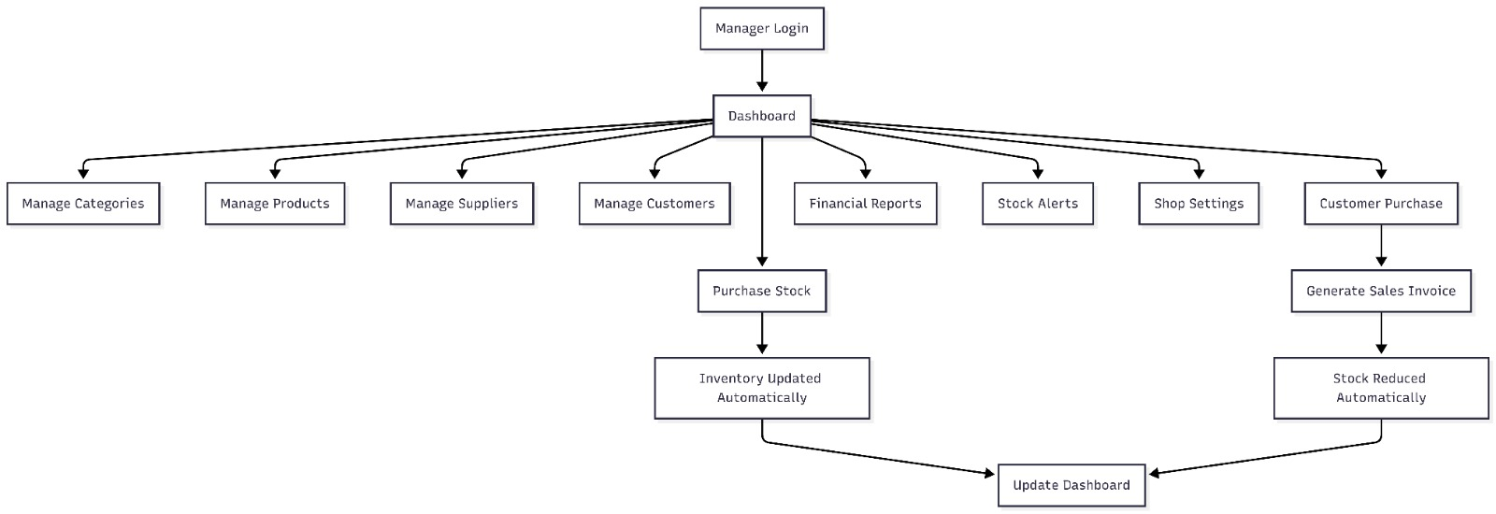
5. SYSTEM DESIGN AND DEVELOPMENT
5.1 Flow Chart:

Slide 20
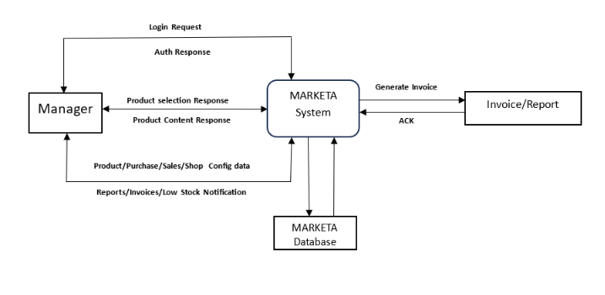
5.2 Data Flow Diagram:
Level 0:-

Slide 21
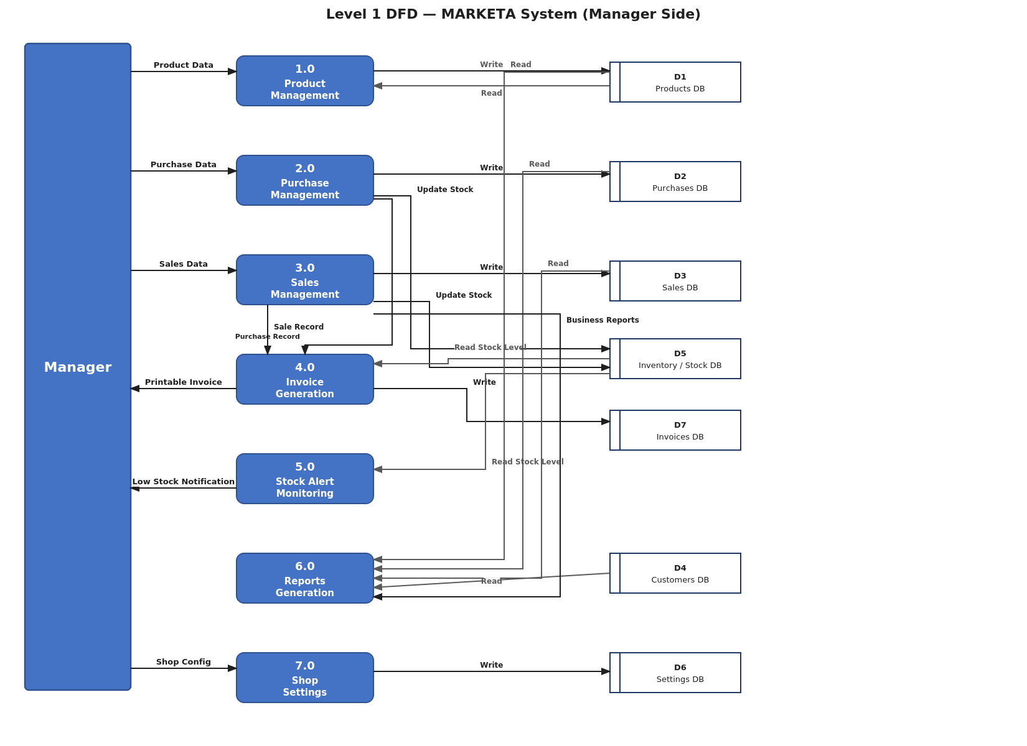
Level 1:-

Slide 22
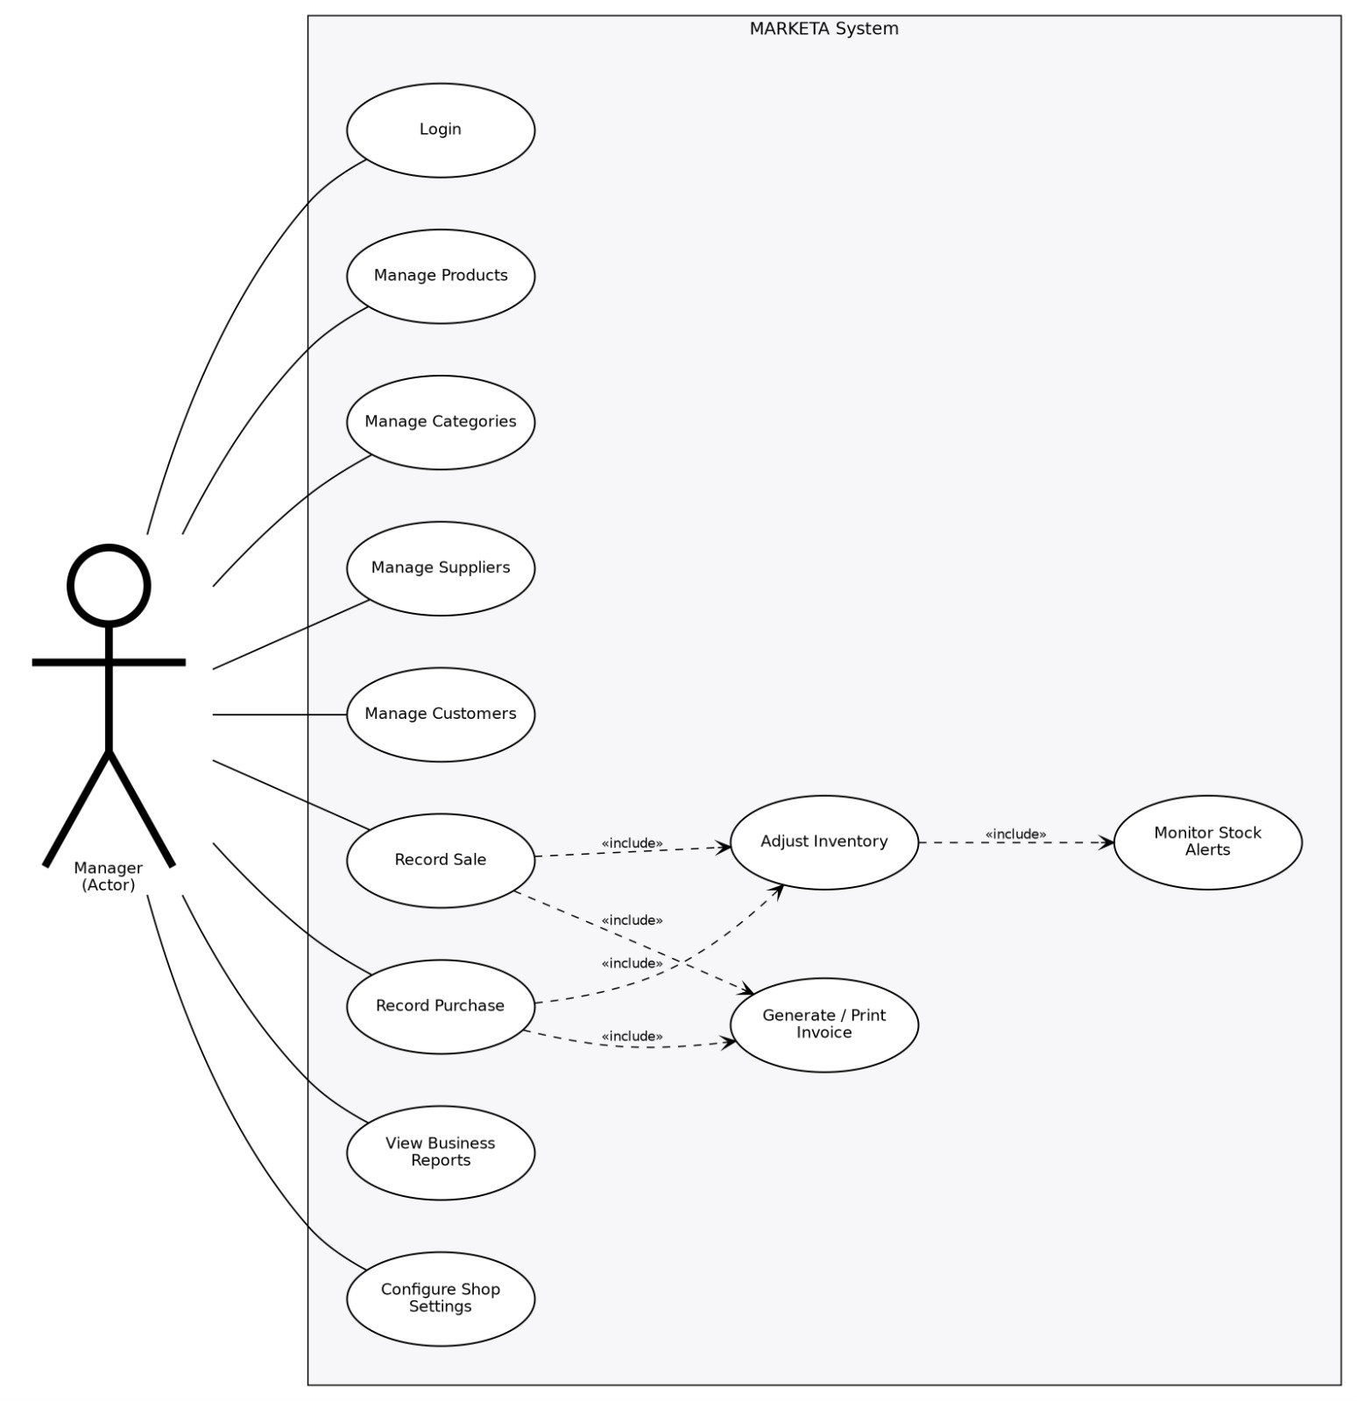
5.3 Use Case Diagram:

Slide 23
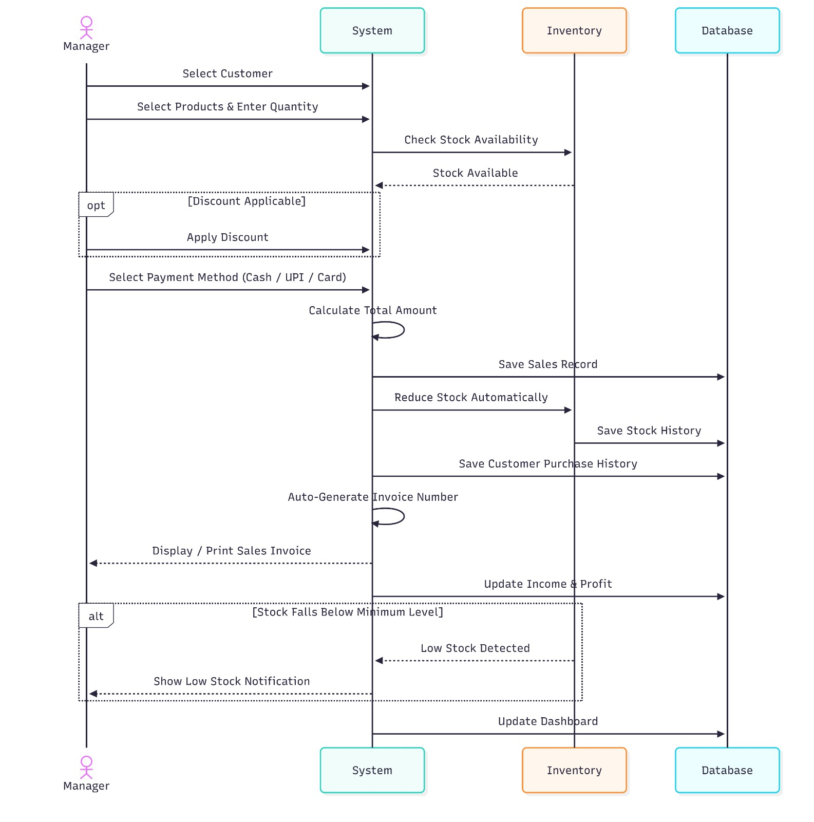
5.4 Sequential Diagram:

Slide 24
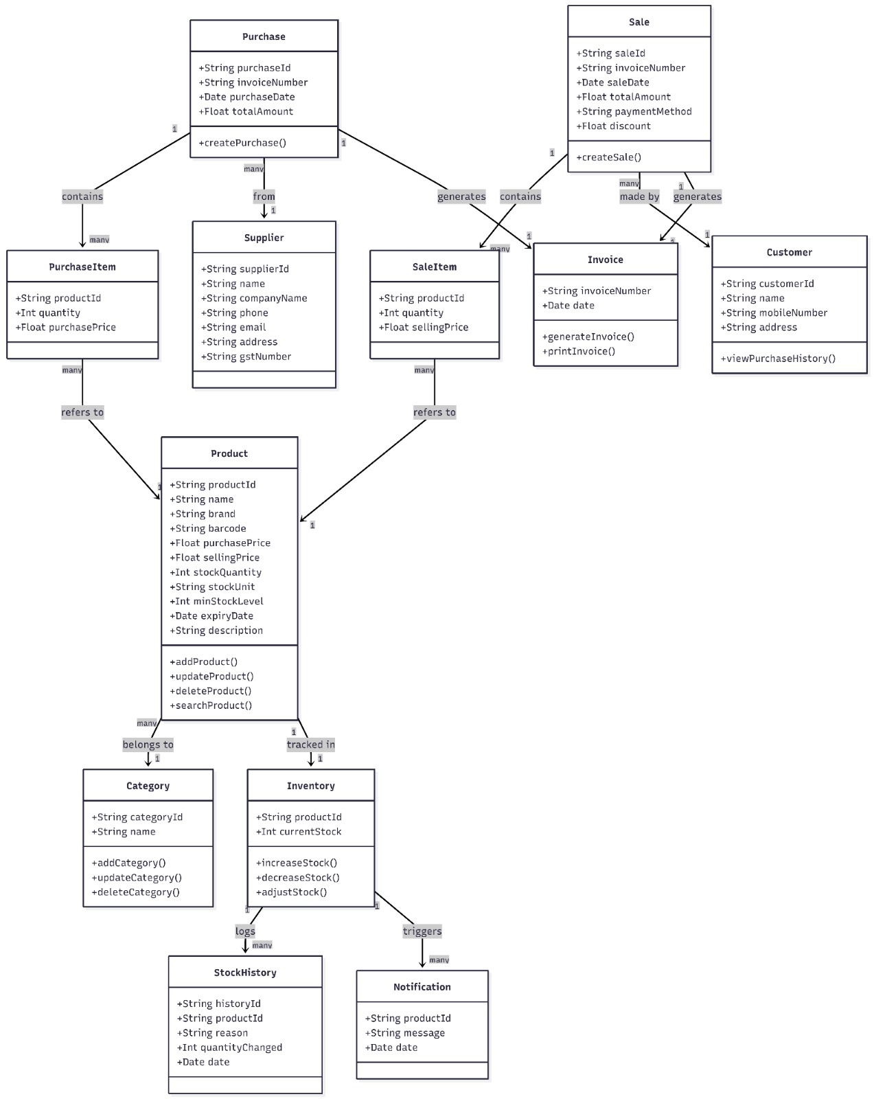
5.5 Class Diagram:

Slide 25
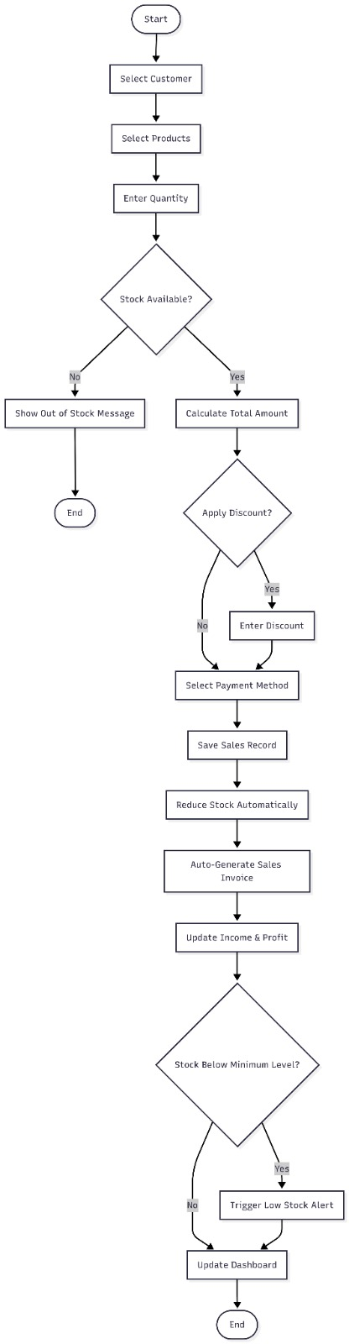
5.6 Activity Diagram:

Slide 26
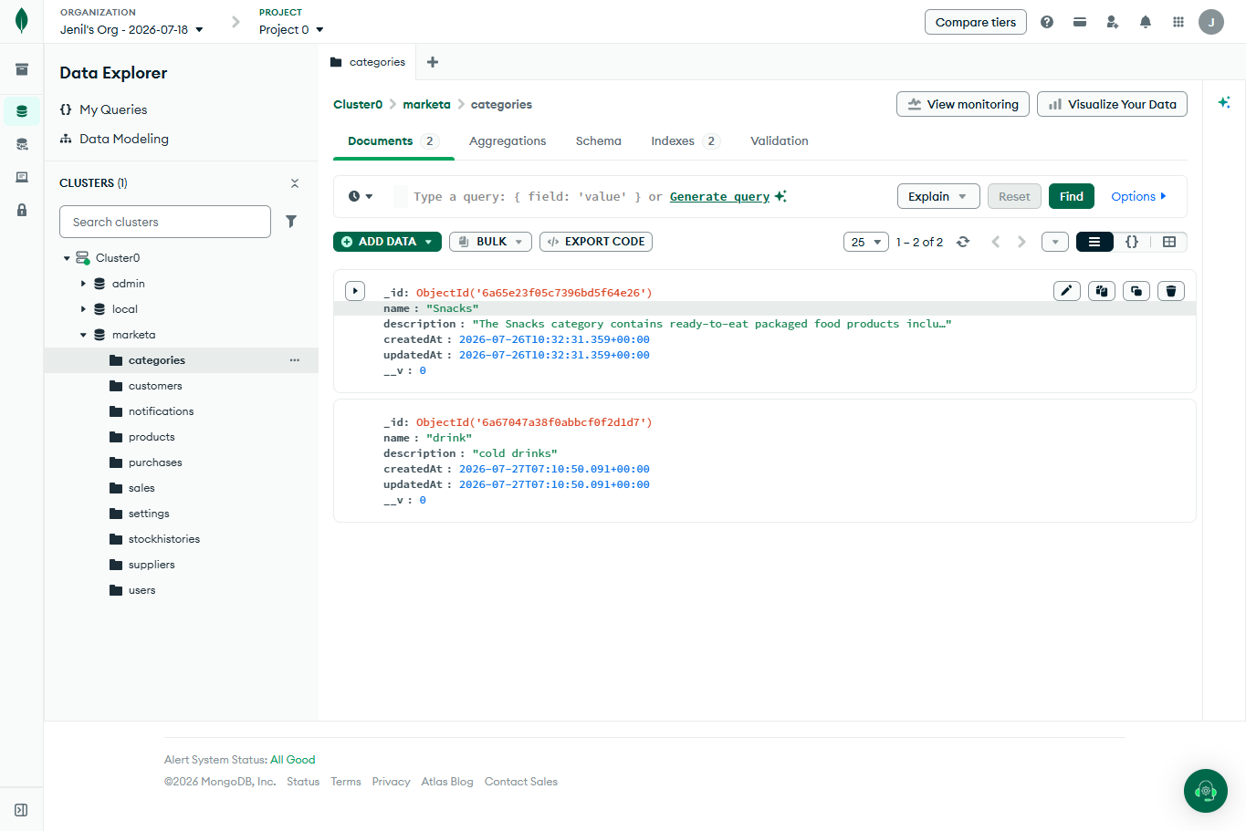
5.7 Database Design:
Figure 5.7.1 Categories

Slide 27
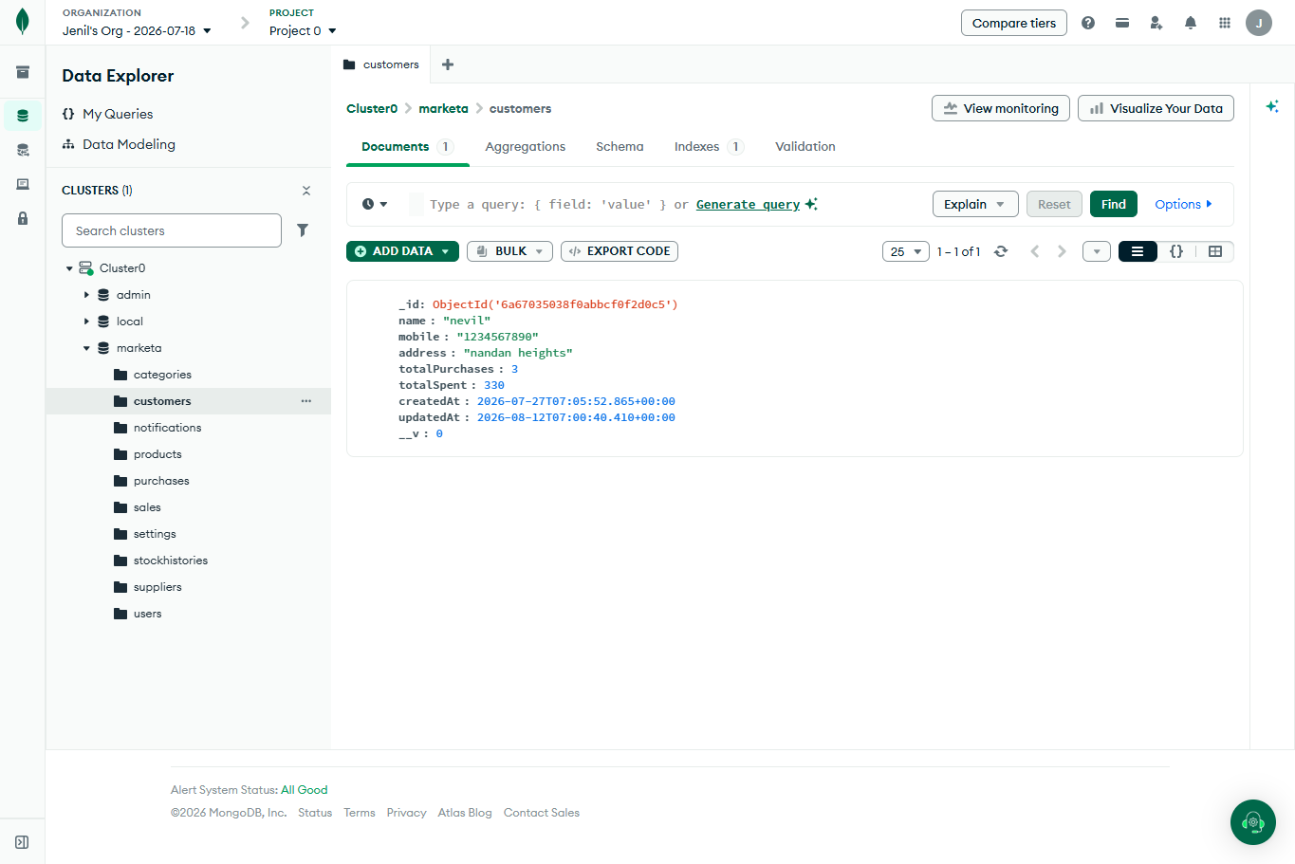
Figure 5.7.2 Customers

Slide 28
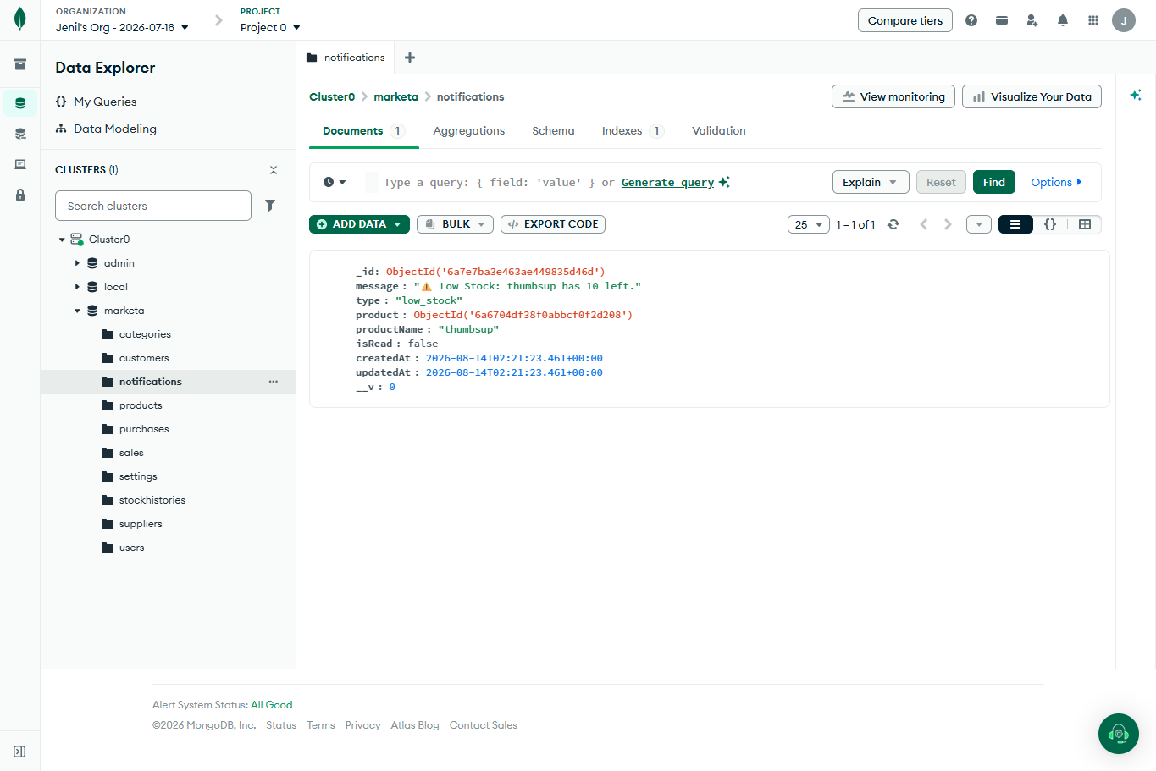
Figure 5.7.3 Notifications

Slide 29
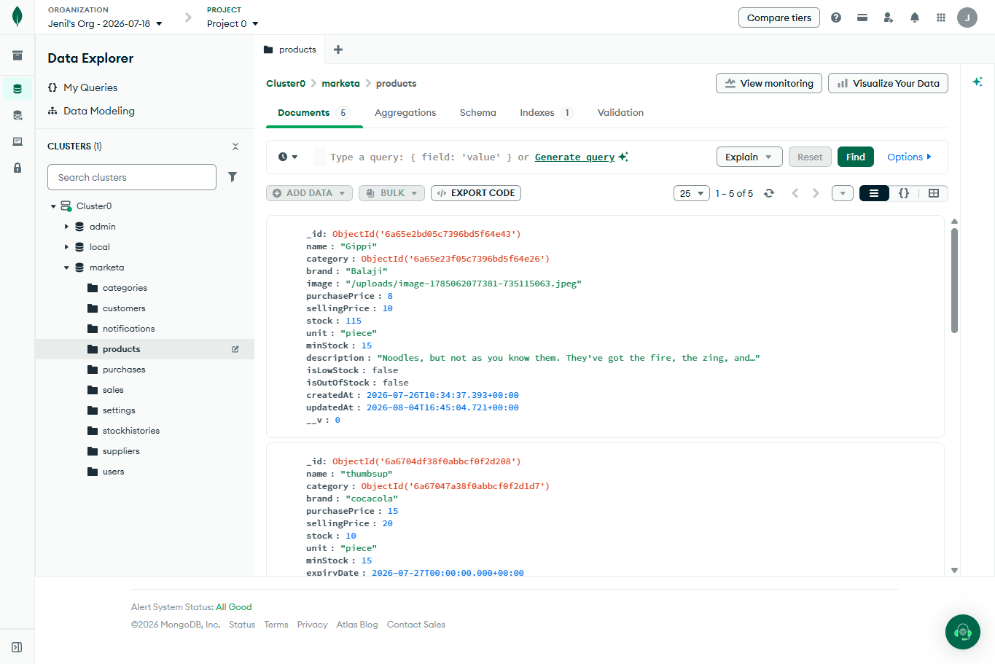
Figure 2.7.4 Products

Slide 30
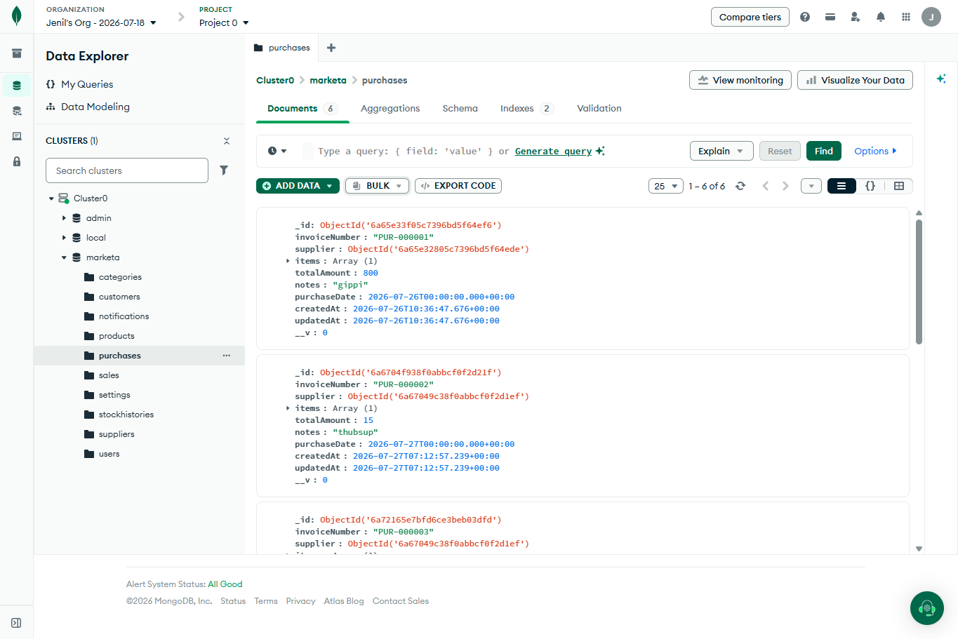
Figure 5.7.5 Purchases

Slide 31
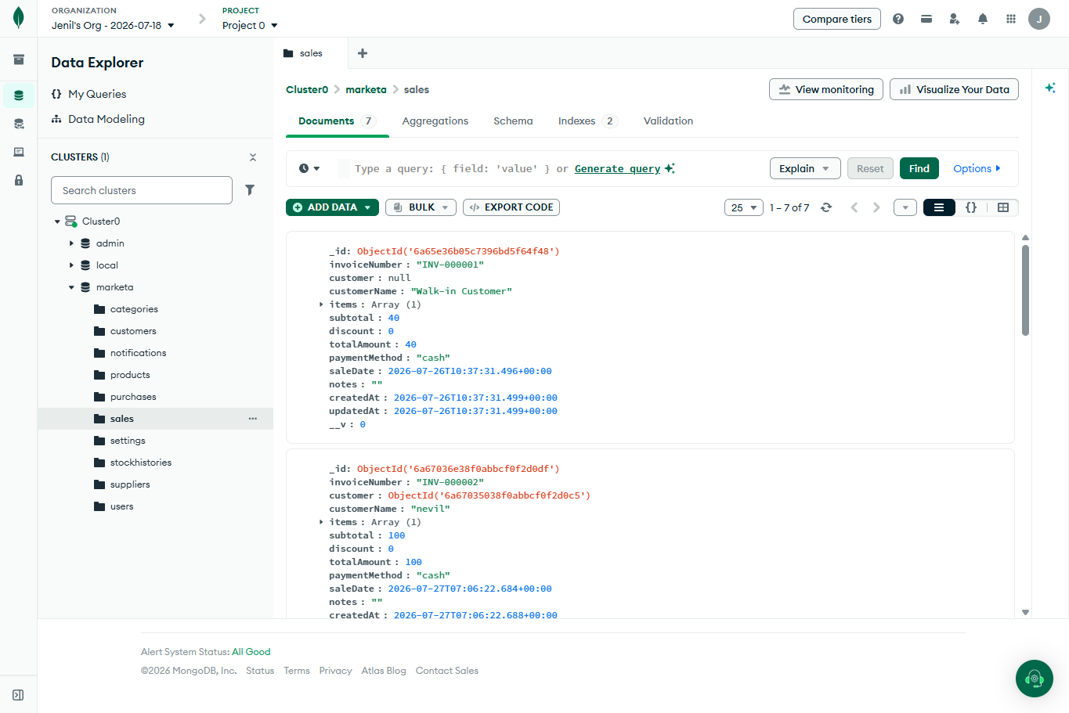
Figure 5.7.6 Sales

Slide 32
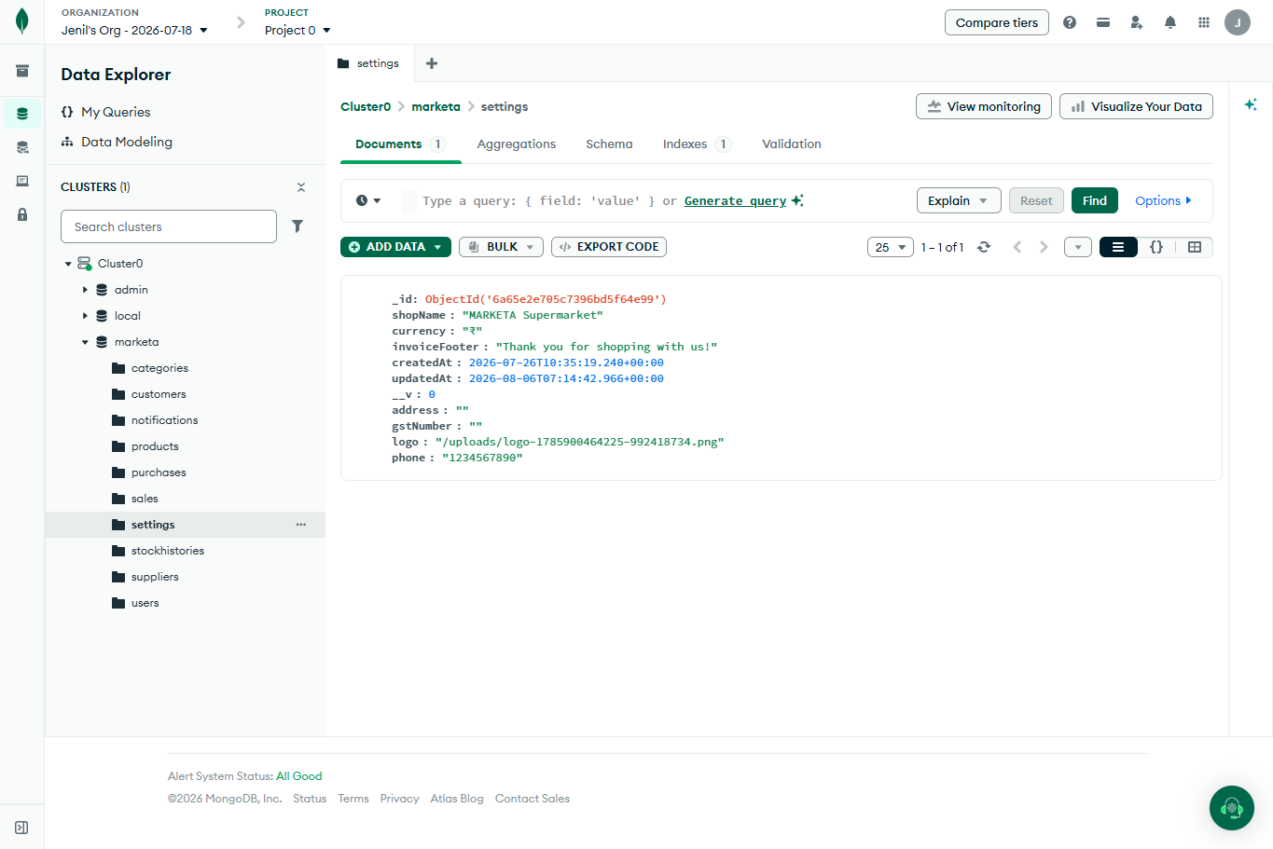
Figure 5.7.7 Settings

Slide 33
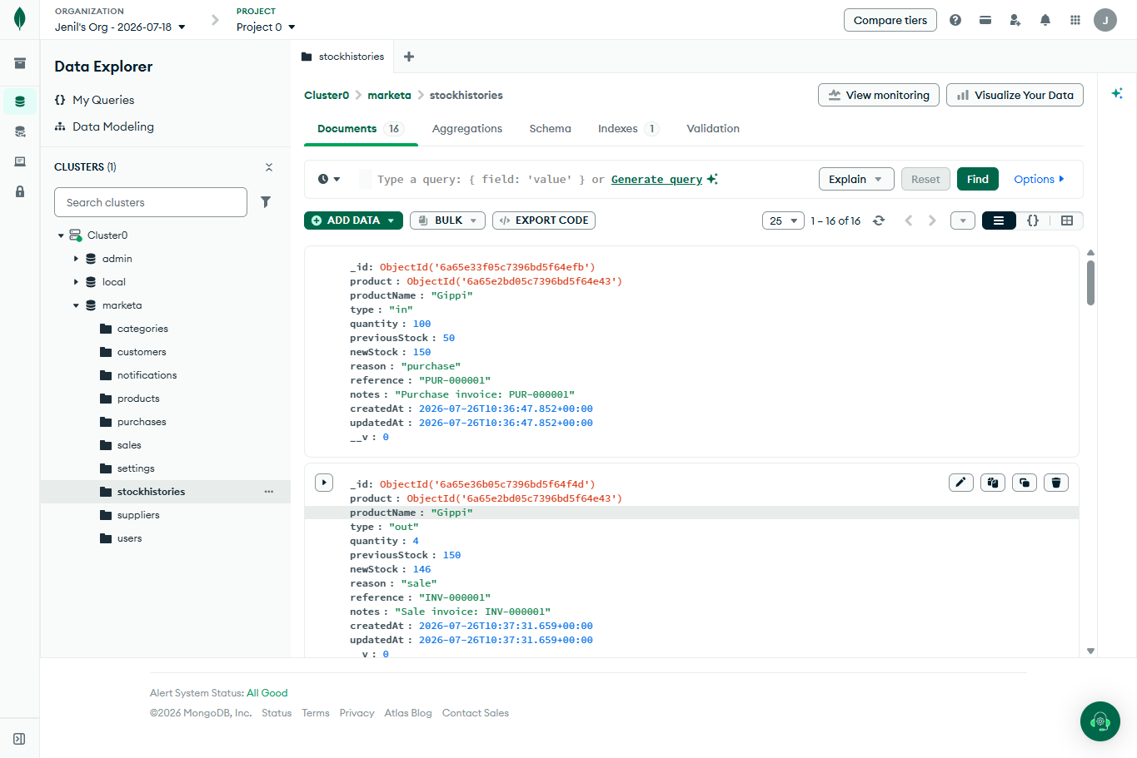
Figure 5.7.8 Stockhistories

Slide 34
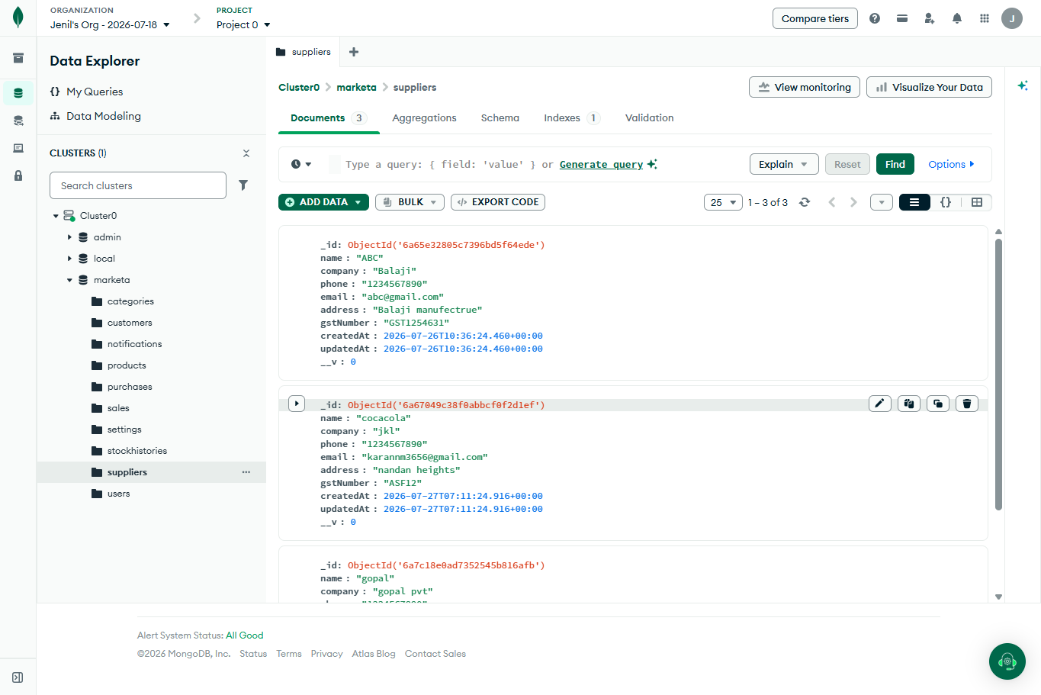
Figure 5.7.9 Suppliers

Slide 35
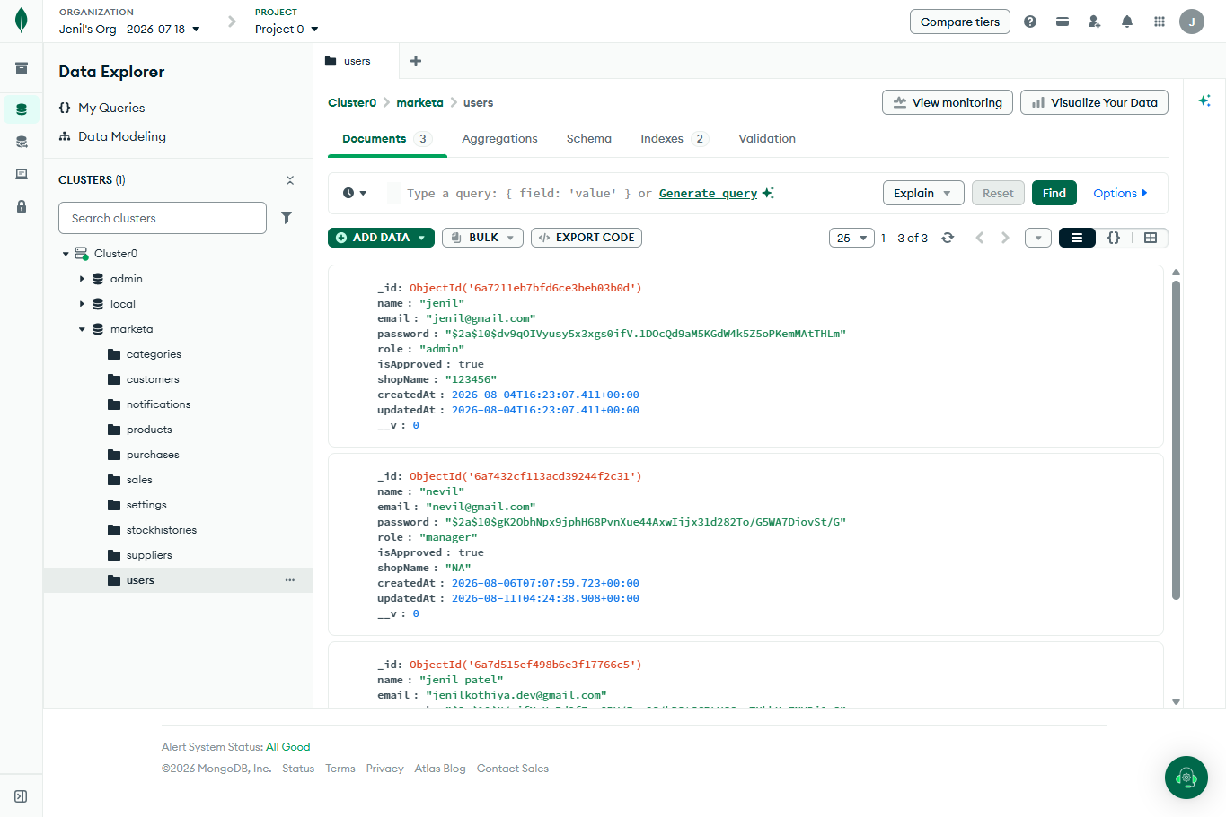
Figure 5.7.10 Users

Slide 36
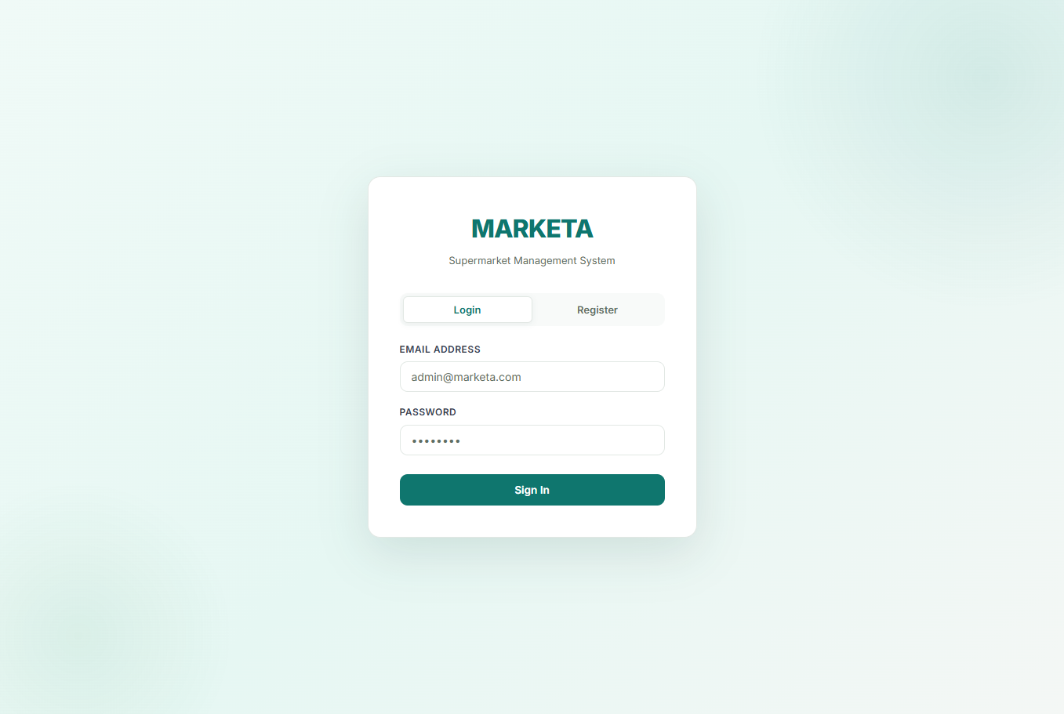
5.8 Menu-Screen Design:
Figure 5.8.1 Login Screen

Slide 37
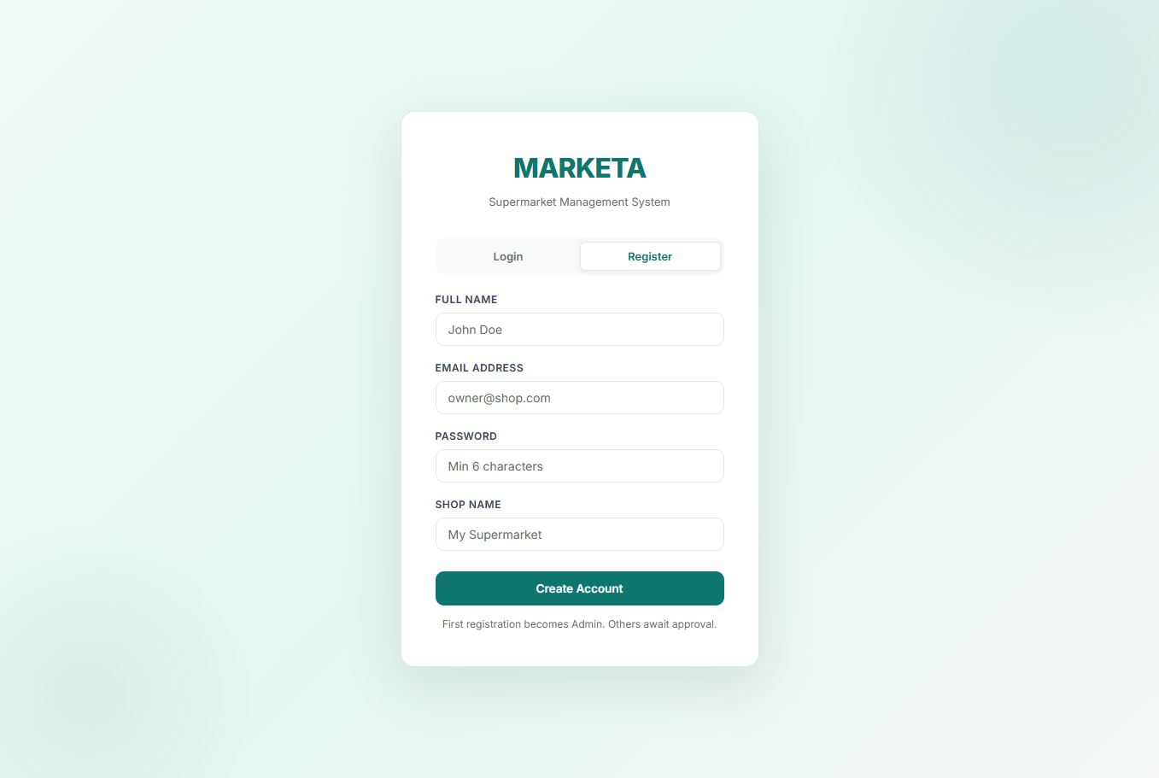
Figure 5.8.2 Register Screen

Slide 38
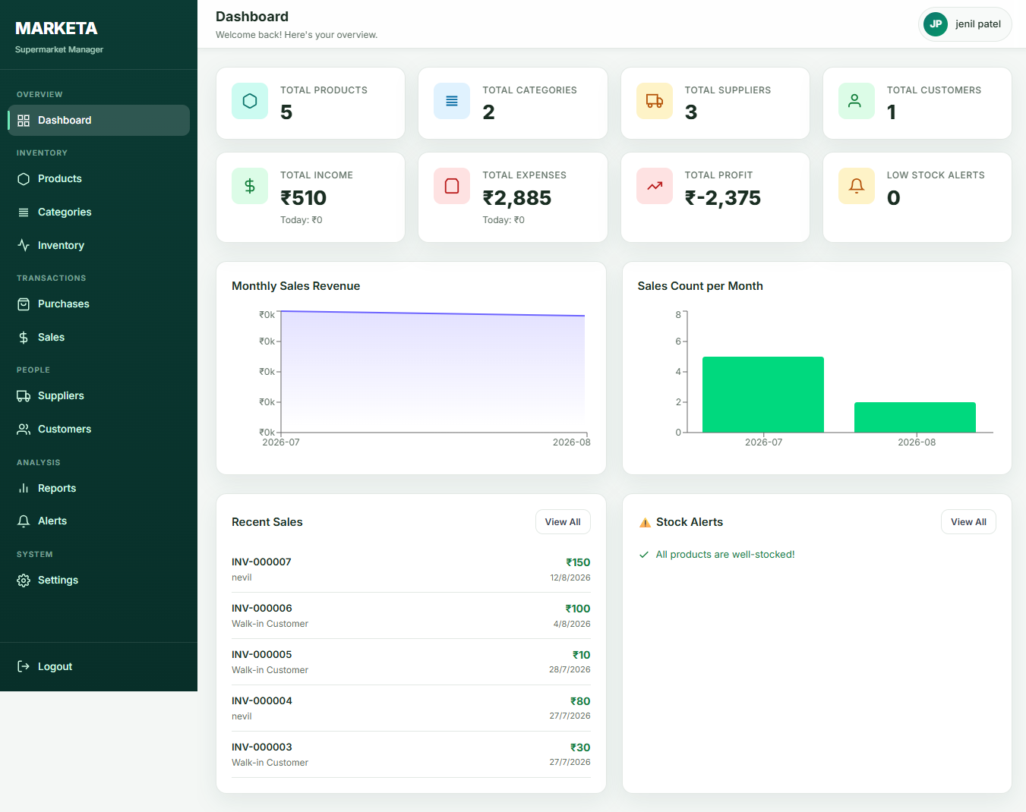
Figure 3.8.3 Dashboard Screen

Slide 39
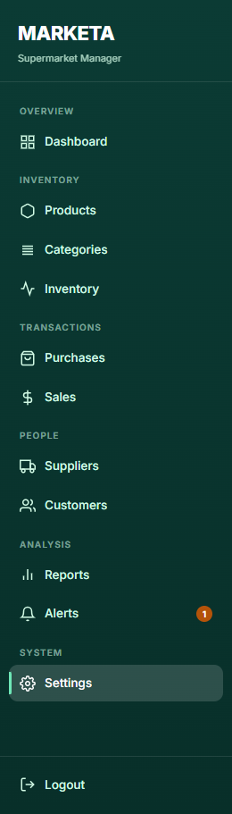
Figure 5.8.4 Modules

Slide 40
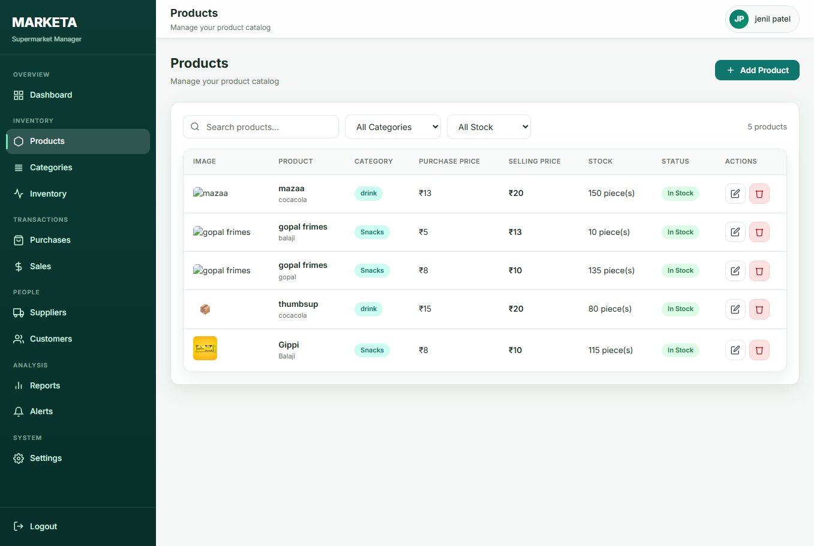
Figure 5.8.5 Products Screen

Slide 41
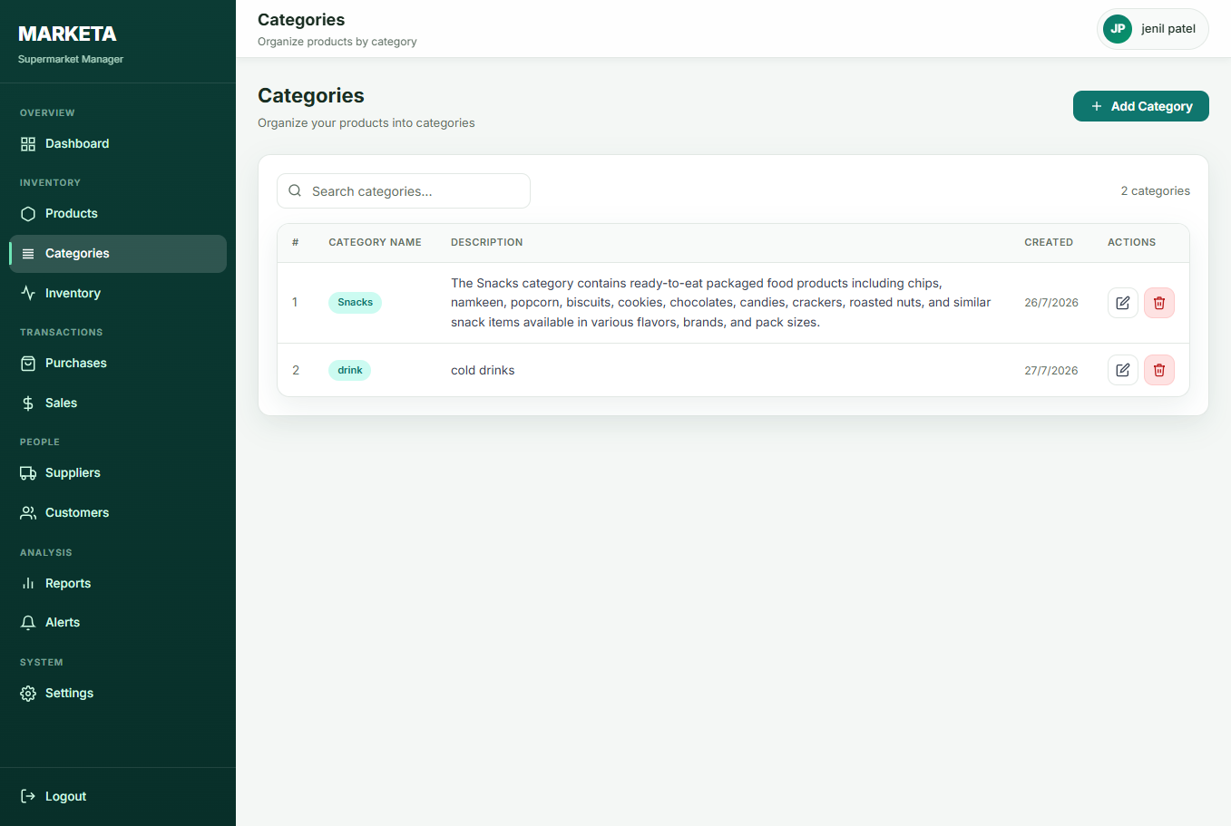
Figure 5.8.6 Categories

Slide 42
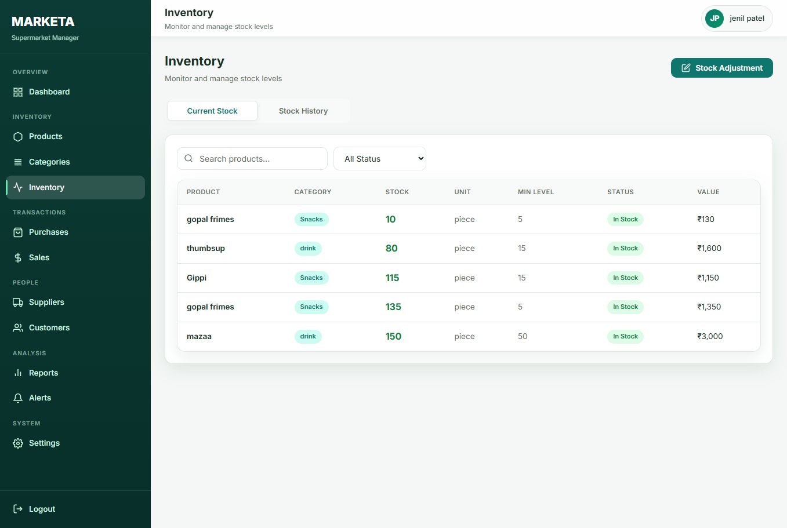
Figure 5.8.7 Inventory Screen

Slide 43
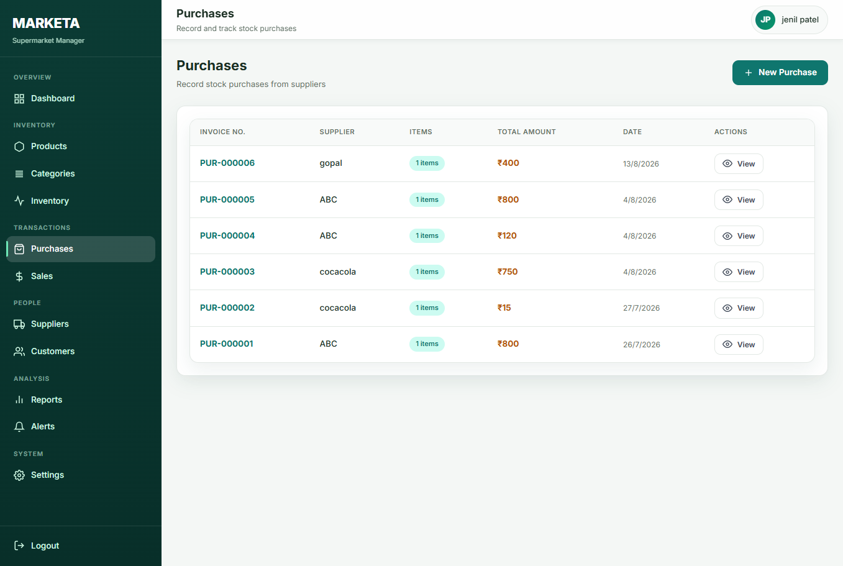
Figure 5.8.8 Purchases Screen

Slide 44
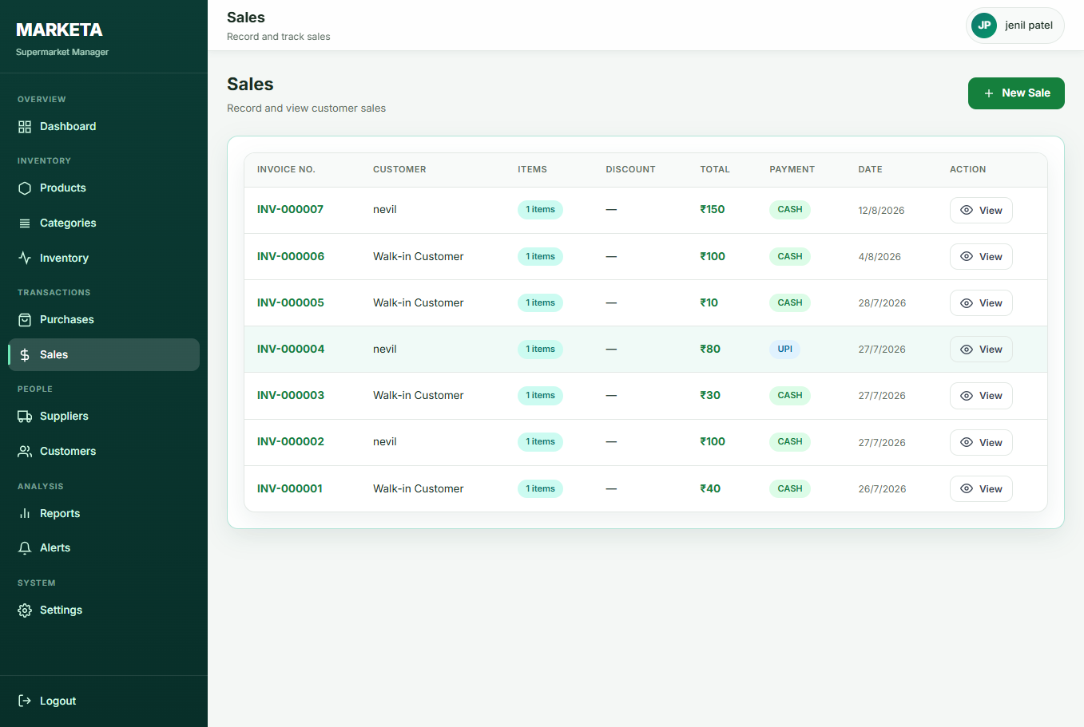
Figure 5.8.9 Sales Screen

Slide 45
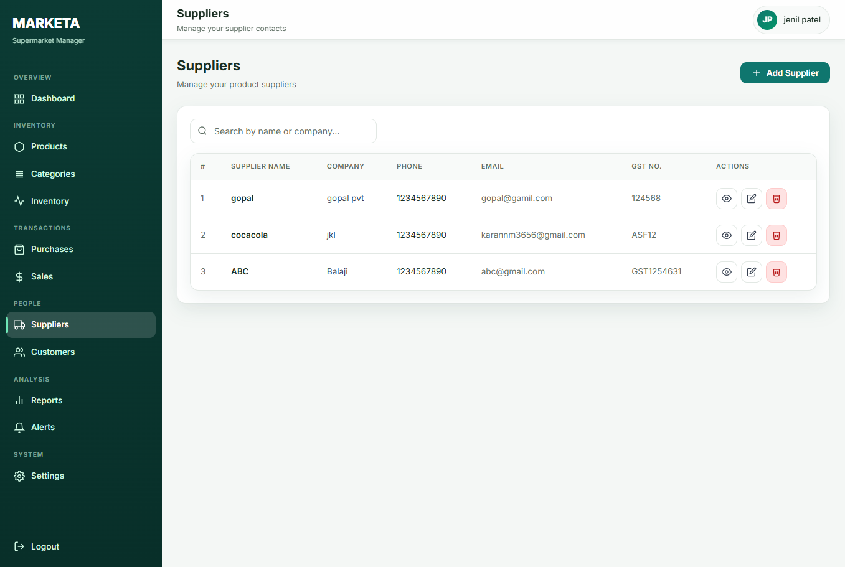
Figure 5.8.10 Suppliers Screen

Slide 46
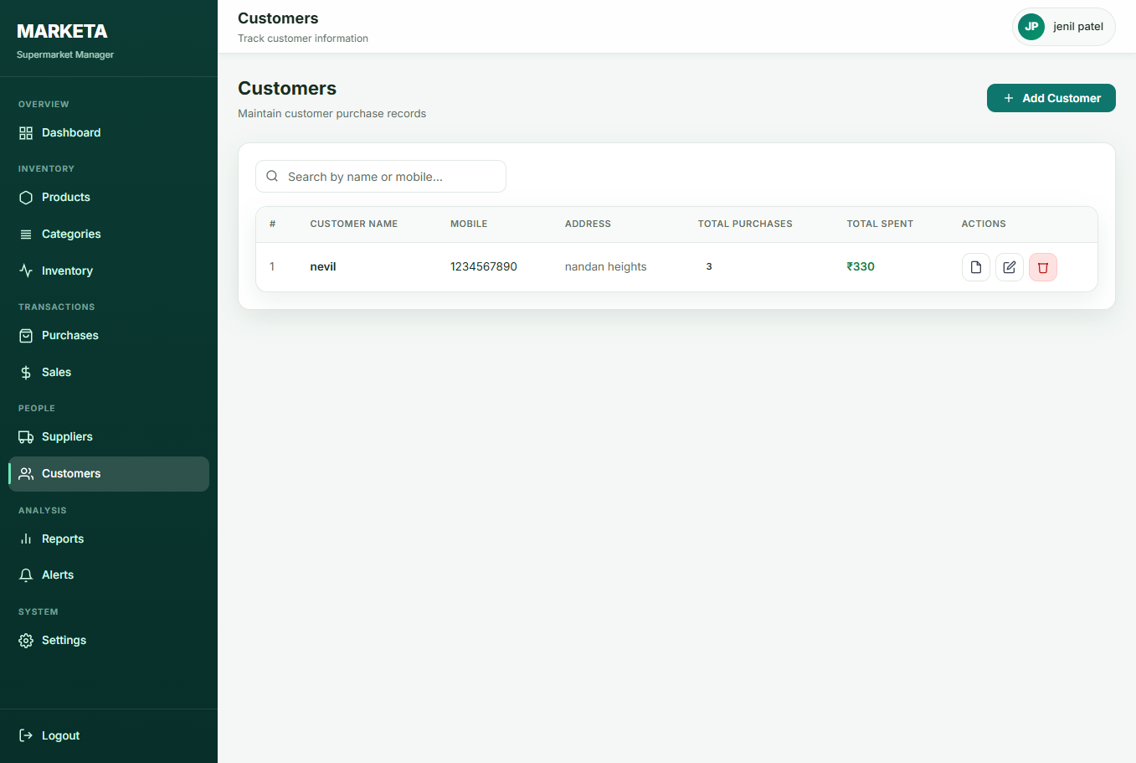
Figure 5.8.11 Customers Screen

Slide 47
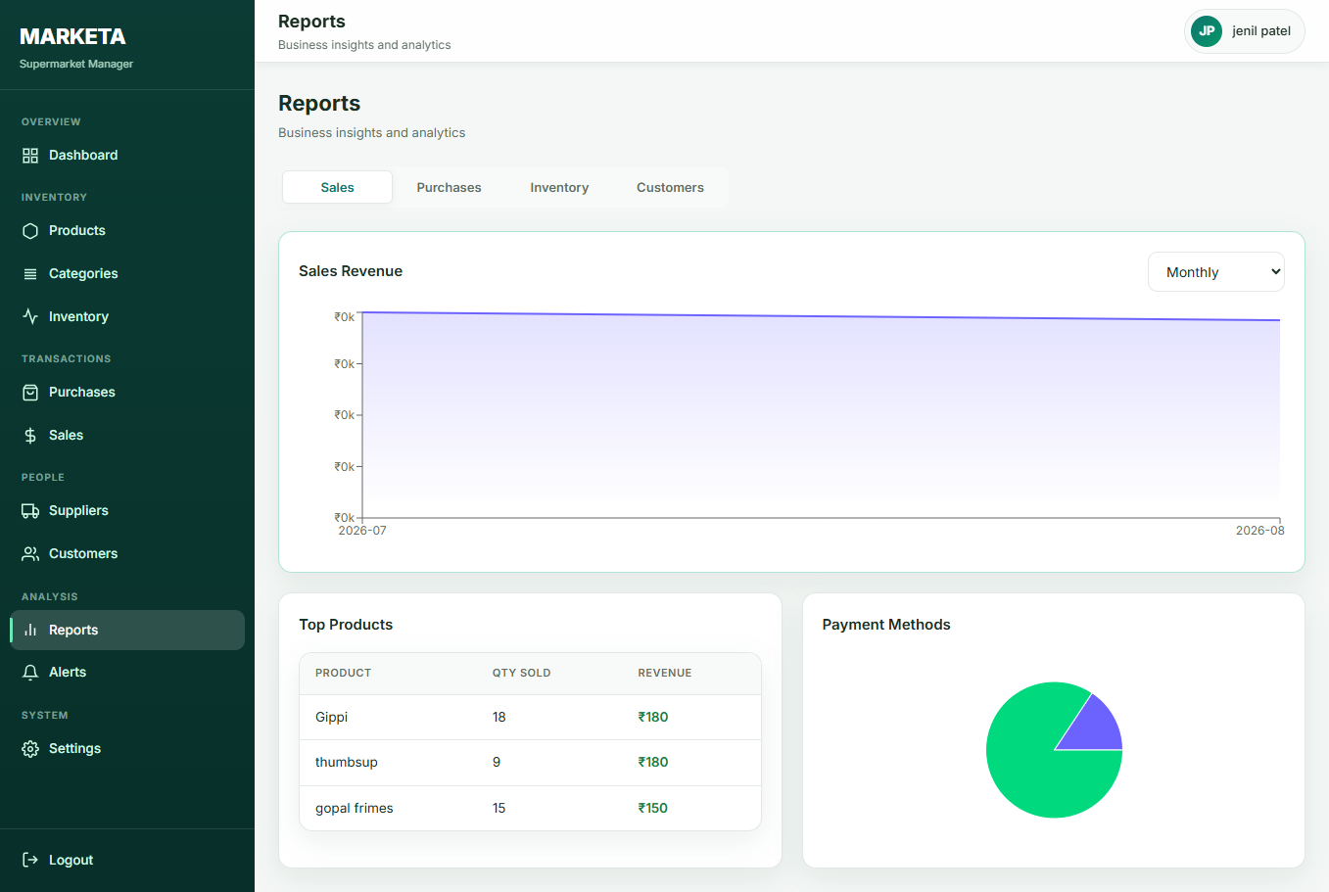
Figure 5.8.12 Report Screen

Slide 48
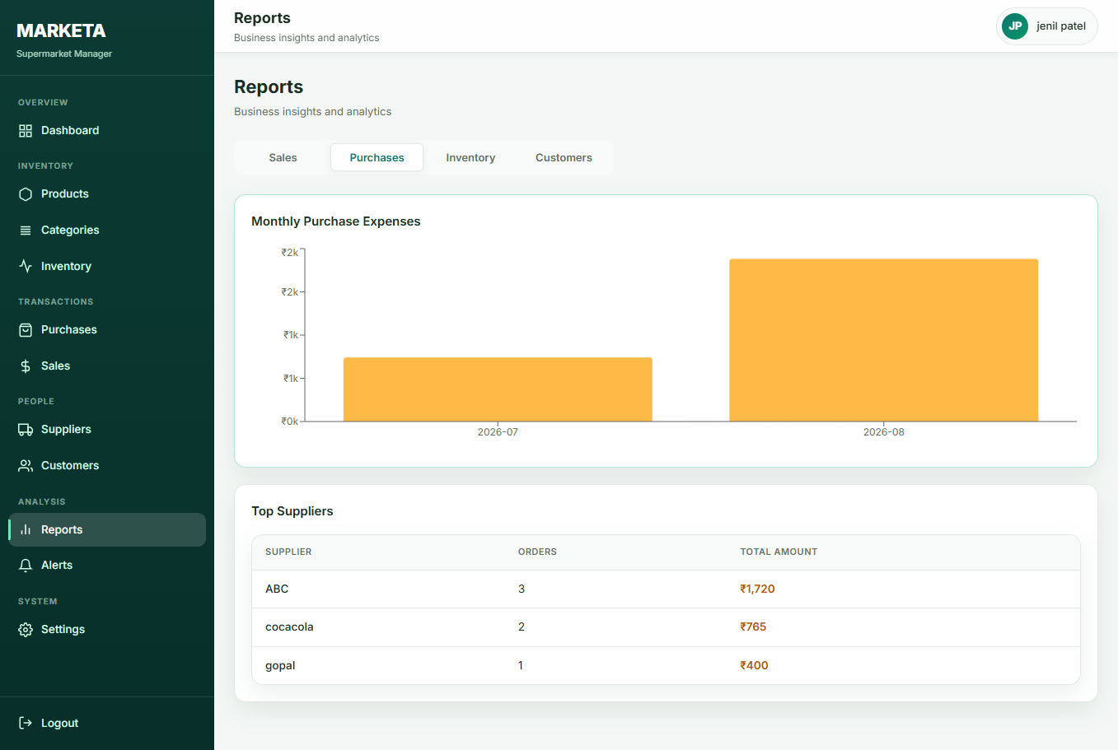
Figure 5.8.13 Report Screen

Slide 49
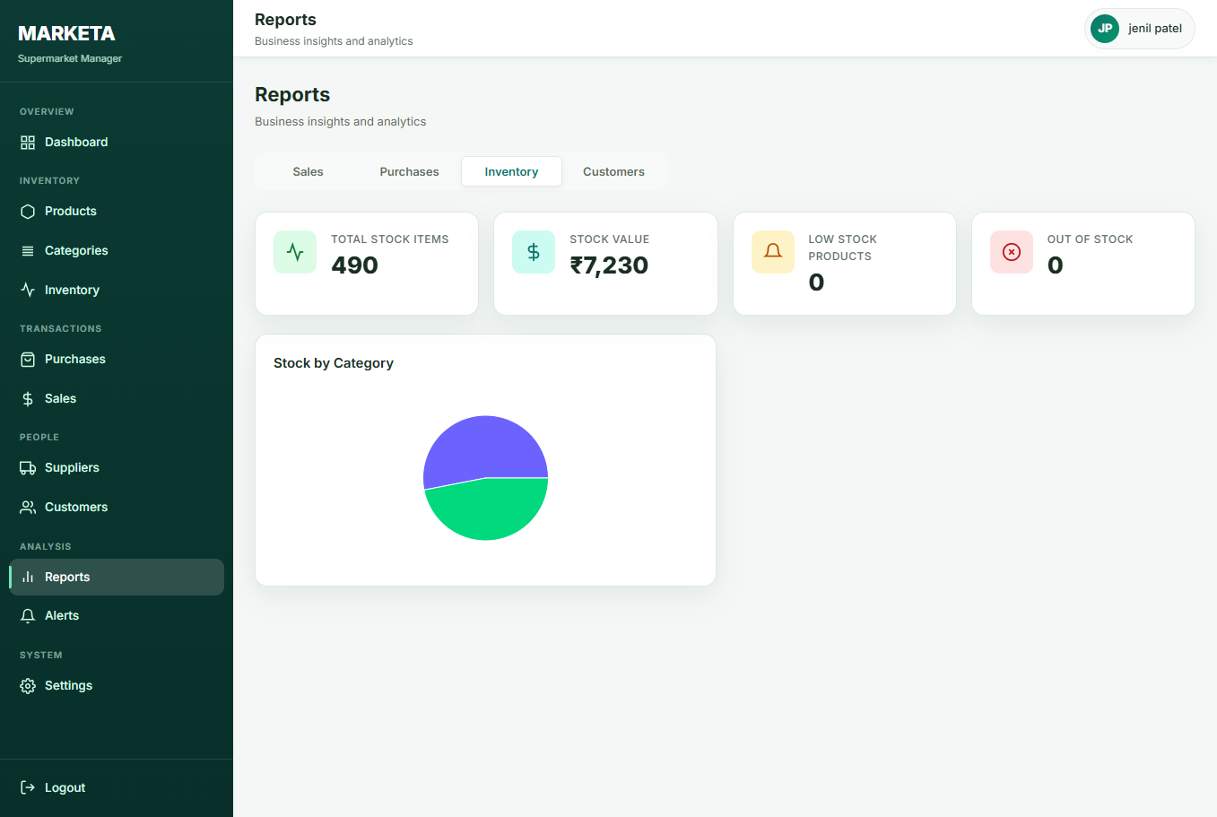
Figure 5.8.14 Report Screen

Slide 50
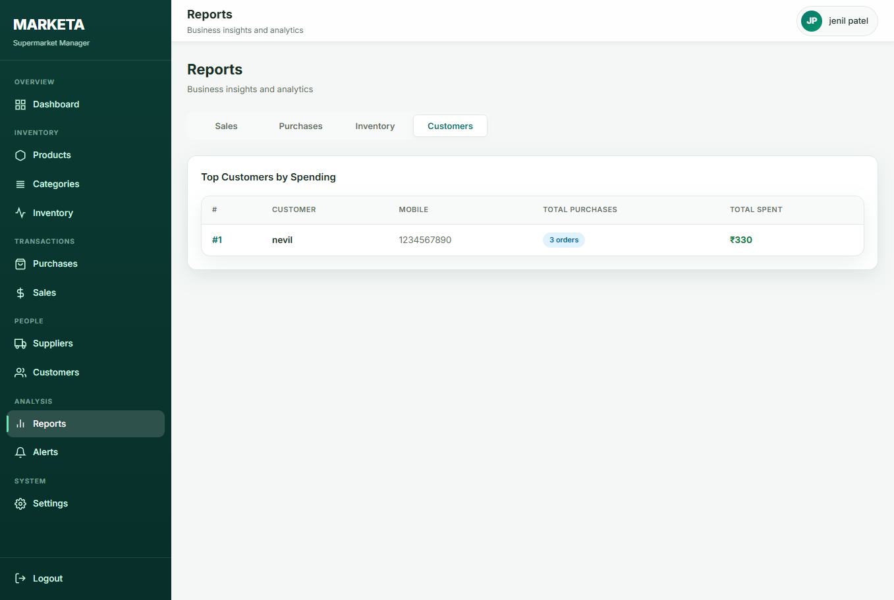
Figure 5.8.15 Reports Screen

Slide 51
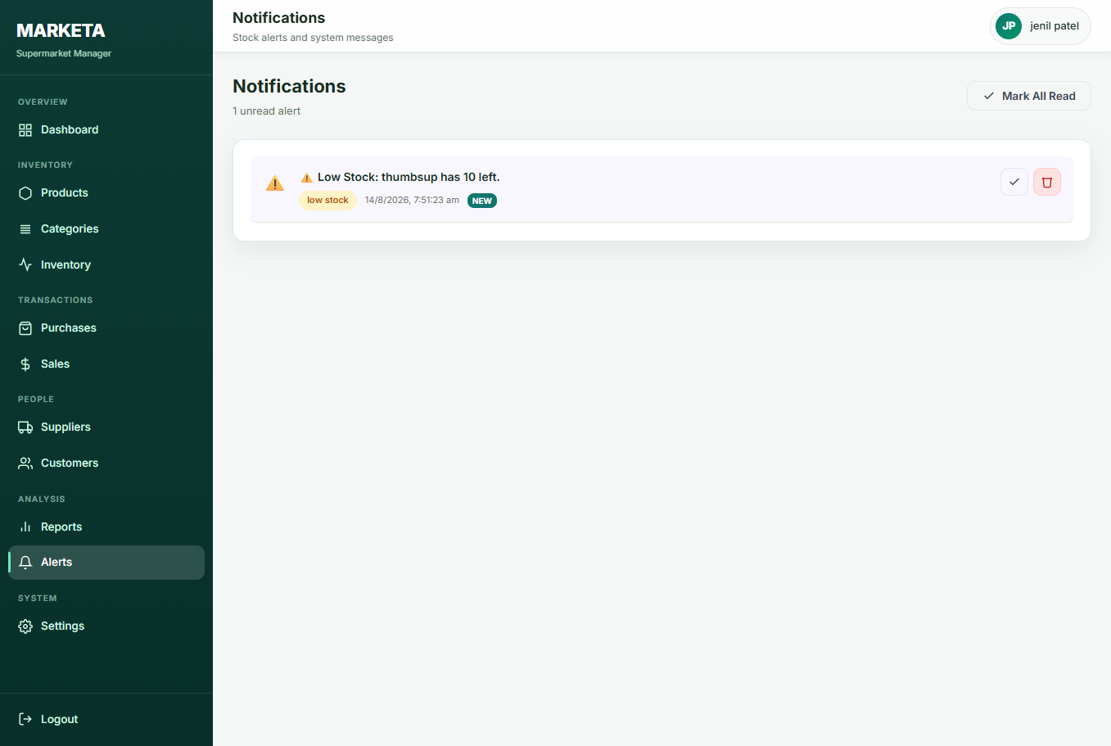
Figure 5.8.16 Alert Screen

Slide 52
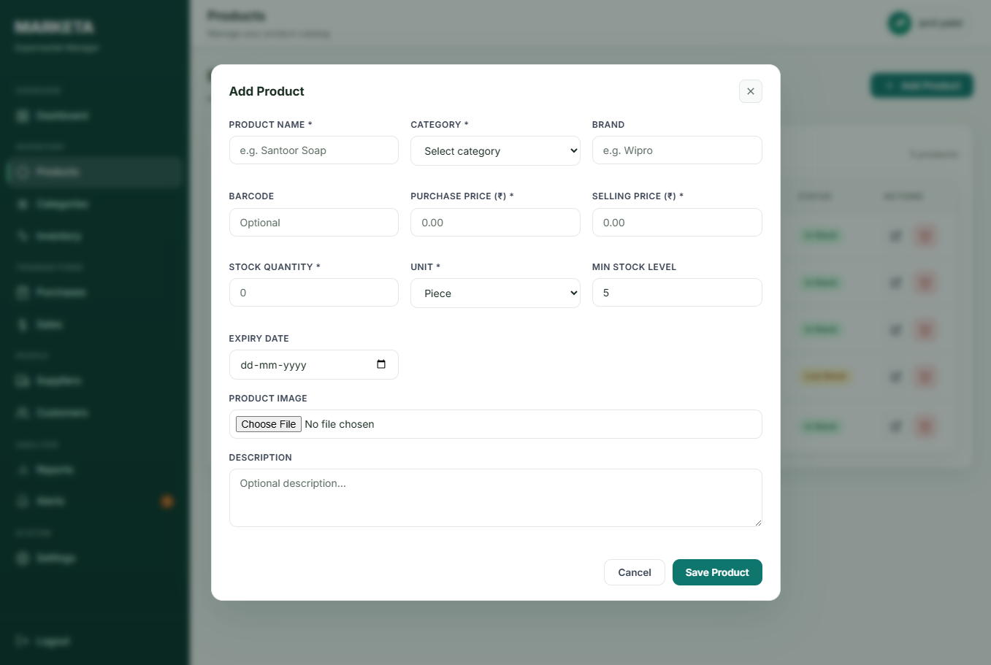
Figure 5.8.17 Add Product Screen

Slide 53
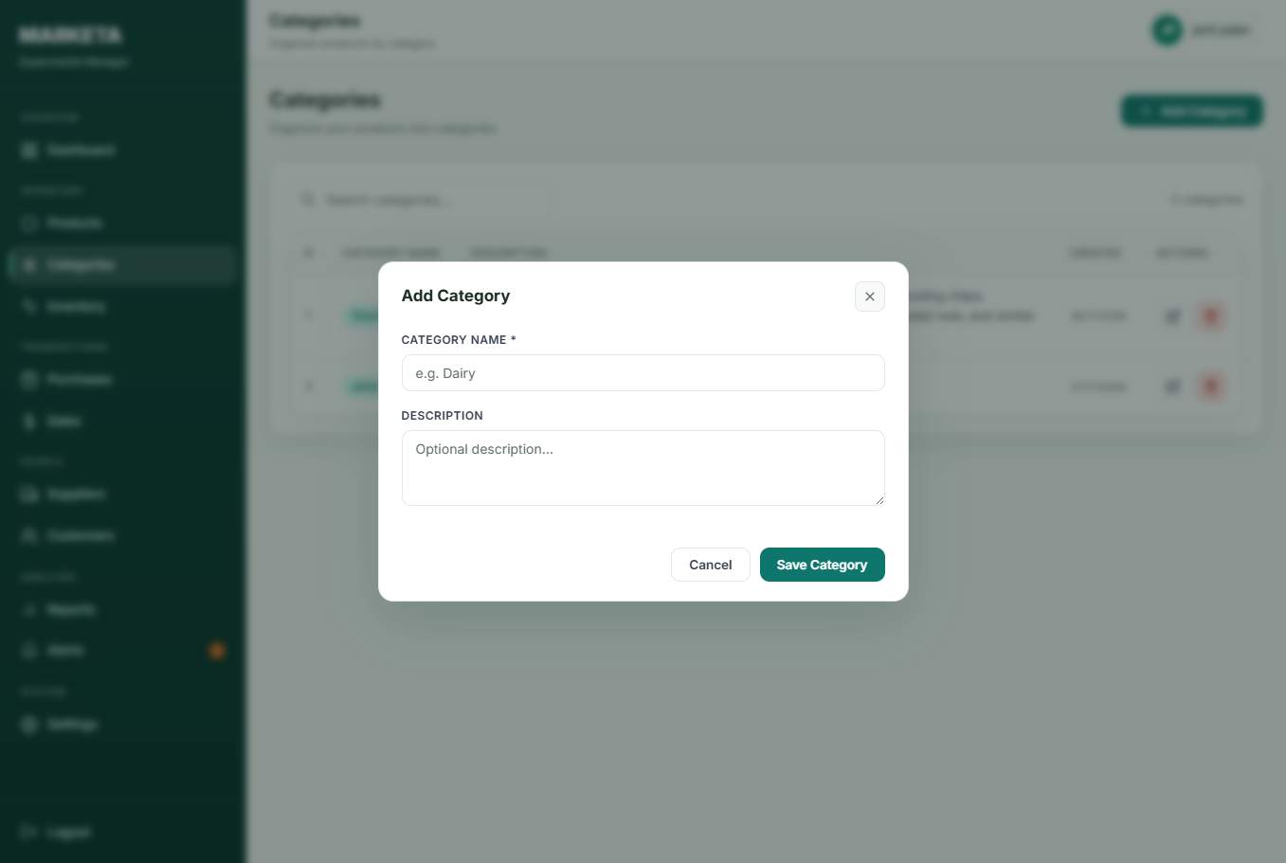
Figure 5.8.18 Add Category Screen

Slide 54
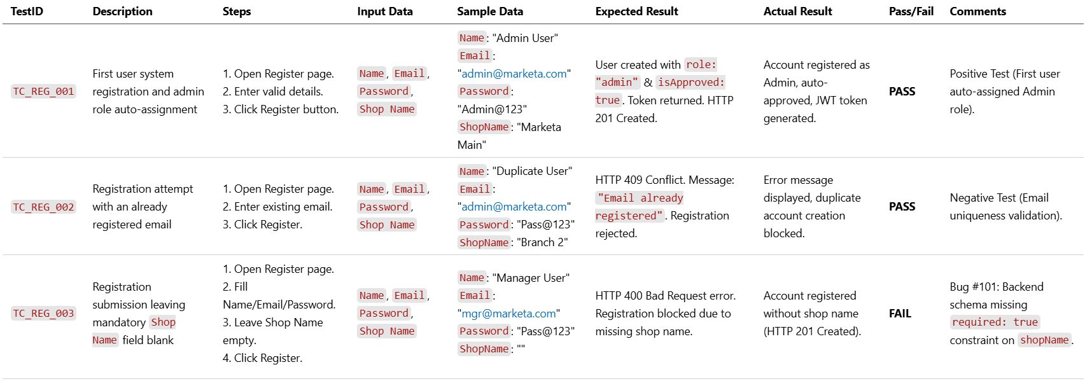
6. SYSTEM TESTING
Module 1: User Registration Testing

Slide 55
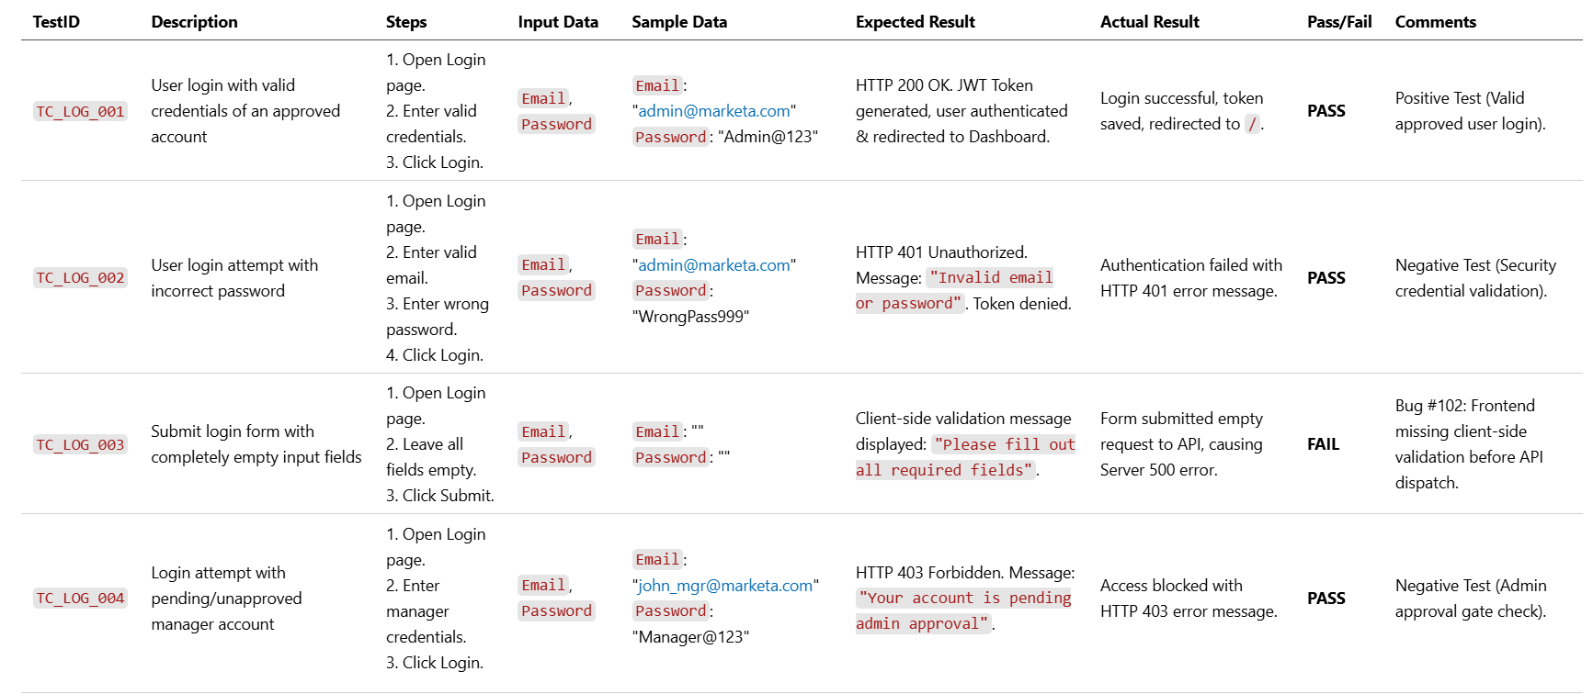
Module 2: User Authentication & Login Testing:

Slide 56
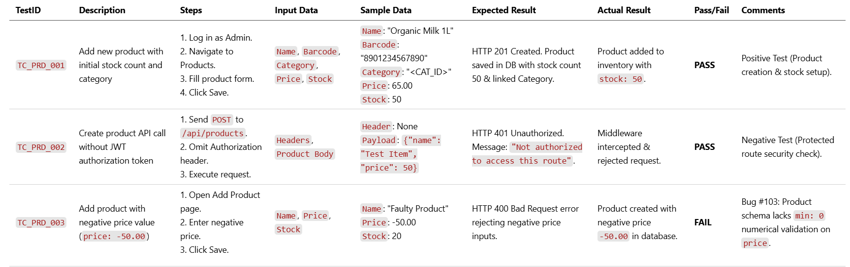
Module 3: Product & Inventory Management Testing:

Slide 57
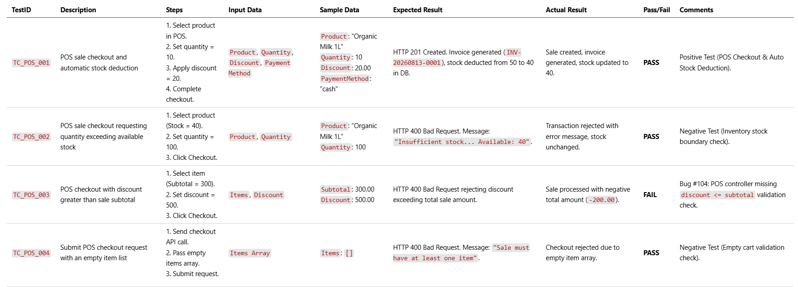
Module 4: Sales & Point of Sale (POS) Testing:

Slide 58
7. CONCLUSION
The MARKETA Supermarket Management System successfully addresses the operational bottlenecks experienced by modern retail stores and supermarkets. Developed using the robust MERN Stack (MongoDB, Express.js, React, Node.js) following MVC architectural principles, the system delivers an end-to-end management platform.
Key achievements of the system include:
Streamlined Authentication: Secured multi-role access control with Admin approval workflows for newly registered managers.
Automated Stock Deduction: POS billing transactions seamlessly calculate taxes, subtotal, discounts, and deduct inventory stock in real time.
Proactive Inventory Monitoring: Automated low-stock and out-of-stock notifications prevent stockouts and improve supply chain replenishment.
Comprehensive Analytics: Intuitive data visualizer dashboards provide store management with actionable sales and revenue insights.
By combining zero licensing costs, platform independence, real-time stock sync, and a user-friendly POS interface, MARKETA provides an efficient, scalable, and cost-effective digital solution for supermarket management.

Slide 59
8. LEARNING DURING PROJECT WORK
During the development of the RunDSA project, we gained practical knowledge in several areas:
Learned complete MERN Stack development.
Improved React.js component-based development.
Understood backend API development using Node.js and Express.js.
Learned MongoDB database design and CRUD operations.
Implemented secure user authentication using JWT.
Improved knowledge of REST APIs and frontend-backend integration.
Learned Git and GitHub for version control.
Enhanced debugging, testing, and problem-solving skills.
Improved teamwork, communication, and project documentation skills.
Gained experience in deploying and maintaining full-stack web applications.

Slide 60
8.1 Future Enhancement:
Native WebHID Barcode Scanner Integration: Implementing browser-level WebHID and WebUSB APIs for zero-latency direct device communication.
Multi-Store Warehouse Synchronization: Extending schema architecture to support multi-branch supermarket chains with central warehouse tracking.
AI-Driven Demand Forecasting: Machine Learning integration (ARIMA time-series models) for predicting product demand trends and automated supplier purchase order drafting.
Customer Loyalty & Rewards System: Points-based customer rewards module integrated into cashier POS checkout.
Offline PWA Support: Service Worker and IndexedDB integration enabling offline POS billing during network outages.
Integrated Dynamic Payment Gateway: Instant UPI QR code generation directly on POS billing screen.

Slide 61
9. BIBLIOGRAPHY
9.1 Online References:
Node.js Official Documentation (v18.x LTS) URL: https://nodejs.org/docs/latest-v18.x/api/ Usage: Referred for ES Modules configuration, asynchronous event handling, and process management.
React 18 Developer Documentation URL: https://react.dev Usage: Referred for functional components, custom hooks, Context API, and state management.
Express.js API Reference (v4.x) URL: https://expressjs.com/en/4x/api.html Usage: Referred for RESTful routing, custom middleware implementation, and error-handling controllers.
MongoDB & Mongoose Object Data Modeling Guide URL: https://mongoosejs.com/docs/api.html Usage: Referred for schema creation, population references, aggregate pipelines, and query optimization.
Vite Frontend Tooling Guide URL: https://vitejs.dev/guide/ Usage: Referred for frontend bundling, HMR configuration, and asset optimization.
MDN Web Docs (Mozilla Developer Network) URL: https://developer.mozilla.org Usage: Referred for REST API standards, HTTP status code specifications, and local storage Web APIs.

Slide 62
9.2 Offline References:
College lecture notes and practical manuals related to MERN Stack and Data Structures.
Project guidance provided by the Faculty of Computer Applications, Marwadi University.
A. Silberschatz, H. F. Korth, and S. Sudarshan, Database System Concepts, 6th ed. New York, NY, USA: McGraw-Hill, 2019.
R. Elmasri and S. B. Navathe, Fundamentals of Database Systems, 7th ed. Boston, MA, USA: Pearson, 2016.

Slide 63
Thank You

