Slide 1

GGJ 2017 Game Submission
GGJ Team

Slide 2
Other languages
Chinese (Simplified);
Chinese (Traditional);
French;
Hebrew;
Italian;
Japanese;
Korean;
Portuguese/Brazil;
Polish;
Spanish;
Thai;
Turkish;

Slide 3
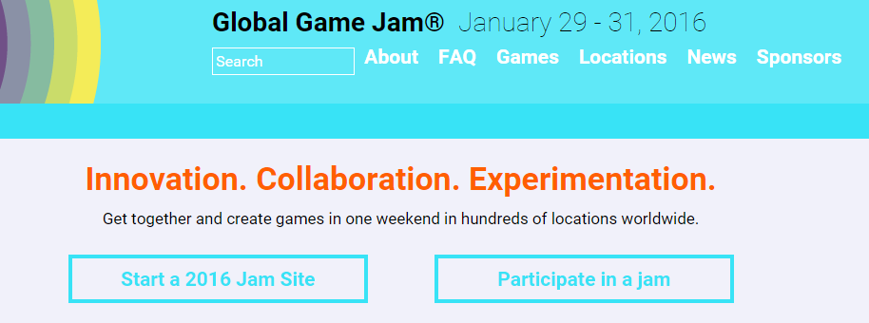
You must be a GGJ user.
To submit a game you must:
Have a GGJ account
Have already chosen a jam site
Be logged into your account

Slide 4
Choose a team leader.
Only ONE person from your team needs to create the game project on our website.
Once they have created the project (see next slide) they can add all the other team members (see slide 8).

Slide 5
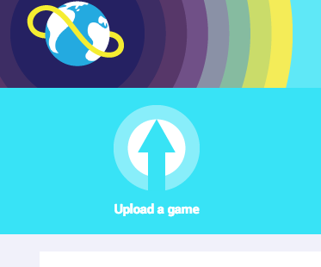
Start your game project.
Click on “Upload a Game” button from top/left of your screen
Enter the information
Upload files
Hit “Save”

Slide 6
Start your game project early.
As soon as you have a team and an idea, start your game project on the GGJ website by Saturday at the latest.
Enter at least your project name and description. Save.
You can do everything else later.

Slide 7
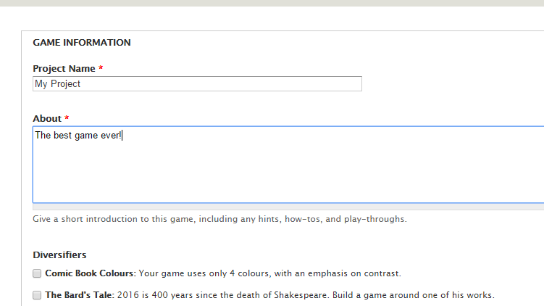

Slide 8
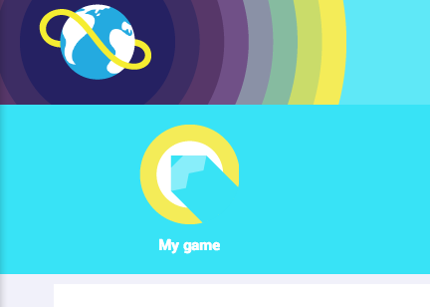

Find your game.
Once you save a game, your game can be found under “My Game” or “My Profile”.

Slide 9
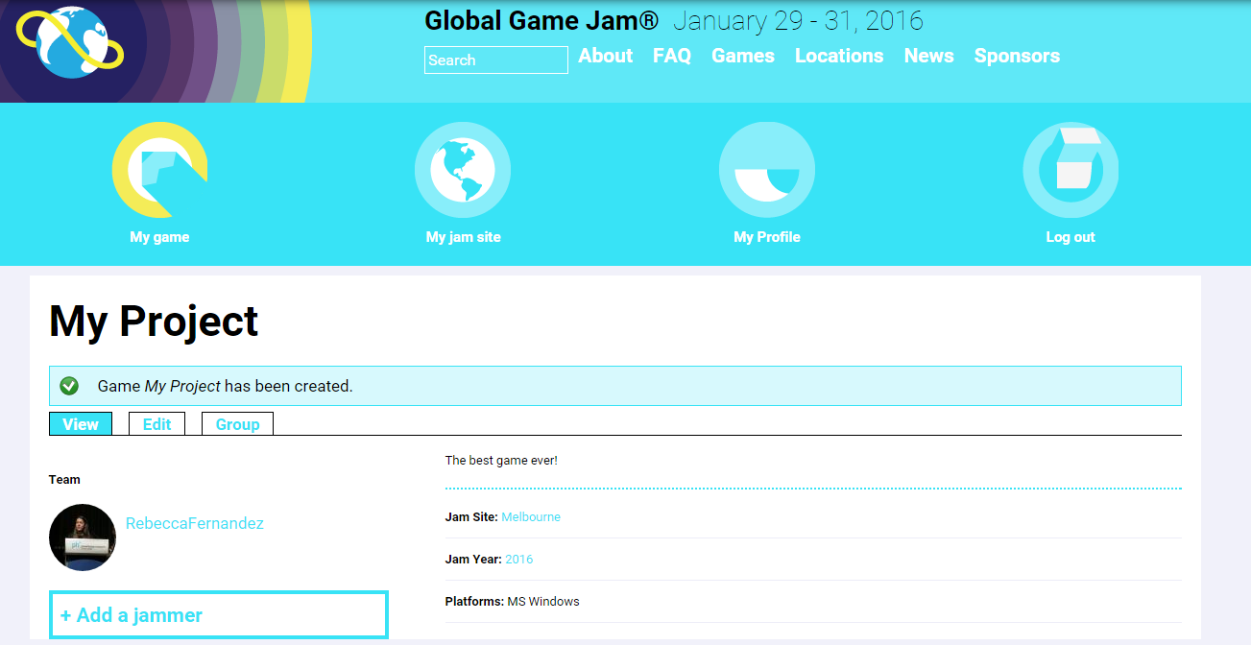

Slide 10
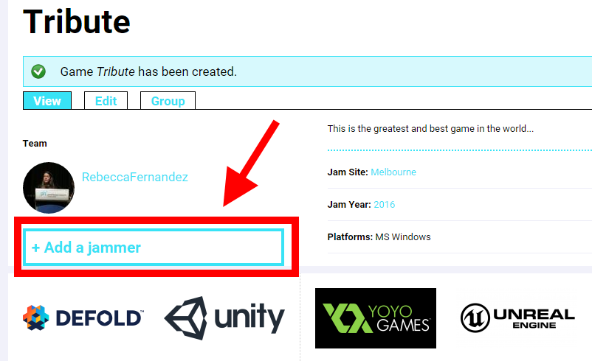
Add team members.
Click on “+ Add a jammer” from the bottom of your game page.

Slide 11
Uploading game files
All GGJ submissions are required to upload their games (even if not complete) including all assets and source code under the CC license.
You must put everything in one zip file.
You can download a model from here:
http://ggj.s3.amazonaws.com/GGJ_directory_structure.zip

Slide 12
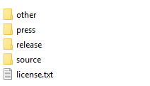
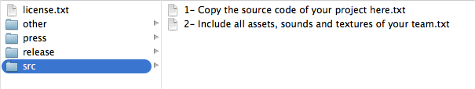
Directory structure of the zip file
Your main directory (folder) should have a license file and 4 sub directories: source, release, press, and other.

Slide 13
sub-directories: source
This is for the actual source files, like C or
C++ files and assets like sound, music and art.
Do not include game engines or tools.
Do include your project folders from Unity or GameMaker.
Write a README file that explains how to use your code to make the game.
For non-digital games, your PDF instructions would go here.
Test to make sure you have everything!

Slide 14
sub-directories: release
This is for the executable version of your game
If possible, you can include multiple versions for different architectures (like Mac OS X, Windows versions and APK files)
Include a README file that explains what OS or environment is needed to run the game

Slide 15
sub-directories: press
This is for screenshots and videos about your
game.
Include at least one 1024x768 screenshot of your game.
If you have links to YouTube videos or other online resources, put them in a text file here.

Slide 16
sub-directories: other
Anything else you like! For example:
More licenses
Credits
Contact information

Slide 17
REMEMBER...
ALL JAMMERS HAVE TO SUBMIT THE SOURCE IN THIS FORMAT!
GGJ reserves the right to take down any submission that has incomplete source code.

Slide 18
How do I zip something?
For Mac OS X+ : Select the folder, then click on File > Compress.
On Windows 8.1+ : Select the file or folder, tap or click Share, and then tap or click Zip
On Windows 7: Right-click file/folder, go to Send to, click “Compressed (zipped) folder”
Older Windows versions: Use a Zip utility such as Winzip.

Slide 19
Do you have any questions?
If you have any doubts on creating the game project or run into problems while uploading, please tell your organiser or contact us:
Slack: #help via https://ggj17.slack.com
Email: help@globalgamejam.org
Twitter: @globalgamejam

