Slide 1
2019
GUH
WeChat Smart Reply
Team666

Slide 2

Basic System
01
- Shu-Ting Chang
CONTENTS
Tianxing Robot
02
Honeybee
- Feifan Chen
Additional Features
03
- Li Win Ang
Weather Report
04
- Wenqing Zong

Slide 3
How the system basically works
Shu-Ting Chang
More Later
Set Modes
QR Code
Start
Set different modes, such as only replying to file transfer helper or all the friends.
Get QR code from online WeChat server.
Once the QR code is generated, scan it to login.
Then the robot will start to auto reply for you in the mode you set before.

Slide 4

Tianxing Robot
Feifan Chen
By using this API, we can customize specific conversation just for our robot
Tiangxing smart
chattining API
Translating Function
It is smart chatting robot, based on tones of phrases (chinese)
Further improve might be translating the conversation into different languages
Special
replying list

Slide 5

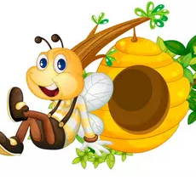
Additional Features
Li Win Ang
Talking Bee
Convert given text to a mp3 audio file with /tts command.
Friendly Bee says Hi
Reply with bee (gif) when responding to hi.
Singing Bee
Bee that sings twinkle twinkle little star. Classic !

Slide 6
Weather Report
Wenqing Zong
Triggered by sending “weather [cityname]”
Any city in the UK
Always get you the latest weather report
Weather, Visibility, Wind Speed, Humidity, Air Pressure

Slide 7
2019
Thank You
GUH

