Slide 1
K-Nearest Neighbors (KNN) Regression
Programming and Data Analysis for Modern Neuroscience
Spring 2020

Slide 2
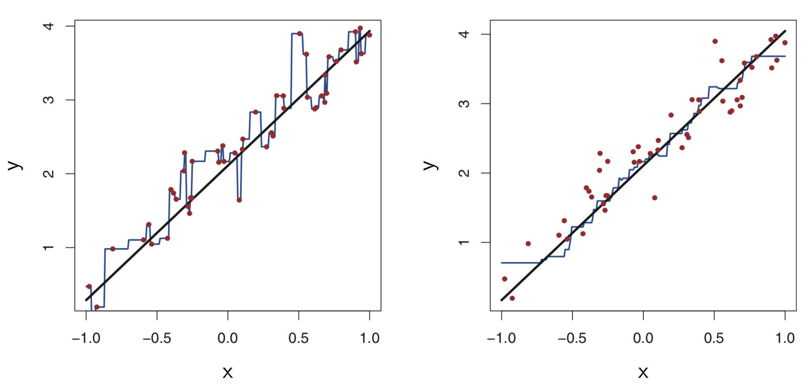
Data
Data
Linear model
Linear model
KNN K=1 model
KNN K=9 model
Images from “An Introduction to Statistical Learning”

Slide 3
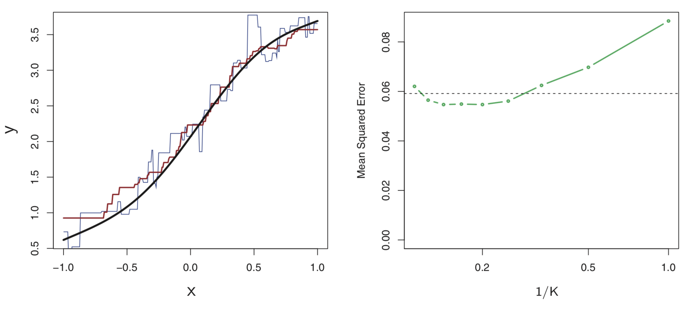
Nonlinear model
test error
KNN K=1 model
KNN K=9 model
Images from “An Introduction to Statistical Learning”

Slide 4
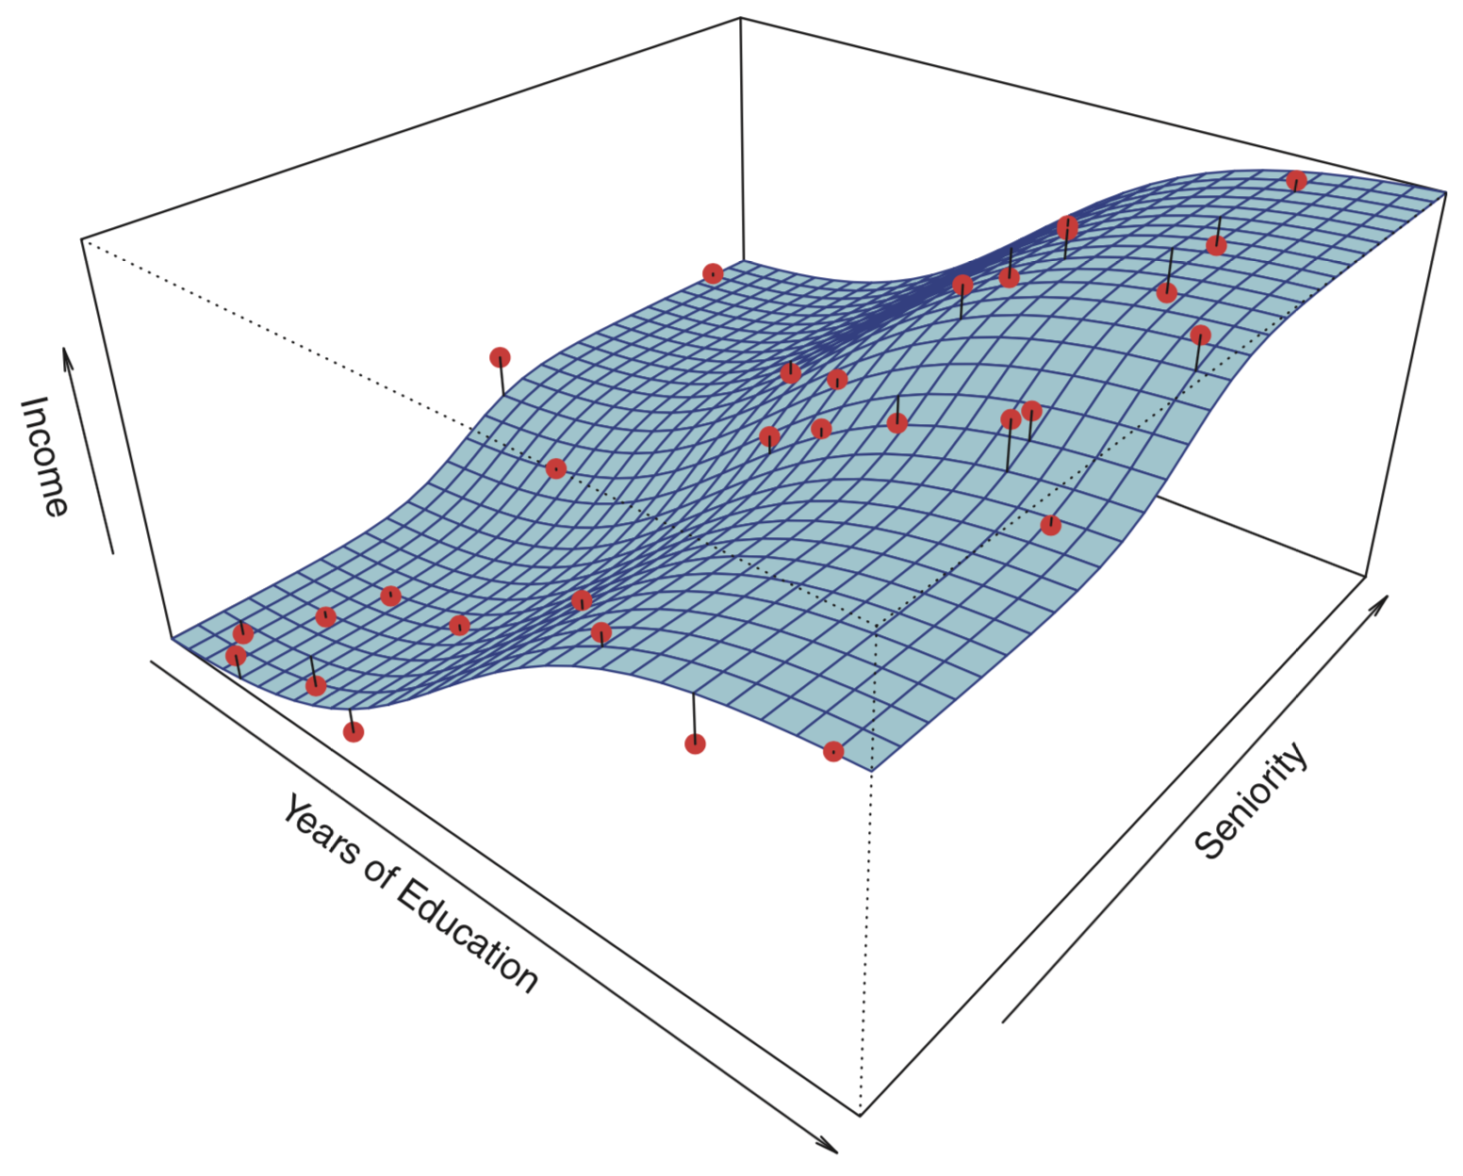
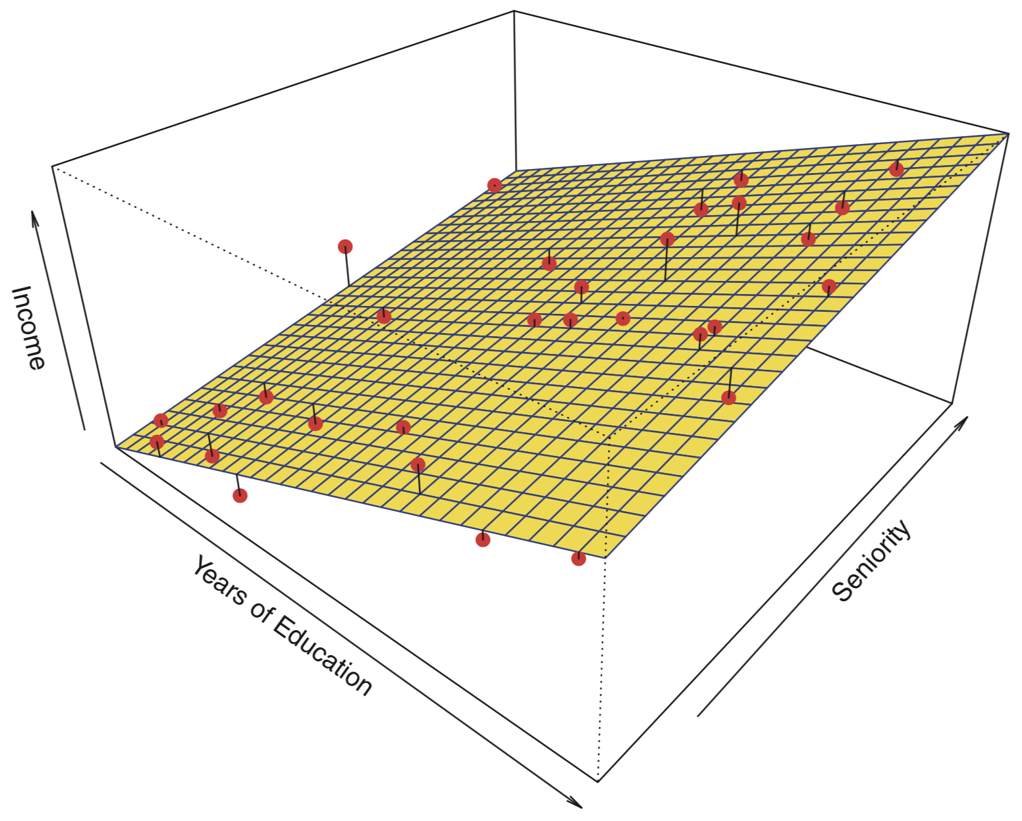
Surface is true simulated model.
Points are randomly simulated data plus noise.
Linear model fit.
Images from “An Introduction to Statistical Learning”

Slide 5
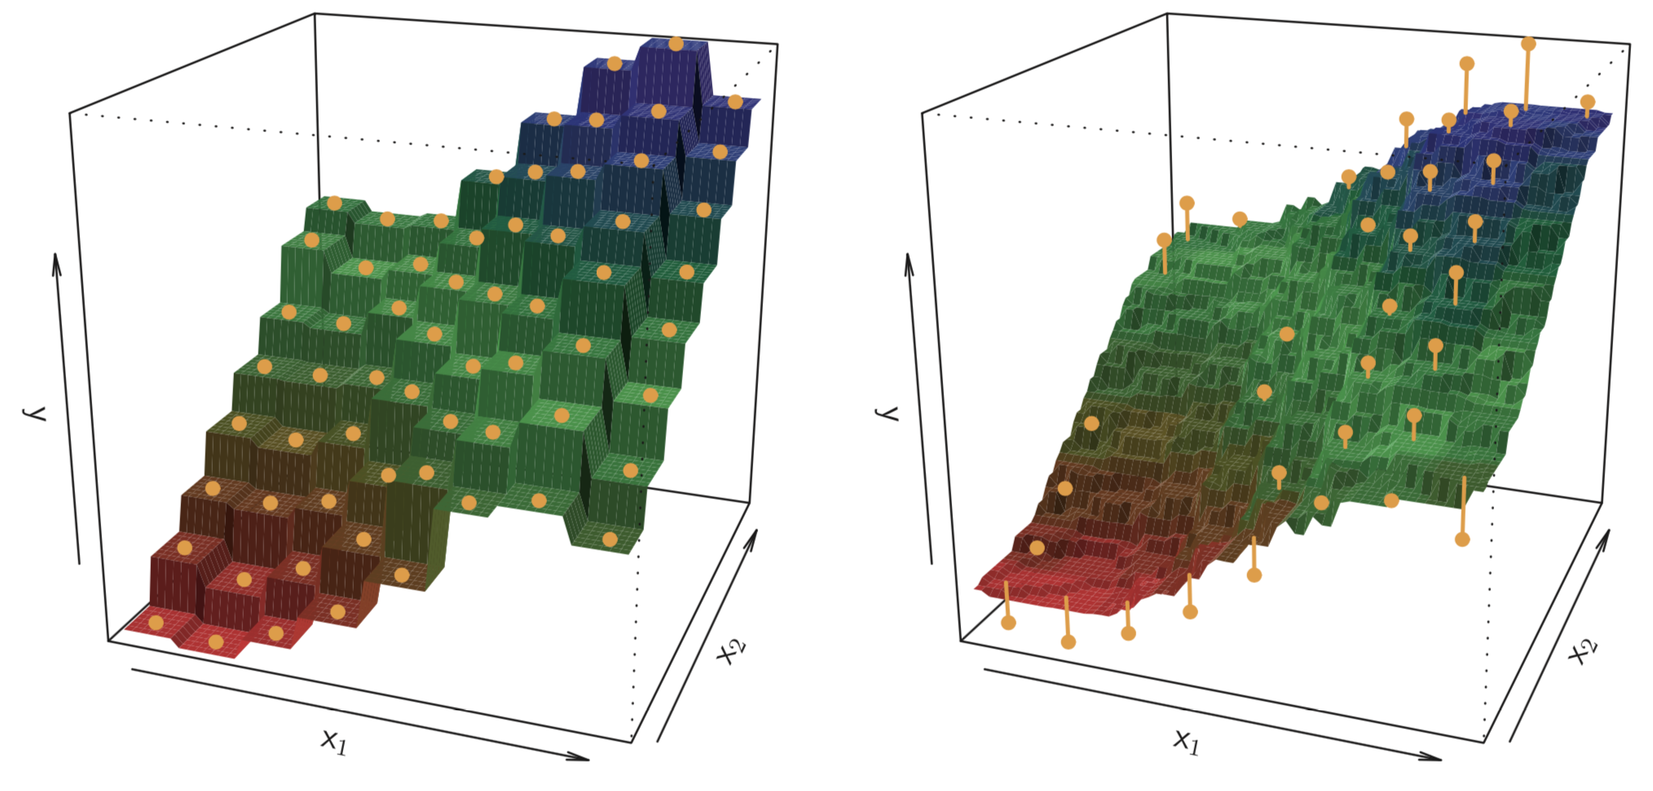
KNN model fits.
K = 1
K = 9
Images from “An Introduction to Statistical Learning”

