Slide 1
Simple Linear Regression
Programming and Data Analysis for Modern Neuroscience
Spring 2020

Slide 2
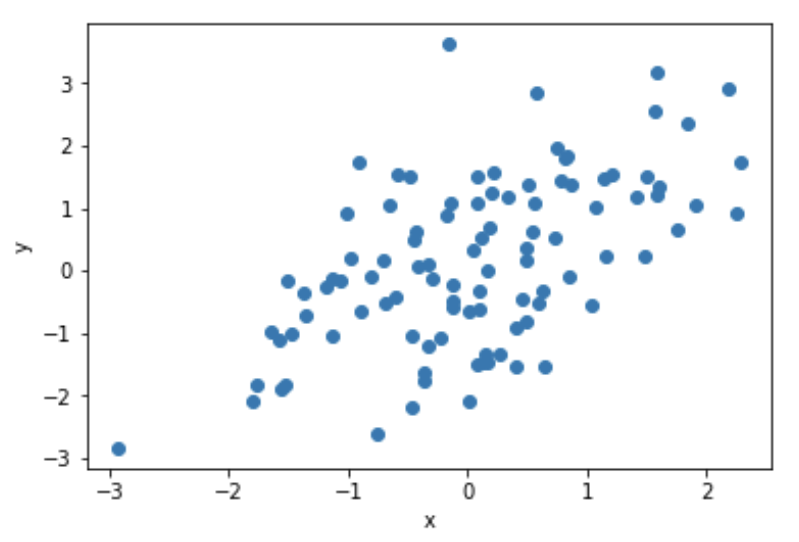
A relation between two random variables

Slide 3
A relation between two random variables
Conductance
Voltage

Slide 4
A relation between two random variables
Performance
Conductance
Voltage
Trials

Slide 5
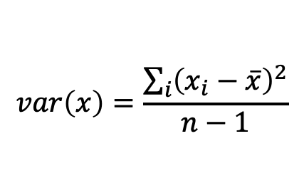
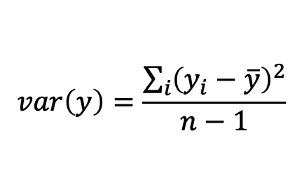
A relation between two random variables
Variance
$$var\left(x\right)=\frac{\sum_{i}{{\left(x_{i}−\overline{x}\right)}^{2}}}{n−1}$$
$$var\left(y\right)=\frac{\sum_{i}{{\left(y_{i}−\overline{y}\right)}^{2}}}{n−1}$$
Performance
Conductance
Voltage
Trials

Slide 6
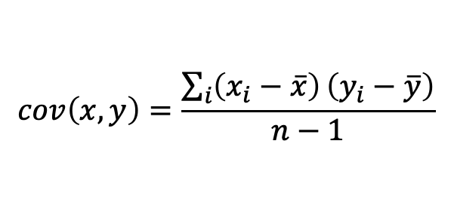
A relation between two random variables
Variance
$$var\left(x\right)=\frac{\sum_{i}{{\left(x_{i}−\overline{x}\right)}^{2}}}{n−1}$$
$$var\left(y\right)=\frac{\sum_{i}{{\left(y_{i}−\overline{y}\right)}^{2}}}{n−1}$$
Covariance
Performance
$$cov\left(x,y\right)=\frac{\sum_{i}{\left(x_{i}−\overline{x}\right)}\left(y_{i}−\overline{y}\right)}{n−1}$$
Conductance
Voltage
Trials

Slide 7
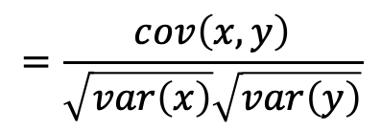
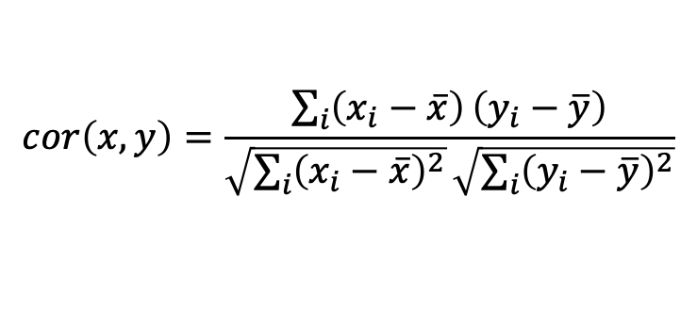
A relation between two random variables
Variance
$$var\left(x\right)=\frac{\sum_{i}{{\left(x_{i}−\overline{x}\right)}^{2}}}{n−1}$$
$$var\left(y\right)=\frac{\sum_{i}{{\left(y_{i}−\overline{y}\right)}^{2}}}{n−1}$$
Covariance
Performance
$$cov\left(x,y\right)=\frac{\sum_{i}{\left(x_{i}−\overline{x}\right)}\left(y_{i}−\overline{y}\right)}{n−1}$$
Conductance
Correlation
$$cor\left(x,y\right)=\frac{\sum_{i}{\left(x_{i}−\overline{x}\right)}\left(y_{i}−\overline{y}\right)}{\sqrt{\sum_{i}{{\left(x_{i}−\overline{x}\right)}^{2}}}\sqrt{\sum_{i}{{\left(y_{i}−\overline{y}\right)}^{2}}}}$$
Voltage
Trials
$$=\frac{cov\left(x,y\right)}{\sqrt{var\left(x\right)}\sqrt{var\left(y\right)}}$$

Slide 8
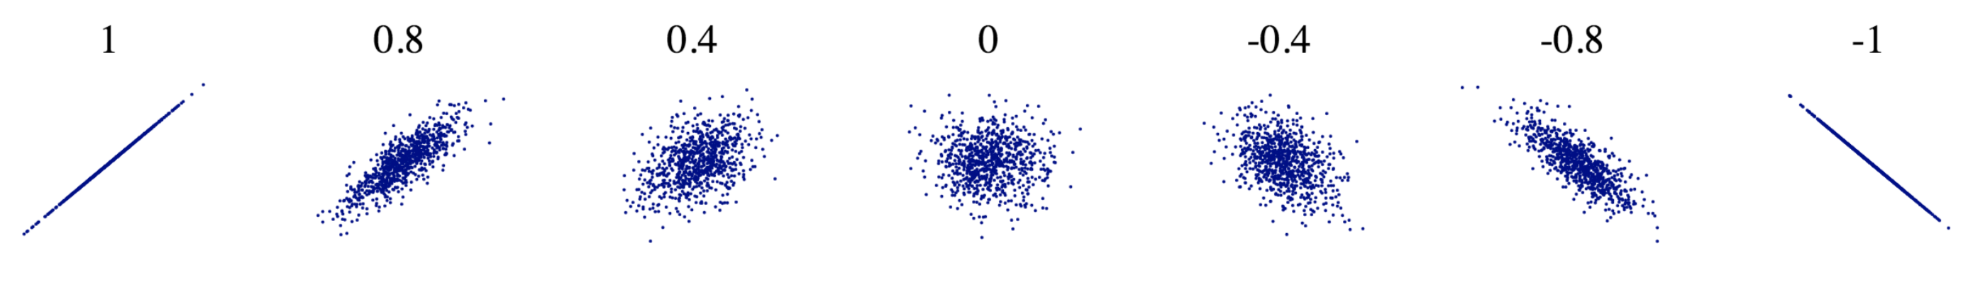

A range of correlations
$$cor\left(x,y\right)$$

Slide 9
What’s the simplest relation you can think of?

Slide 10
What’s the simplest relation you can think of?
How about a straight line.

Slide 11


A simple linear model of the data
$$y\left(x\right)=β_{0}+β_{1} x$$
$$β_{0}, β_{1}$$
y intercept
slope

Slide 12

A simple linear model of the data
$$y\left(x\right)=β_{0}+β_{1} x+ε$$
$$β_{0}, β_{1}$$
residuals
y intercept
slope
residuals

Slide 13














A simple linear model of the data
$$y\left(x\right)=β_{0}+β_{1} x+ε$$
$$β_{0}, β_{1}$$
$$y_{0}$$
$$x_{0}$$
$$ε_{0}$$
residuals
$$y_{1}$$
$$x_{1}$$
$$ε_{1}$$
.
.
.
.
.
.
.
.
.
$$=$$
$$β_{0}$$
$$+$$
$$β_{1}$$
$$+$$
$$y_{n}$$
$$x_{n}$$
$$ε_{n}$$

Slide 14





A simple linear model of the data
$$y\left(x\right)=β_{0}+β_{1} x+ε$$
$$β_{0}, β_{1}$$
$$y_{0}$$
$$1$$
$$x_{0}$$
$$ε_{0}$$
residuals
$$y_{1}$$
$$1$$
$$x_{1}$$
$$ε_{1}$$
.
.
.
.
.
.
.
.
.
.
.
.
$$=$$
$$β_{0}$$
$$+$$
$$β_{1}$$
$$+$$
$$y_{n}$$
$$1$$
$$x_{n}$$
$$ε_{n}$$

Slide 15
A simple linear model of the data
$$y\left(x\right)=β_{0}+β_{1} x+ε$$
$$β_{0}, β_{1}$$
$$y_{0}$$
$$1$$
$$x_{0}$$
$$ε_{0}$$
residuals
$$y_{1}$$
$$1$$
$$x_{1}$$
$$ε_{1}$$
.
.
.
.
.
.
.
.
.
.
.
.
$$=$$
$$β_{0}$$
$$+$$
$$β_{1}$$
$$+$$
$$y_{n}$$
$$1$$
$$x_{n}$$
$$ε_{n}$$
Goal is to estimate $β_{0}$ and $β_{1}$ given the data (x, y).

Slide 16
A simple linear model of the data
$$y\left(x\right)=β_{0}+β_{1} x+ε$$
$$β_{0}, β_{1}$$
$$y_{0}$$
$$1$$
$$x_{0}$$
$$ε_{0}$$
residuals
$$y_{1}$$
$$1$$
$$x_{1}$$
$$ε_{1}$$
.
.
.
.
.
.
.
.
.
.
.
.
$$=$$
$$β_{0}$$
$$+$$
$$β_{1}$$
$$+$$
$$y_{n}$$
$$1$$
$$x_{n}$$
$$ε_{n}$$
!!! The residuals are assumed to be normally distributed uncorrelated random values.
e.g. noise

Slide 17
Ordinary Least Squares (OLS) Linear Regression
$$y\left(x\right)=β_{0}+β_{1} x+ε$$
$$β_{0}, β_{1}$$
$$y_{0}$$
$$1$$
$$x_{0}$$
$$ε_{0}$$
residuals
$$y_{1}$$
$$1$$
$$x_{1}$$
$$ε_{1}$$
.
.
.
.
.
.
.
.
.
.
.
.
$$=$$
$$β_{0}$$
$$+$$
$$β_{1}$$
$$+$$
$$y_{n}$$
$$1$$
$$x_{n}$$
$$ε_{n}$$
One way to get best estimate is to minimize the sum of squared residuals (RSS).
This is ordinary least squares (OLS) linear regression.

Slide 18
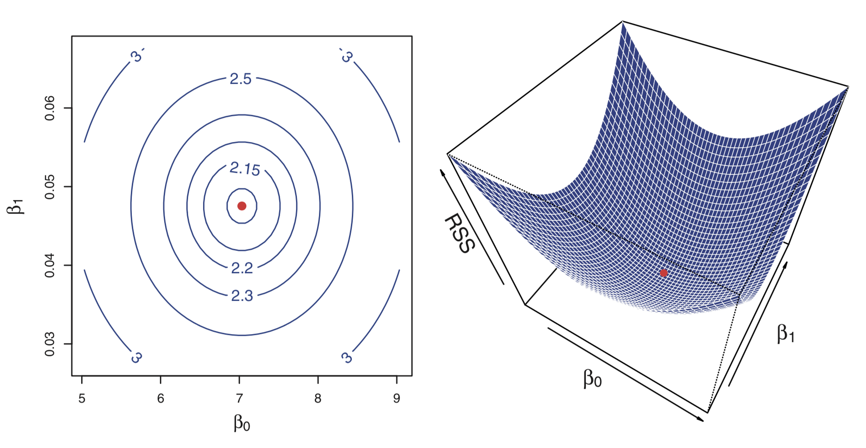
OLS minimizes the sum of squared residuals (RSS)

Slide 19
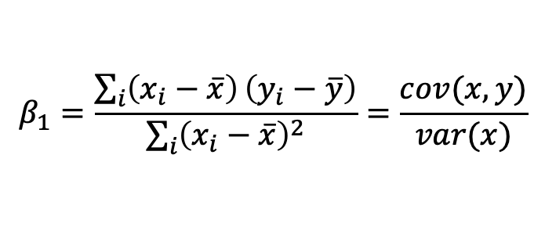

OLS has an analytical solution
$$y\left(x\right)=β_{0}+β_{1} x+ε$$
$$β_{0}, β_{1}$$
residuals
$$β_{1}=\frac{\sum_{i}{\left(x_{i}−\overline{x}\right)}\left(y_{i}−\overline{y}\right)}{\sum_{i}{{\left(x_{i}−\overline{x}\right)}^{2}}}=\frac{cov(x,y)}{var(x)}$$
$$β_{0}=\overline{y}−β_{1}\overline{x}$$

Slide 20
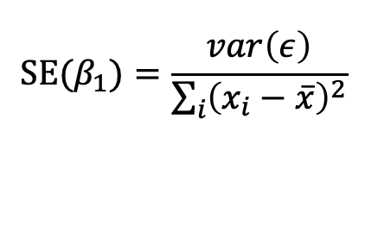
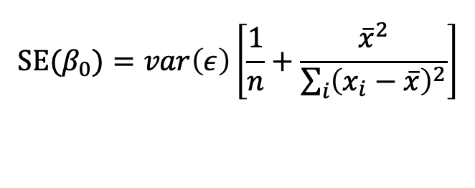
OLS has an analytical solution
$$y\left(x\right)=β_{0}+β_{1} x+ε$$
$$β_{0}, β_{1}$$
residuals
$$β_{1}=\frac{\sum_{i}{\left(x_{i}−\overline{x}\right)}\left(y_{i}−\overline{y}\right)}{\sum_{i}{{\left(x_{i}−\overline{x}\right)}^{2}}}=\frac{cov(x,y)}{var(x)}$$
$$β_{0}=\overline{y}−β_{1}\overline{x}$$
Standard Error (SE) in parameter estimates
$$SE(β_{1})=\frac{var\left(ε\right)}{\sum_{i}{{\left(x_{i}−\overline{x}\right)}^{2}}}$$
$$SE(β_{0})=var\left(ε\right)\left[\frac{1}{n}+\frac{{\overline{x}}^{2}}{\sum_{i}{{\left(x_{i}−\overline{x}\right)}^{2}}}\right]$$

Slide 21


OLS has an analytical solution
$$y\left(x\right)=β_{0}+β_{1} x+ε$$
$$β_{0}, β_{1}$$
residuals
$$β_{1}=\frac{\sum_{i}{\left(x_{i}−\overline{x}\right)}\left(y_{i}−\overline{y}\right)}{\sum_{i}{{\left(x_{i}−\overline{x}\right)}^{2}}}=\frac{cov(x,y)}{var(x)}$$
$$β_{0}=\overline{y}−β_{1}\overline{x}$$
Confidence interval for parameter estimates
$$β_{1}±t_{α/2,n−2}SE(β_{1})$$
$$β_{0}±t_{α/2,n−2}SE(β_{0})$$
$$t_{α/2,n−2}=scipy.stats.t.ppf(α/2,n−2)$$

Slide 22

Hypothesis Test
$$y\left(x\right)=β_{0}+β_{1} x+ε$$
$$β_{0}, β_{1}$$
residuals
H₀: No relation between x and y
H_{a}: x and y are related to each other
Confidence interval for parameter estimates
$$β_{1}±t_{α/2,n−2}SE(β_{1})$$
If the confidence interval for the slope contains zero, then don’t reject H₀ (i.e. no relation is plausible). Otherwise reject H₀.

Slide 23
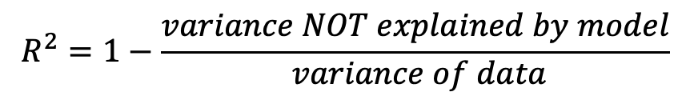
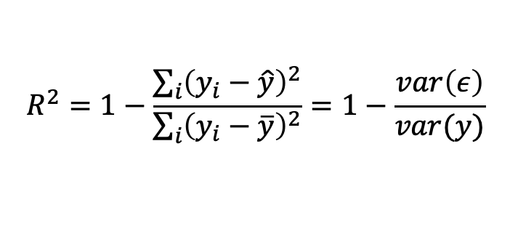
Explained Variance (R²)
$$y\left(x\right)=β_{0}+β_{1} x+ε$$
$$β_{0}, β_{1}$$
residuals
Linear model (i.e. fit line)
$$R^{2}=1−\frac{\sum_{i}{{\left(y_{i}−\hat{y}\right)}^{2}}}{\sum_{i}{{\left(y_{i}−\overline{y}\right)}^{2}}}=1−\frac{var\left(ε\right)}{var(y)}$$
$$R^{2}=1−\frac{variance NOT explained by model}{ variance of data}$$

Slide 24
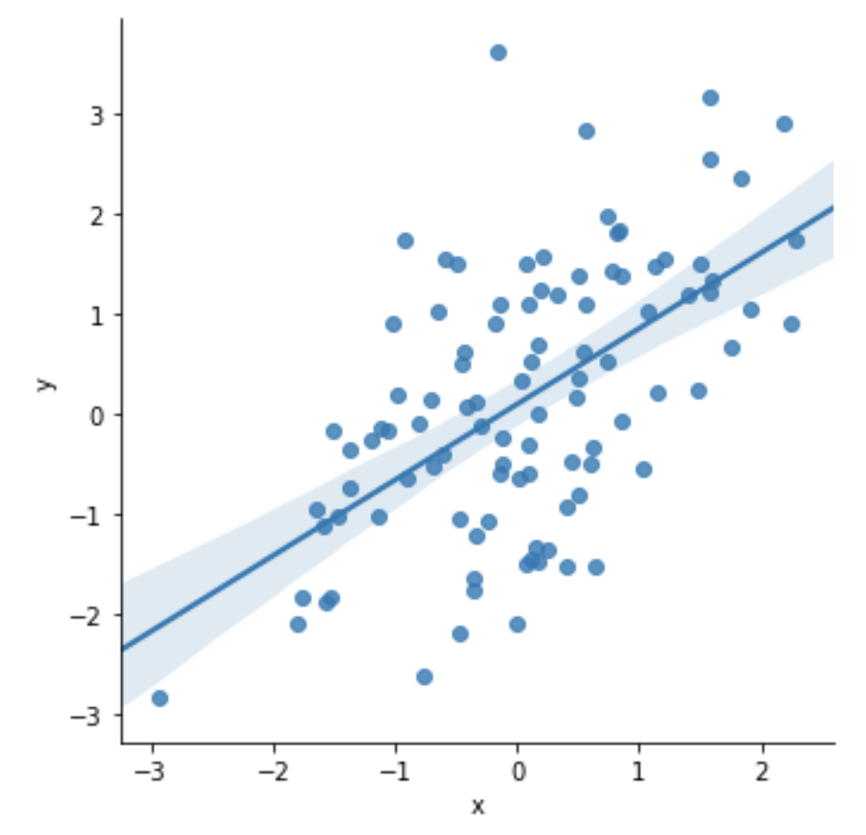
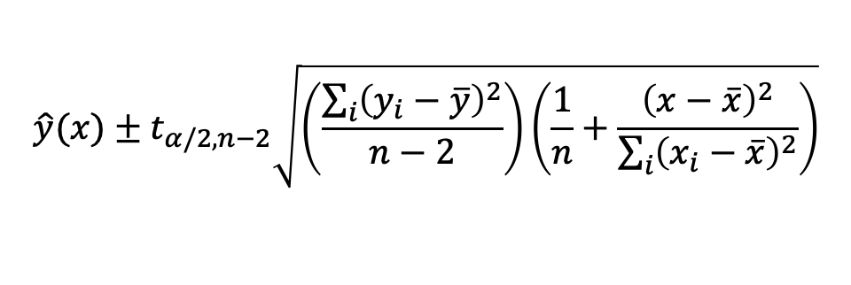
A graphical depiction of the model’s confidence interval
Linear model (i.e. fit line)
$$\hat{y}(x)±t_{α/2,n−2}\sqrt{\left(\frac{\sum_{i}{{\left(y_{i}−\overline{y}\right)}^{2}}}{n−2}\right)\left(\frac{1}{n}+\frac{{\left(x−\overline{x}\right)}^{2}}{\sum_{i}{{\left(x_{i}−\overline{x}\right)}^{2}}}\right)}$$
$$t_{α/2,n−2}=scipy.stats.t.ppf(α/2,n−2)$$

Slide 25
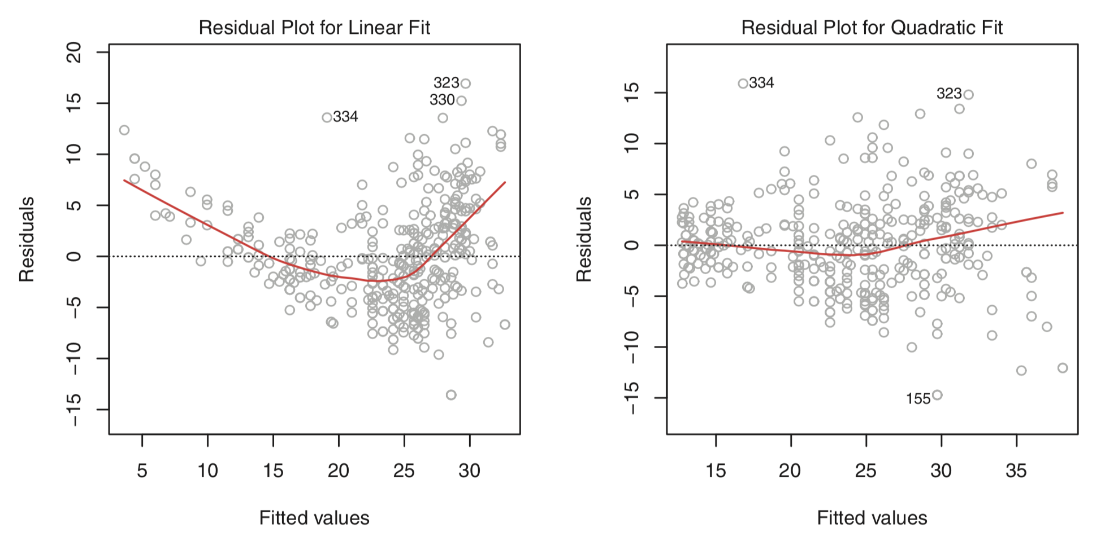
Use residuals to visually assess whether linear fit is appropriate.

Slide 26
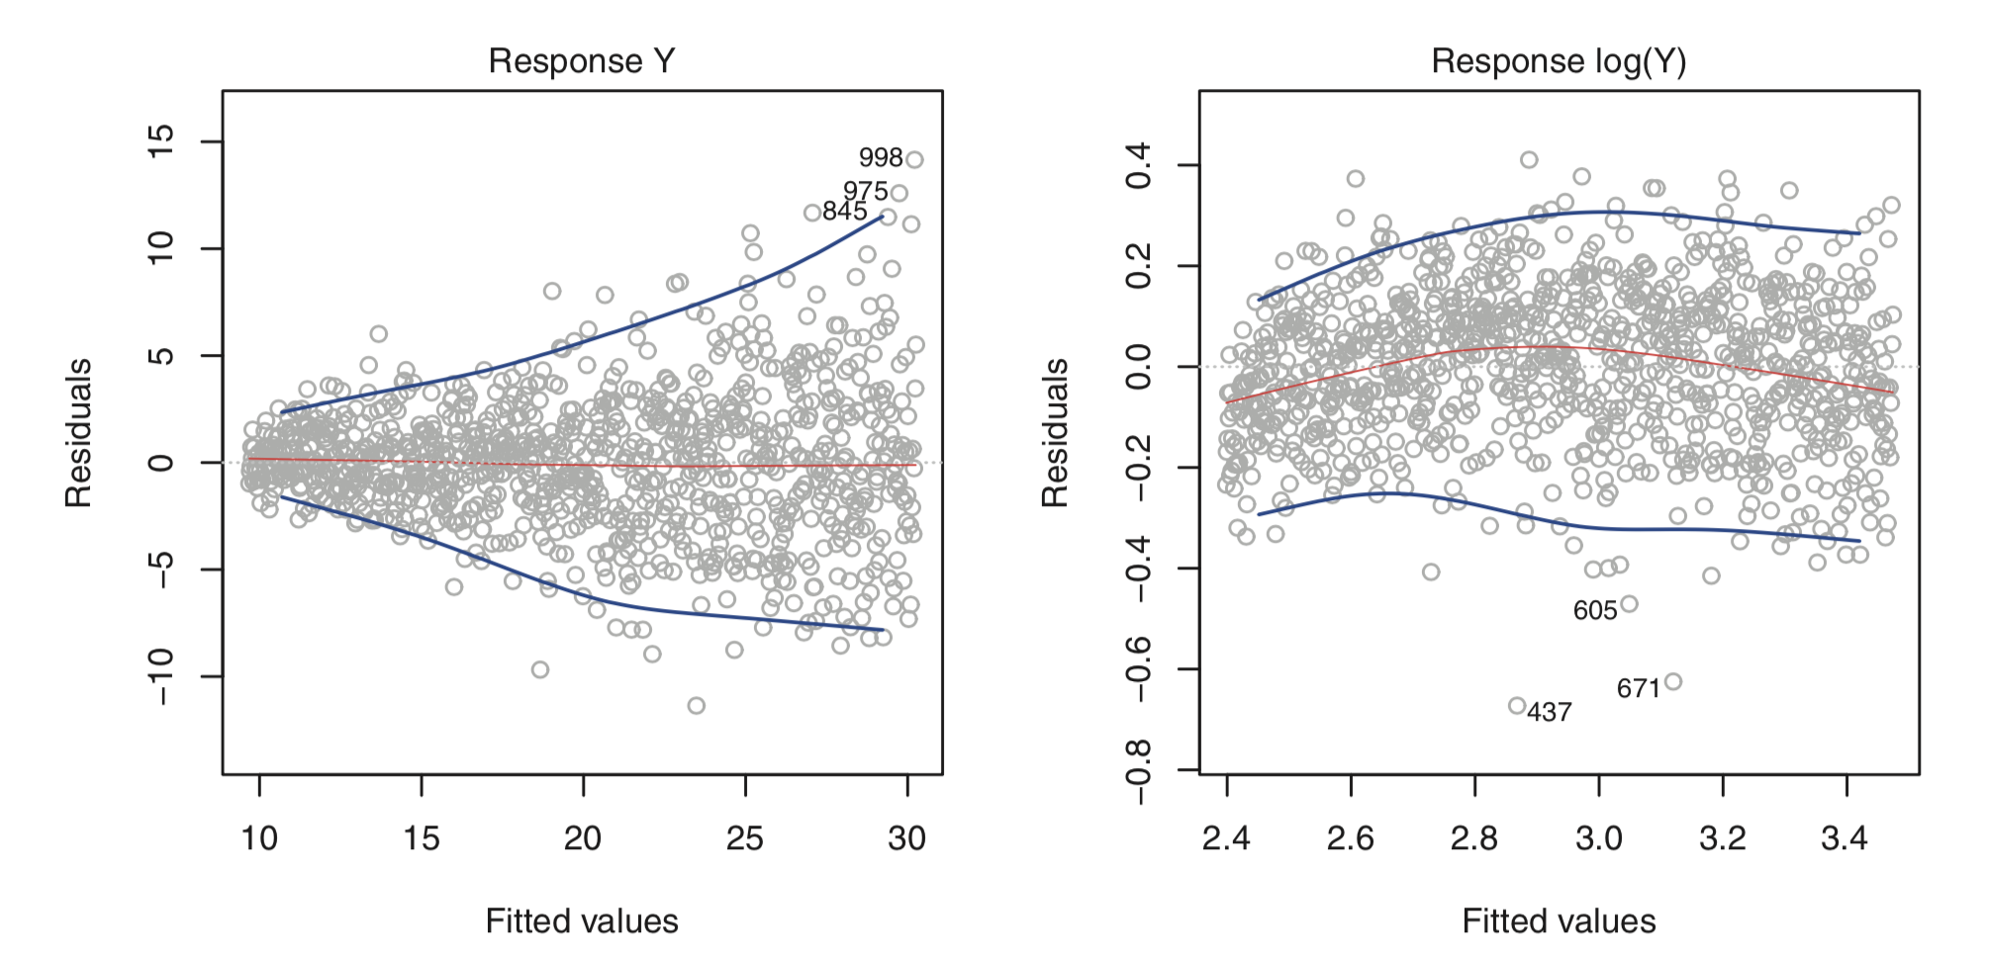
Variance should be normally distributed equally throughout.
If not, can we transform data to achieve this?

Slide 27
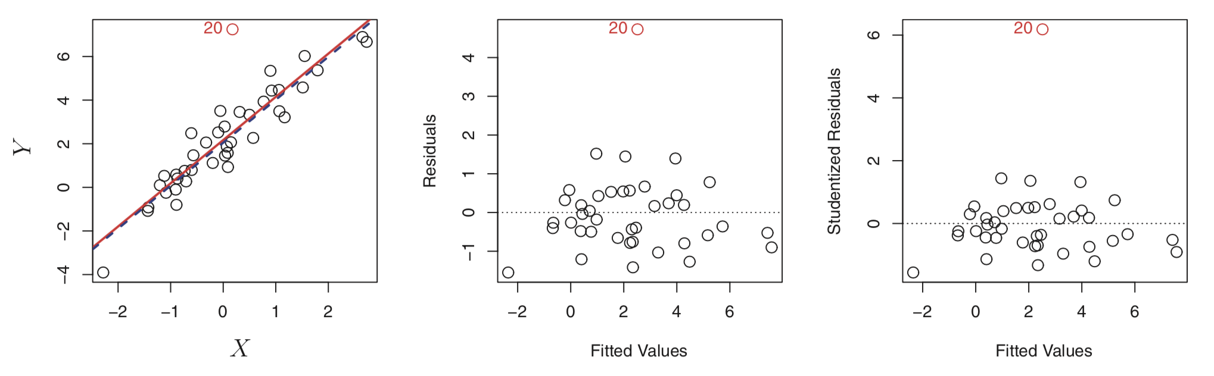
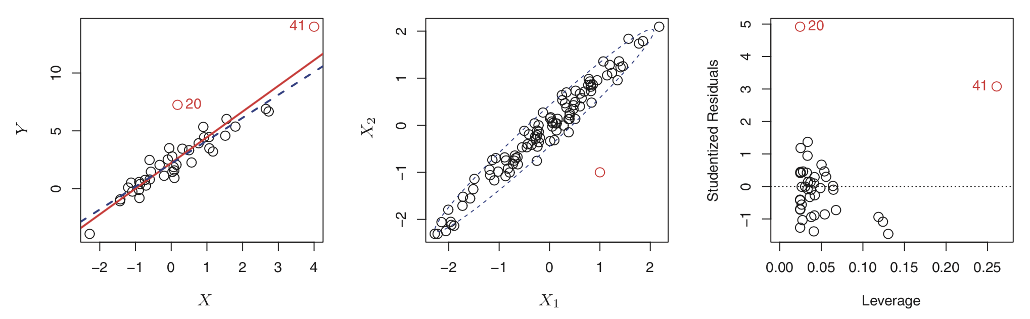
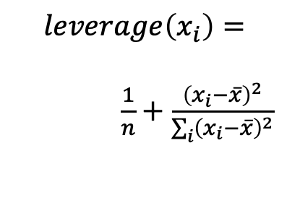
Outliers and leverage.
$$leverage\left(x_{i}\right)=$$
$\frac{1}{n}+\frac{{\left(x_{i}−\overline{x}\right)}^{2}}{\sum_{i}{{\left(x_{i}−\overline{x}\right)}^{2}}}$

Slide 28
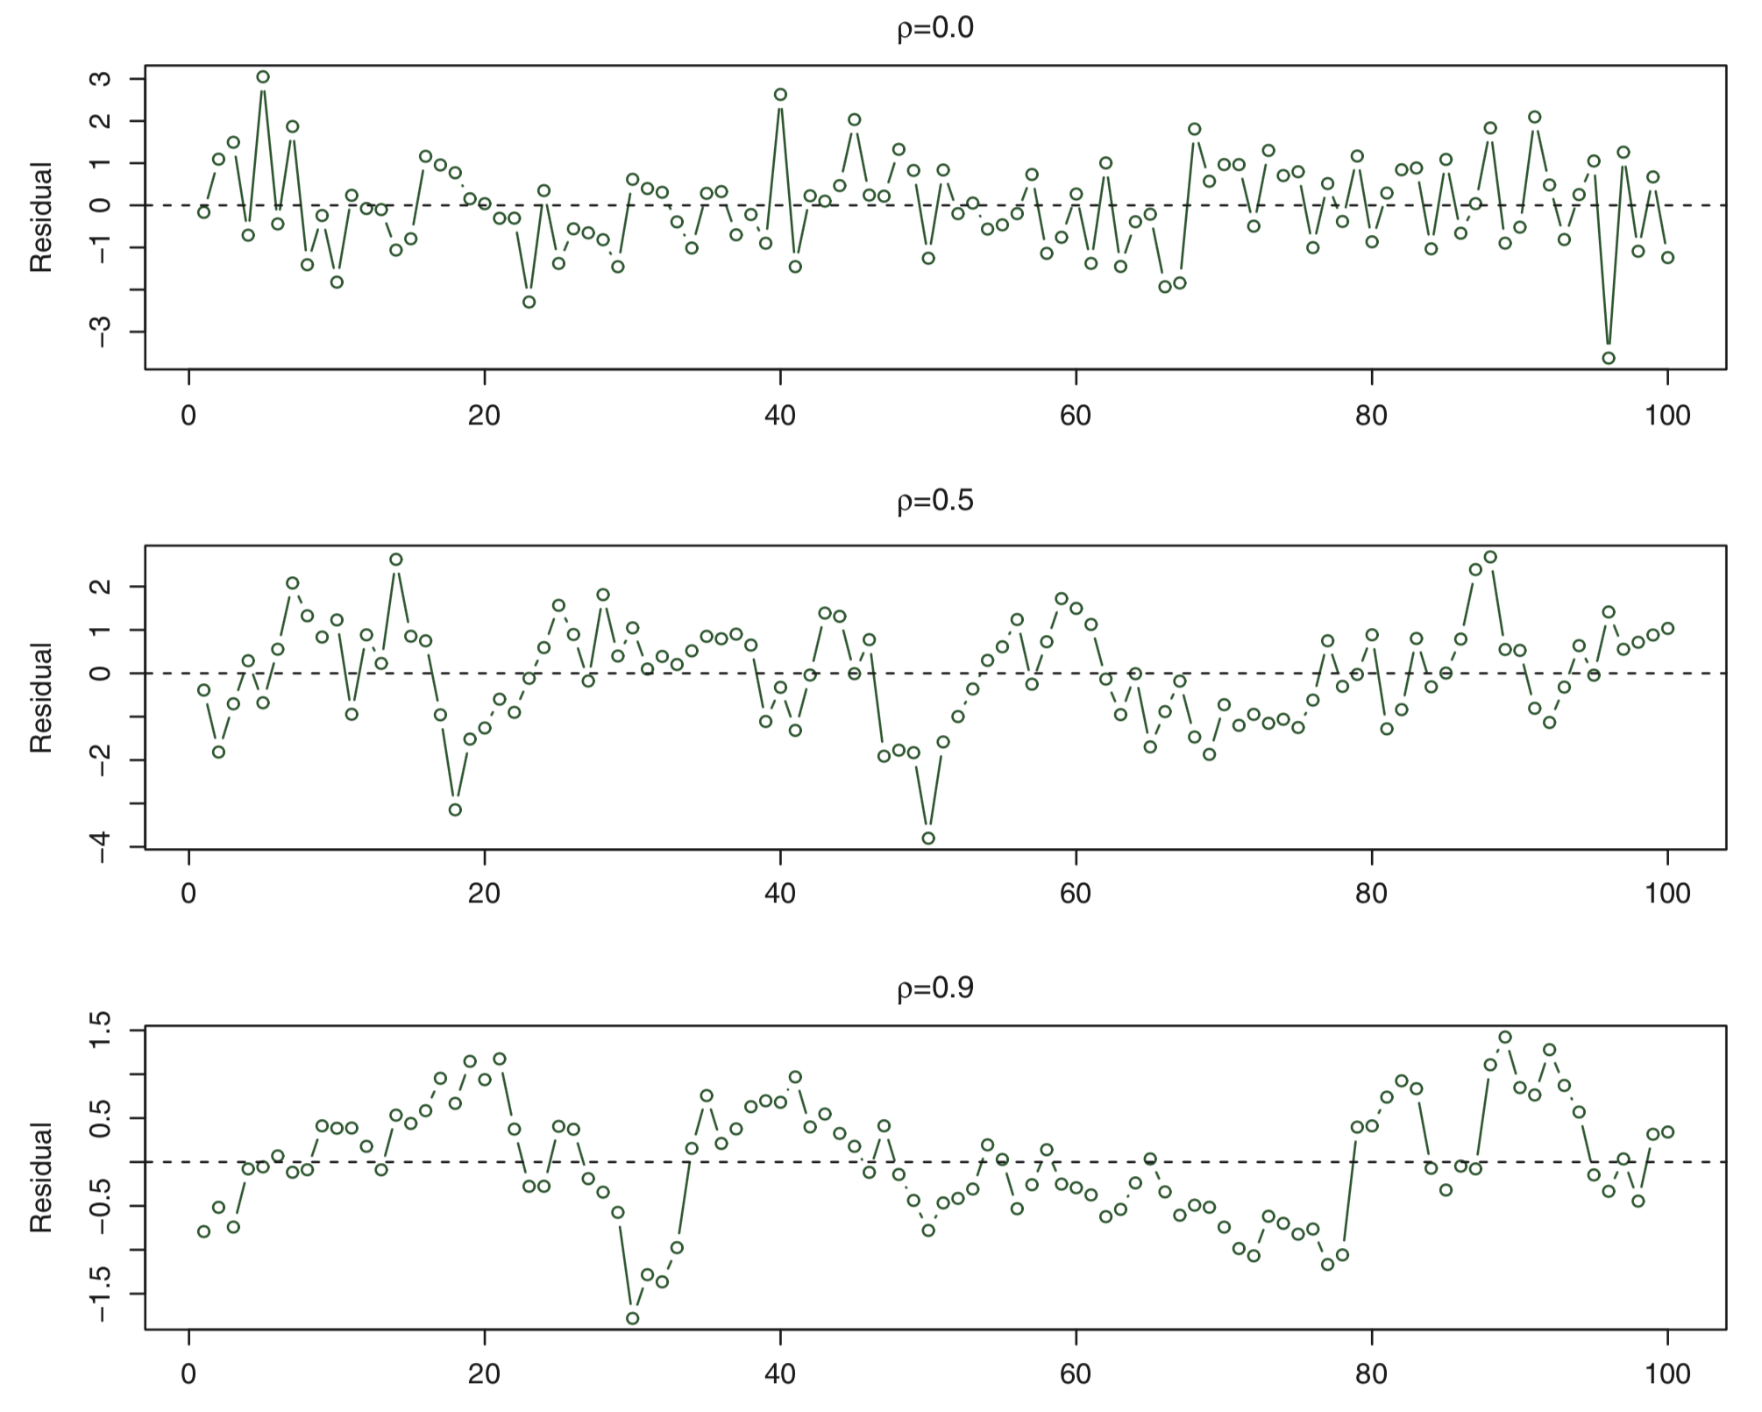
!!! OLS assumes errors are NOT correlated.

