Slide 1
Cross Validation
Programming and Data Analysis for Modern Neuroscience
Spring 2020

Slide 2
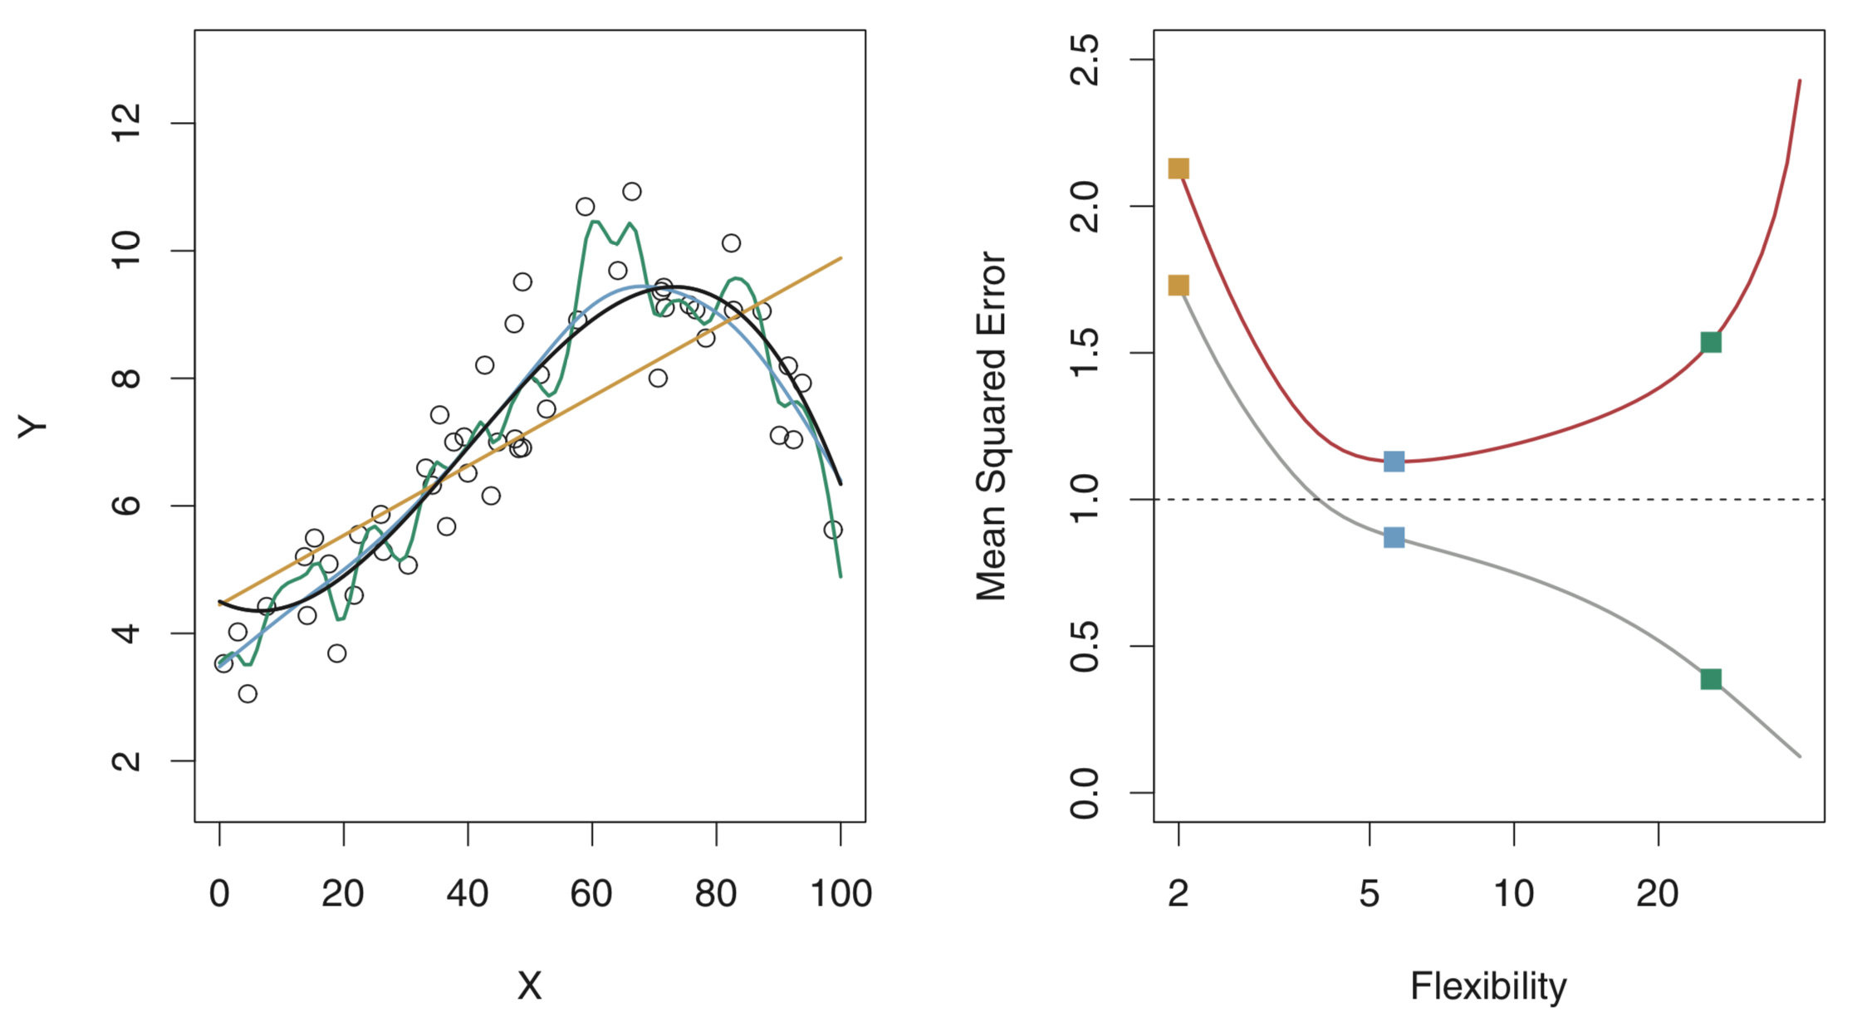
Training and Testing Error vs. Model Flexibility
True simulated relationship
test error
Linear fit
Smooth fit
Rough fit
training error
Images from “An Introduction to Statistical Learning”

Slide 3
Training and Testing Error vs. Model Flexibility
True simulated relationship
test error
Linear fit
Smooth fit
Rough fit
training error
Images from “An Introduction to Statistical Learning”

Slide 4
Training and Testing Error vs. Model Flexibility
True simulated relationship
under fitting
(high bias)
test error
Linear fit
Smooth fit
Rough fit
best
over fitting
(high variance)
training error
Images from “An Introduction to Statistical Learning”

Slide 5
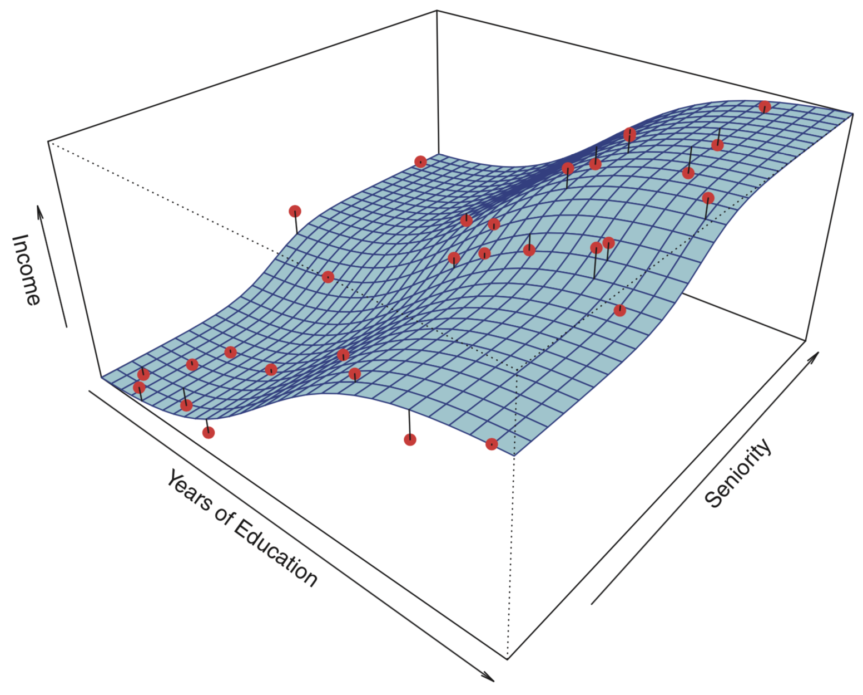
Surface is true simulated model.
Points are randomly simulated data plus noise.
Images from “An Introduction to Statistical Learning”

Slide 6
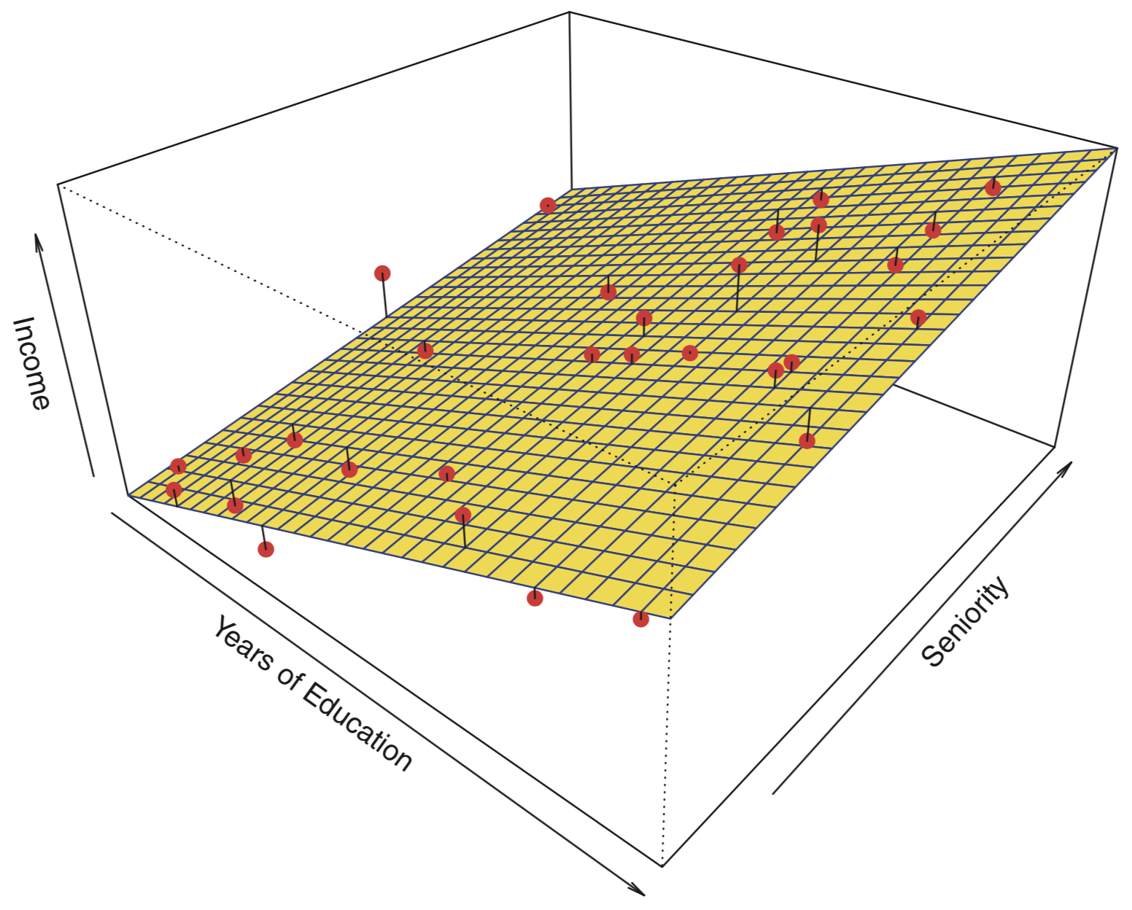
Surface is true simulated model.
Points are randomly simulated data plus noise.
Linear model fit.
Images from “An Introduction to Statistical Learning”

Slide 7
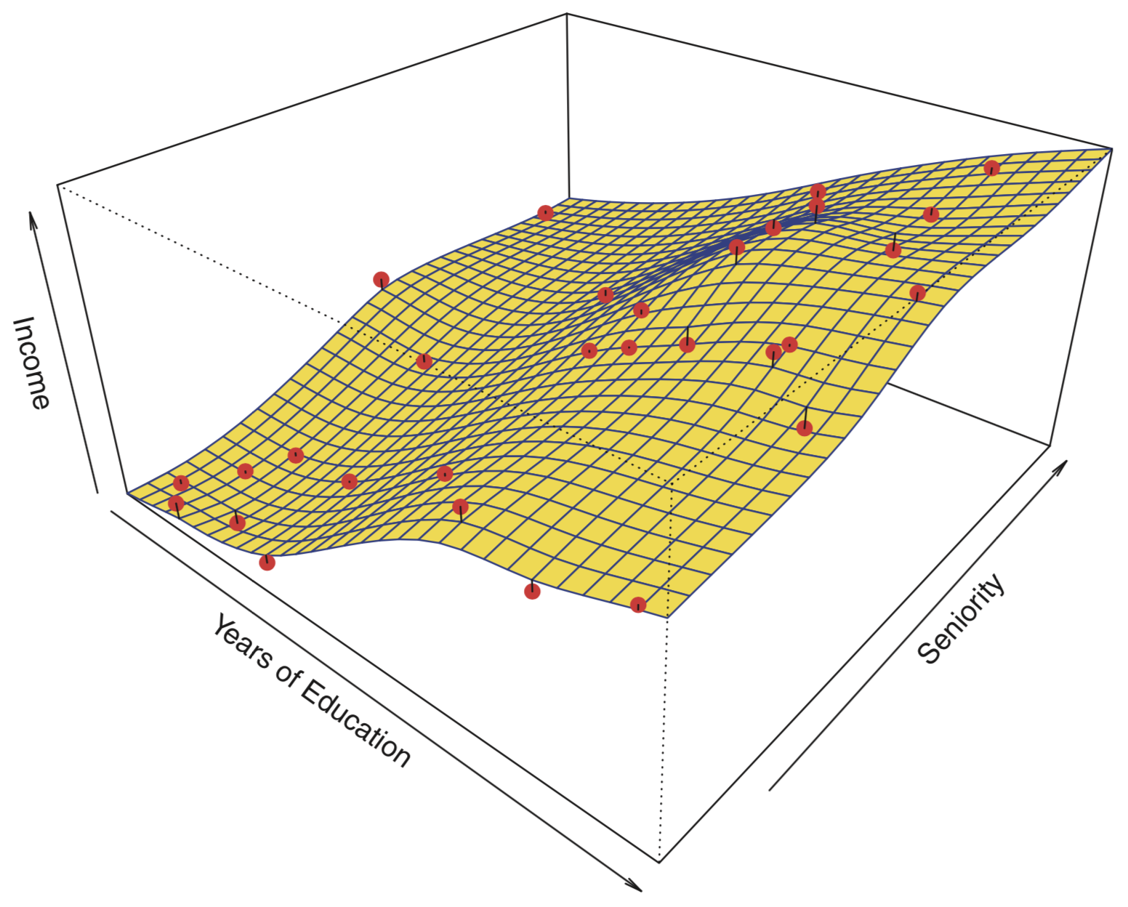
Surface is true simulated model.
Points are randomly simulated data plus noise.
Smooth spline model fit.
Images from “An Introduction to Statistical Learning”

Slide 8
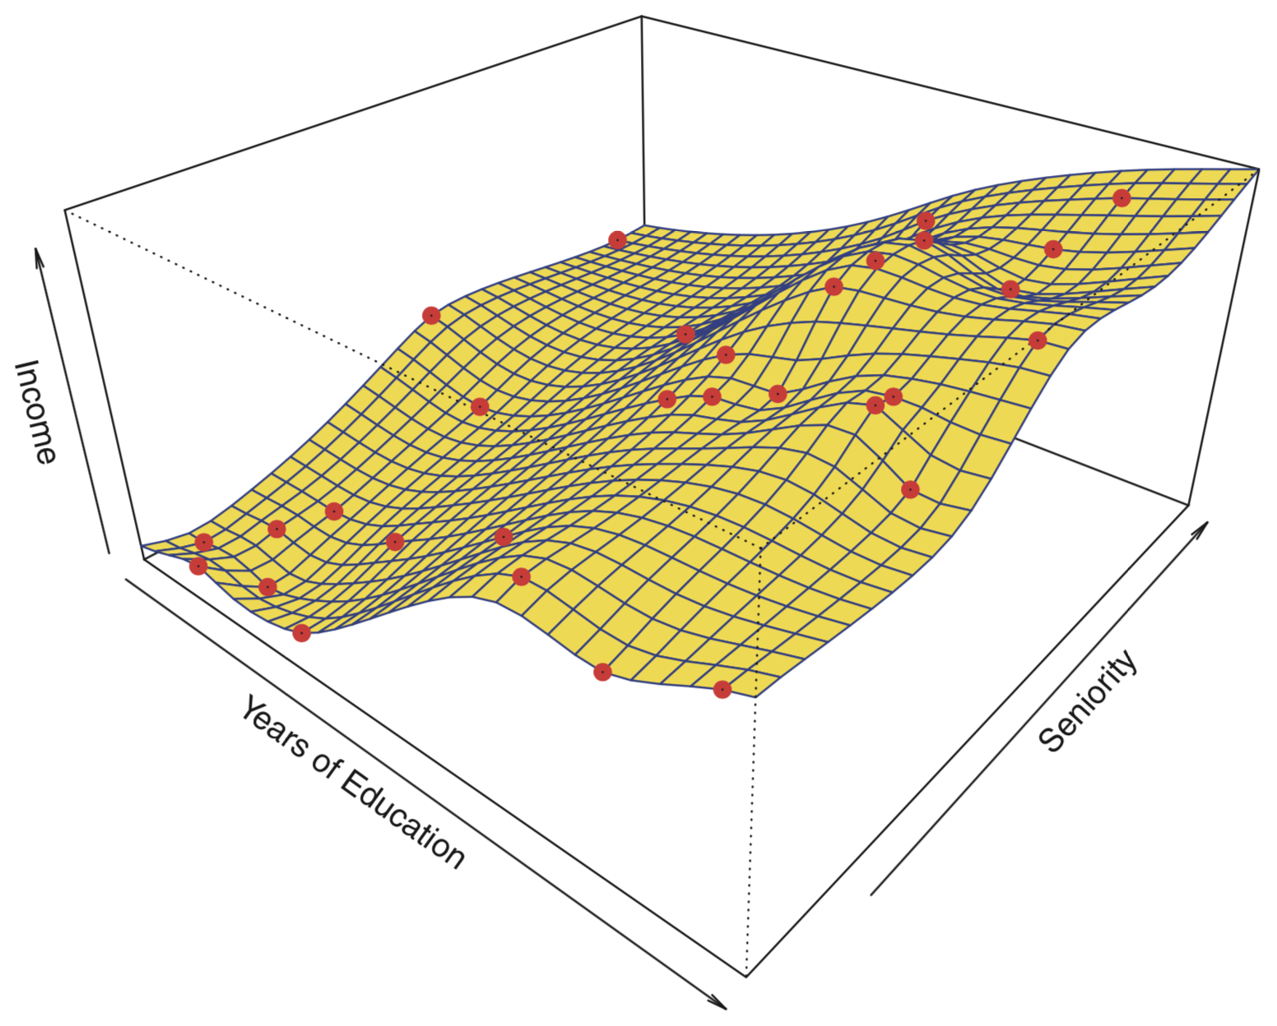
Surface is true simulated model.
Points are randomly simulated data plus noise.
Rough spline model fits data perfectly!
Images from “An Introduction to Statistical Learning”

Slide 9
So we have a data set…
And a model we want to use to describe it…
How do we keep that model from overfitting (i.e. fitting noise)?

Slide 10
Train/Fit the model to a subset of our data…
Test the model on the remaining data it was NOT trained on.

Slide 11
data set
training set
test set

Slide 12
data set
training set
test set
This represents new data that we want the model to be able to predict!

Slide 13
data set
training set
test set
This represents new data that we want the model to be able to predict!
A good model should not only fit the training data, but also be able to predict new data!

Slide 14
data set
training set
test set
How you split the data is up to you.
Although it may matter, there is no a priori single right way to do it.
training set
test set
training set
test set

Slide 15
data set
training set
test set
However, certain aspects of the data set can make how you do this splitting very important.

Slide 16
data set
training set
test set
Task Start
Task End
Imagine you are observing a monkey perform a visual task in order to receive a reward.
And that your data set is organized in time from the start to the end of the task.

Slide 17
data set
training set
test set
Task Start
Task End
What if the monkey got tired towards the end of the task and its performance dropped momentarily?

Slide 18
data set
training set
test set
Task Start
Task End
What if it took a while for the monkey to decide it really cared about doing the task?

Slide 19
data set
training set
test set
Task Start
Task End
What if the monkey became distracted for some unknown reason in the middle of the task?

Slide 20
data set
randomly shuffled data set
training set
test set

Slide 21
data set
randomly shuffled data set
training set
test set

Slide 22
data set
randomly shuffled data set
training set
test set
Average
test set
training set

Slide 23
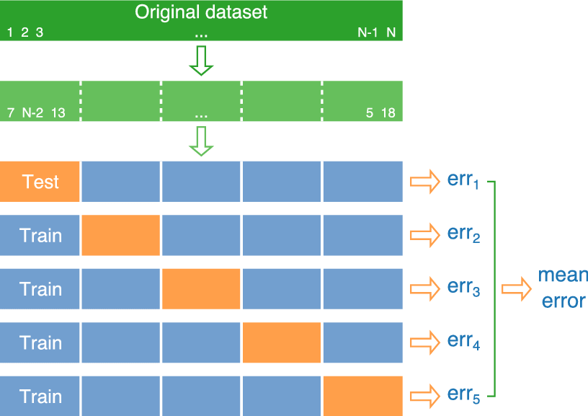
K-fold Cross Validation
K = 5

Slide 24
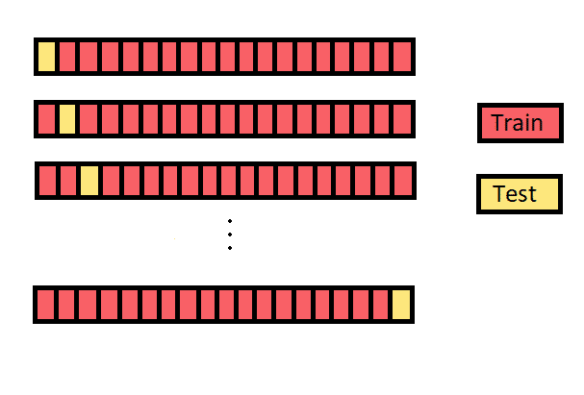
Leave-One-Out Cross Validation
It’s just K-fold with K = the number of data points!

Slide 25
Train - Validate - Test
data
train
test
e.g. K-fold cross validation to find optimal hyperparameters
train
validate
train
validate
train
validate
train
Use optimal hyperparameters from above
train
test

