Slide 1
Git and GitHub
Programming and Data Analysis for Modern Neuroscience
Spring 2020

Slide 2
Git: 1. Tracks changes/versions for files in a repository (i.e. folder). 2. Simplifies handling multiple people editing the same files.
GitHub:
An online server for Git repositories.
Simplifies sharing files and collaborating with other people.
A decent lecture on Git basics: https://www.youtube.com/watch?v=eulnSXkhE7I

Slide 3
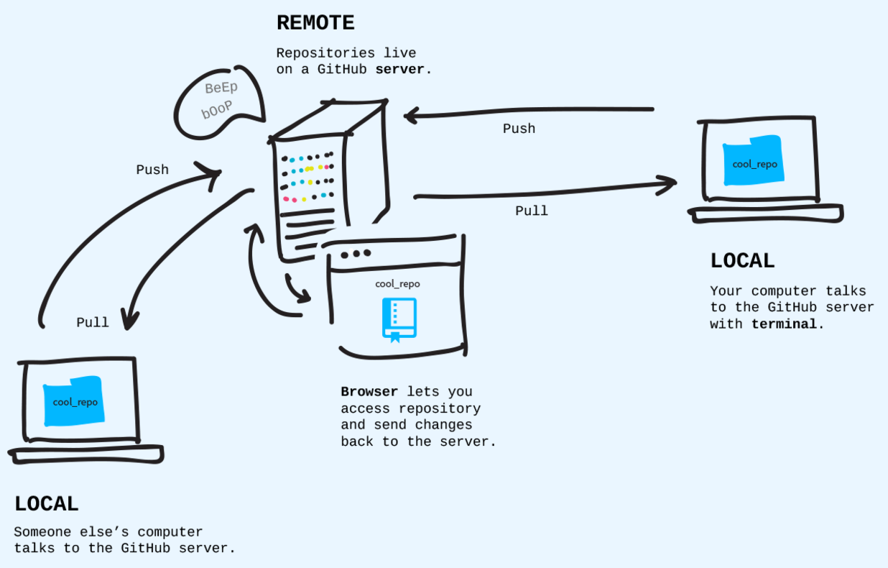
GitHub
A Friend’s
Computer
Your
Computer
Image from Git-it

Slide 4
GitHub
A Friend’s
Computer
NEU337-Spring2020
Login to GitHub
Go to the course repository https://github.com/marcel-goldschen-ohm/NEU337-Spring2020
Watch the course repo
Star the course repo
Fork the course repo
Your
Computer
Image from Git-it

Slide 5
GitHub
A Friend’s
Computer
Your
Computer
Open GitHub Desktop
Login with your GitHub credentials
Image from Git-it

Slide 6
GitHub
A Friend’s
Computer
cool-repo
Your
Computer
Create a new repo “cool-repo”
Include a README
Image from Git-it

Slide 7
GitHub
A Friend’s
Computer
Clone
cool-repo
cool-repo
Your
Computer
Clone “cool-repo” onto your computer
Image from Git-it

Slide 8
GitHub
A Friend’s
Computer
cool-repo
cool-repo
Your
Computer
“cool-repo” is now both on GitHub and your computer
Image from Git-it

Slide 9
GitHub
A Friend’s
Computer
cool-repo
v2
Not the same!
cool-repo
Your
Computer
Edit the README file on GitHub
Image from Git-it

Slide 10
GitHub
A Friend’s
Computer
cool-repo
v2
Same!
cool-repo
v2
Your
Computer
Pull the updated files from GitHub onto your computer
Image from Git-it

Slide 11
GitHub
A Friend’s
Computer
cool-repo
v2
Not the same!
cool-repo
v3
Your
Computer
Edit the README file on your computer
Image from Git-it

Slide 12
GitHub
A Friend’s
Computer
cool-repo
v3
Same!
cool-repo
v3
Your
Computer
Commit and push the updated files to GitHub
Image from Git-it

Slide 13
GitHub
A Friend’s
Computer
cool-repo
v3
Not the same!
cool-repo
v4
Your
Computer
Add a new file “coolstuff.py” to the repo directory on your computer
Image from Git-it

Slide 14
GitHub
A Friend’s
Computer
cool-repo
v4
Same!
cool-repo
v4
Your
Computer
Commit and push the new file to GitHub
Image from Git-it

Slide 15
GitHub
A Friend’s
Computer
cool-repo
v4
Not the same!
cool-repo
v5a
Your
Computer
Edit ”coolstuff.py” on your computer
Image from Git-it

Slide 16
GitHub
A Friend’s
Computer
cool-repo
v5b
Not the same!
cool-repo
v5a
Make a different change to ”coolstuff.py” on GitHub
Your
Computer
Image from Git-it

Slide 17
GitHub
A Friend’s
Computer
cool-repo
v5b
Conflict!
cool-repo
v5a
Your
Computer
v5a
your computer
your computer
and GitHub
v4
Commit and push the updated file to GitHub
v5b
GitHub
Image from Git-it

Slide 18
GitHub
A Friend’s
Computer
cool-repo
v5b
Merge v5a,b
cool-repo
v5a/b merge
Your
Computer
v5a
v4
Pull v5a from GitHub and merge it with v5a on your computer
v5merge
v5b
Image from Git-it

Slide 19
GitHub
A Friend’s
Computer
cool-repo
v5merge
Same!
cool-repo
v5merge
Your
Computer
v5a
v4
Pushed the merged files to GitHub
v5merge
v5b
Image from Git-it

Slide 20
GitHub
A Friend’s
Computer
cool-repo
v??
cool-repo
v???
cool-repo
v?
Your
Computer
A merging nightmare!
Image from Git-it

Slide 21
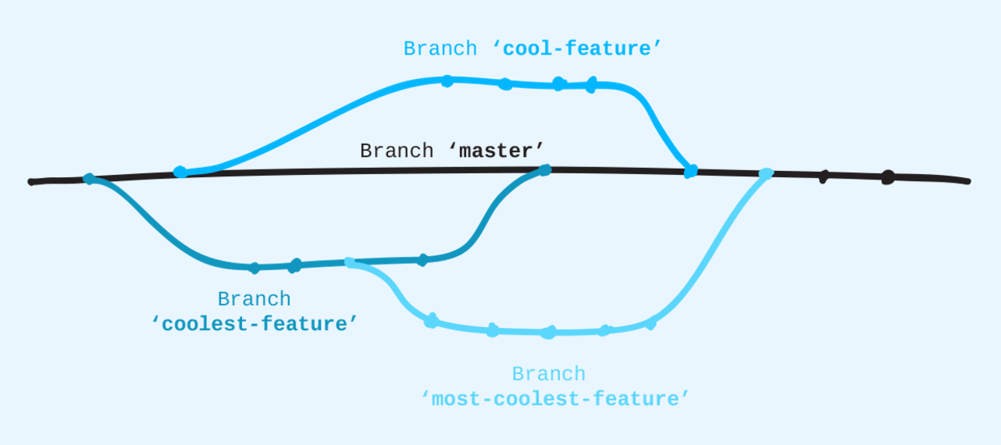
https://guides.github.com/introduction/flow/
Image from Git-it

Slide 22
GitHub
A Friend’s
Computer
cool-repo
v6
cool-repo
v6
Your
Computer
Image from Git-it

Slide 23
GitHub
A Friend’s
Computer
master branch v6
coolest-feature branch v1
Your
Computer
v1
v6
v1
Create a “coolest-feature” branch
Image from Git-it

Slide 24
GitHub
A Friend’s
Computer
master branch v6
coolest-feature branch v2
Your
Computer
v6
v1
Edit coolstuff.py in your coolest-feature branch
!!! Your master branch is not changed !!!
v2
Image from Git-it

Slide 25
GitHub
A Friend’s
Computer
master branch v7
Someone else edited README in the master branch on GitHub
coolest-feature branch v2
Your
Computer
v6
v7
v1
v2
Edit coolstuff.py in your coolest-feature branch
Image from Git-it

Slide 26
GitHub
A Friend’s
Computer
cool-feature branch v1
Your friend creates a cool-feature branch
master branch v7
coolest-feature branch v2
Your
Computer
v6
v7
v1
v1
v2
Image from Git-it

Slide 27
GitHub
A Friend’s
Computer
cool-feature branch v5
Your friend works on their cool-feature branch
master branch v8
coolest-feature branch v5
Someone else works on the master branch on GitHub
Your
Computer
v5
v6
v7
v1
v1
v8
v2
v5
You work on your coolest-feature branch
Image from Git-it

Slide 28
GitHub
A Friend’s
Computer
cool-feature branch v5
Now both master and coolest-feature branches are on GitHub
coolest-feature branch v5
coolest-feature branch v5
Your
Computer
v5
v6
v7
v1
v1
v8
v2
v5
Push your branch onto GitHub
Image from Git-it

Slide 29
GitHub
A Friend’s
Computer
cool-feature branch v5
coolest-feature branch v5
coolest-feature branch v5
Create a pull request to merge the coolest-feature branch into the master branch on GitHub
Your
Computer
v5
v6
v7
v1
v1
v8
v2
v5
Image from Git-it

Slide 30
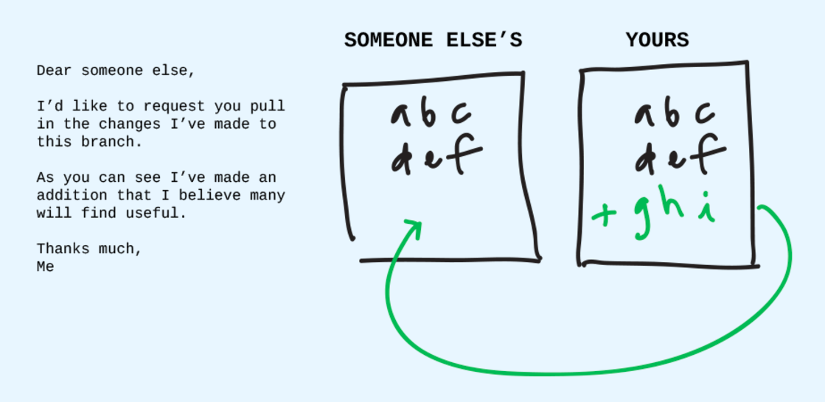
Image from Git-it

Slide 31
GitHub
A Friend’s
Computer
cool-feature branch v5
coolest-feature branch v5
coolest-feature branch v5
See what changes are proposed in the request
Your
Computer
v5
v6
v7
v1
v1
v8
v2
v5
Image from Git-it

Slide 32
GitHub
A Friend’s
Computer
cool-feature branch v5
coolest-feature branch v5
coolest-feature branch v5
Converse with others working on the project
Your
Computer
v5
v6
v7
v1
v1
v8
v2
v5
Image from Git-it

Slide 33
GitHub
A Friend’s
Computer
cool-feature branch v5
master branch v9
coolest-feature branch v5
When satisfied, merge the pull request into the master branch
Your
Computer
v5
v6
v7
v1
v1
v8
v9
v2
v5
Image from Git-it

Slide 34
GitHub
A Friend’s
Computer
cool-feature branch v5
master branch v9
master branch v9
Your
Computer
v5
v6
v7
v1
v1
v8
v9
v2
v5
Pull the updated master branch onto your computer
Image from Git-it

Slide 35
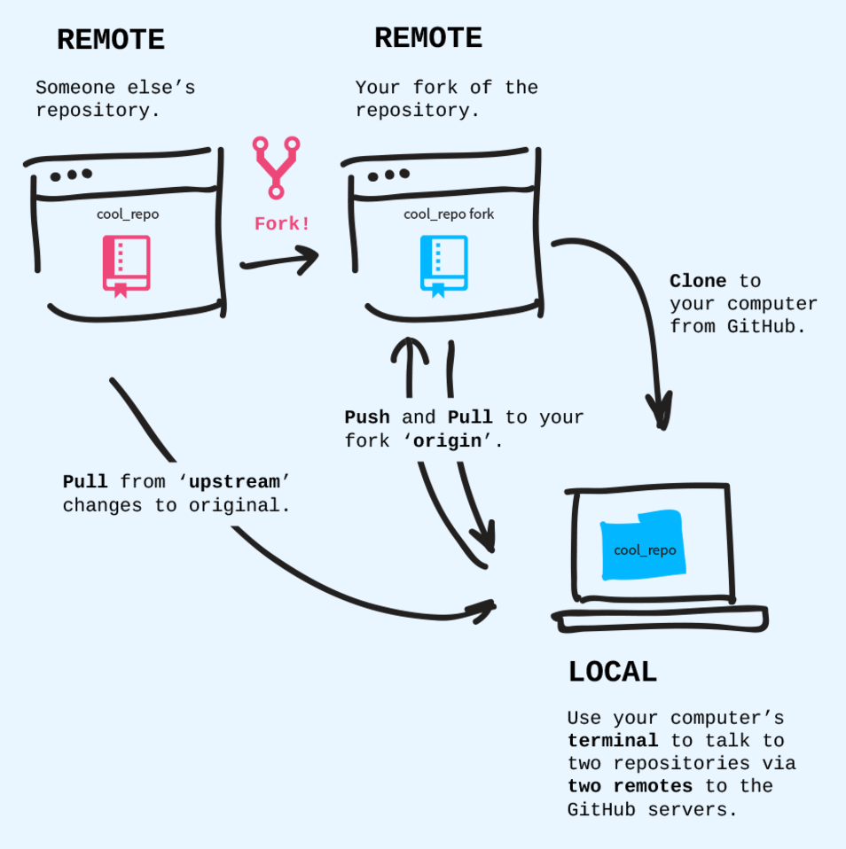
Forks
Image from Git-it

