Slide 1
How I have been influenced.
By Nevin Ndonwi

Slide 2
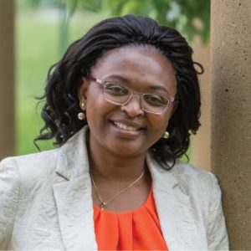
One person who has positively influenced me is my mother.
She got a Phd in microbiology and worked in research for many years.
How she has influenced me: She had a Phd in microbiology and did research for many years. However, when she realized how much time research took away from spending time with her children and how unstable it could be , she wasn’t afraid to change jobs and work as something else. This influenced me to not be afraid to try new things and to passionately put all of my effort into things I’m interested/ willing to do.
On a scale of 1-10: 10 ( I have a high respect for my mother)
If it wasn’t for my mother, I would probably be more afraid to get into something out of fear that I can’t get out of it. For example, being a month late into Koric’s class. I was afraid of the make up work but my mother told me that if I am interested in something, I should give it my all and that is what I did, she is one of the reasons I am in your class and I hope that I am like her someday.

