Slide 1

Analysis of Google Play Store Applications
Submitted By
Team Mind Benders

Slide 2




Project Overview
The purpose of our project is to gather and analyze detailed information on various apps on google play store
Dataset of over 10,000 records of distinct applications on the google play store
We plan to generate meaningful insights that can be used by the developers in developing more mobile apps to engage customers and investors
And marketers to ensure that their application succeeds and doesn’t get lost in the shuffle

Slide 3





Data Process Flow
Data Gathering
Data Pre-Processing
Build Visualization
Predictive Analysis

Slide 4



Methodology
Data Pre-Processing
Analysis
Used R Studio and Tableau Desktop for performing predictive analysis and build visualization
Determined a breakdown of the android app market to identify which category of apps has the most installations
Analyzed the significant difference between various factors under App store
Predicted the number of installs for upcoming apps based on app category and price
The dataset has some duplicate,
missing and inconsistent data
Values
Detected and corrected inaccurate
records from the record
set for performing analysis
Used R studio , Excel and Tableau
Prep for formatting inconsistent data into uniform format

Slide 5
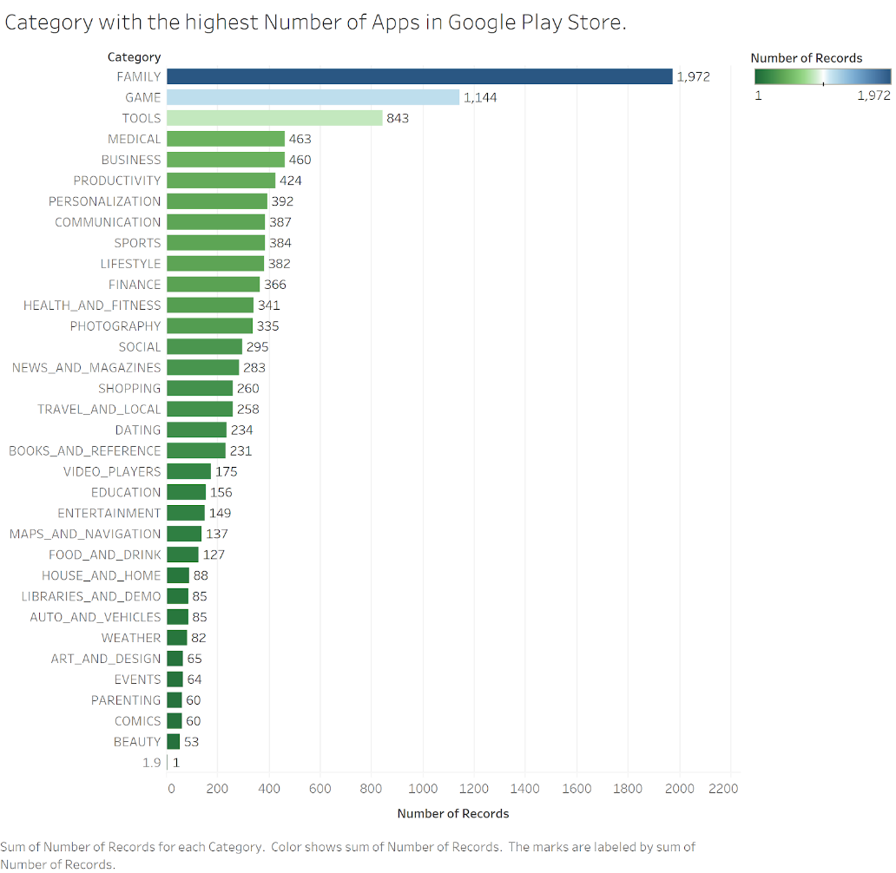

Categories with Highest Number of Apps?
Family
Category indicates the highest number of Apps
Notes:
We can see that there is a high demand for family apps, 1972. So, we now apply a filter in the Family category to identify the highest number of apps in this Genre

Slide 6
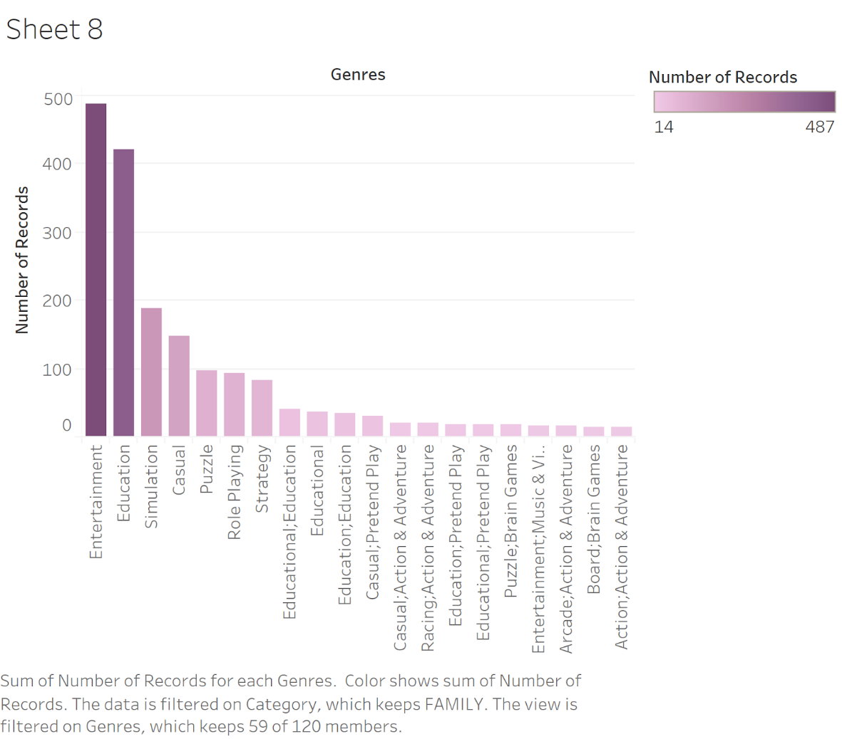

Highest contributor of Genres to Family Category?
Entertainment
Genre has the highest number of records
Notes:
From the Genre we see that Entertainment Apps have the highest record 487. Though our data had a significant number of genres we have only considered the ones which have a record greater than 14.

Slide 7
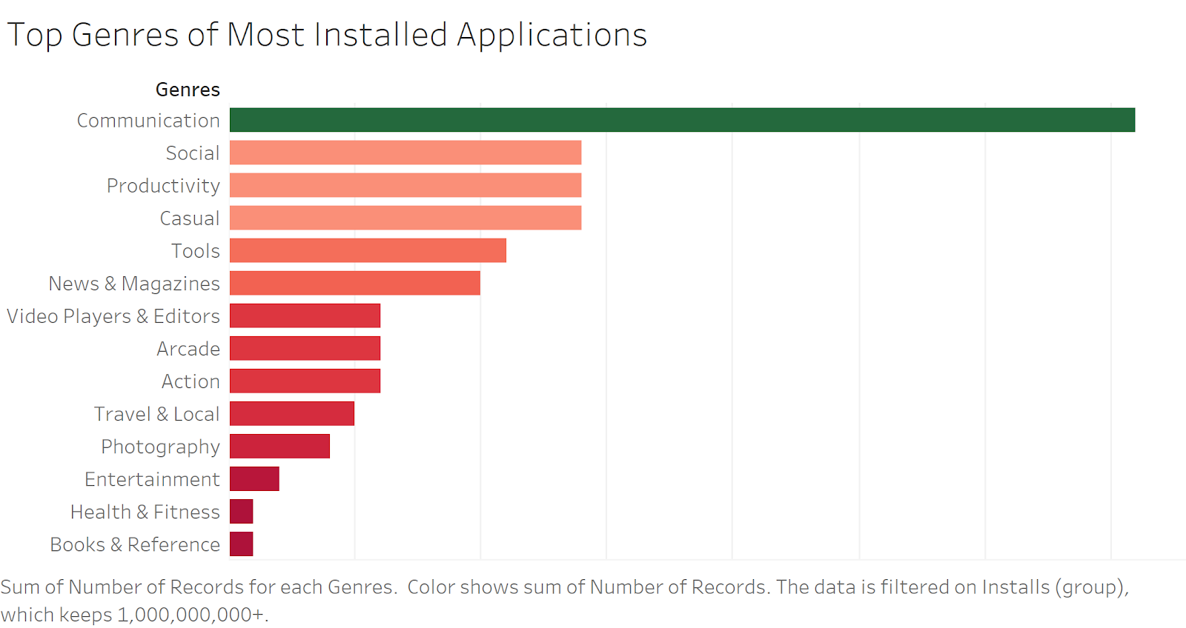

Most Installed Genre on Play Store ?
Communication
Genre has the most installed application
Notes:
In this case we also had a large number of genres with a variety of installation numbers, for a clear analysis we have filtered our results for installs greater than 1,000,000,000+

Slide 8
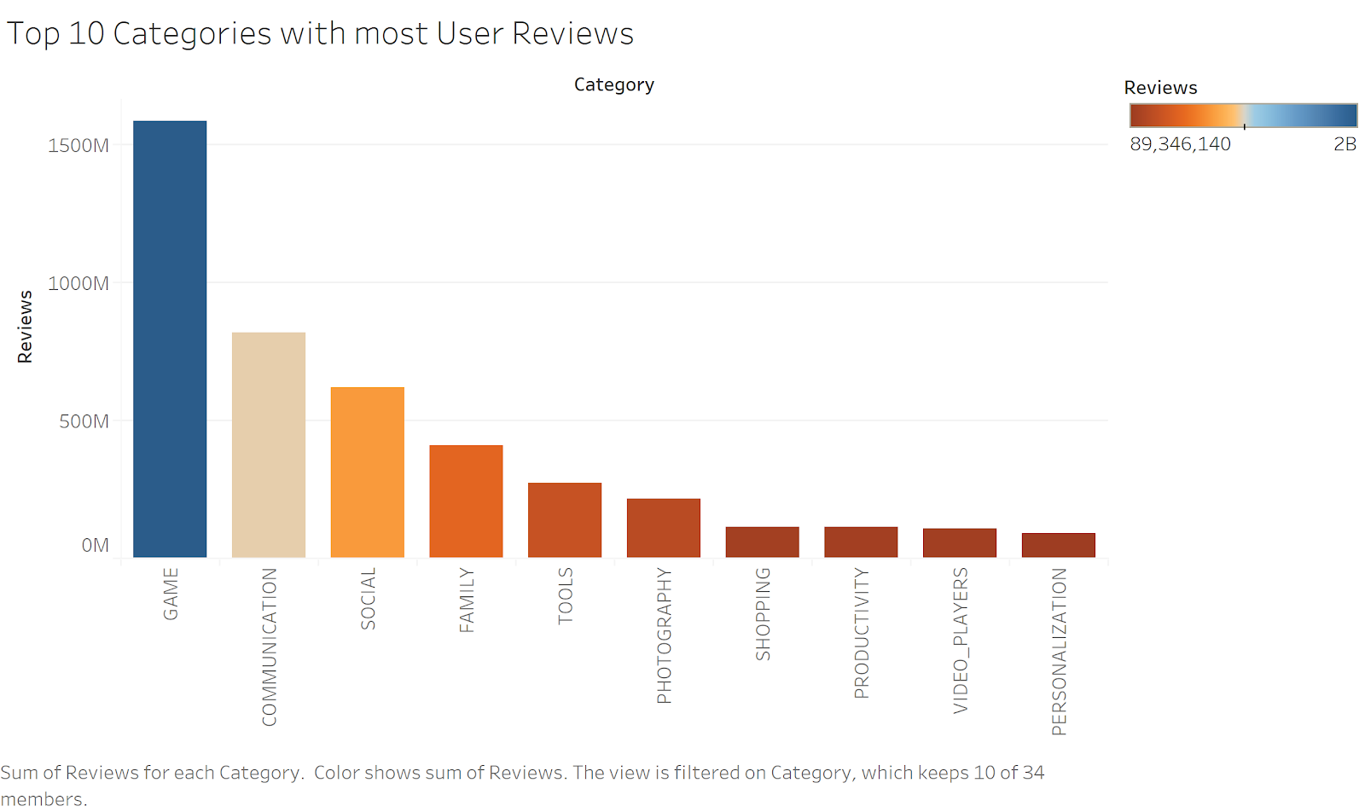

Top 10 Categories With Highest User Reviews
Games
category has the highest number of User Reviews
Notes:
We see that the games category has the highest number of user reviews, around 1.6 Billion

Slide 9
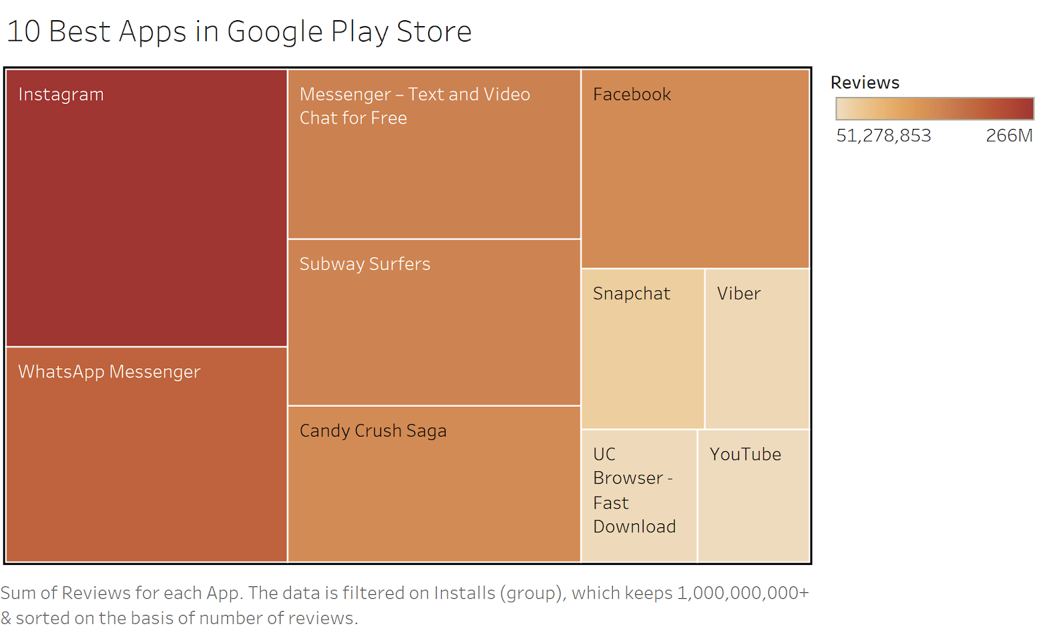

Top 10 Best Apps in Play Store
Instagram
is considered to be the best app

Slide 10
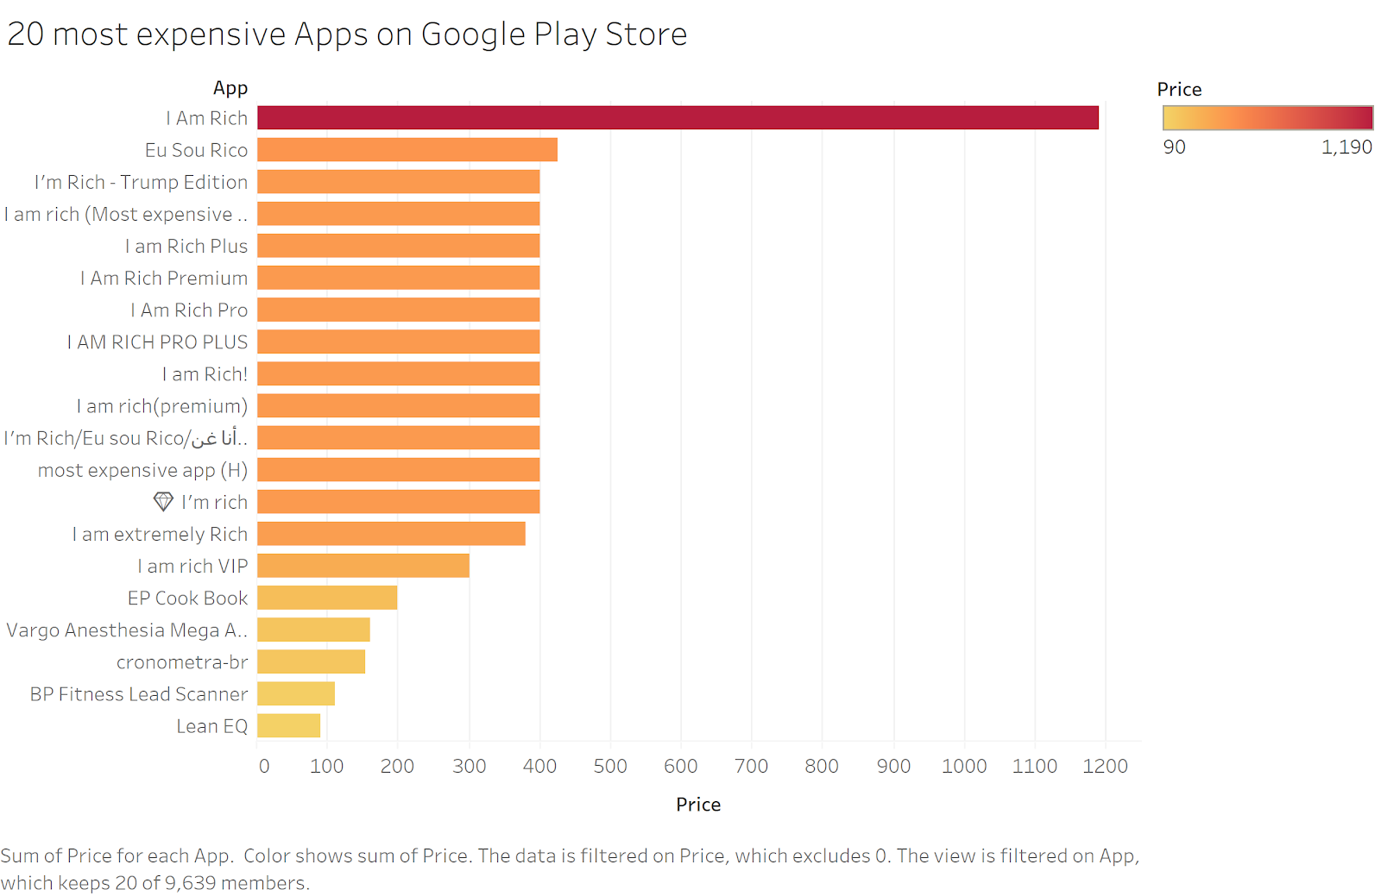
Most Expensive Apps on Play Store?
I Am Rich
app is the most expensive priced at $1,190

Slide 11
Is there Difference in Ratings for Paid and Unpaid Apps
Created Subsets
Created two subsets, one where the app price is zero and another one where the price is more than zero
1
Evaluated Results
Since P - value is less 0.05 we can reject the null hypothesis
And therefore there is significant difference
Operationalized Hypothesis
Null Hypothesis - There is no difference in ratings for paid and unpaid apps
Alternative Hypothesis - There is difference in ratings for paid and unpaid apps
4
2
3
Performed T - Test
Performed T-test in R using rating as the variable and found p value less than 0.05 (significance level )

Slide 12
Is there Difference in Ratings for Restricted and Unrestricted Apps
Created Subsets
Created two subsets, one where the app content rating is everyone and another one where it is not everyone
1
Evaluated Results
Since P - value is less 0.05 we can reject the null hypothesis
And therefore there is significant difference!
Operationalized Hypothesis
Null Hypothesis - There is no difference in ratings for restricted and unrestricted apps
Alternative Hypothesis - There is difference in ratings for restricted and unrestricted apps
4
2
3
Performed T - Test
Performed T test using rating as the variable and found p value less than 0.05 (significance level )

Slide 13

Predictive Analysis
Predict the Number of Installs
Categories
Predicted the number of installs of the upcoming apps based on categories and price
Created a linear model in R for dependent variable ‘installs’ and independent variable ‘categories’ and ‘price’
Performed Multiple Linear Regression
Number of Installs
Prices

Slide 14
Predictive Analysis
Predict the App Ratings
Categories
Predicted the app’s future ratings based on categories and price
Created a linear model for dependent variable ‘installs’ and independent variable ‘categories’ and ‘price’
Performed Multiple Linear Regression
App Rating
Prices

Slide 15





Implications of Findings
Developers
Marketers
Can utilize existing apps factors such as price, reviews, content rating to develop new apps
Segment the audience to find valuable insights
Unlock powerful insights on in-app purchases
Factor in the results of predictive analysis in order to determine patterns and future outcomes and app installs
Use data to measure what matters for your target audience

Slide 16

Link to GitHub Repository
https://github.com/Neviya/MindBenders

Slide 17

Thank You

