Slide 1
office macro detected

Slide 2



Our team
Lior Vinman
Nevo Gadassi
Yoad Tamar

Slide 3
Table of contents
01
02
03
04
Introduction
Danger
What is office macro
The danger in office macro
Our modle
Results
Explaine for train.py and interface.py
Accuracy percentages and testing test_without_lables

Slide 4
01
Introduction
What is office macro

Slide 5
What is office macro?
-A macro in the context of Microsoft Office typically refers to a set of instructions that automate tasks in applications like Microsoft Word, Excel, PowerPoint, and others. Macros are written in programming languages such as Visual Basic for Applications (VBA).
-They can be used to automate repetitive tasks, perform complex calculations, or customize the behavior of Office applications.

Slide 6
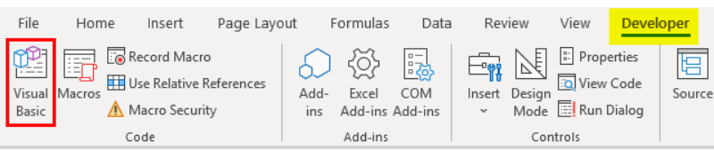
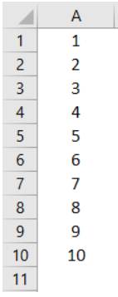
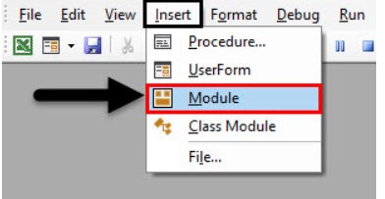
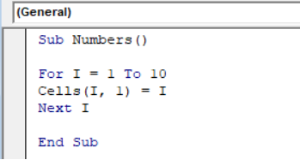
Writing Macros in VBA?

Slide 7
So Macro Looks perfect ?

Slide 8
02
Danger
The Danger in office macro

Slide 9
Why macro can be danger?
Remote Code Execution :
Macros can contain embedded scripts or code that, when executed, can perform malicious actions on a user's computer. This may include activities such as deleting files, modifying data, or even installing malware.

Slide 10
Microsoft Office applications, especially Excel, have security measures to protect users from potentially harmful macros. These security settings may change, and users need to manually enable macros if they want to use them.

Slide 11
03
Our modle

Slide 12
macro_competition
Our dataset
Our code
._train_dataset
._validation_dataset
._test_dataset_without_labels
Train.py Interface.py
output
Well trained model
New dataset._test_dataset_with_labels

Slide 13
How we train our model
Tf-idf
A numerical figure that reflects the importance of a word in a document within a collection of documents
RandomForest
Builds multiple decision trees during training and merges them together to improve accuracy and generalization for classification and regression tasks.
KNeighbors
Classifies a data point based on the majority class of its k nearest neighbors in the feature space.
XGBoost
builds a series of decision trees sequentially, where each tree corrects the errors of the previous one, and it combines their predictions to make a final, more accurate prediction

Slide 14
How we train our model
Ensemble learning
A technique that combines predictions from multiple models to improve overall performance, accuracy
Soft voting
A method in which the final prediction of an ensemble model is based on the weighted average of the predicted probabilities from several individual models. Each model assigns a probability to each class, and the final prediction is determined by the class with the highest weighted average probability across all models.

Slide 15
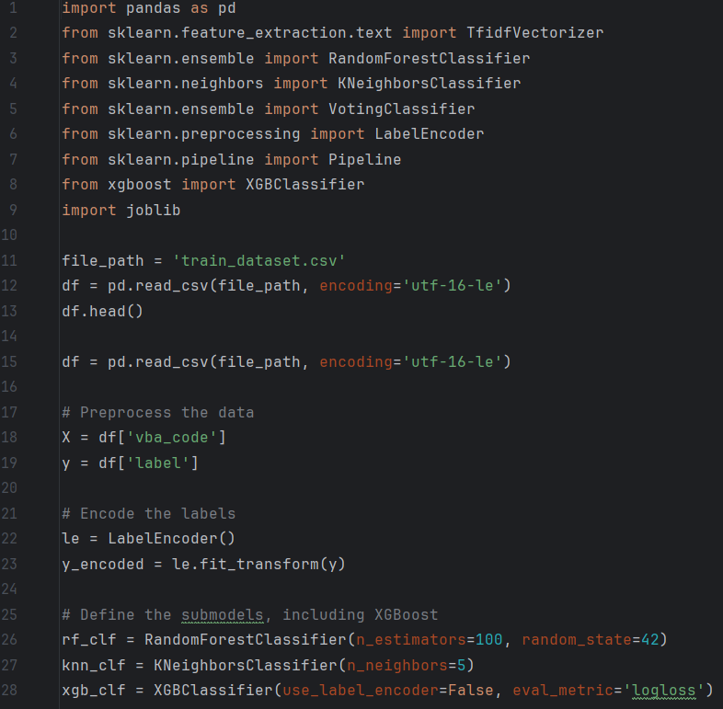
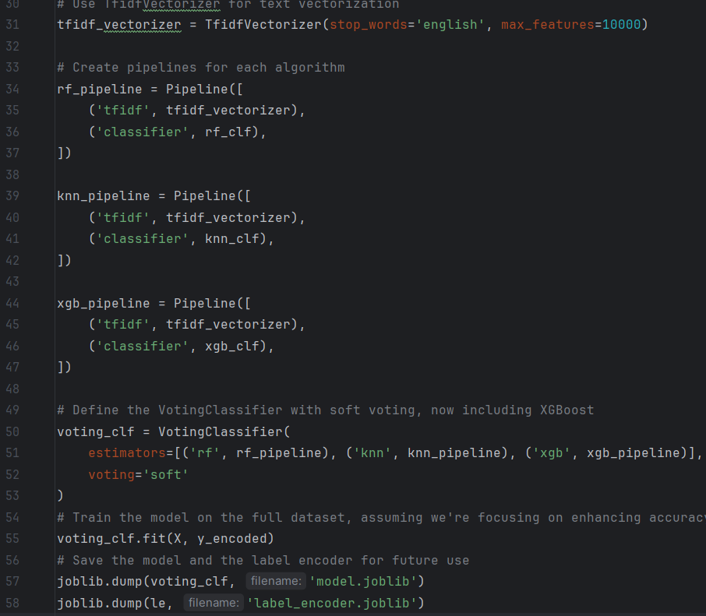
Train.py

Slide 16
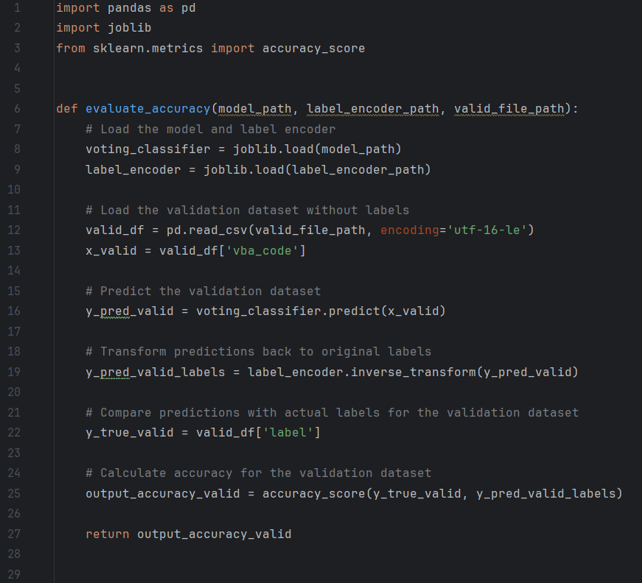
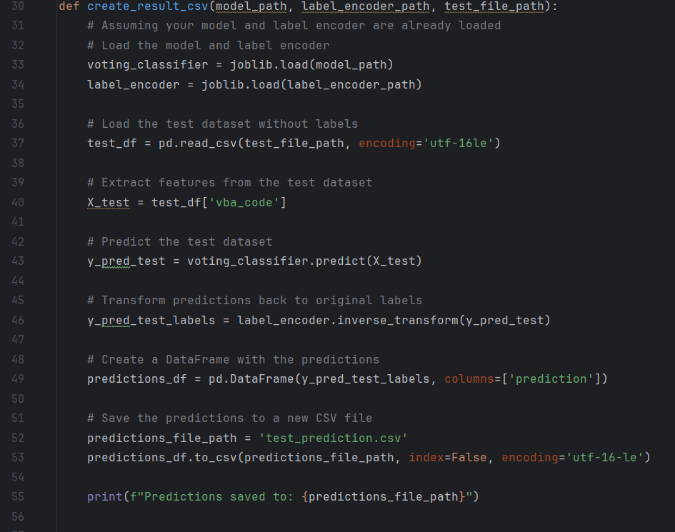
inference.py

Slide 17
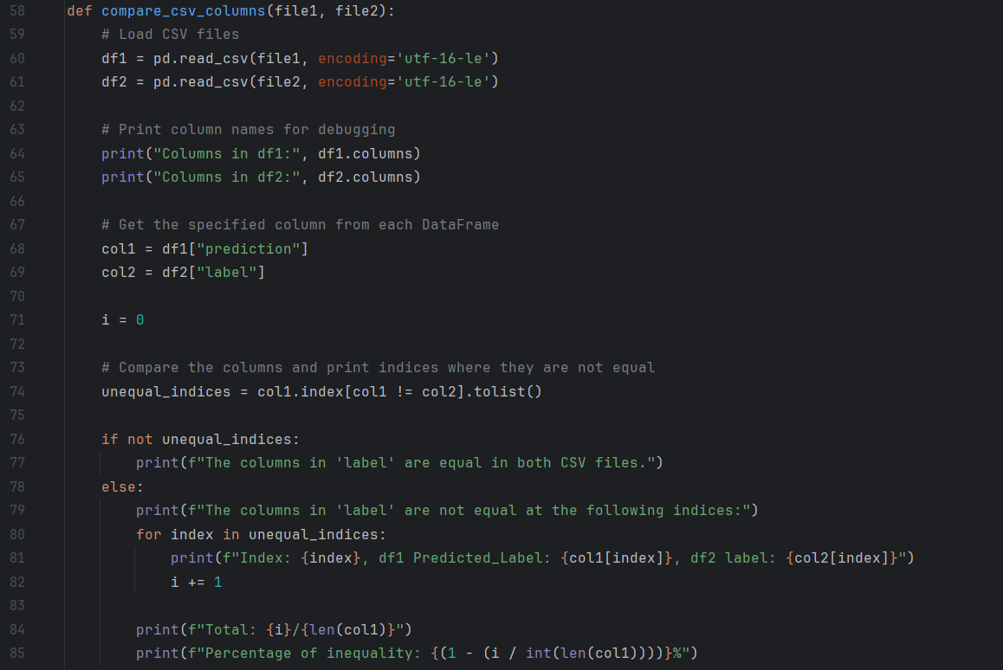
inference.py

Slide 18
04
Our Results

Slide 19
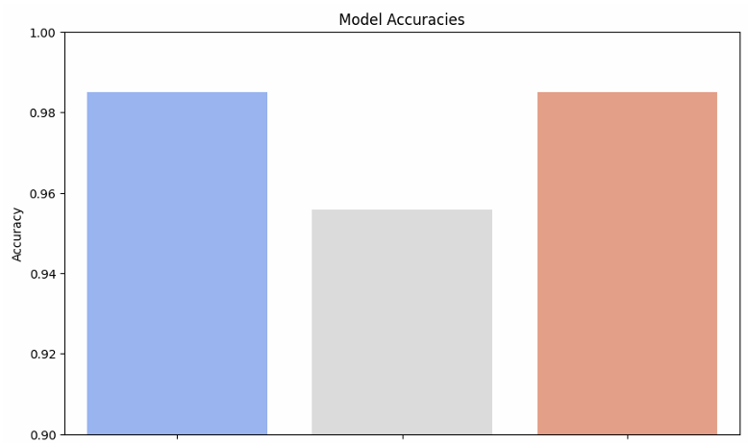
RandomForest
Tf-idf
KNeighbors

Slide 20
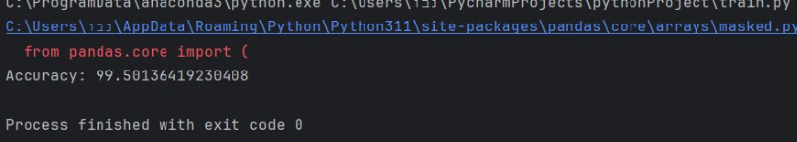
Accuracy on validation set: 99.5%

Slide 21
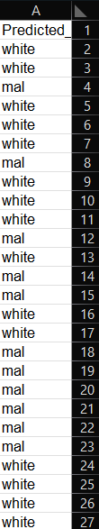
output test_with_labels
After building and training the module we run the module in tes_without_lable and get a new prediction here is a look at the results

Slide 22
Thanks!

