Slide 1
Malicious URL Classification

Slide 2



Our team
Lior Vinman
213081763
Nevo Gadassi
325545887
Yoad Tamar
213451818

Slide 3
01
INTRODUCTION
03
Data Exploration and Feature Extraction
modern cybersecurity
networking usage
02
Our solution
results
04
architecture outlined in the project
Accuracy percentages

Slide 4
01
Introduction
modern cybersecurity
networking usage

Slide 5
Navigating the Cybersecurity Landscape
Introduction
Highlighted Challenge
In the ever-evolving cybersecurity landscape, increased networking activities have led to a surge in online interactions. With daily engagement in web activities becoming the norm, securing this vast digital domain is crucial. The growing reliance on the internet for various tasks poses a primary challenge: mitigating the risks linked to malicious activities.
A key cybersecurity challenge is the use of malicious URLs as a primary method for cyber threats. Social engineering exploits, like deceptive messages from seemingly trustworthy sources, create an environment where users unknowingly fall victim to phishing attempts

Slide 6
Example of Malicious URL Exploits
Setting the Stage
Deceptive URL Creation
Social Engineering Tactics
Exploiting Human Vulnerabilities

Slide 7
02
Our solution
architecture outlined in the project

Slide 8
Our solution
A
B
Exploratory Data Analysis
Data Exploration and Feature Extraction
Url Classification
C
D
Model Training
Tests

Slide 9
A
B
Exploratory Data Analysis
Data Exploration and Feature Extraction
Embarking on an investigation to effectively view and comprehend the content within our dataset article.

Slide 10
A
B
Data Exploration and Feature Extraction
Import ML libraries, load labeled dataset, clean redundancies, and perform feature extraction for key URL characteristics essential for model comprehension.

Slide 11
03
Data Exploration and Feature Extraction

Slide 12
Protocol and Subdomain
03
01
Length :
Count of 'http' occurrences ('count_http')
Count of 'https' occurrences ('count_https')
Count of 'www' occurrences ('count_www')
Features
Length of hostname ('length_hostname')
Length of path ('length_path')
Length of the first directory ('length_fd')
Length of the top-level domain (TLD) ('length_tld')
Composition Analysis
04
Count of digits ('count_digits')
Count of letters ('count_letters')
02
Counts
URL Structure Complexity
05
Directory count ('dir_count')
Count of dashes ('count_dash')
Count of '@' symbols ('count_at')
Count of '?' symbols ('count_question')
Count of '%' symbols ('count_percent')
Count of dots ('count_dot')
Count of equals signs ('count_equals')
Binary Feature
06
Presence of an IP address ('presence_ip')

Slide 13
Example of how the Features affect malicious URL

Slide 14
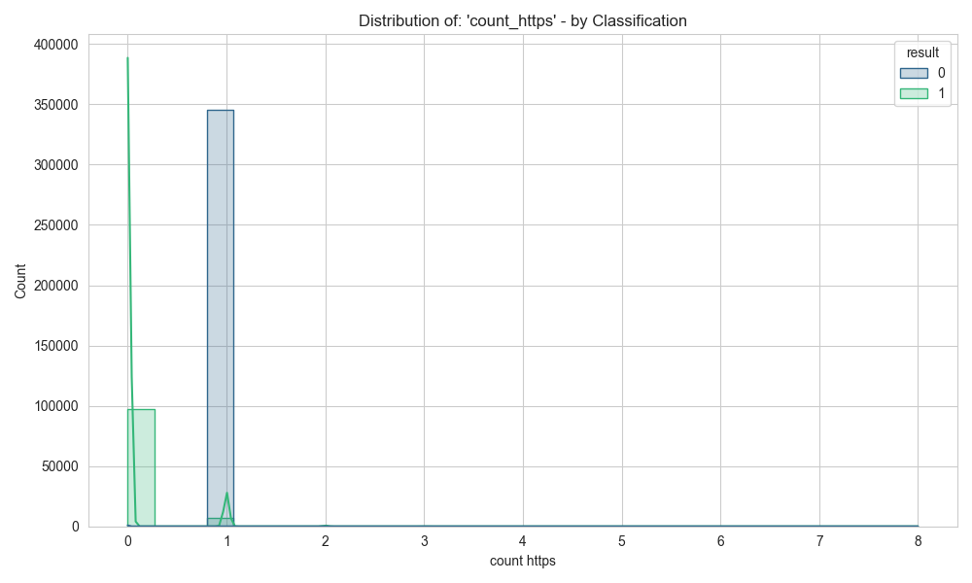
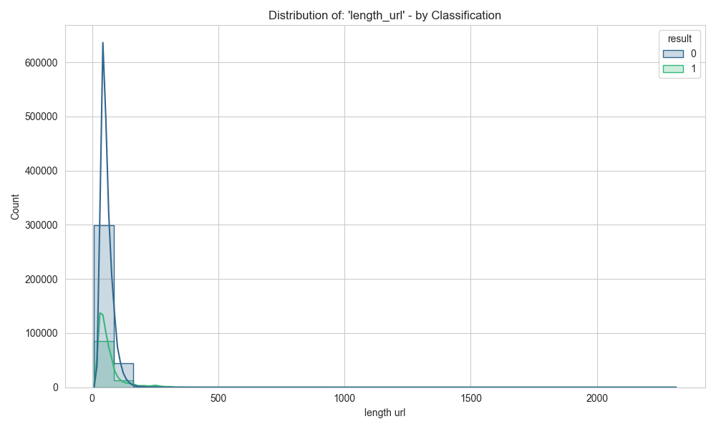
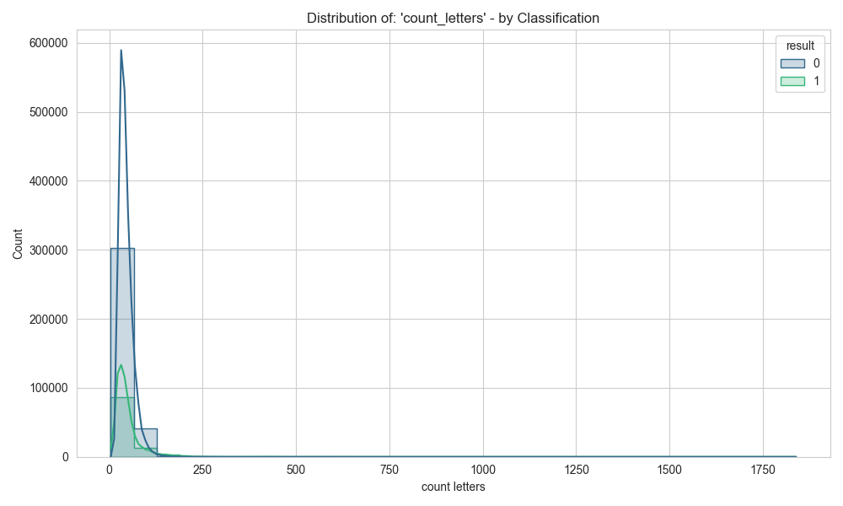

Slide 15
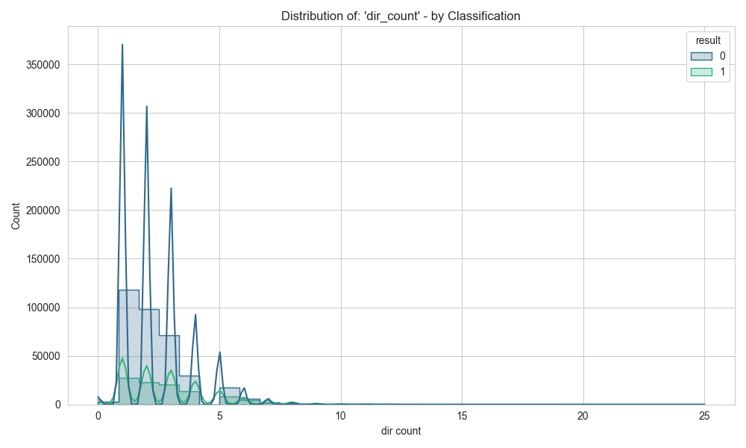
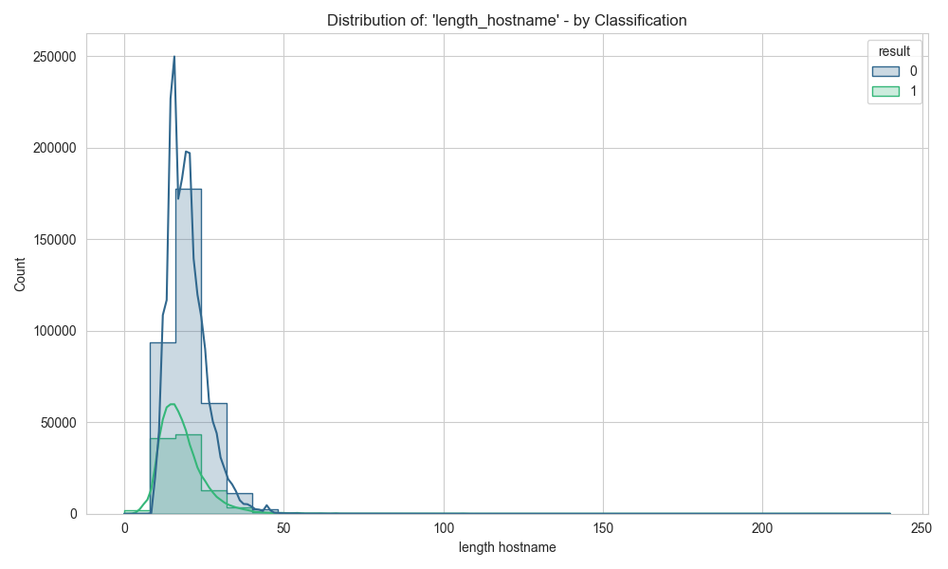
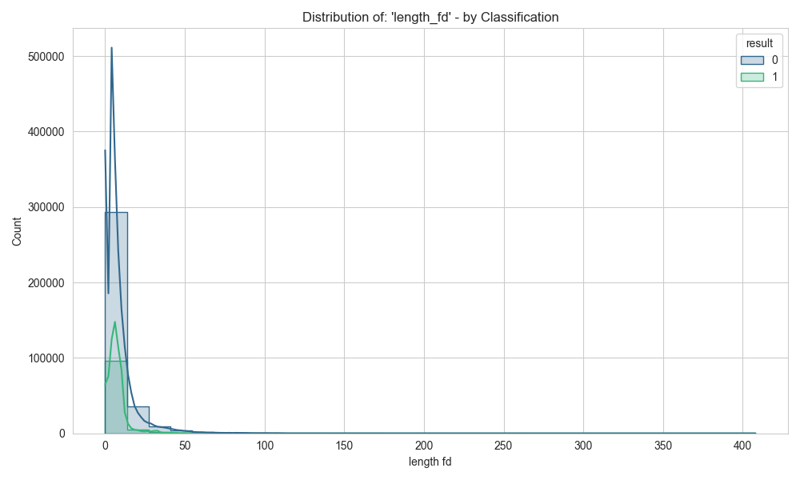
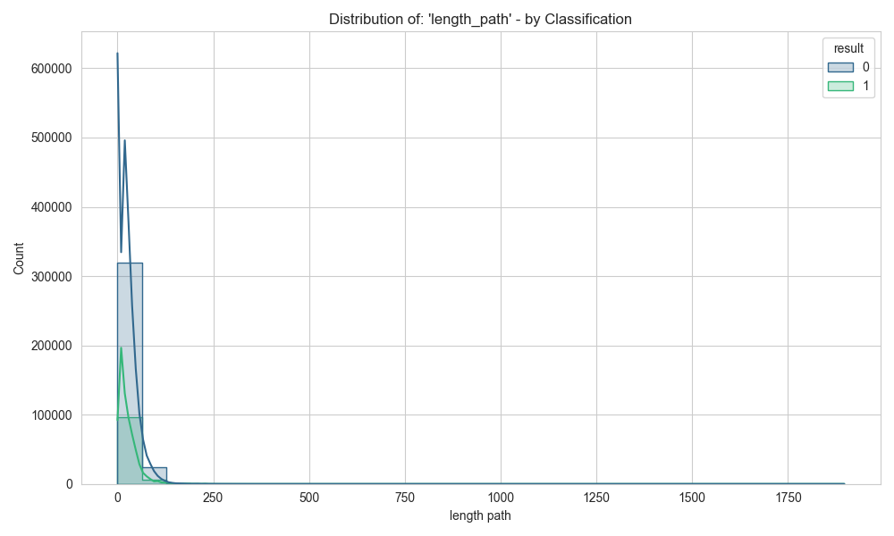

Slide 16
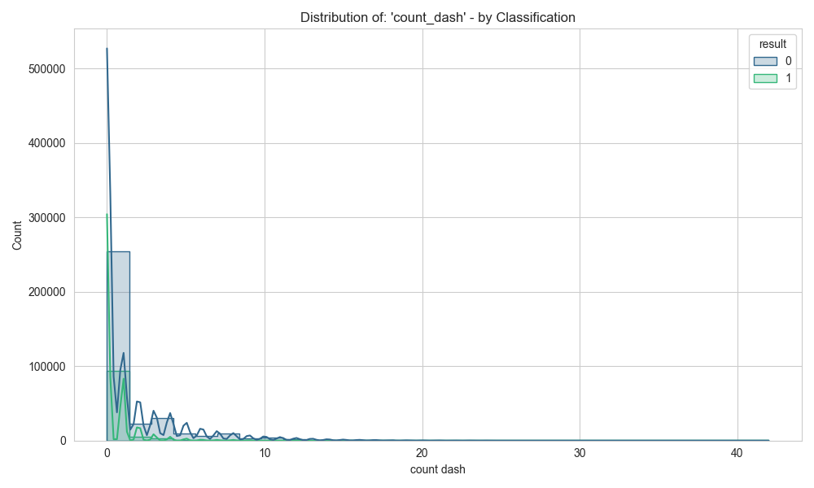
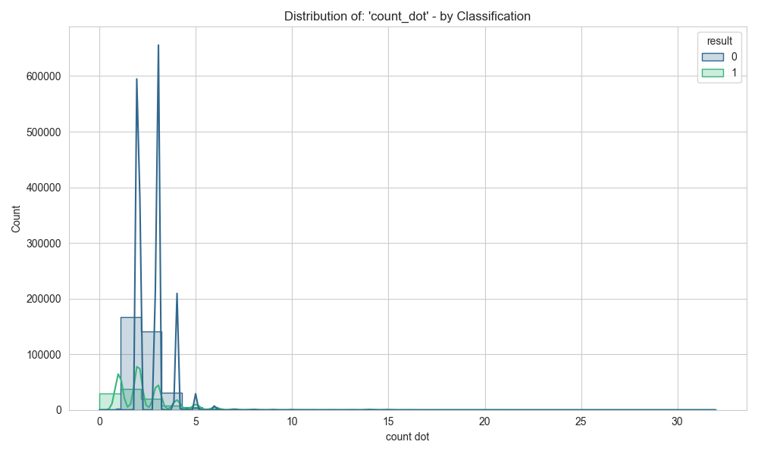
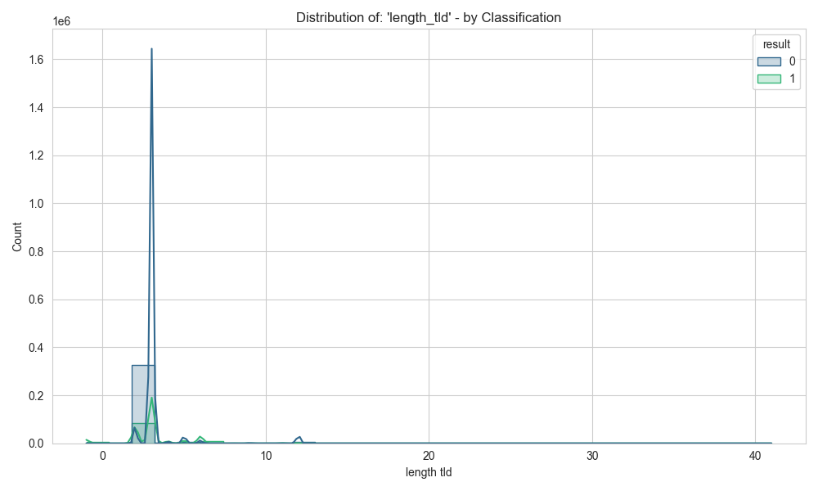
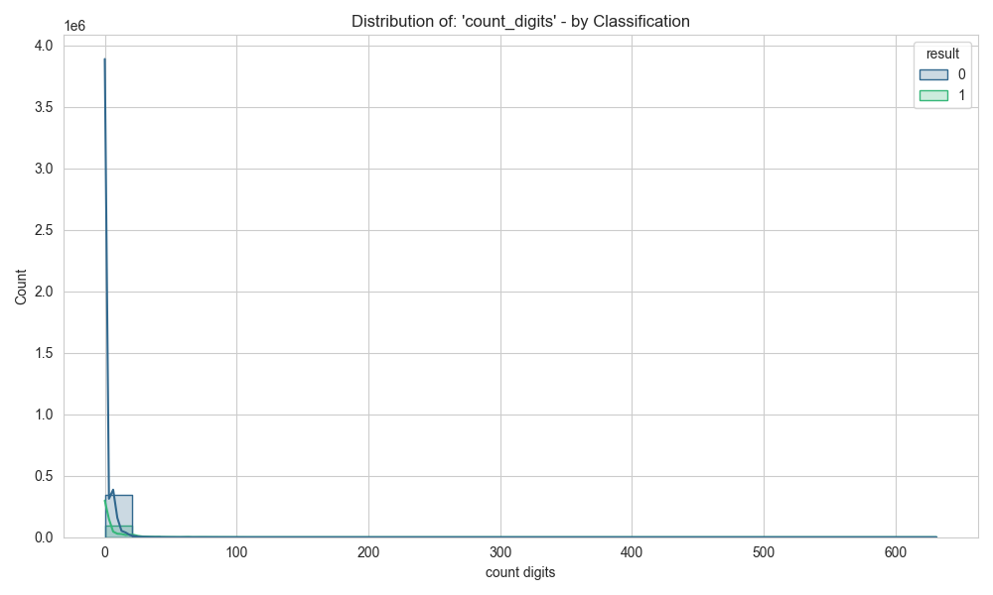

Slide 17
How we train our model
Ensemble learning
A technique that combines predictions from multiple models to improve overall performance, accuracy in this case ew use random forest
RandomForest
Builds multiple decision trees during training and merges them together to improve accuracy and generalization for classification and regression tasks.
Tf-Idf
A numerical figure that reflects the importance of a word in a document within a collection of documents

Slide 18
04
Our Results

Slide 19
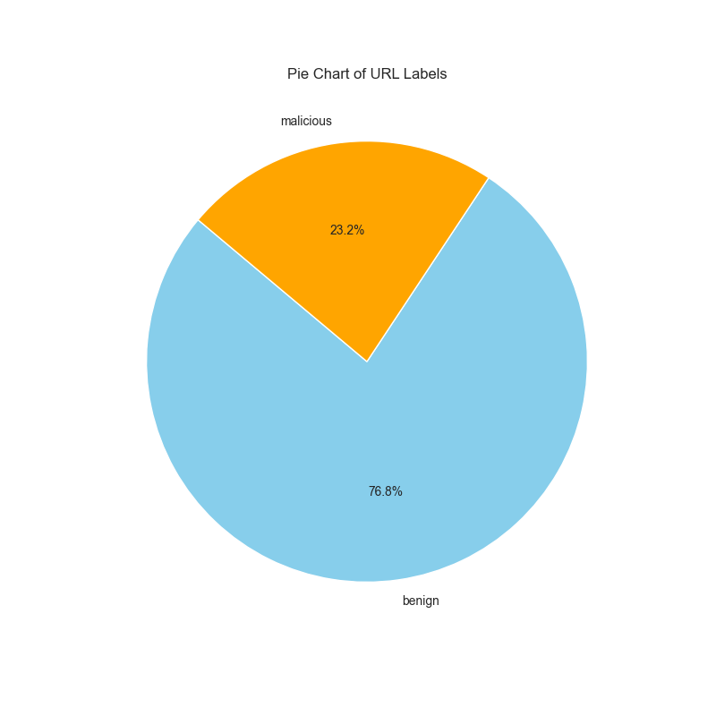

Slide 20
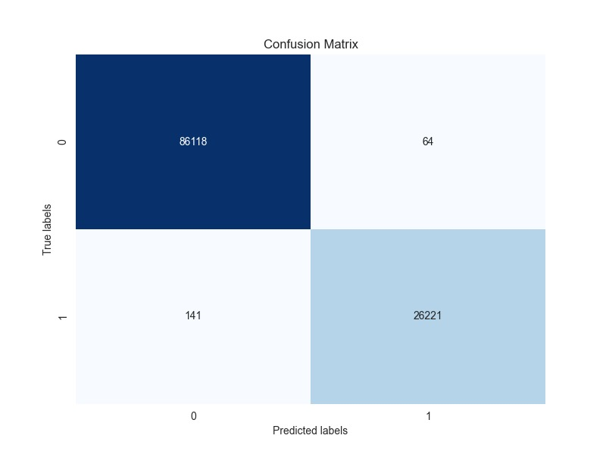
Accuracy score:99.8178%

Slide 21
Thanks!

