Slide 1
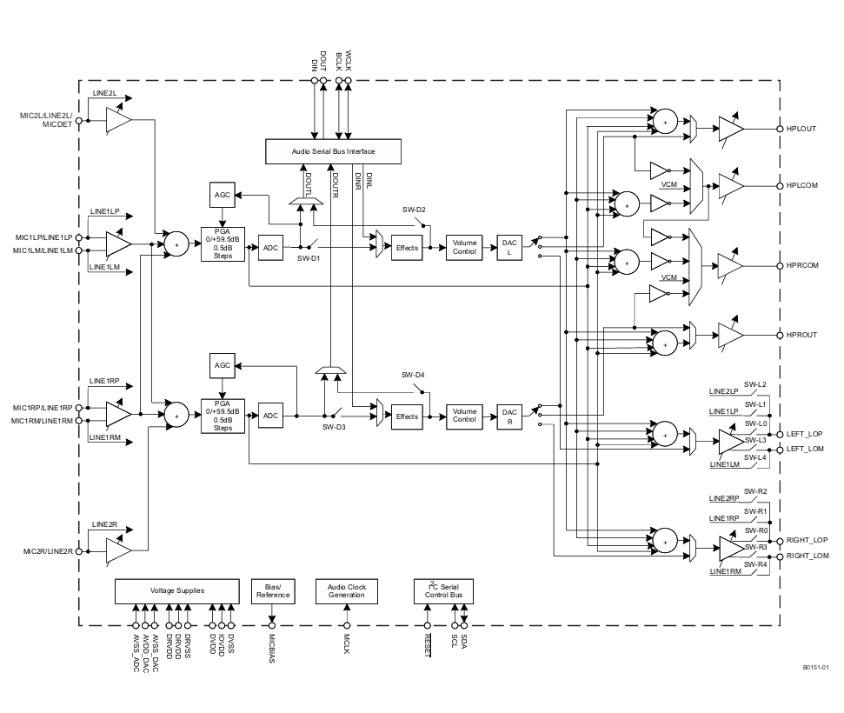
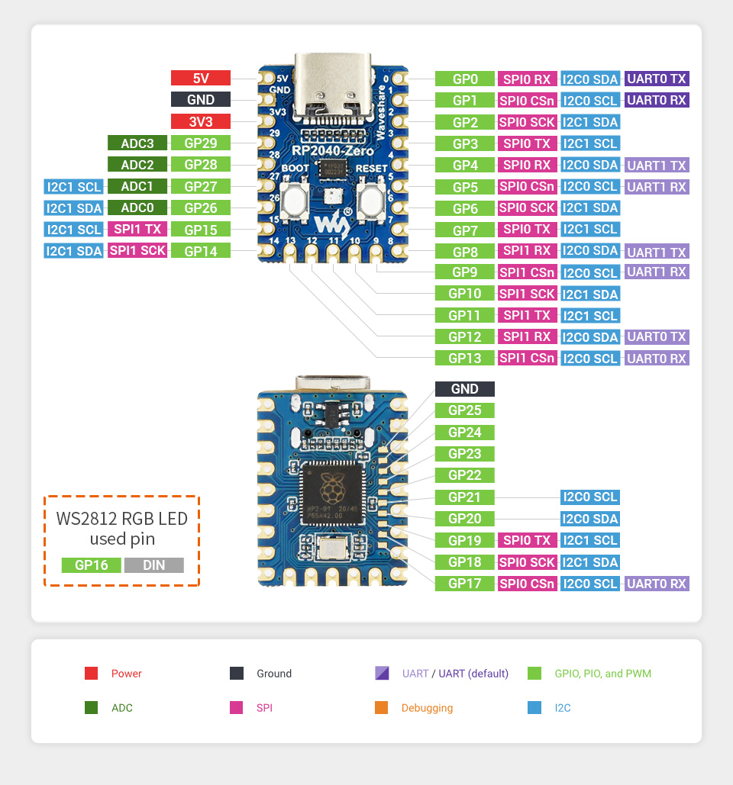
Texas Instruments TCA9548ARGER Datasheet
Texas Instruments TLV320AIC3101IRHBR Datasheet

Slide 2
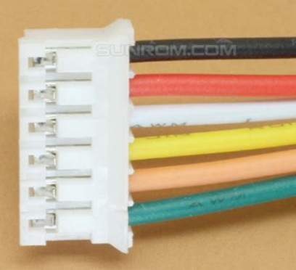
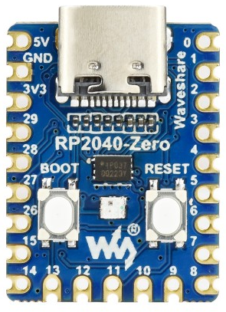
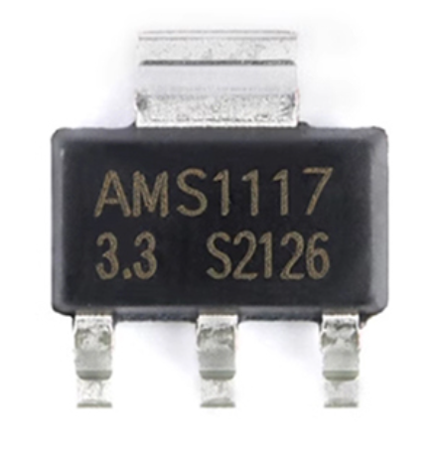
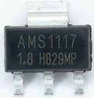
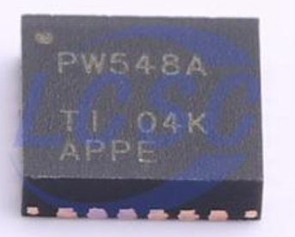


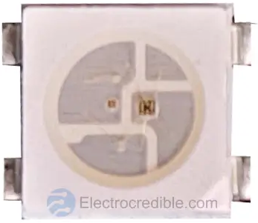
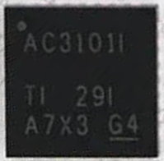
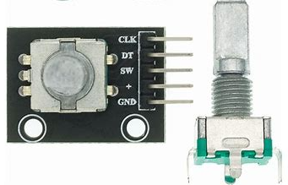

Power
SPI-2
I2C
Encoder
I2S CK
Analog
I2S-IN
SPI-1
WS2812b
I2S-OUT
Power
I2C
I2C
I2S CK
Analog
I2S
WS2812b

Slide 3
