Slide 1
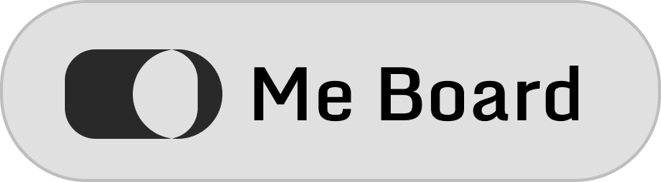

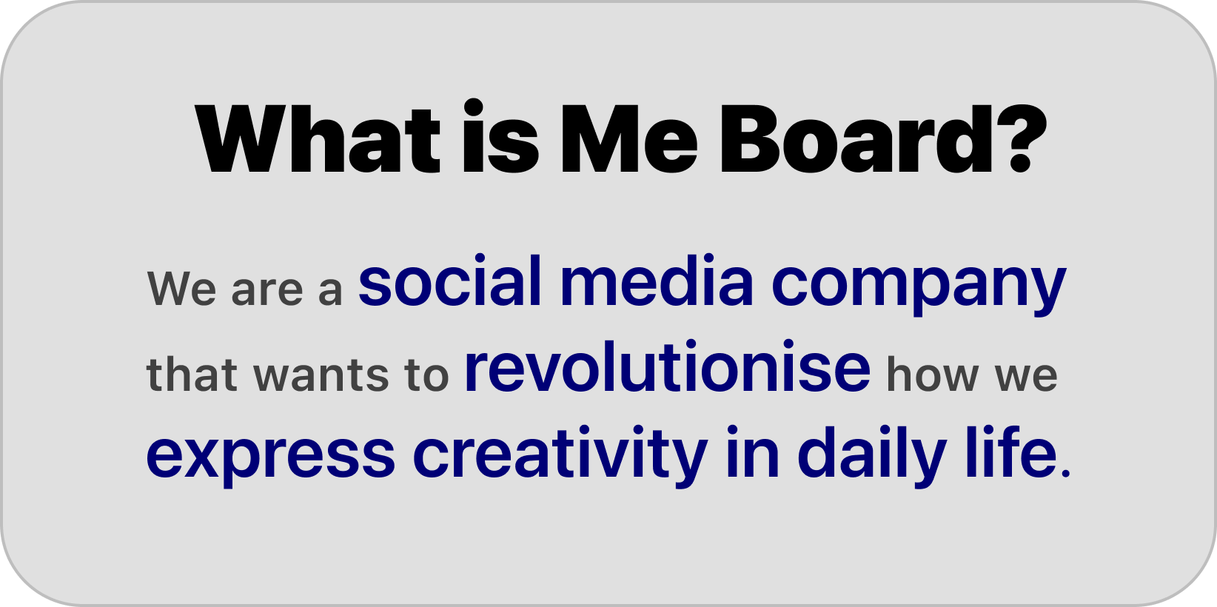

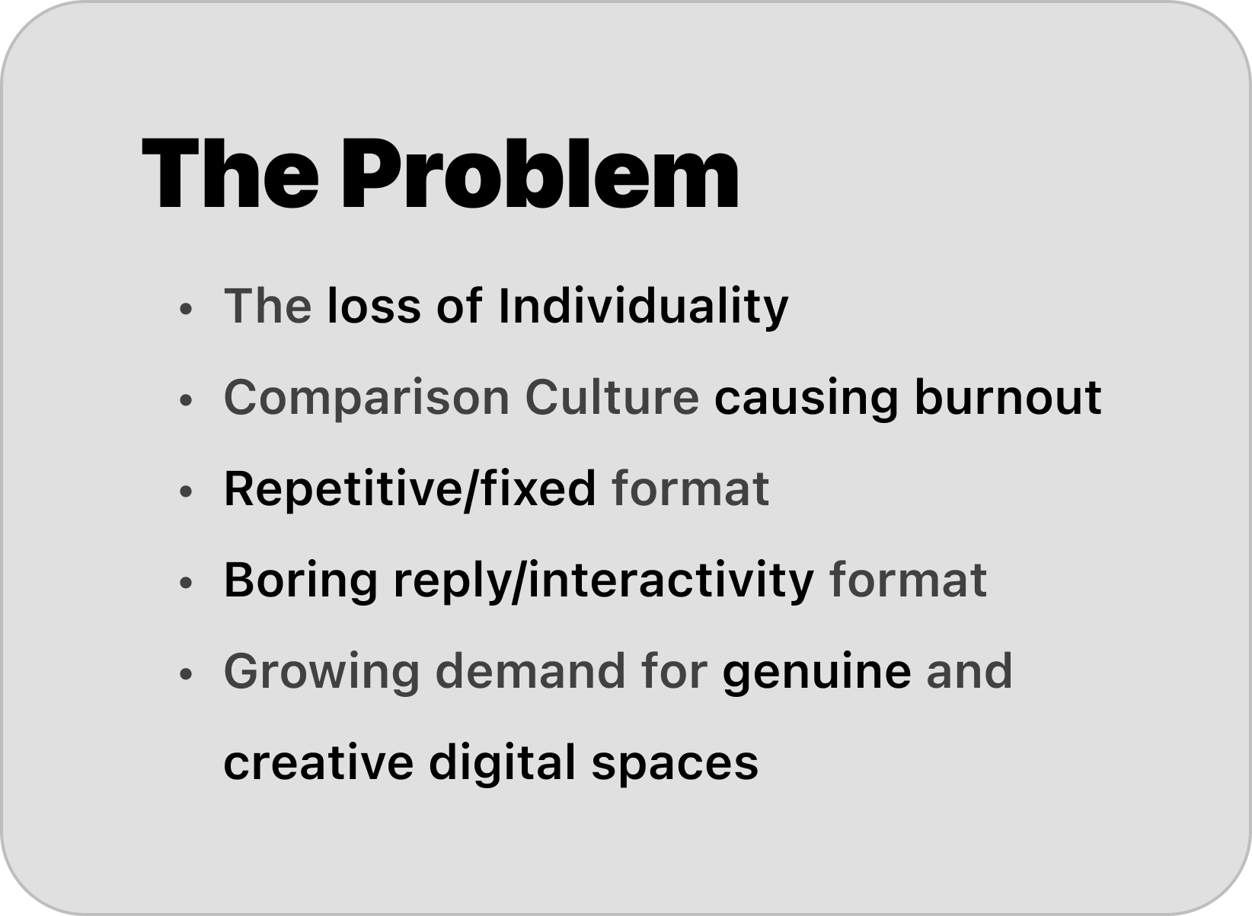
Members
Braven Chiam - 242350F
(CTO) App developer and UI/UX designer
Abel Goh - 242020X
(CMO) Marketing strategist
Md Sadiq – 240454T
(CEO & Founder) Management director
Tan Yong Rui- 242509G
(COO) Project and HR management

Slide 2
Members
Braven Chiam - 242350F
(CTO) App developer and UI/UX designer
Abel Goh - 242020X
(CMO) Marketing strategist
Md Sadiq – 240454T
(CEO & Founder) Management director
Tan Yong Rui- 242509G
(COO) Project and HR management

Slide 3

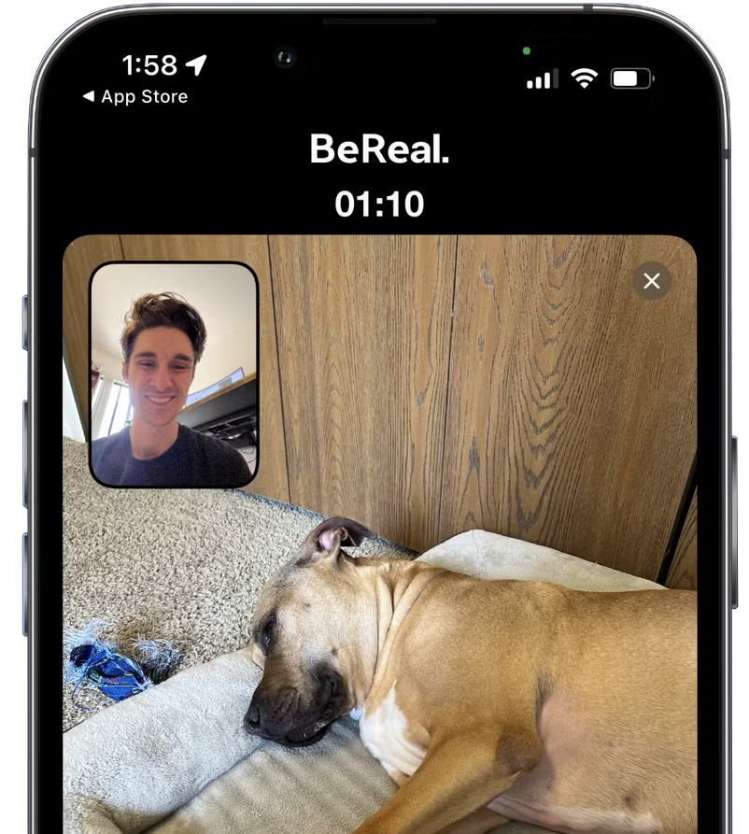
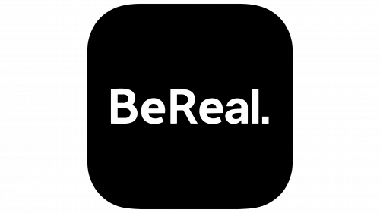
BeReal.
It’s a social media app where users post one photo per day.
The app sends a random daily notification, and you must post within 2 minutes.
It captures both front and back camera at the same time to show “real life.”
You can only see your friends’ posts after you upload your own
BeReal.

Slide 4
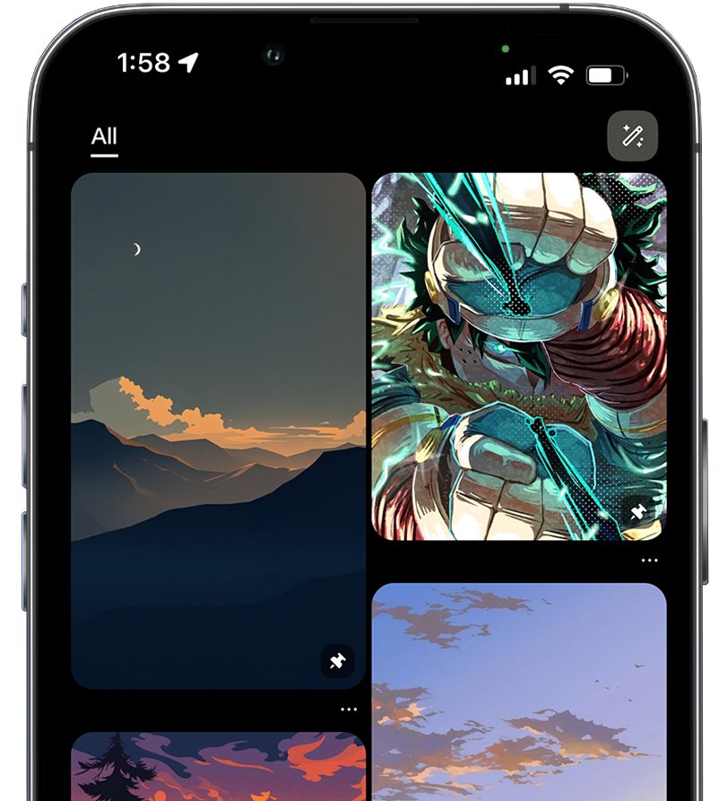
BeReal.
BeReal.
It’s a social media app where users post one photo per day.
The app sends a random daily notification, and you must post within 2 minutes.
It captures both front and back camera at the same time to show “real life.”
You can only see your friends’ posts after you upload your own

Slide 5


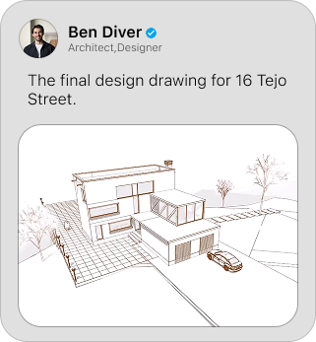
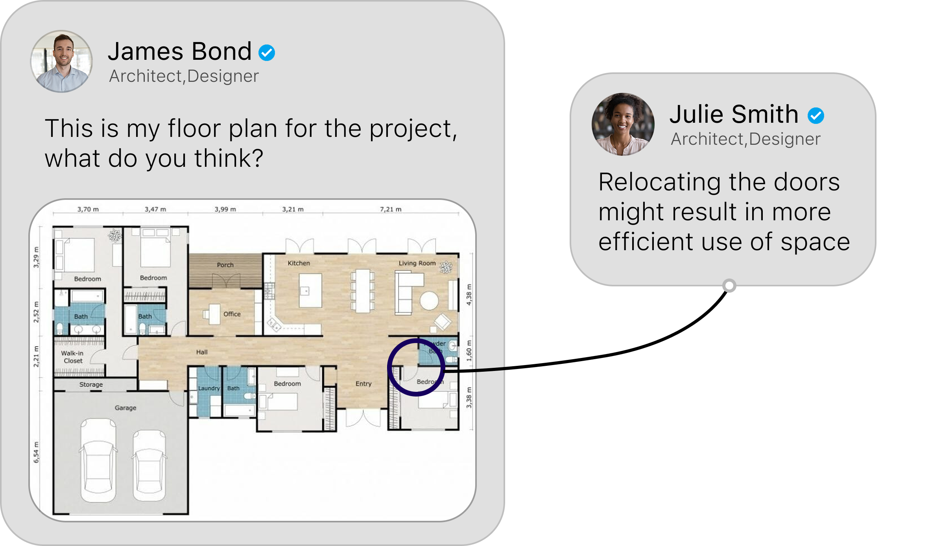
Pinterest
Pinterest
A visual platform where users save and discover ideas through images (“Pins”).
Users create boards to organize Pins into themes like recipes, fashion, or DIY.
It’s widely used for inspiration, planning, and creative brainstorming.
Pins can link to external websites, making Pinterest a tool for finding tutorials, products, and guides.

Slide 6
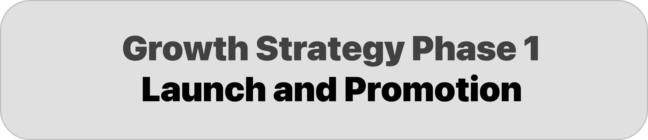

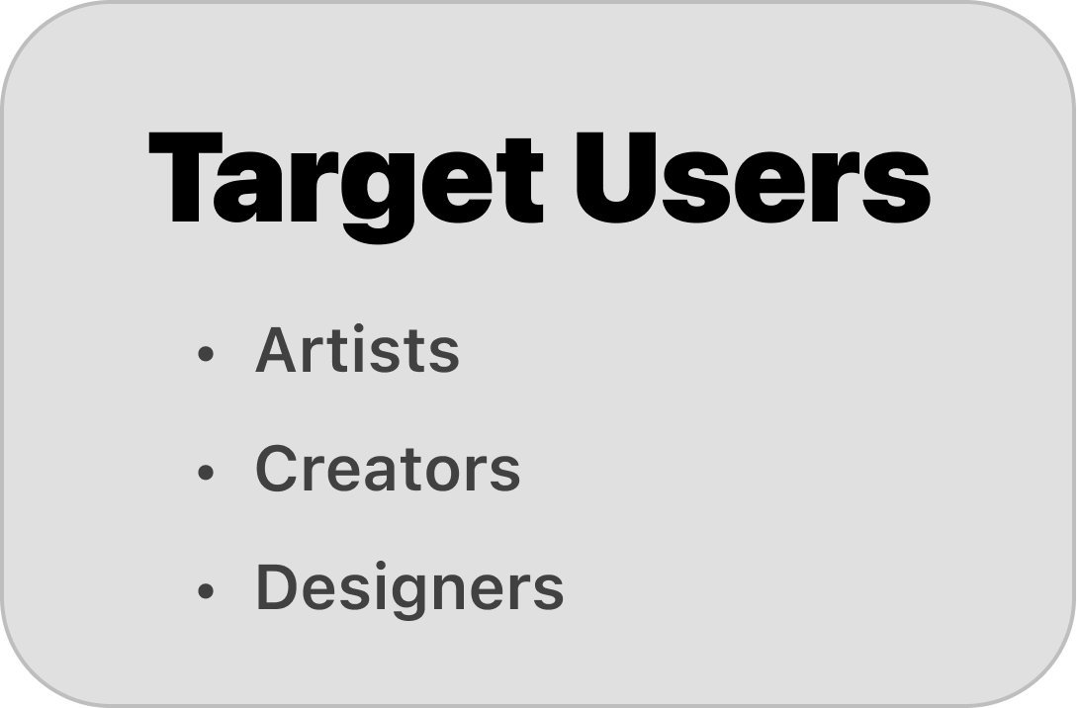
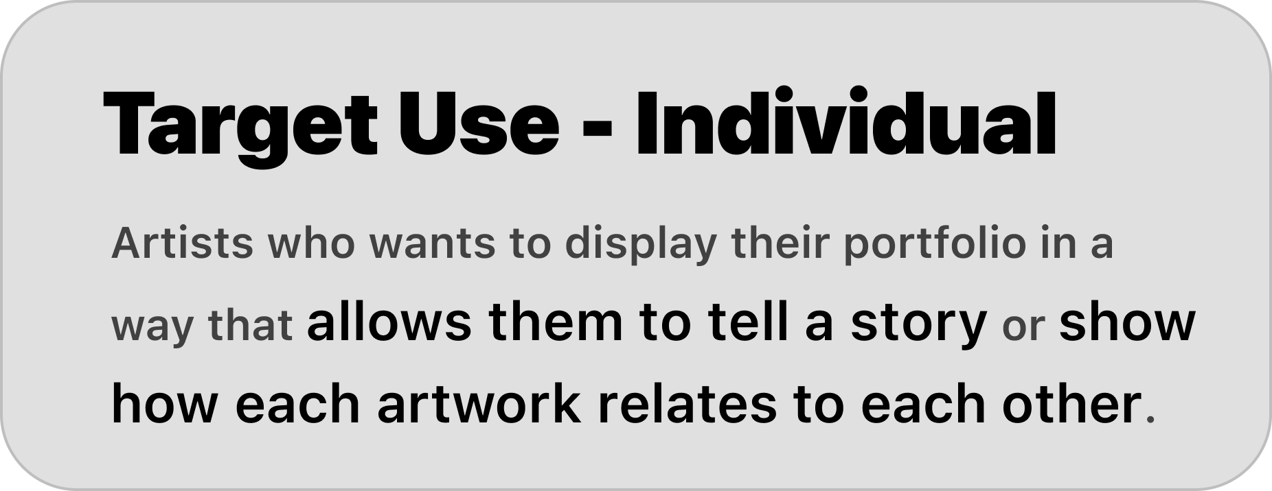
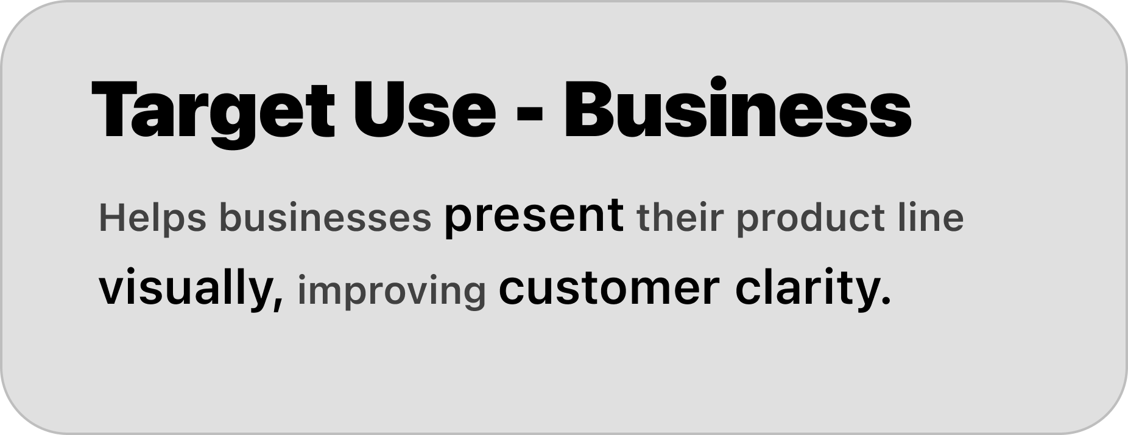
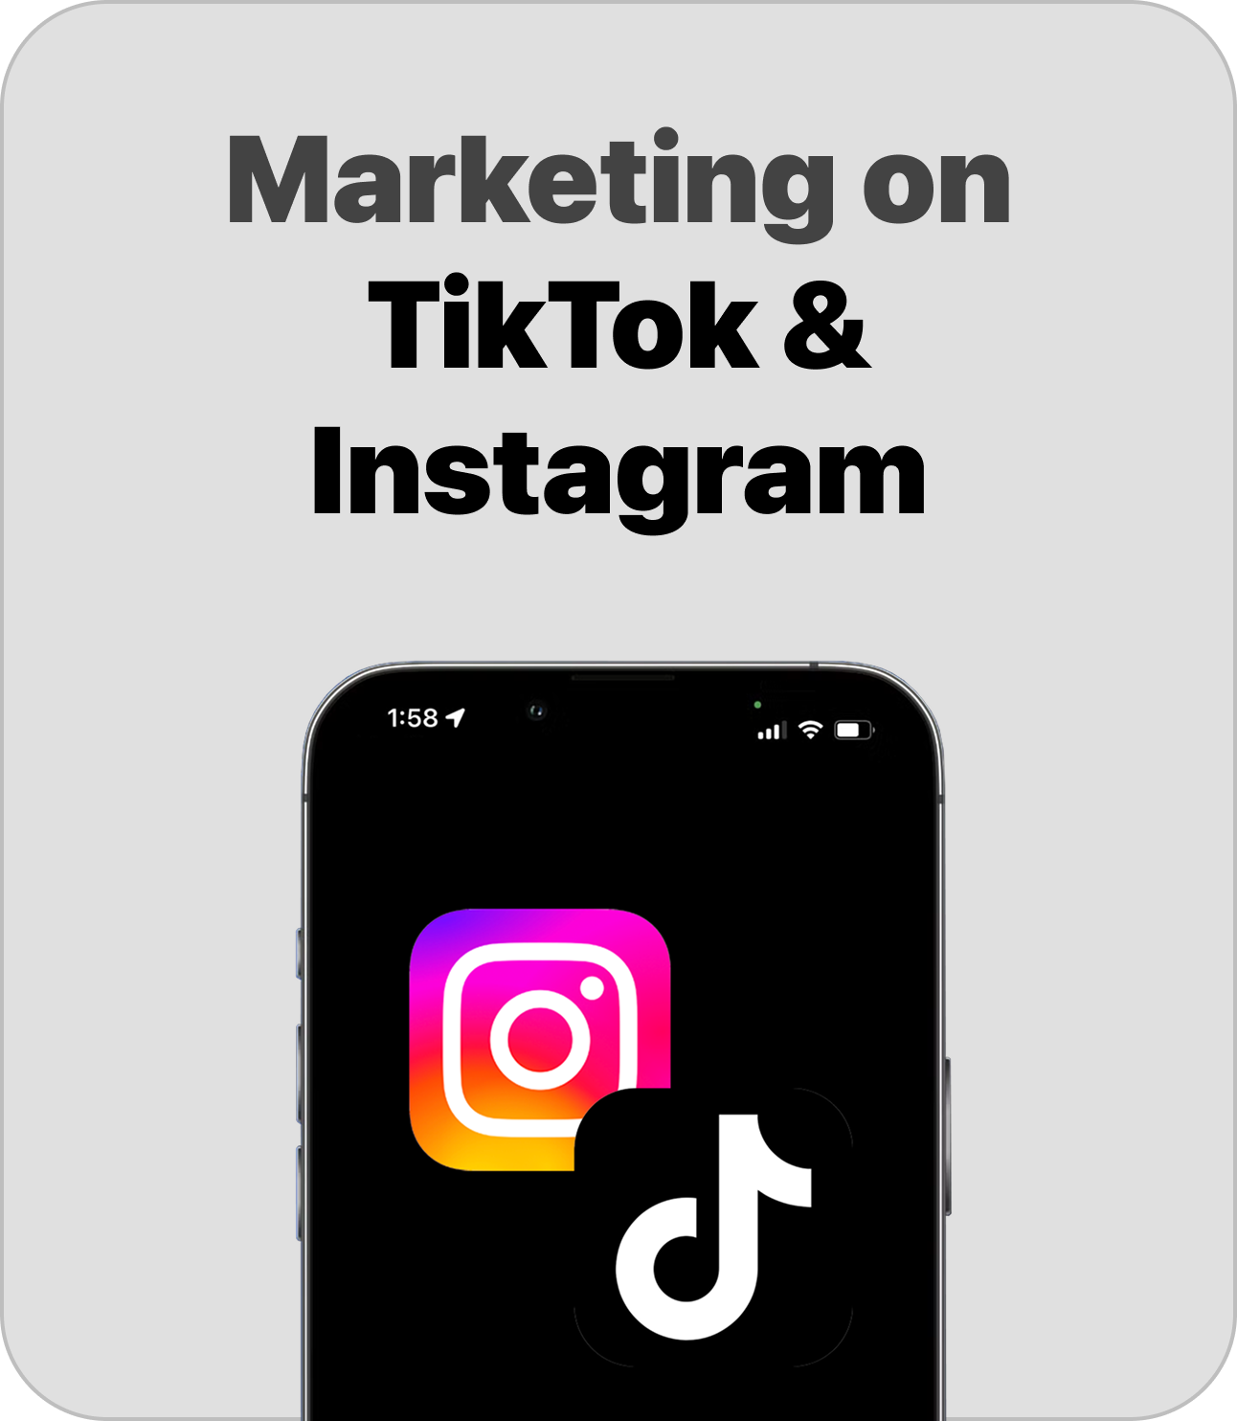
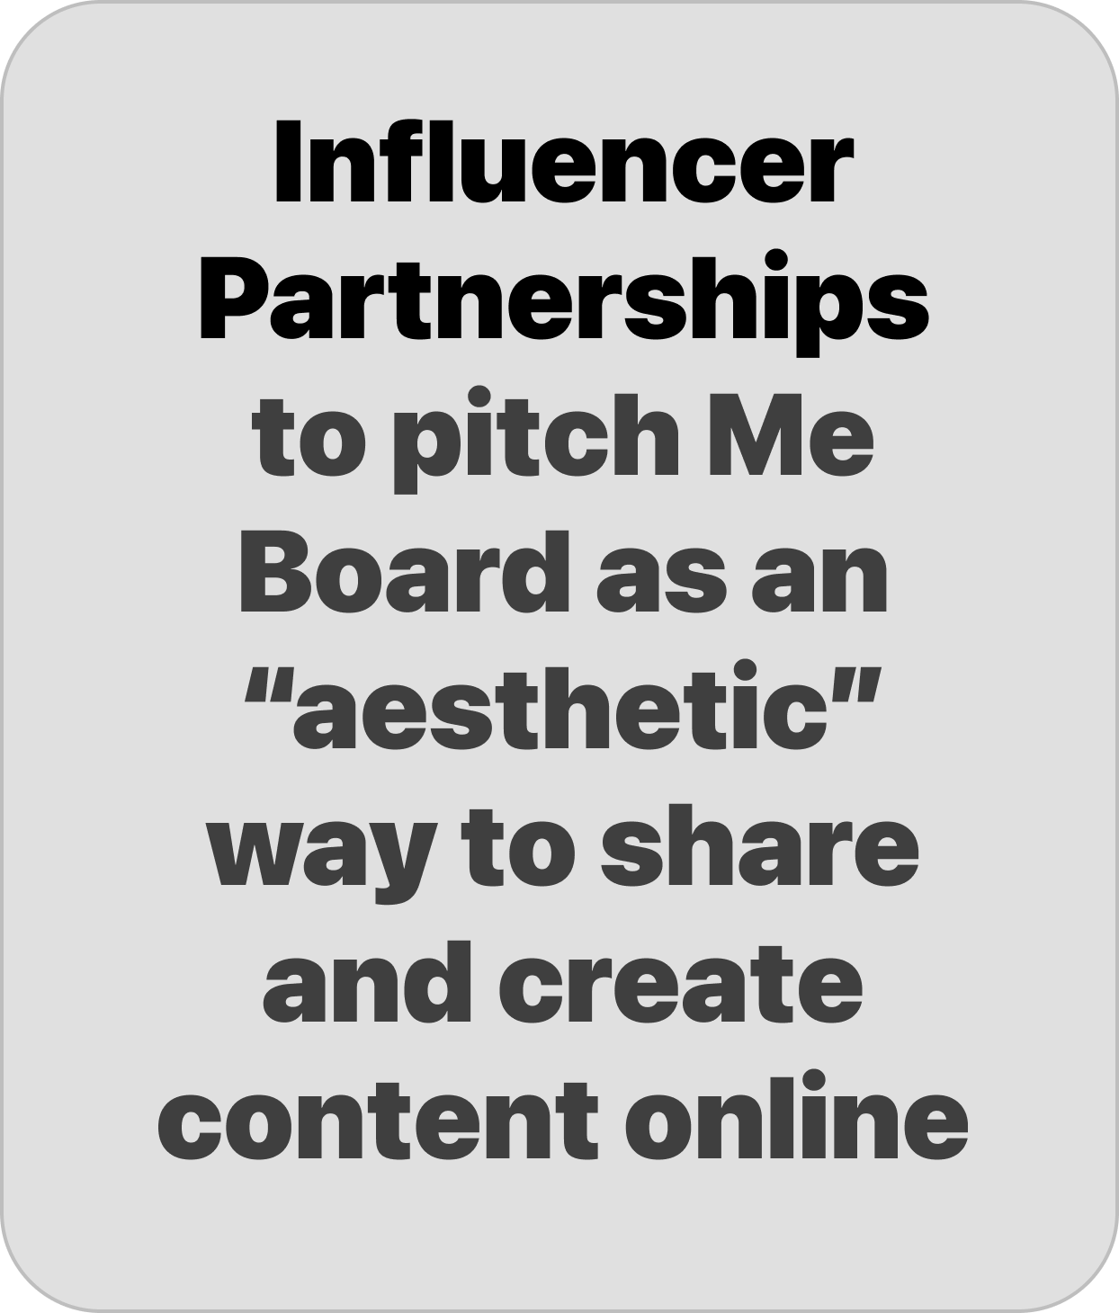

Pinterest
Target Audience
Pinterest
A visual platform where users save and discover ideas through images (“Pins”).
Users create boards to organize Pins into themes like recipes, fashion, or DIY.
It’s widely used for inspiration, planning, and creative brainstorming.
Pins can link to external websites, making Pinterest a tool for finding tutorials, products, and guides.

Slide 7
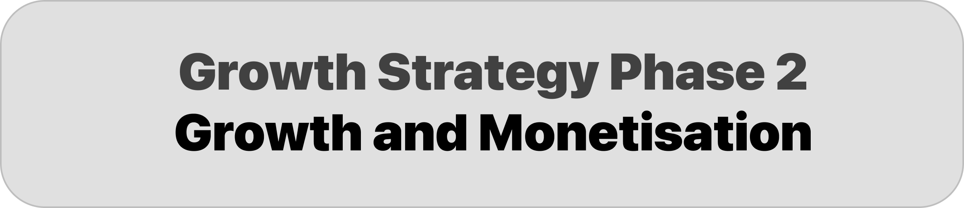

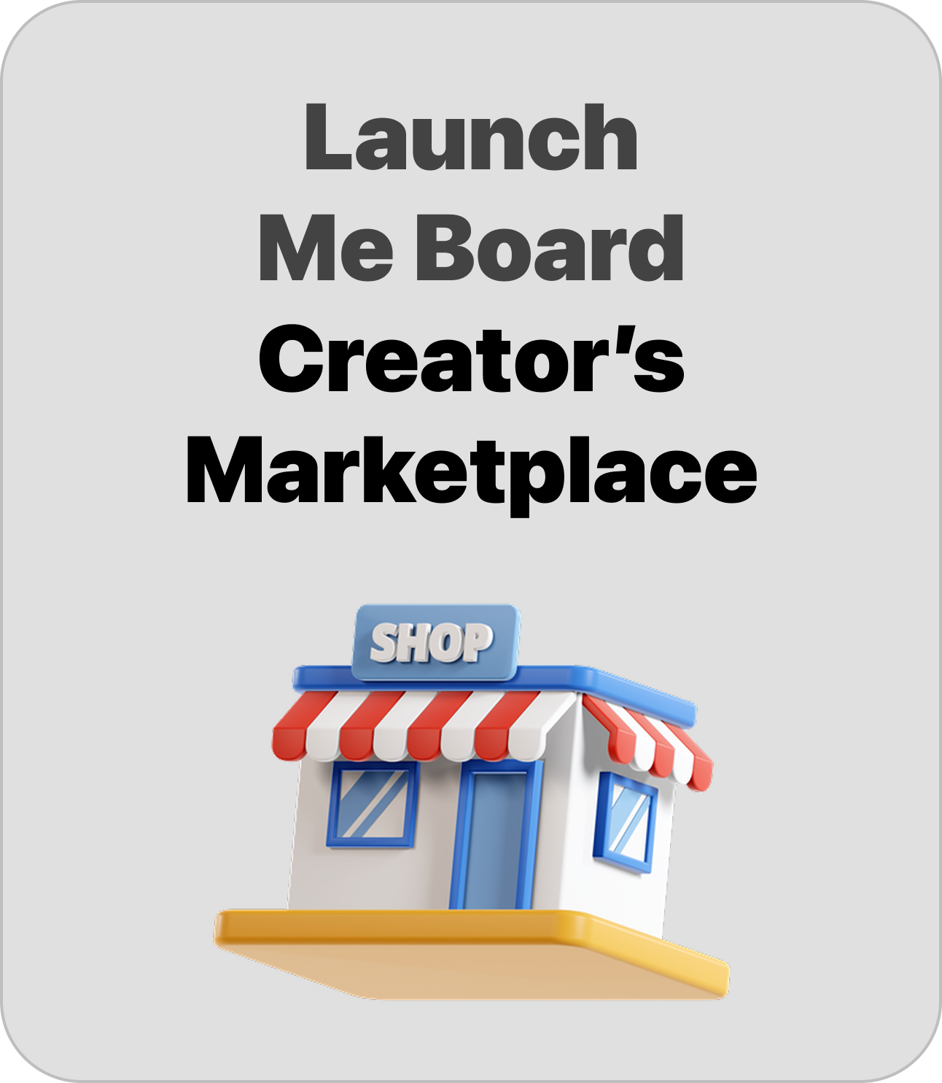

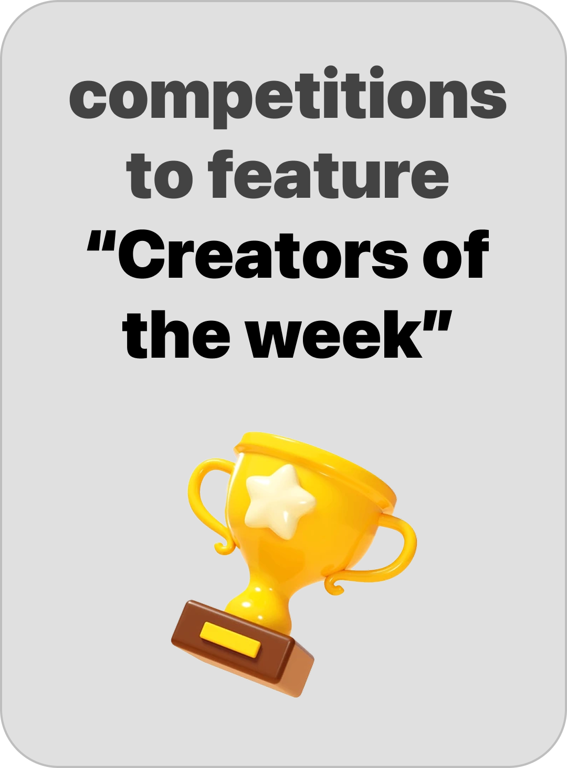
Target Audience

Slide 8

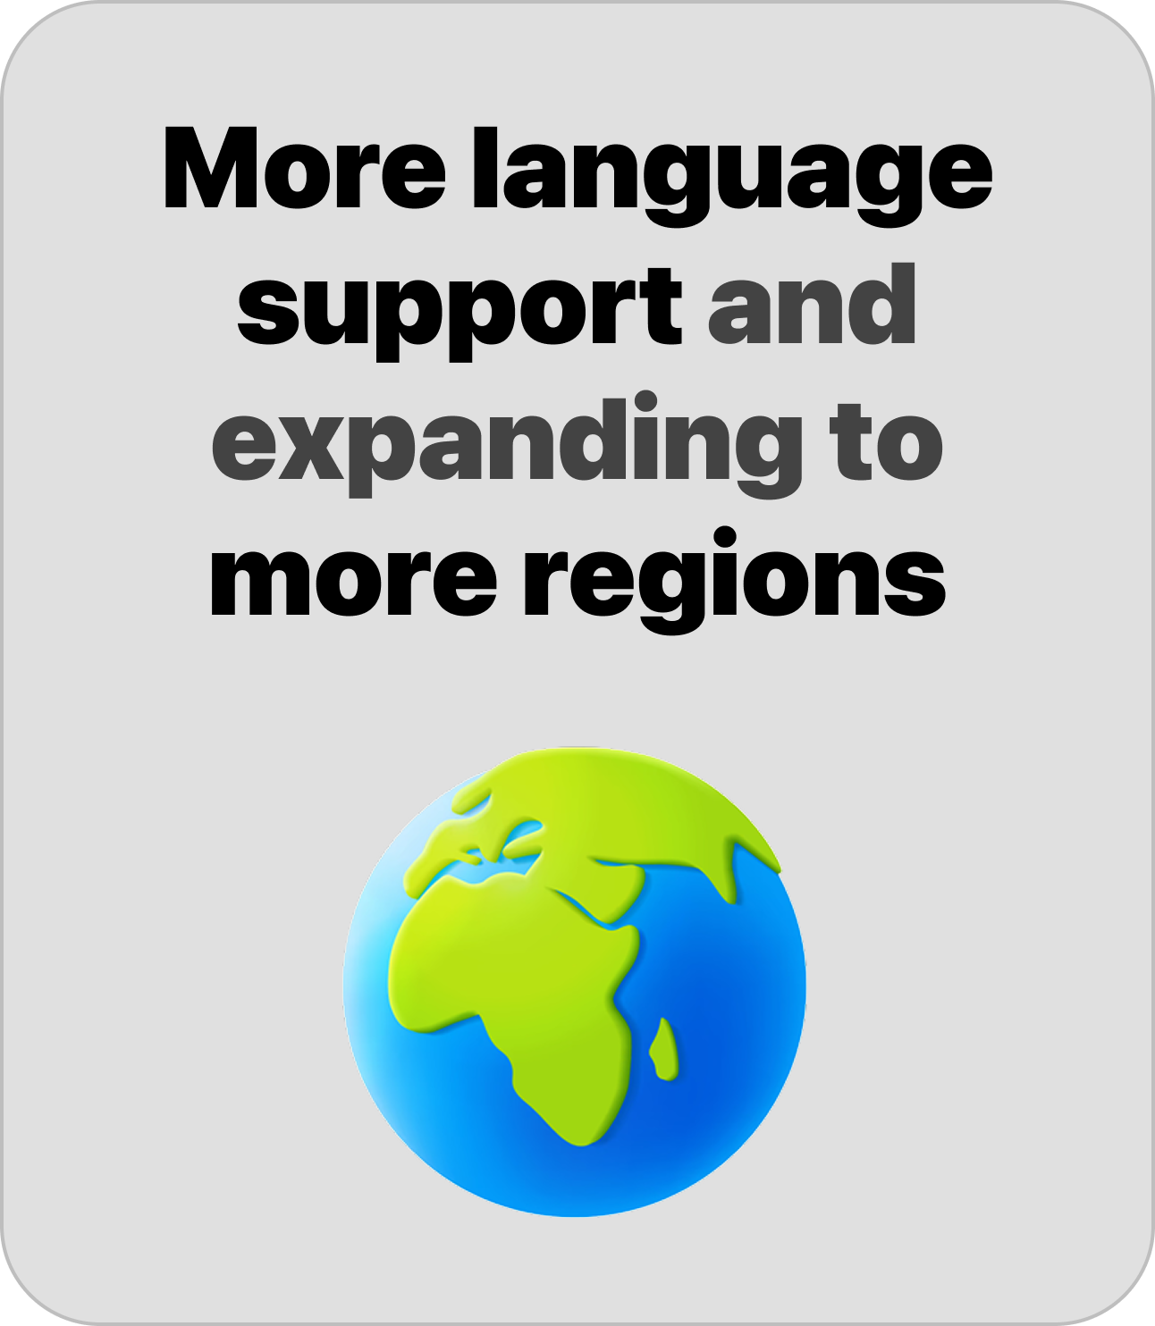
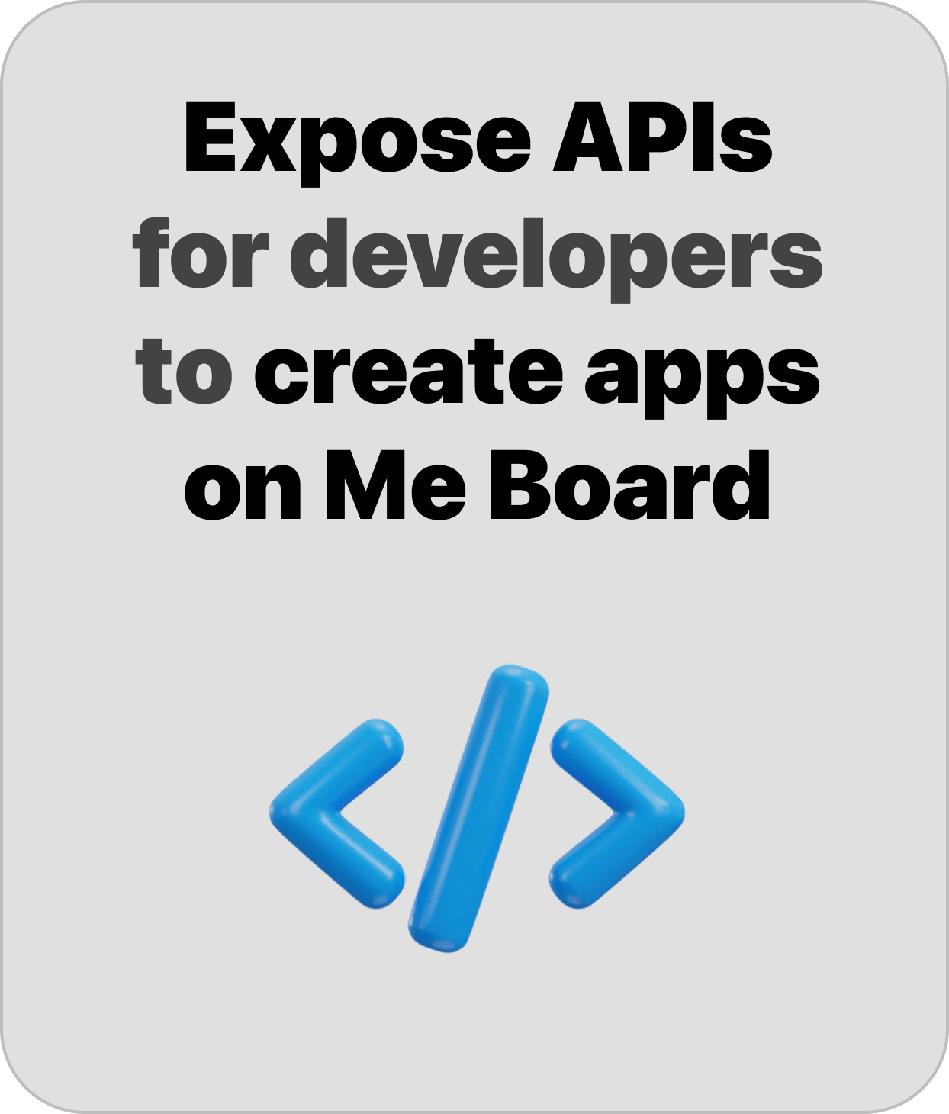
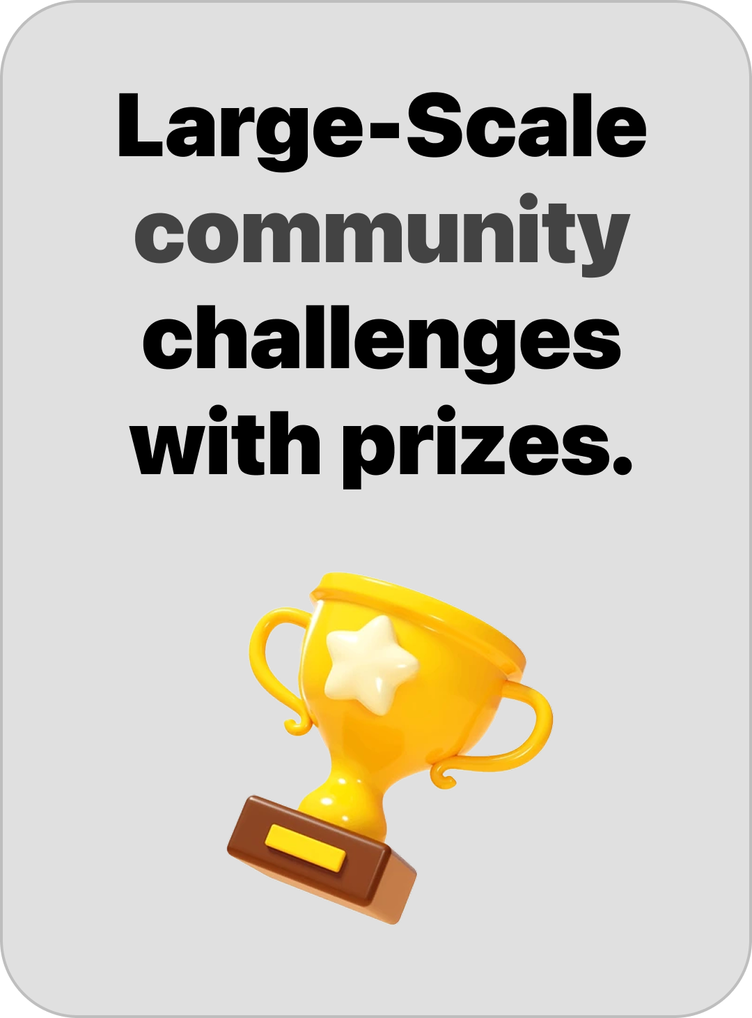

Slide 9

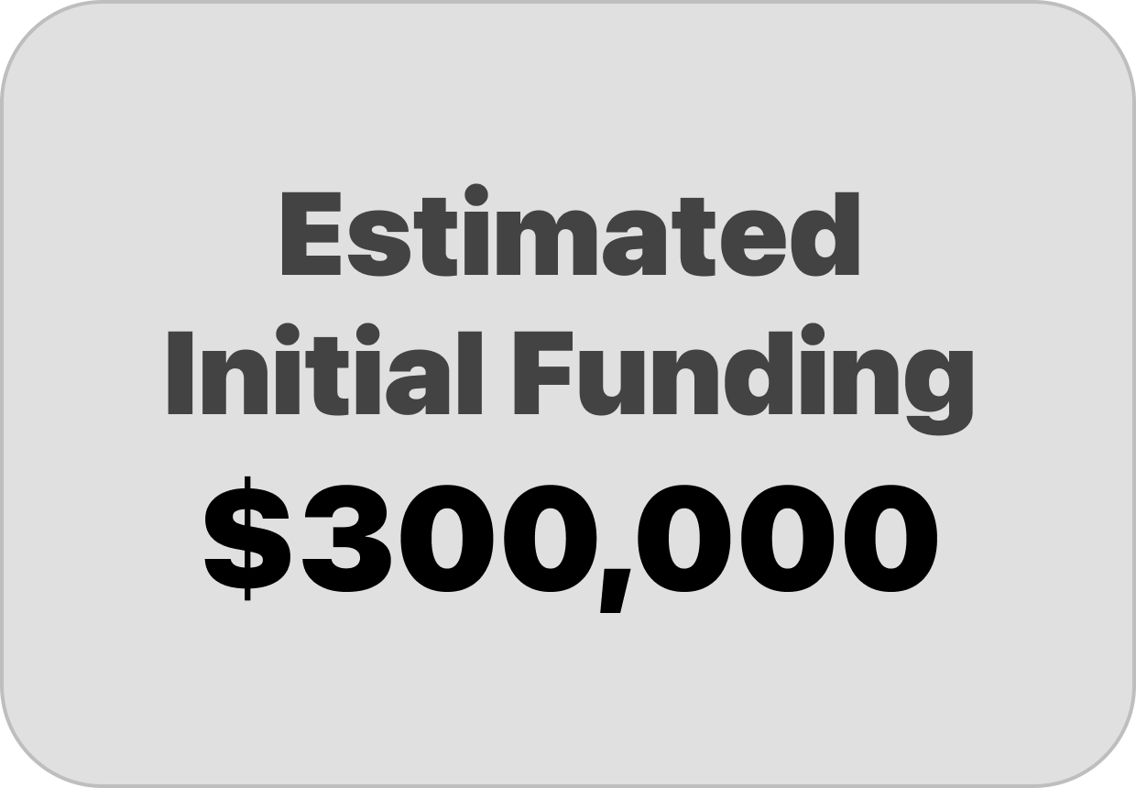
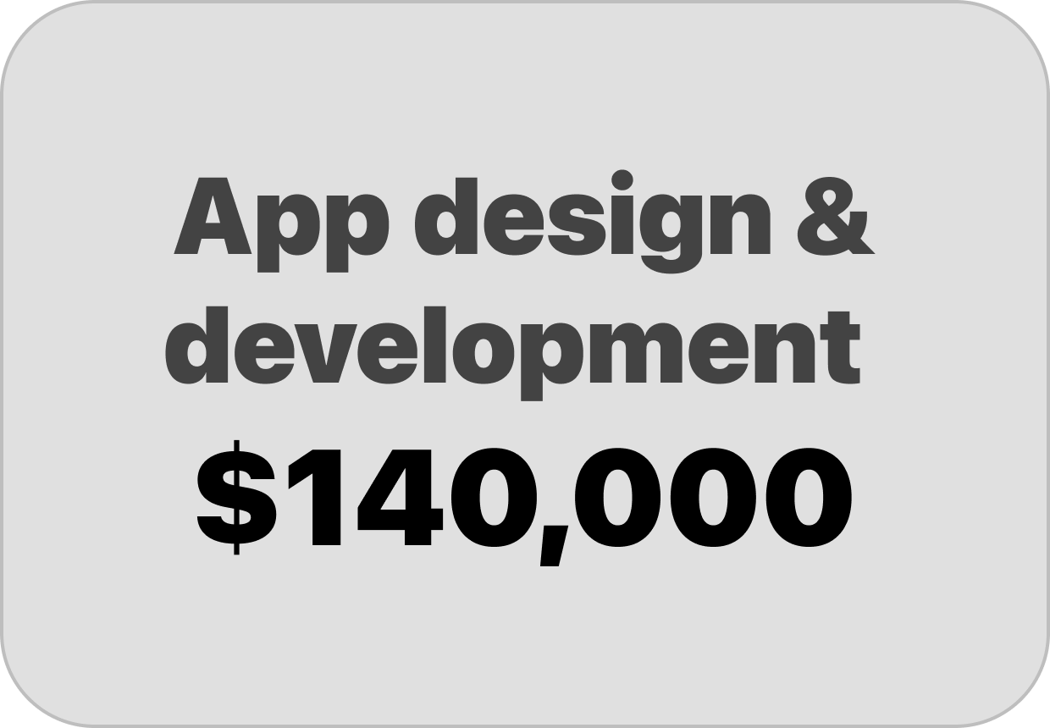



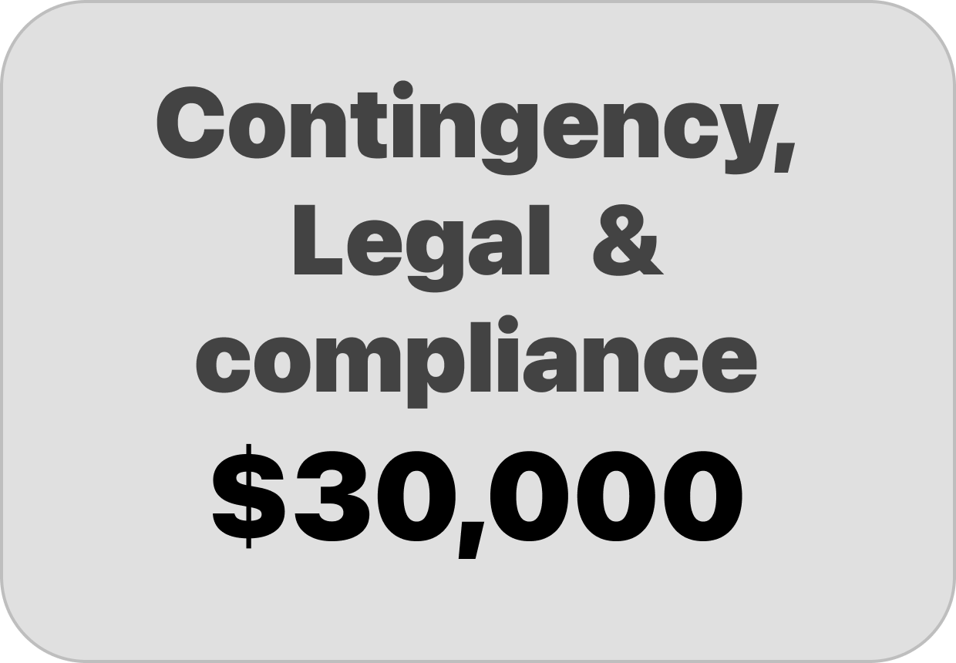

Slide 10
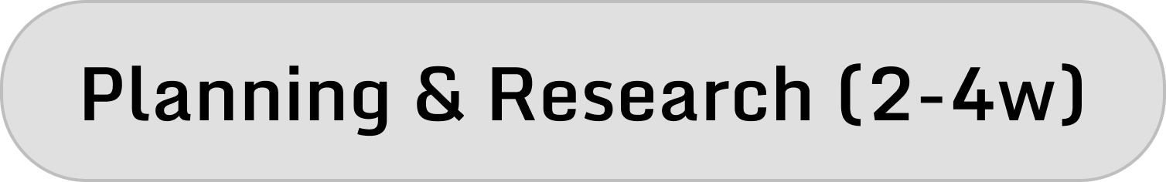




Time

Slide 11
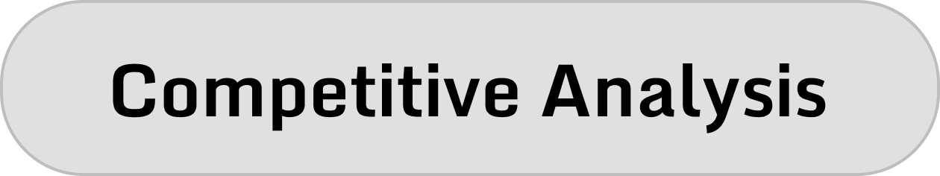
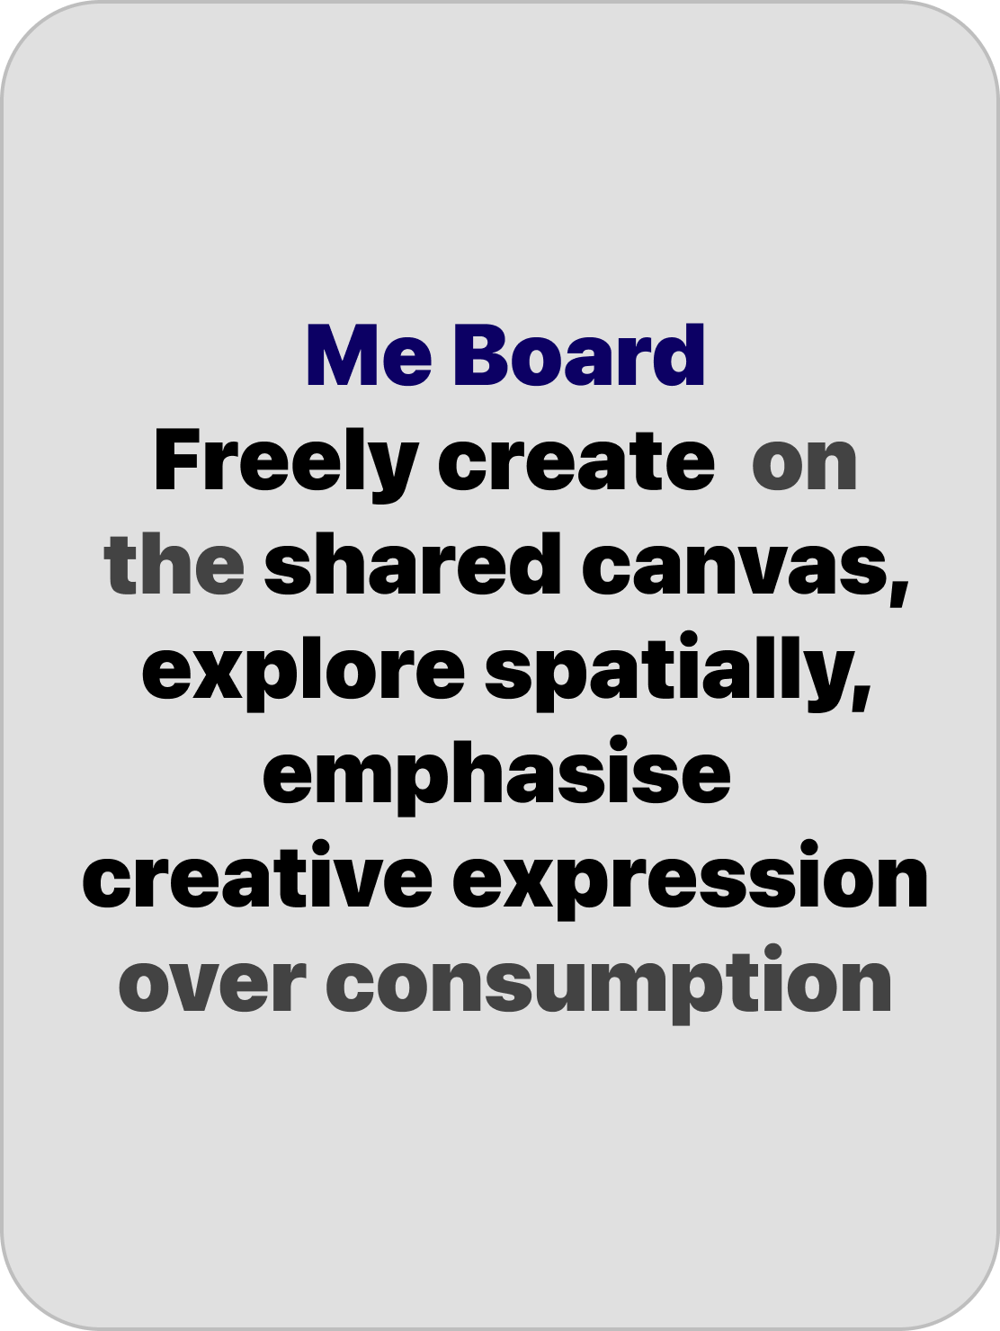


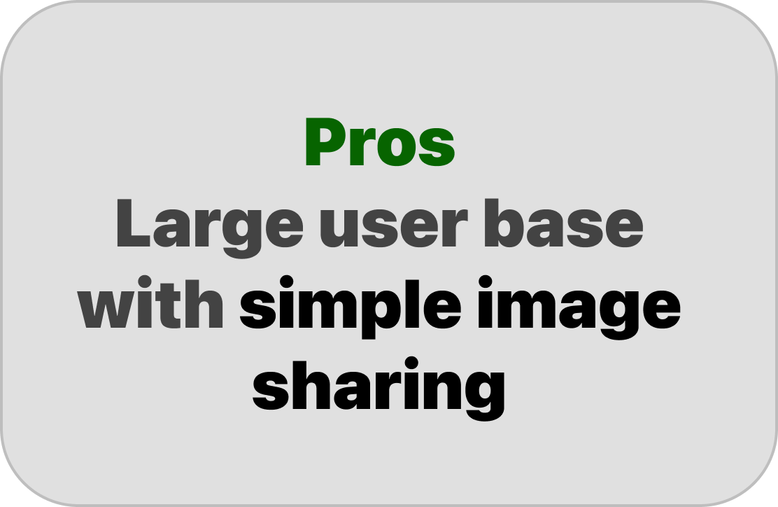
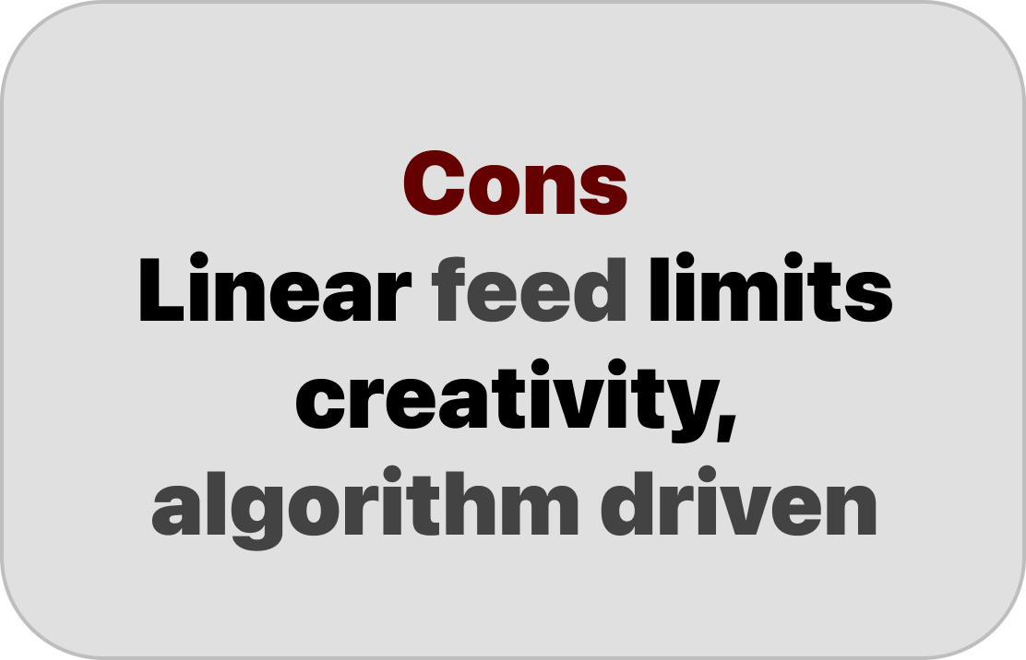
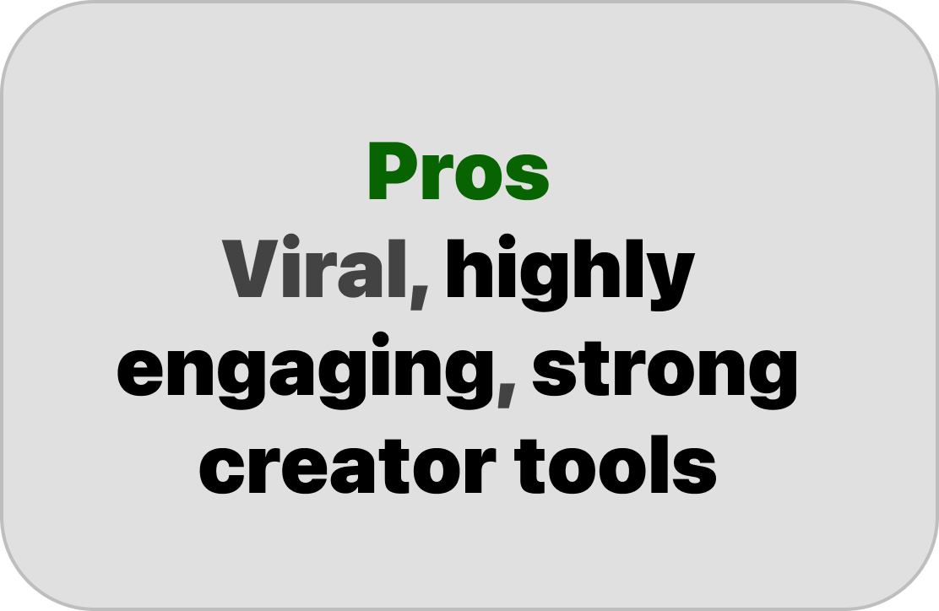
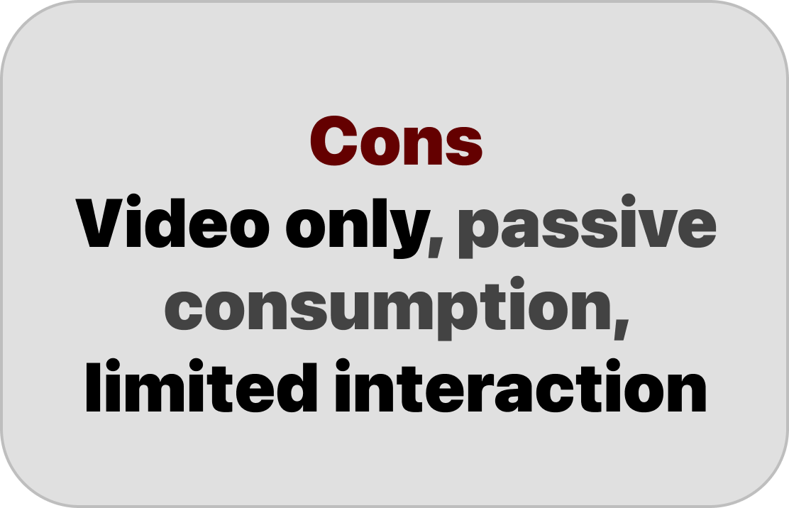
Time

Slide 12
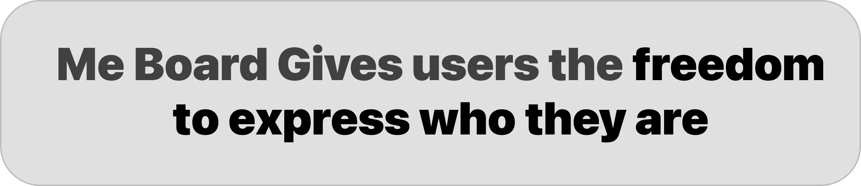
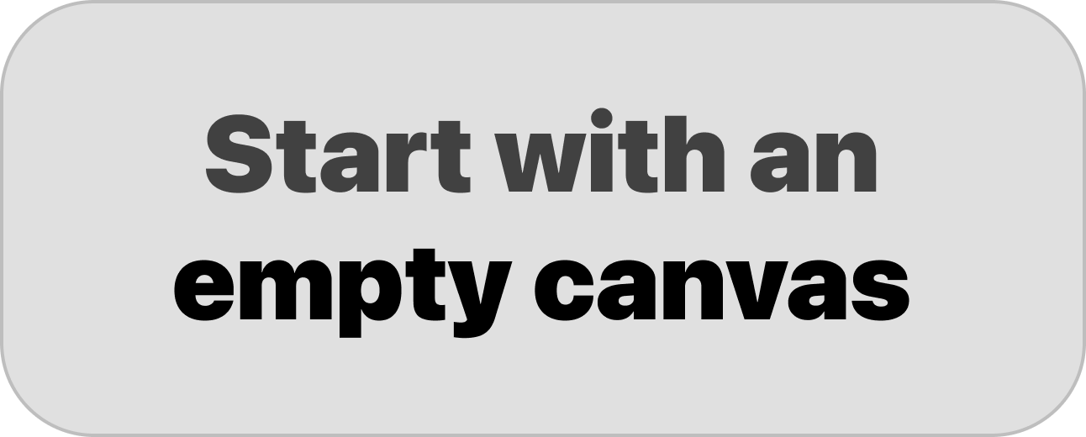
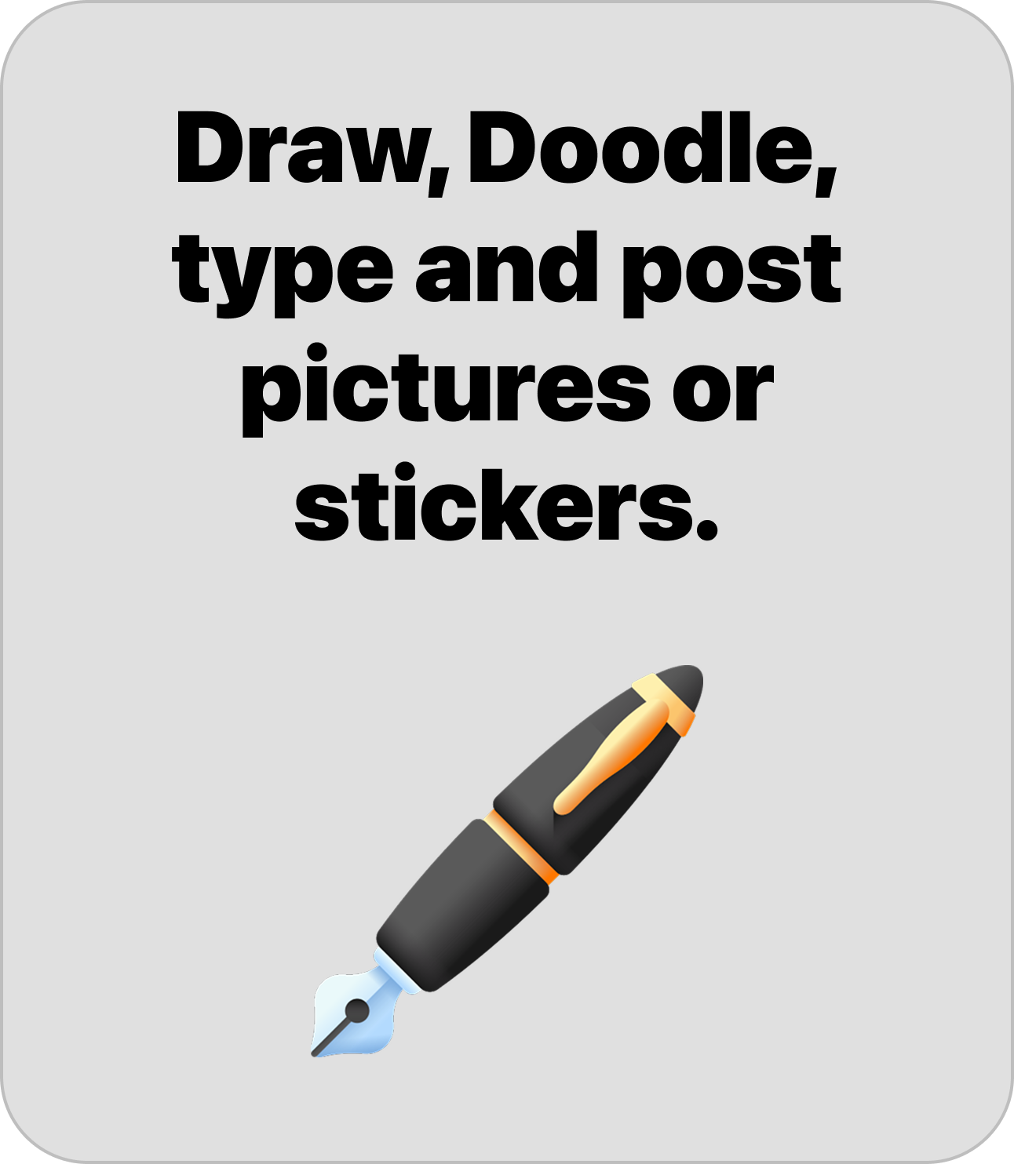
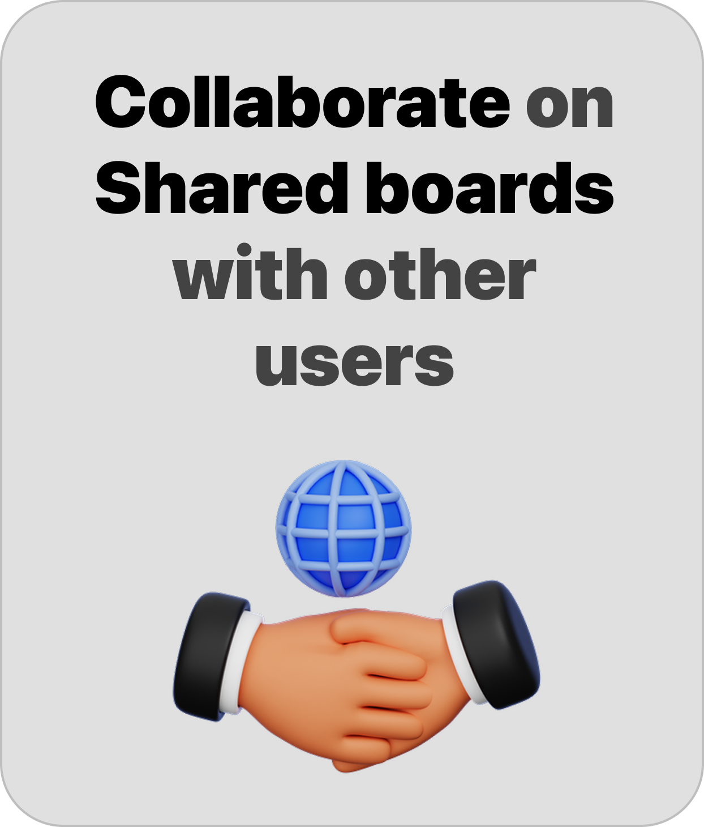
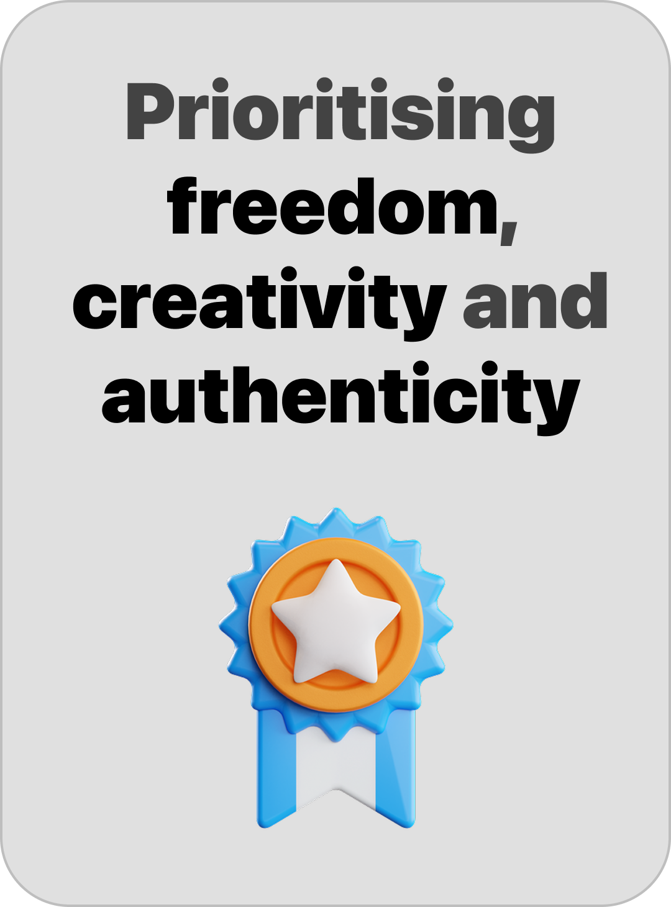
Time

Slide 13
Thank You

Slide 14
Competitive analysis
Twitter(x) / Reddit:
Pros: Community discussion, trending topics
Cons: text heavy, static threads, low visual interactivity
Me Board: focus on visual creativity, play discovery, realtime interaction. Users co create a dynamic world rather than posting in isolated threads
Me Board’s Advantages:
Creative freedom
Collaborative and social
Exploratory discovery
Multi-format content
community-driven

Slide 15
Demo

