Slide 1
Chapter 2: Operating-System Structures

Slide 2

Operating System Design:
Layered Approach
A common approach to design is to make it hierarchical
  user at one extreme, hardware at the other
A theoretical construct, but useful

Slide 3
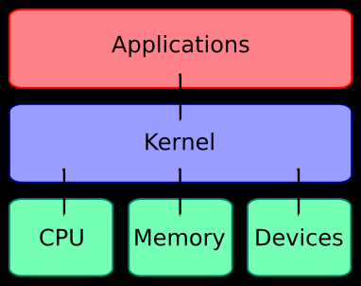
A Historical Perspective
Most early operating systems
  Monolithic kernel
    All drivers (sometimes all possible drivers)
    All ISRs
    All process management routines
    All concurrency control
  In short, everything that might need all loaded when OS is loaded

Slide 4
Modules
Most modern operating systems have evolved into the use of kernel modules
  Uses object-oriented approach
  Each core component is separate
  Each talks to the others over known interfaces
  Each is loadable as needed within the kernel
Overall, similar to layers but with more flexible
Load only what is needed when it is needed
All loaded into kernel space
Application
Kernel
Modules

Slide 5


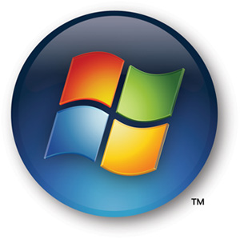
Examples of Kernels with Modules
Unix
Linux
Windows

Slide 6
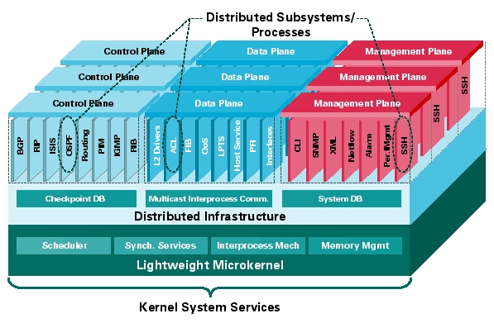
Microkernel System Structure
Recent trend: downsizing
Make the kernel as small as possible
Moves as much from the kernel into “user” space
Communication takes place between user modules using message passing

Slide 7
Benefits:
Easier to extend a microkernel
Easier to port the operating system to new architectures
More reliable (less code is running in kernel mode)
More secure

Slide 8
Detriments:
Performance overhead of user space to kernel space communication

Slide 9
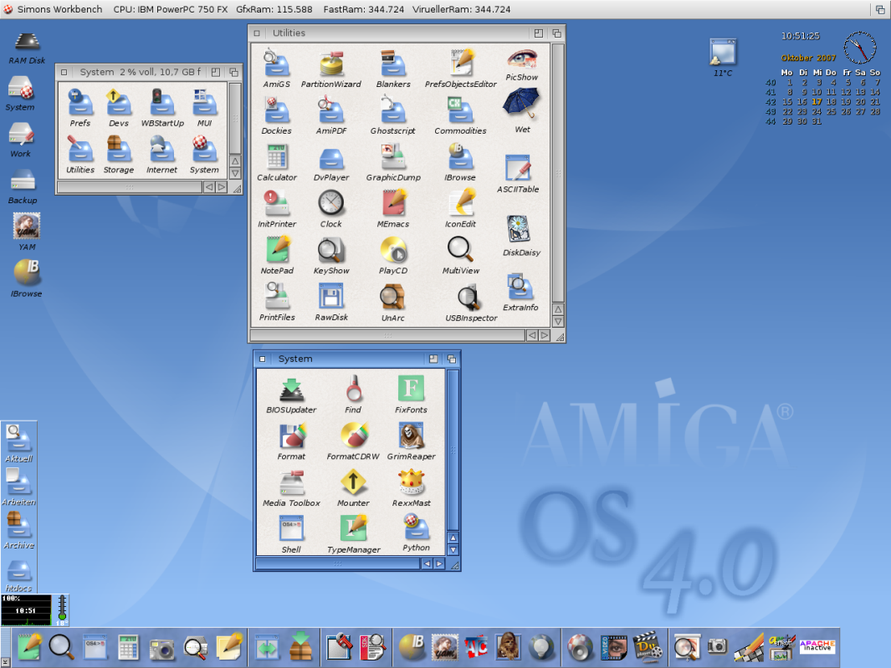
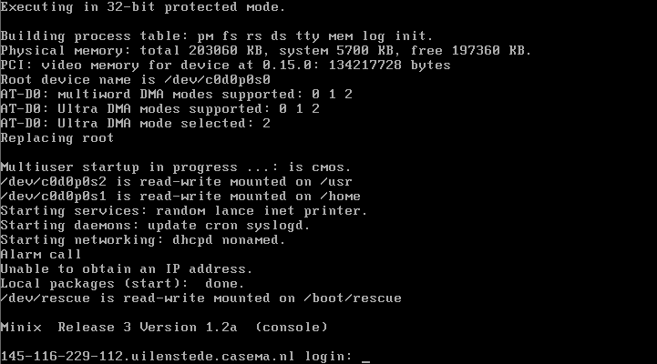
Examples of Microkernel OSs
AmigaOS
Minix

Slide 10

Mac OS X is a hybrid
Mach is a microkernel
  Scheduling
  Memory management
  IPC
BSD Unix handles
  file system
  command line
  Networking

Slide 11

Virtual Machines
A virtual machine takes the layered approach to its logical conclusion. It treats hardware and the operating system kernel as though they were all hardware
A virtual machine provides an interface identical to the underlying bare hardware
The operating system creates the illusion of multiple processes, each executing on its own processor with its own (virtual) memory

Slide 12

Advantages
Backups are easy
  Shutdown the guest operating system
  Backup the image file
Hardware upgrades are easy
  Install new system
  Install Virtual Machine software
  Copy the image over
Great for R & D
  Can experiment in a safe environment
Good protection

Slide 13

Disadvantages
The virtual machine concept is difficult to implement due to the effort required to provide an exact duplicate to the underlying machine
Won’t necessarily have complete support for ancillary devices
  Example: To support some of the cooler Vista graphics must support Aero (translucent windows, etc.)
Slower

Slide 14

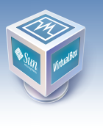
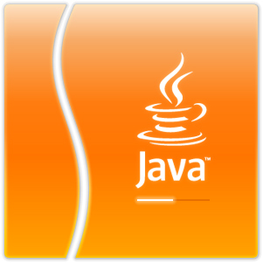
Examples
VMWare
Sun’s VirtualBox
Sun’s Java Virtual Machine
  Not really an entire OS
  But… platform independent code

Slide 15
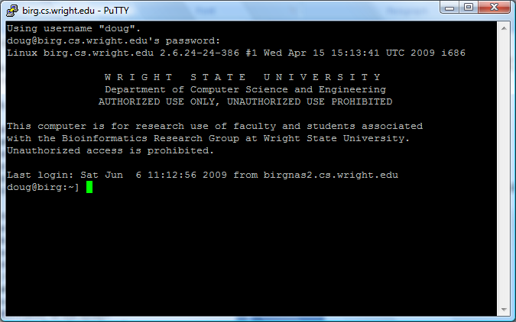
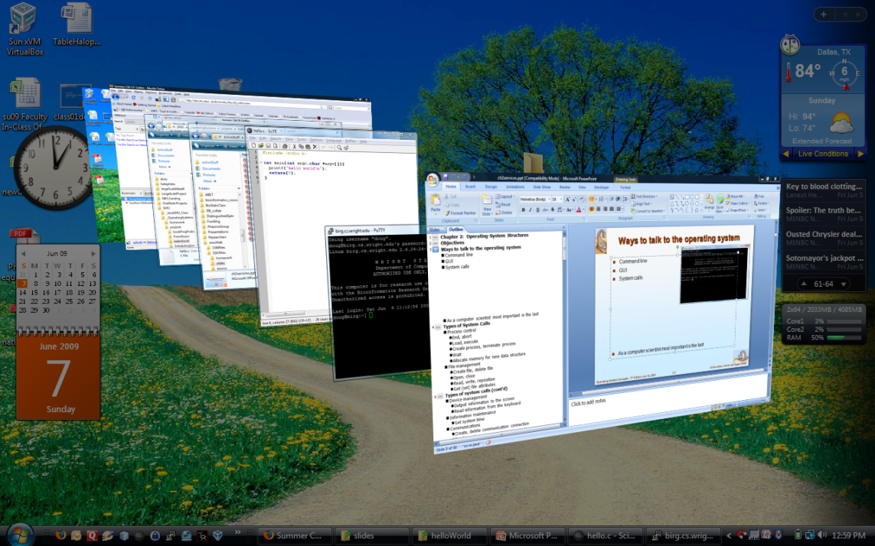
Ways to talk to the operating system
Regardless of architecture
  Command line
  GUI
  System calls
As a computer scientist most important is the last
  First two are actually instances of the last

Slide 16
(6) Types of System Calls
Process A
Launch new process
Process control
  End, abort
  Load, execute
  Create process, terminate process
  Wait
  Allocate memory for new data structure
File management
  Create file, delete file
  Open, close
  Read, write, reposition
  Get (set) file attributes
Process B
Process
Open File

Slide 17
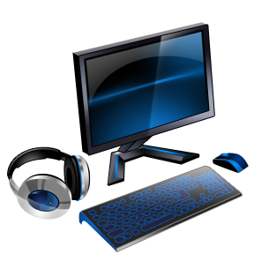

(6) Types of system calls (cont’d)
Device management
  Output information to the screen
  Read information from the keyboard
Information maintenance
  Get system time
Communications
  Create, delete communication connection
  Send, receive messages
Protection
  Memory boundaries
  File system permissions

Slide 18

System Calls
Application Program Interface (API)
  #include <stdio.h>
  printf("hello world\n");
Actual implementation is embedded in the kernel
  Similar to an interrupt service routine
    Typically, a number associated with each system call
    System-call interface maintains a table indexed according to these numbers

Slide 19
Examples of system calls
Win32 API for Windows
POSIX API for POSIX-based systems (including virtually all versions of UNIX, Linux, and Mac OS X)
Type | Windows | Unix
Process Control | CreateProcess() ExitProcess() | fork() exit()
File Manipulation | CreateFile() | open()
Communication | CreatePipe() | pipe()

Slide 20
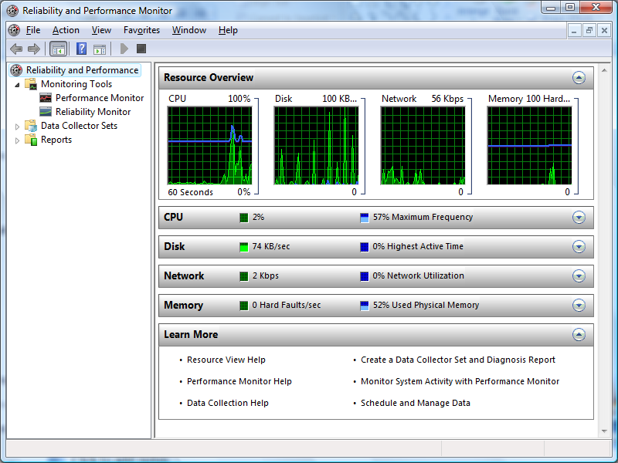
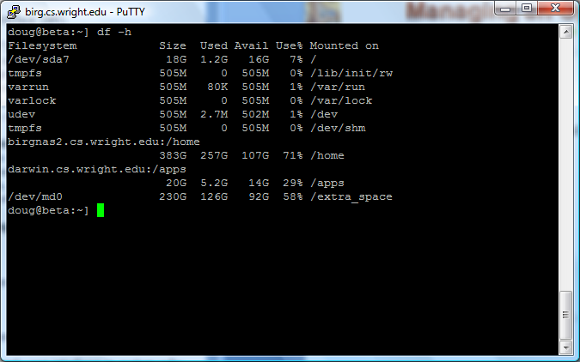
Interacting with an Operating System but not as a programmer
i.e. CLI or GUI
File management
Get Status of system
  How busy
  How much disk space available

Slide 21
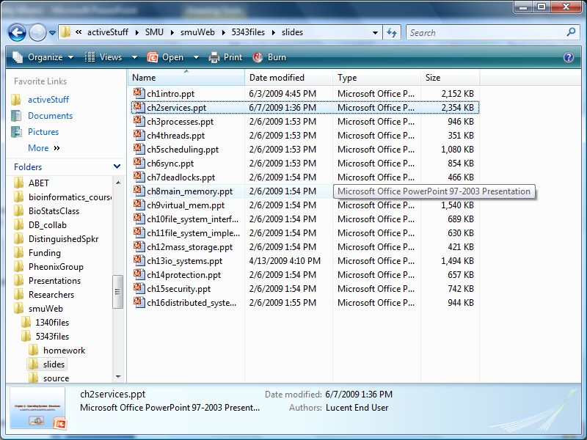
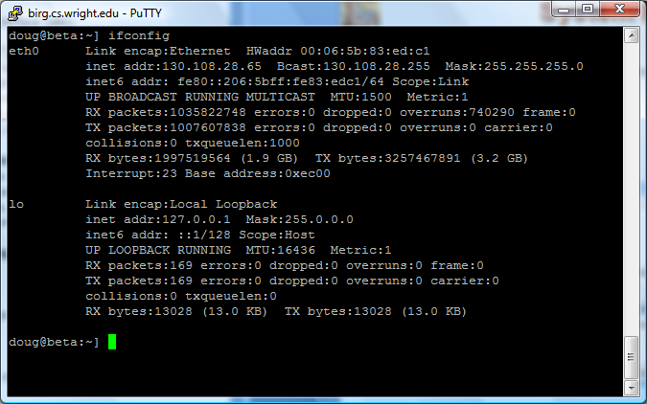
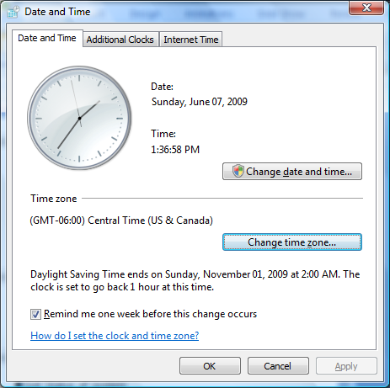
System Programs
Collection of programs useful in managing/interfacing with the system

Slide 22
End of Chapter 2

