Slide 1
Chapter 8: Main Memory

Slide 2
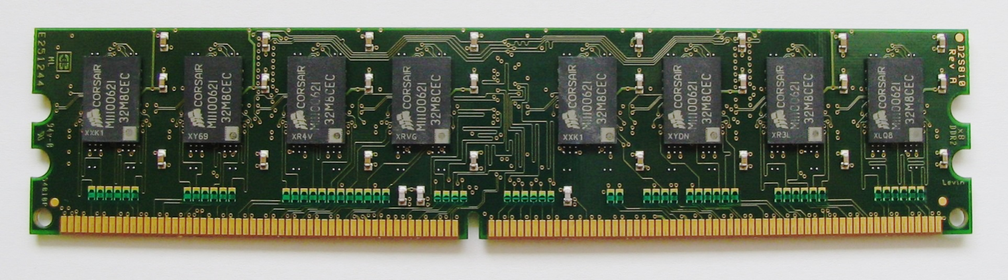
Memory and Addressing
It all starts with addressing
Each method and variable must be associated with a physical address
But…
  Dynamic allocation (heap) of means data can be anywhere
  A process doesn’t know where it will be in memory
Address binding is the process of associating actual memory addresses with the locations of instructions and data

Slide 3
Binding of Instructions and Data to Memory
Address binding of instructions and data to memory addresses can happen at three different stages
  Compile time: must know exact location, a priori
  Load time: relative addressing
  Execution time: DLL’s, Shared Libraries
Relative addressing can help with some of the issues
Address
Instruction/Data

Slide 4

Logical Addressing
All process addresses begin at zero: known as logical (or virtual) addresses
Must be mapped to physical address
Requires hardware support: Memory Management Unit (MMU)
  Value in the relocation register is added to every address

Slide 5
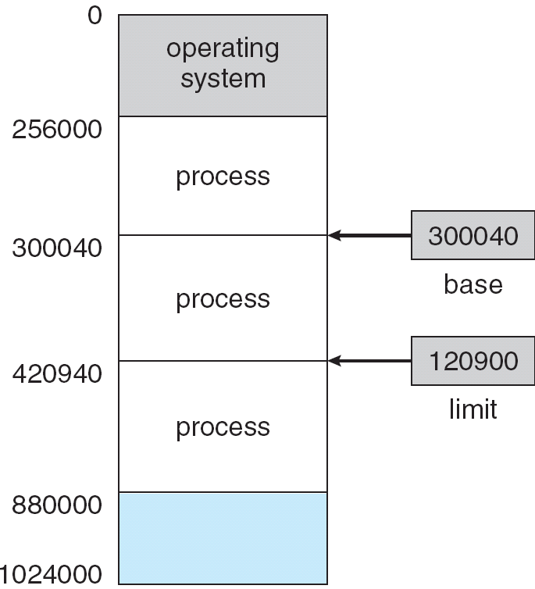

Base and Limit Registers
OS must protect itself (and the system)
A pair of base and limit registers define the logical address space
Compares every memory access address
Note the term register: hardware

Slide 6

Evolution of Operating Systems
As processing requirements grew, not all processes could fit in memory
First fix: Swapping
Backing store – holds memory images

Slide 7
Issues
Contiguous allocation can lead to fragmentation
  Hole – block of available memory; holes of various size are scattered throughout memory
  When a process arrives, it is allocated memory from a hole large enough to accommodate it
  Operating system maintains information about:
  a) allocated partitions b) free partitions (hole)
OS
OS
OS
OS
process 5
process 5
process 5
process 5
process 9
process 9
process 8
process 10
process 2
process 2
process 2
process 2

Slide 8
Dynamic Storage-Allocation Problem
How to satisfy a request of size n from a list of free holes
First-fit: Allocate the first hole that is big enough
Best-fit: Allocate the smallest hole that is big enough; must search entire list, unless ordered by size
  Produces the smallest leftover hole
Worst-fit: Allocate the largest hole; must also search entire list
  Produces the largest leftover hole
First-fit and best-fit better than worst-fit in terms of speed and storage utilization

Slide 9
Two Flavors of Fragmentation
External Fragmentation – total memory space exists to satisfy a request, but it is not contiguous
Internal Fragmentation – allocated memory in binary increments 16, 32, 64, 128, etc.
  May be slightly larger than requested memory; this size difference is memory internal to a partition, but not being used
Fragmentation

Slide 10
Possible Solution
Reduce external fragmentation by compaction (defrag)
  Shuffle memory contents to place all free memory together in one large block
  Compaction is possible only if addressing is dynamic, and is done at execution time
Issues
    Takes away cycles from normal OS duties
    Must Latch job in memory while executing
Compaction

Slide 11

Another Solution: Paging
Instead of loading entire process into a large enough hole
  Bust up the program into uniformly sized chunks (pages)
  Load the pages into memory where ever there is space
No fragmentation, but…
  Need a lookup table (page table) to know where the pages are

Slide 12
Address Translation Scheme
Address generated by CPU is divided into:
  Page number (p) – used as an index into a page table which contains base address of each page in physical memory
  Page offset (d) – combined with base address to define the physical memory address that is sent to the memory unit
  For given logical address space 2^{m} and page size 2^{n}
    m-n bits used to ID page
2^{m}
Logical Memory Address
m bits in length
2^{n}
page number
page offset
Logical Memory
p
d
m - n
n

Slide 13

Paging Hardware
Hardware is very good at this kind of thing
Translation from “page” to “frame”
  Page: in logical space
  Frame: in physical space

Slide 14
Implementation of Page Table
Page table is kept in main memory
Page-table base register (PTBR) points to the page table
Page-table length register (PTLR) indicates size of the page table
Every data/instruction access requires two memory accesses.
Page Table
PTBR
size
PTLR

Slide 15

Attacking the two memory-access problem
Fast-lookup hardware cache called associative memory or translation look-aside buffers (TLBs)

Slide 16
Effective Access Time
Hit ratio – percentage of times that a page number is found in the associative registers; ratio related to number of associative registers
Hit ratio = α
Effective Access Time (EAT)
EAT =percentage of time data found in TLB *
(time to access TLB and Memory) +
percentage of time data not found in TLB *
(access TLB and memory twice)
=α (T_{TLB}+T_{M}) +(1- α)(T_{TLB}+T_{M}+T_{M})
= αT_{TLB} + αT_{M} + T_{TLB} + 2T_{M} - αT_{TLB} - 2αTM
= -αT_{M} + T_{TLB} + 2T_{M}
=2T_{M} - αT_{M} + T_{TLB}
So, if hit ratio near 100% EAT approaches T_{M} + T_{TLB}

Slide 17
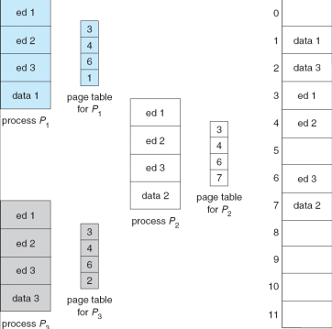
Implications
Each process has own page table
TLB’s get flushed each context switch
  Unless support: address-space identifiers (ASIDs)
Some systems allow shared code

Slide 18



Some variations
Hierarchical Paging
Hashed Page Tables
Inverted Page Tables

Slide 19

Hierarchical Page Tables
Page tables can be quite large
  Break up the page table into pages and have a top-level page table that points to each of the pages

Slide 20
Two-Level Paging Example
A logical address (on 32-bit machine with 1K page size) is divided into:
  a page offset consisting of 10 bits (2¹⁰ = 1k)
  a page number consisting of 22 bits (10+22 = 32)
Since the page table is paged, the page number is further divided into:
  a 12-bit page number (2¹² or 4K space, each entry points to page)
  a 10-bit page offset (once again, page size 1K)
Thus, a logical address is as follows:
where p_{i} is an index into the outer page table, and p₂ is the displacement within the page of the outer page table
page number
page offset
p_{i}
p₂
d
12
10
10

Slide 21
Address-Translation Scheme
p₁ is an index into the top page table
  That entry points to the next level page table
p₂ is an index into that table where the frame location is found
D is the index into the frame
  Actual instruction or word of data being addressed

Slide 22


Could have more levels

Slide 23
Hashed Page Tables
Common in address spaces > 32 bits
Rather than two or more page table reads as in hierarchical
Hash into the page table instead of index
  Only slightly slower, and might get lucky

Slide 24

Inverted Page Table
One entry for each real page of memory
Use hash table to limit the search to one — or at most a few — page-table entries
Hash
Notes:
The entire virtual address space of each process is described in an auxiliary structure, typically a B*-tree, that can efficiently store contiguous, sparse, or large address space descriptions. This auxiliary structure may itself be paged to avoid permanently consuming physical memory⁽¹⁾ resources.
http://www.memorymanagement.org/glossary/i.html#inverted.page.table
The Lisp Machine was an early workstation that used an inverted page table with hardware lookup. The Alpha, UltraSPARC®, and PowerPCTM architectures all include inverted page tables. Some implementations of these architectures have hardware-assisted lookup.

Slide 25

Segmentation
Paging is not the only way to slice up a process
Segmentation:
  Break up into logical units

Slide 26
Logical View of Segmentation
1
1
4
2
3
4
2
3
user space
physical memory space

Slide 27
Segmentation Architecture
Similar to paging
  Segment table
  Segment-table base register (STBR)
  Segment-table length register (STLR)
Fragmentation an issue again
1
1
4
2
3
4
2
3
user space
physical memory space

Slide 28
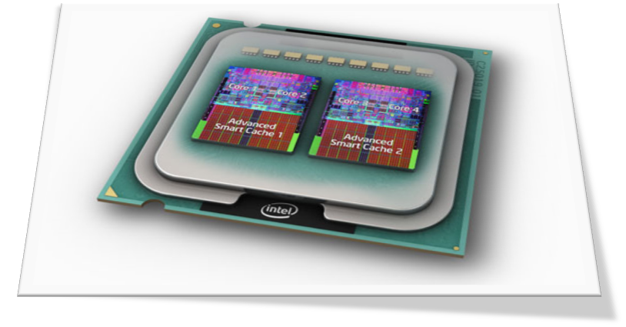
Example: The Intel Pentium
Supports both segmentation and segmentation with paging
Segments that are paged

Slide 29
End of Chapter 8

