Slide 1
Chapter 9: Virtual Memory

Slide 2
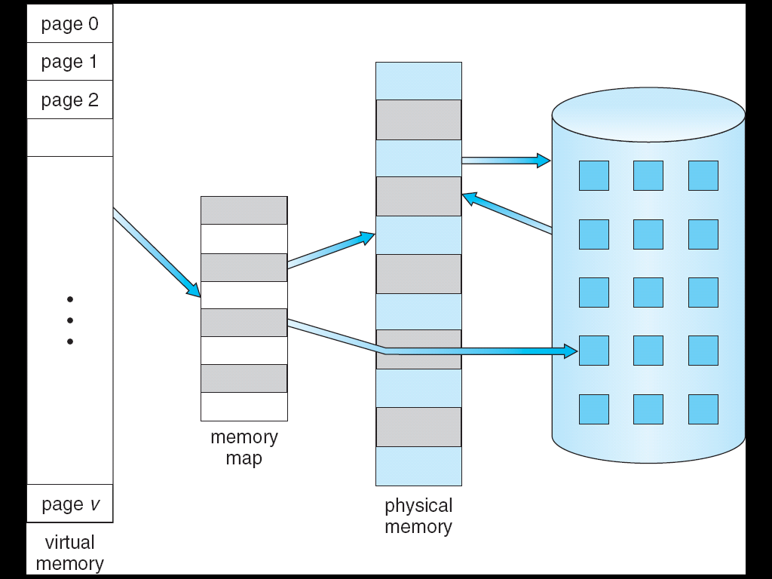
Virtual Memory
Can be implemented via:
  Demand paging
  Demand segmentation temp

Slide 3
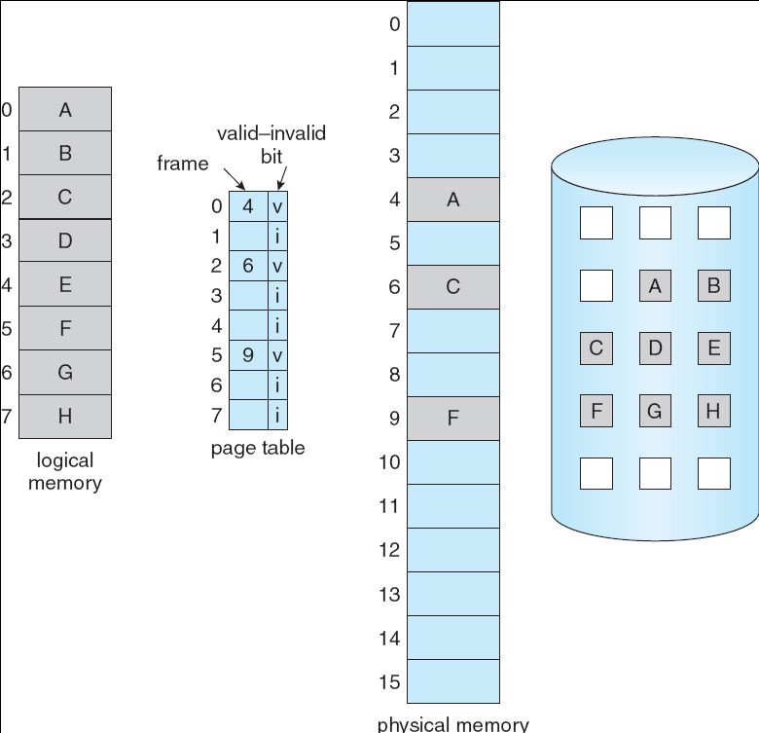
Demand Paging
Bring a page into memory only when it is needed
Page table used for tracking which pages are in memory
Page fault if not in memory
  Get empty frame
  Swap page into frame
  Reset tables
  Set validation bit = v
  Restart the instruction that caused the page fault

Slide 4
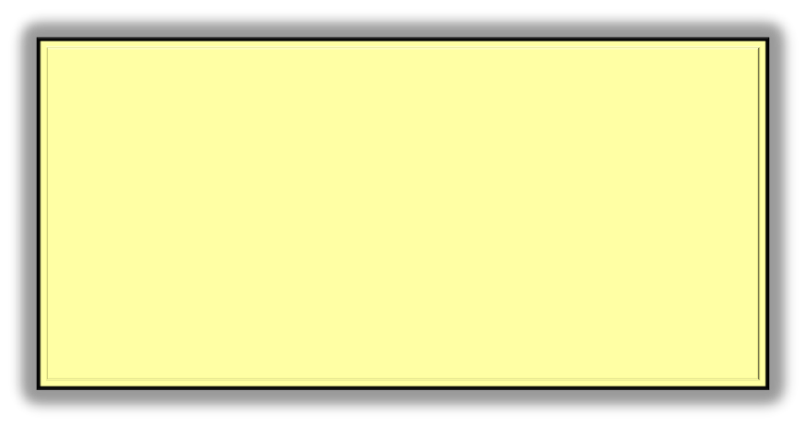
Performance of Demand Paging
Page Fault Rate p
Overhead: two context switches
  switch to a different process while waiting for page to come in
Effective Access Time (EAT)
EAT = (1 – p) x memory access time
+ p (page fault overhead
+ write page out
+ read page in
+ restart overhead
)

Slide 5
Demand Paging Example
Memory access time = 200 nanoseconds
Average page-fault service time = 8 milliseconds
EAT = (1 – p) x 200 + p (8 milliseconds)
= (1 – p x 200 + p x 8,000,000
= 200 + p x 7,999,800
If one access out of 1,000 causes a page fault, then
EAT = 8.2 microseconds.
This is a slowdown by a factor of 40!!

Slide 6
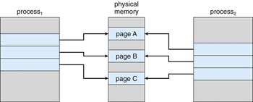
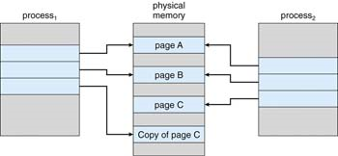
Process Creation
Virtual memory allows other benefits during process creation:
  ProcessCreate or fork
    Copy-on-Write

Slide 7

What if make a change to Frame
Remember Frame = page in memory
If change data in frame, should it be written immediately to the backing store?
Instead keep track
  Then when not busy…
  Or if need some space and must replace it…

Slide 8

Which pages are in memory?
Which to replace?
Which page to replace

Slide 9

Page Replacement Algorithms
Want lowest page-fault rate
Don’t replace a page that will need
Algorithms
  FIFO
  LRU (least recently used)
  LFU (least frequently used)
  MFU (most frequently used)

Slide 10

Performance: FIFO
Can compare by examining a series of page references
In all our examples, the reference string is
7 0 1 2 0 3 0 4 2 3 0 3 2 1 2 0 1 7 0 1
How many hits? Misses?

Slide 11

Optimal Page Replacement
If could see in the future could devise an optimal algorithm
  Replace the page that will not be used for the longest period
  Same string of page references but 11 hits instead of 5

Slide 12
Least Recently Used (LRU) Algorithm
Popular algorithm
Several approaches, two true LRU algorithms, and two approximation
The two true implementations
  Time stamp in page table for each page
    Known as a counter implementation
    Contents of the clock register
  Stack
    Keep list of page references in a stack to determine oldest
Trick is how to implement LRU

Slide 13

Stack
Page number pushed on stack at first reference
When referenced move to top
Replace page at bottom of stack

Slide 14

LRU Performance
12 page faults (FIFO had 15)
Stack implementation
  A little slower managing hits (requires 6 pointers to be changed)
  Faster at picking replacement page (no search)

Slide 15
LRU Approximation Algorithms
Searching clock times or managing stacks: too much overhead
With less overhead can do a fairly good job
  Reference bit
  Second chance (clock) algorithm
True LRU ⇒ too much overhead

Slide 16
Reference bit
When a page is referenced a bit set
Periodically cleared
When searching for a page to replace, target pages that have not been referenced
Order unknown: just know that pages with bit set have been accessed at some point since the last time cleared
Can improve accuracy with more bits
  Periodically shift reference bit into a register
  Gives snapshot of accesses over time
shift
Page Table Entry
Page number ref bit
0 1 0 0 1

Slide 17

Second-Chance (clock) Algorithm
Combination of FIFO and Reference bit
Next victim pointer cycles through pages (FIFO)
If reference bit set, has been referenced, clear bit and move on

Slide 18
LFU/MFU
Keep a counter of the number of references that have been made to each page
  Known as “counting algorithms”
LFU Algorithm: replaces page with smallest count
  Could age by shifting counter bits periodically
MFU Algorithm: based on the argument that the page with the smallest count was probably just brought in and has yet to be used
Frequency of Use

Slide 19
Buffering the Pages
If replacement page has been modified (dirty bit) must write out page before can replace
Some systems make sure there are a number of frames ready for use (a pool) so process can begin using immediately
Targeted page gets written out to backing-store later and then moved to free frame list
Efficiency Issues

Slide 20

Allocation of Frames
Another efficiency issue has to do with how many frames each process should be allocated
  Too many ⇒ wasteful
  Too few ⇒ inefficient lots, of page faults
Page
Page
Page
Page
Page
Page
Page
Page
Page
Page
Page
Page
Page
Page
Page
Page
Page
Page

Slide 21
There is a minimum
The maximum number of frames that an instruction can possibly access
  Example: IBM 370 – 6 pages to handle SS MOVE instruction:
    instruction is 6 bytes, might span 2 pages
    2 pages to handle from
    2 pages to handle to

Slide 22
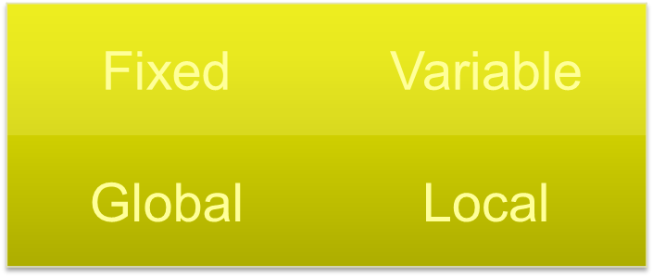
Allocation Algorithms
Fixed (set at start of process) or variable (can change over time)
Global (select replacement from set of all frames) or local (select replacement from own pages)

Slide 23


Fixed Allocation
Equal allocation – For example, if there are 100 frames and 5 processes, give each process 20 frames.
Proportional allocation – Allocate according to the size of process

Slide 24

Global vs. Local Allocation
Global replacement – process selects a replacement frame from the set of all frames; one process can take a frame from another
Local replacement – each process selects from only its own set of allocated frames

Slide 25
Priority Allocation
Fixed/local: use a proportional allocation scheme using priorities rather than size
Variable/Global: If process P_{i} generates a page fault,
  select for replacement one of its frames
  select for replacement a frame from a process with lower priority number
Priority Based: Take frames from lower priority processes

Slide 26
Why Paging Works
Locality model: locality of reference
  References tend to be to memory locations near recent references
What happens when don’t allocate enough to handle locality?
Instruction references
Data references

Slide 27

Thrashing
If a process does not have “enough” pages, the page-fault rate is very high. This leads to:
  low CPU utilization
  operating system thinks that it needs to increase the degree of multiprogramming
  another process added to the system
Thrashing ≡ a process is busy swapping pages in and out

Slide 28

Working-Set Model
Allocation
  Set a process’s number of allocated frames based upon the number of pages referenced over some period of time

Slide 29
Keeping Track of the Working Set
Ways to lower the overhead
  Multiple reference bits with a timer
shift
Page Table Entry
Page number ref bit
0 1 0 0 1

Slide 30

Page-Fault Frequency Scheme
Alternative: measure PFF directly
Establish “acceptable” page-fault rate
  If actual rate too low, process loses frame
  If actual rate too high, process gains frame

Slide 31
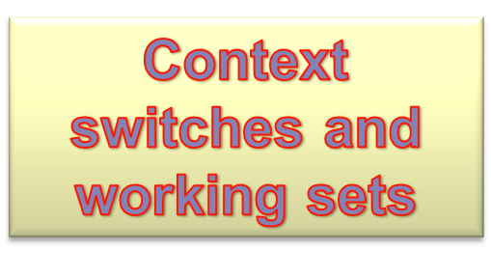
Just a few related topics
Context switches and working sets
Pre-paging
Pages with IO buffers
Allocating kernel memory
Pre-paging
Pages containing IO buffers
Kernel memory

Slide 32
After a context switch
What if some or all of the working set no longer in memory when come off ready Q?
At first page fault request just the faulted page? Or all pages in the working set?
Physical Memory
Working set pages

Slide 33
Pre-paging
Which pages should be brought in for a new process?
Any?
  None is pure demand paging
All?
  Wasteful
Balancing act: must have a scheme for determining how many and which
Physical memory
Pages

Slide 34

Other Issues – I/O interlock
I/O Interlock – Pages must sometimes be locked into memory
Must have a place to put IO data or can get buffer overruns

Slide 35
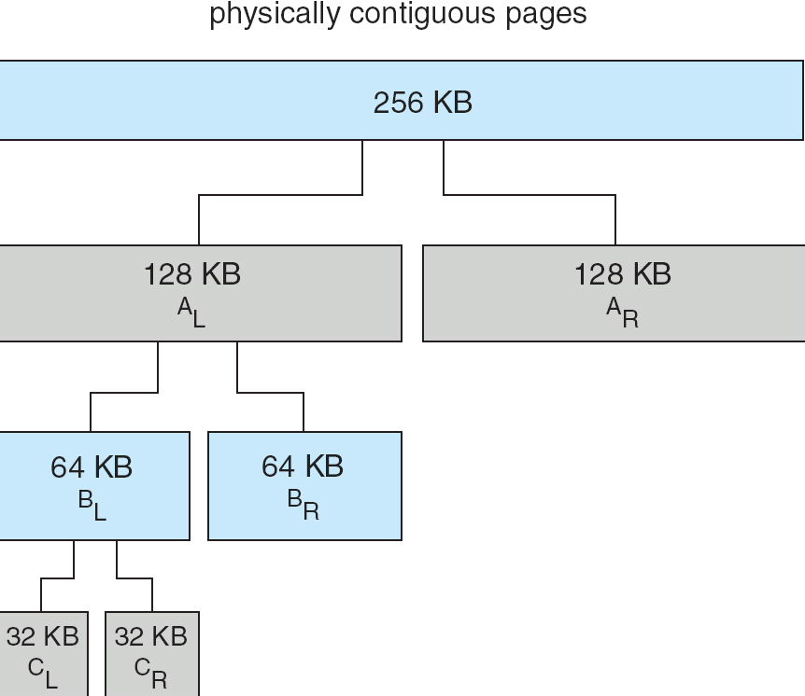
Allocating Memory the Old Way
Before paging how did a process get allocated additional memory
  For instance: when heap and stack grew too close
Kernel still takes this approach
Buddy system: power-of-2 allocator
Allows easy merging and splitting of memory segments

Slide 36
End of Chapter 9

