Slide 1
Chapter 10: File-System Interface

Slide 2
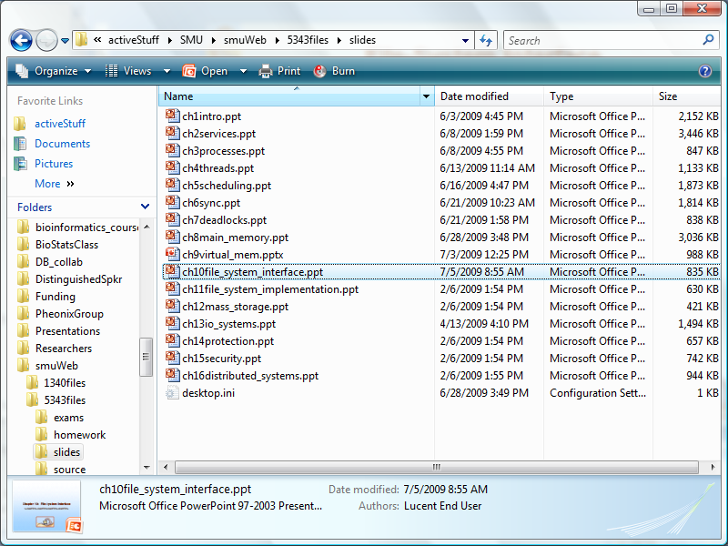
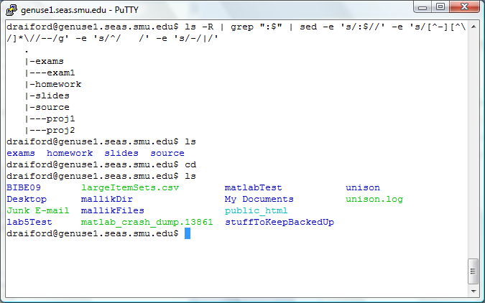
File-System Interface
What do we expect from a file-system?
  Store, access, and organize our data
What do we expect from an interface
  Save data
    Easy to use API
  Organize data
    Easy to use user interface

Slide 3
File Concept
Before we can talk about a File-system…
What is a file?
  Contiguous logical address space
  On storage medium
Types:
  Data
    numeric
    character
    binary
  Program
File:
Data
Program

Slide 4
File Operations
File-system interface must allow operations such as:
  Create
  Write
  Read
  Reposition within file
  Delete
  Truncate
API calls
open()
read()
write()

Slide 5

Open Files
Several pieces of data are needed to manage open files:
  File pointer: pointer to last read/write location, per process that has the file open
  File-open count: counter of number of times a file is open – to allow removal of data from open-file table when last processes closes it
  Disk location of the file: cache of data access information
  Access rights: per-process access mode information
Operating system maintains an open file table

Slide 6
Access Methods
Sequential Access
Direct Access
Sequential
Direct (Random) Access

Slide 7

File Attributes
File-system interface must facilitate maintaining and accessing information about files
  Name – only information kept in human-readable form
  Identifier – unique tag (number) identifies file within file system
  Type – needed for systems that support different types
  Location – pointer to file location on device
  Size – current file size
  Protection – permissions, who read, write, execute
  Time, date, and user identification – data for protection, security, and usage monitoring
Name
Where is this information kept?
File
ID
Size
Permissions

Slide 8
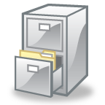

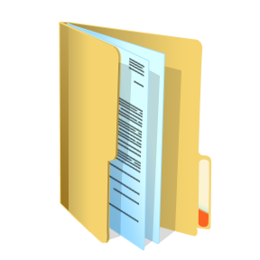
Organize the data
Interface must provide for ability to organize
  Directories

Slide 9

What is a directory?
[dougr@evolution /]$ tree -L 1
.
|-- bin
|-- boot
|-- dev
|-- etc
|-- home
|-- lib
|-- lib64
|-- lost+found
|-- media
|-- misc
|-- mnt
|-- net
|-- opt
|-- proc
|-- root
|-- sbin
|-- selinux
|-- srv
|-- sys
|-- testdir
|-- tftpboot
|-- tmp
|-- usr
`-- var
Reserved space on a disk?
Does it even exist?
  Or is it just an attribute of a file?

Slide 10

What is a directory
File Types
Regular file -
Directory d
Character Device c
Block Device b
Local Domain Socket s
Named Pipe p
Symbolic Link l
Implementation
  Just another file with lists of files and pointers
  Moving a file from one directory to another
    Very fast no matter the size of the file
File name | Type | ID
ch13io_systems.ppt | - | 0xFF3A
ch2services.ppt | - | 0xA23D
ch10file_system_interface.ppt | - | 0x178E
ch11file_system_implementation.ppt | - | 0xADE1

Slide 11
Filetype: directory
System calls
  opendir
  readdir
  rewinddir,
  closedir
struct dirent {
ino_t d_ino; /* inode number */
unsigned char d_type; /* file type */
char d_name[256]; /* filename */
};

Slide 12

Directories
Might have another directory as one of the files in the list
Directory (and the interface into the directory) should support
Searching, creation, deletion, browsing, renaming, traversing

Slide 13
Tree-Structured Directories (Cont)
In Unix and Linux, cd, pwd, ls
In Mac, Windows, X Window: GUI

Slide 14
Sharing data
Symbolic links can point to directories or files that reside elsewhere in a tree
Example:
Tree
|-user1
|---private_data
|---shared_data
|-user2
|---project1
|-----archive
|-----data
|---project2
cd user2
ln -s ../user1/shared_data shared_data
ls
project1 project2 shared_data
cd shared_data
|---shared_data

Slide 15

No longer a tree: a GRAPH
Issues: dangling pointers
Solutions
  Backpointers, so we can delete all pointers
  Variable size records a problem
  Backpointers using a daisy chain organization
  Entry-hold-count solution

Slide 16
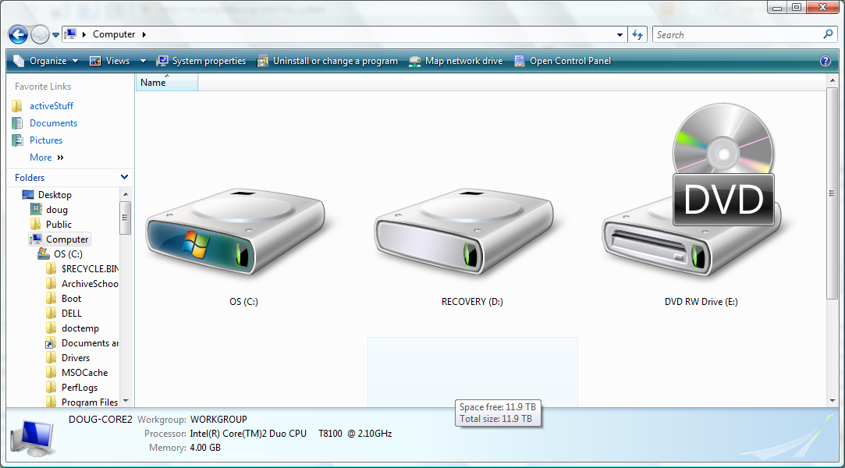
Making a file-system available
In Windows a drive letter is associated with the file-system
In Unix, a file-system is mounted
  All the files on all the devices appear to exist in a single hierarchy
  Create a virtual file system
  Uses a RAM disk as its root directory (directly accessible by kernel)
  File-systems are mounted somewhere in this common hierarchy

Slide 17
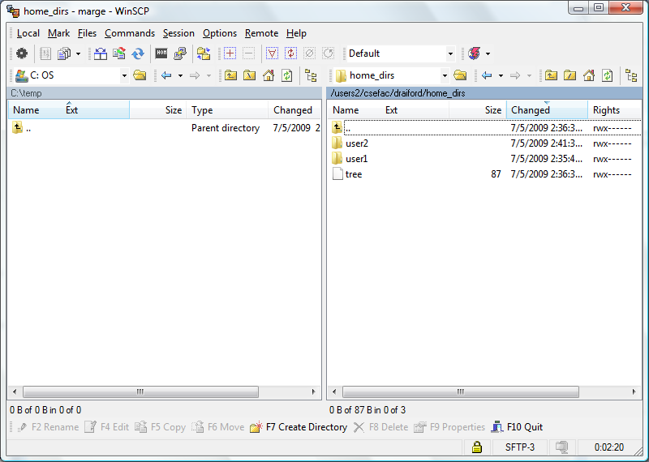
File Sharing – Remote File Systems
Uses networking to allow file system access between systems
Manually via programs like FTP

Slide 18
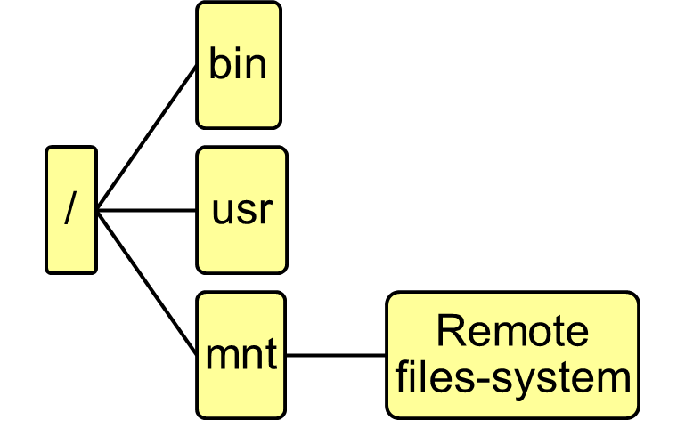
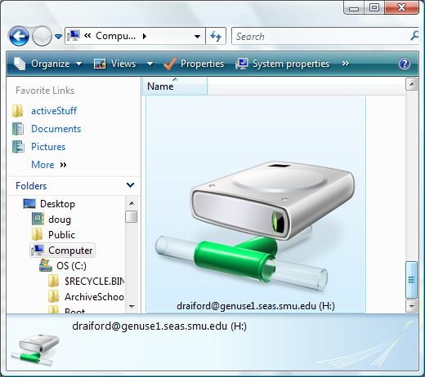
Distributed file systems
Unix NFS (Networked File System)
  Mount a remote file-system into the root system hierarchy
  Navigate remote system as if local
Windows
  Locally: SMB (Server Message Block protocol)
  Across broadband or internet: CIFS (Common Internet File System)
  “Maps” remote file-system to a drive letter

Slide 19
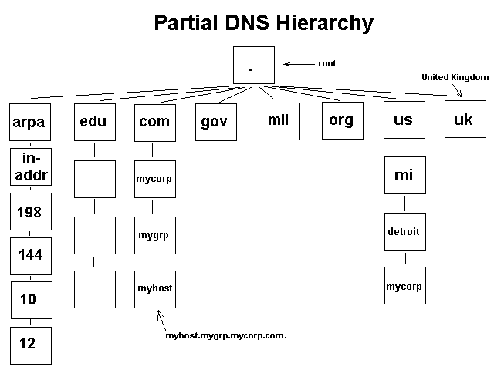

Managing distributed systems
Naming services
  LDAP
  DNS
  NIS
  Active Directory
Notes:
The Lightweight Directory Access Protocol, or LDAP (pronounced /ˈɛl dæp/), is an application protocol for querying and modifying directory services running over TCP/IP.[1]
The Network Information Service or NIS (originally called Yellow Pages or YP) consists of a client-server directory service protocol for distributing system configuration data such as user and host names between computers on a computer network. Sun Microsystems developed the NIS and licenses this technology to virtually all other Unix vendors.
Active Directory (AD) is a directory service created by Microsoft for Windows domain networks. It is included in most Windows Server operating systems.

Slide 20

Protection
Interface should provide for resource protection
File owner/creator should be able to control:
  what can be done
  by whom
Types of access
  Read
  Write
  Execute
  Append
  Delete
  List

Slide 21
End of Chapter 10

