Slide 1
Boot Loader

Slide 2
GCC
Compiler is called assembler and the language is called assembly
AT&T vs Intel
  AT&T: mov $5, %eax
  Intel: mov eax, 5

Slide 3
Websites
Writing your own bootloader for a toy operating system
  http://www.websofia.com/2011/10/writing-your-own-bootloader-for-a-toy-operating-system-2/
First sector, boot sector, 512 bytes
  For a floppy drive: Boot Parameter Block
  located at offset 0×3
bootsector:
iOEM: .ascii "DevOS " # OEM String
iSectSize: .word 0x200 # bytes per sector
iClustSize: .byte 1 # sectors per cluster
iResSect: .word 1 # #of reserved sectors
iFatCnt: .byte 2 # #of FAT copies
iRootSize: .word 224 # size of root directory
iTotalSect: .word 2880 # total # of sectors if over 32 MB
iMedia: .byte 0xF0 # media Descriptor
iFatSize: .word 9 # size of each FAT
iTrackSect: .word 9 # sectors per track
iHeadCnt: .word 2 # number of read-write heads
iHiddenSect: .int 0 # number of hidden sectors
iSect32: .int 0 # # sectors for over 32 MB
iBootDrive: .byte 0 # holds drive that the boot sector came from
iReserved: .byte 0 # reserved, empty
iBootSign: .byte 0x29 # extended boot sector signature
iVolID: .ascii "seri" # disk serial
acVolumeLabel: .ascii "MYVOLUME " # volume label
acFSType: .ascii "FAT16 " # file system type

Slide 4
Skeletal Code
.code16
.intel_syntax noprefix
.text
.org 0x0
LOAD_SEGMENT = 0x1000 #segment for loading 2nd stage
.global main
main:
jmp short start
nop
# BPB and EBPB here (Boot Parameter Block)
start:
# rest of code

Slide 5
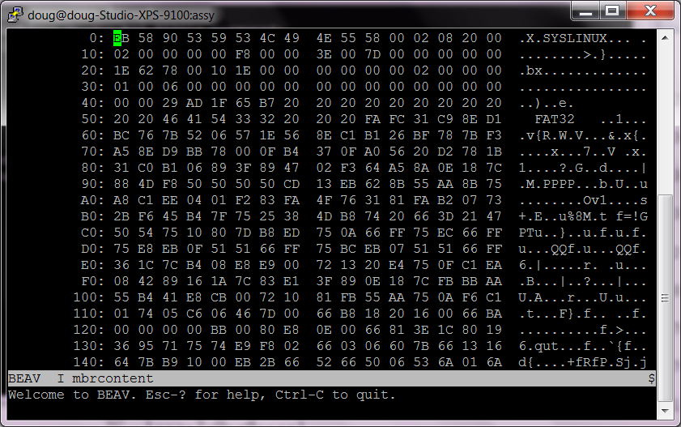
USB?
bootsector:
iOEM: .ascii "DevOS " # OEM String
iSectSize: .word 0x200 # bytes per sector
iClustSize: .byte 1 # sectors per cluster
iResSect: .word 1 # #of reserved sectors
iFatCnt: .byte 2 # #of FAT copies
iRootSize: .word 224 # size of root directory
iTotalSect: .word 2880 # total # of sectors if over 32 MB
iMedia: .byte 0xF0 # media Descriptor
iFatSize: .word 9 # size of each FAT
iTrackSect: .word 9 # sectors per track
iHeadCnt: .word 2 # number of read-write heads
iHiddenSect: .int 0 # number of hidden sectors
iSect32: .int 0 # # sectors for over 32 MB
iBootDrive: .byte 0 # holds drive that the boot sector came from
iReserved: .byte 0 # reserved, empty
iBootSign: .byte 0x29 # extended boot sector signature
iVolID: .ascii "seri" # disk serial
acVolumeLabel: .ascii "MYVOLUME " # volume label
acFSType: .ascii "FAT16 " # file system type
In Ubuntu created a bootable USB thumb drive with Startup Disk Creator
Copy the boot block to a separate file
  dd: Convert and copy, allusion to DD statement in IBM’s JCL
  dd if=/dev/sdb1 of=~/mbrcontent bs=1 count=512
Got /dev/sdb1 from the Ubuntu "Disk Utility"
BEAV: Binary editor and viewer
Notes:
00 02, is same as .word 0x200

Slide 6
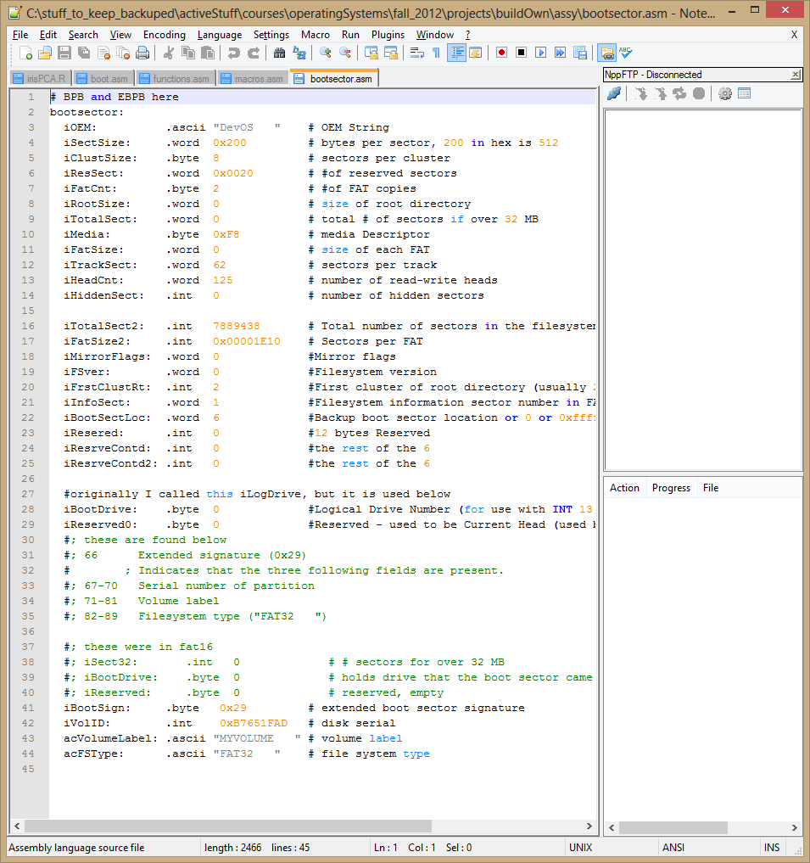
Look at code
Boot.asm

Slide 7
Creating boot file
Compile then link
Creates an operating system specific executable with specialized headers, etc.
  Elf: executable and linking format
Need a flat binary with just the machine code
Objcopy strips off any headers and leaves us with a flat binary
  objcopy -O binary -j .text boot.out boot.bin
Then copy it over to the first 512 bytes of the USB thumb drive
  dd if=load.bin of=/dev/sdf1 bs=1 count=512

Slide 8
Simple WriteString
.func WriteString
WriteString:
lodsb # load byte at ds:si into al (advancing si)
or al, al # test if character is 0 (end)
jz WriteString_done # jump to end if 0.
mov ah, 0xe # Subfunction 0xe of int 10h (video
# teletype output).
mov bx, 9 # Set bh (page number) to 0, and bl (attribute)
# to white (9).
int 0x10 # call BIOS interrupt.
jmp WriteString # Repeat for next character.
WriteString_done:
retw
.endfunc

Slide 9
End

