Slide 1
Chapter 13: I/O Systems

Slide 2
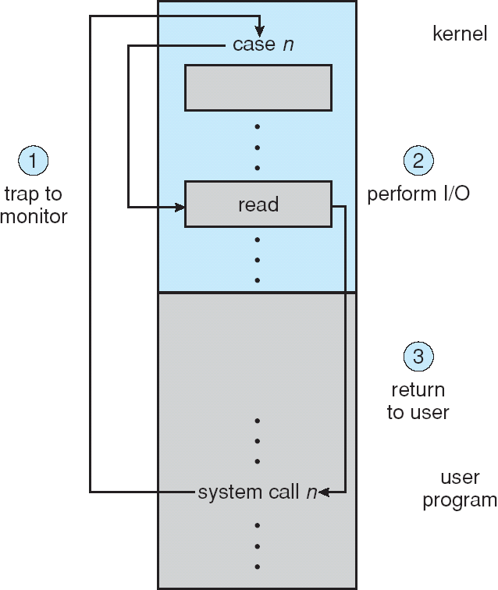
I/O through system calls
Protection
Managed access
But what does the kernel do?

Slide 3

I/O devices accessed via bus
OS must communicate with devices over their attached bus
Devices on busses have addresses
OS uses that address to establish connections with controllers

Slide 4
I/O Controllers
Vendor provides device driver
OS talks to driver
Controllers have command registers and data buffers
  Certain bit pattern
  Driver converts common set of commands to bit string
Command Register
DATA BUFFER

Slide 5
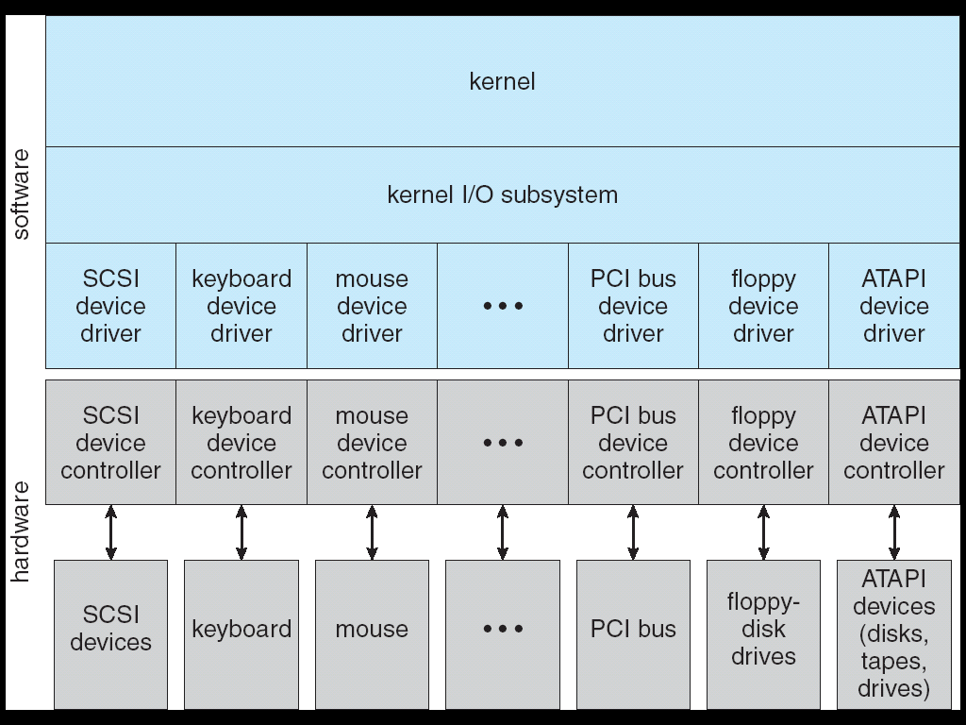
Driver: common interface to OS
Open/close, read/write

Slide 6
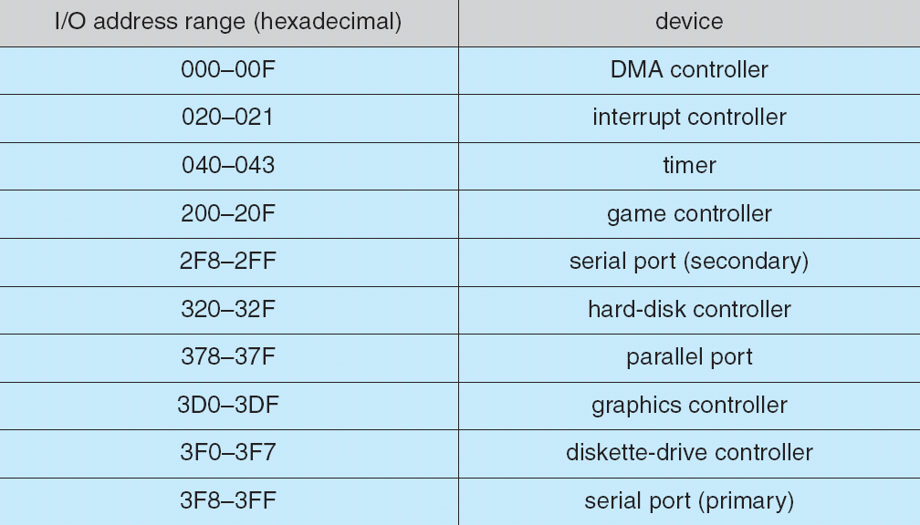
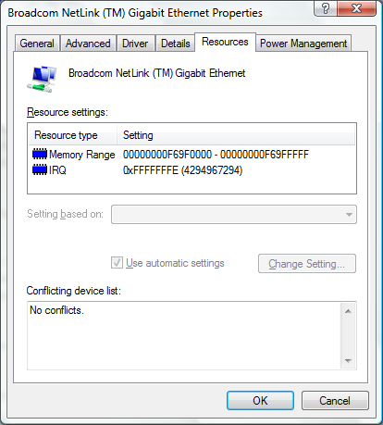
Port-mapped I/O (AKA Programmed I/O)
Composed of four registers (separate addressing space)
  Buffers
    Data-in
    Data-out
  Instruction
    Control
    Status
Data pumped into a buffer a byte or word at a time through the port
Notes:
Port-mapped I/O uses a special class of CPU instructions specifically for performing I/O. This is generally found on Intel microprocessors, specifically the IN and OUT instructions which can read and write a single byte to an I/O device. I/O devices have a separate address space from general memory, either accomplished by an extra "I/O" pin on the CPU's physical interface, or an entire bus dedicated to I/O.
A device's direct memory access (DMA) is not affected by those CPU-to-device communication methods, especially it is not affected by memory mapping. This is because, by definition, DMA is a memory-to-device communication method, that bypasses the CPU.

Slide 7
Memory-mapped I/O
Alternative to different address space
  Reads and writes to a “mapped” section of memory get redirected to device
  Can manipulate registers and buffers with same commands that normally use to manipulate memory
Example: video controller (sometimes uses programmed I/O for instructions and memory mapped I/O to write contents of screen)
Memory
Reads and Writes to these addresses redirected to device
Mapped memory not available
Device registers
Device buffers

Slide 8
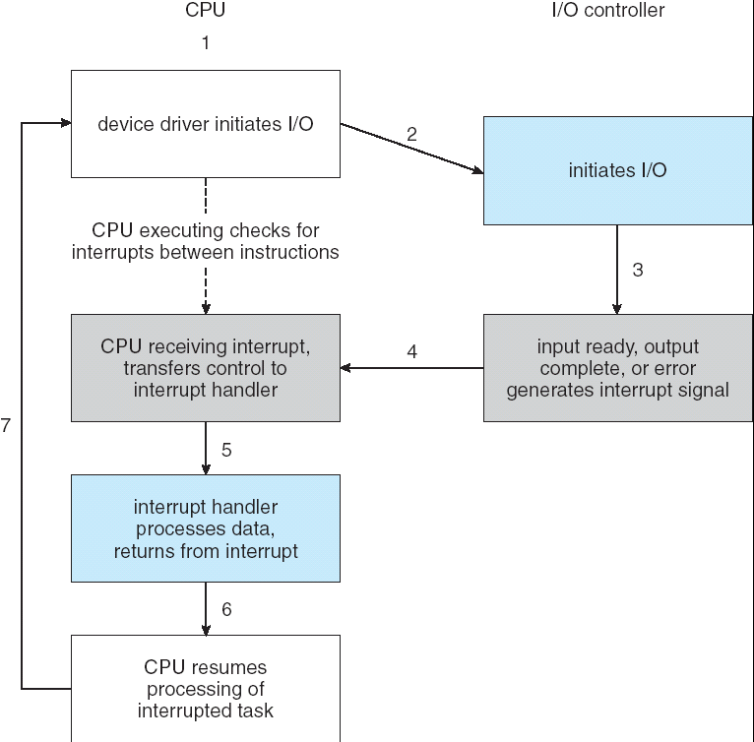
Communicating with adapters
Polling
  Checks busy bit repeatedly
Interrupts
  Think of as blocking at the driver level
  CPU Interrupt-request line triggered by I/O device
  Interrupt vector contains address of correct handler

Slide 9

Direct Memory Access
Frees up CPU for more important things (unlike memory mapped)
Requires DMA controller.
  Some systems have central DMA controller
  PCI-based: any controller can be bus master
CPU cannot access memory (cycle steeling)

Slide 10
Block and Character Devices
Block devices include disk drives
  Commands include read, write, seek
  Raw I/O or file-system access
  Memory-mapped file access possible
Character devices include keyboards, mice, serial ports
  Commands include get, put
  Libraries layered on top allow line editing
Block
Character

Slide 11
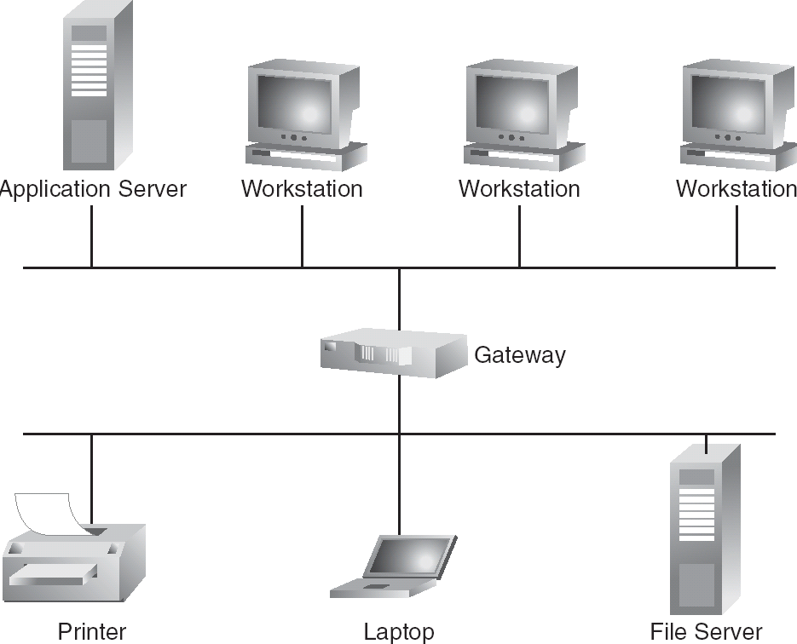
Network Devices
Different enough from block and character to have own interface
Approaches vary widely (sockets, pipes, FIFOs, streams, queues, mailboxes)

Slide 12
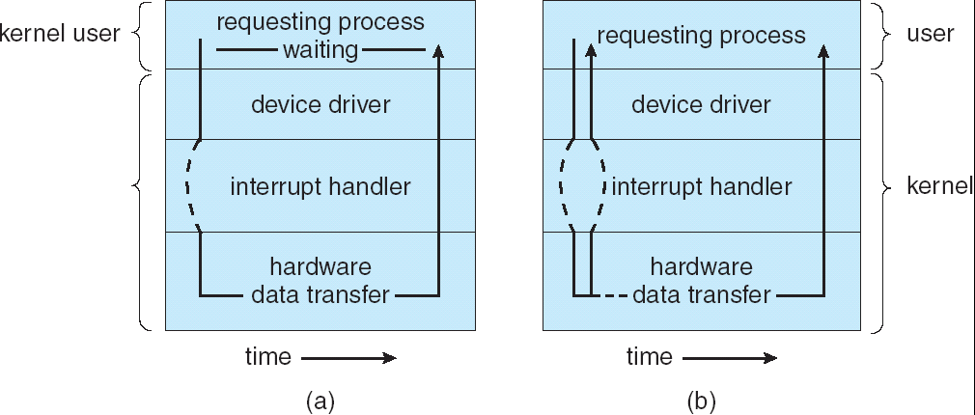
Blocking and Nonblocking I/O
Blocking - process suspended until I/O completed
Nonblocking - I/O call returns as much as available
Synchronous
Asynchronous

Slide 13
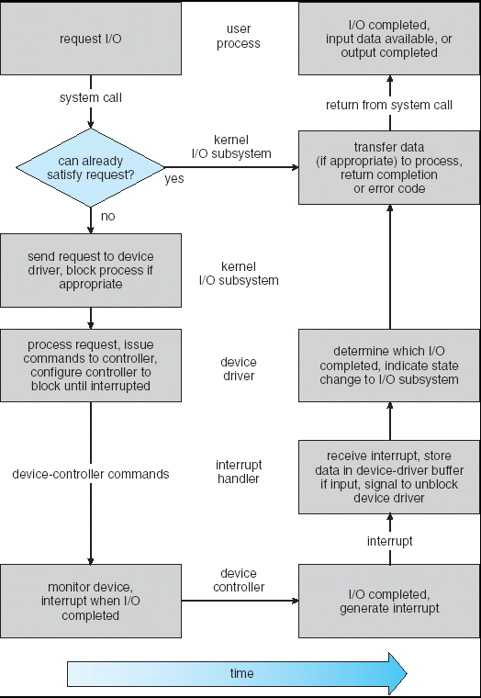
Life Cycle of An I/O Request
Putting it all together
  System call
  Context switch
  Command sent to driver along with data
  Driver loads register with command and buffer with data
  Ready bit set, driver blocks
  Controller sets busy bit
  When complete, clears busy bit and sets interrupt
  ISR moves data to driver buffer and unblocks driver
  Determine which I/O completed inform OS
  OS transfers data to process space (or to kernel buffer)
  Move process to ready Q

Slide 14
Intercomputer communications
Example: Telnet
Type a character
Keyboard places character in keyboard buffer
Interrupts processor
ISR passes to telnet app
telnet app performs system call
Character placed in network card buffer
>>>>>Frame sent over network<<<<<
Frame received by network card at destination
Network card/driver extracts character and places in card buffer
Network card interrupts processor
ISR hands off character to telnet daemon
telnet daemon hands off character to shell
Shell “echoes” character (system call)
Kernel hands character to network driver
Character placed in network card buffer
Character packaged-up in frame
>>>>>Frame sent over network<<<<<
Frame received by network card
Network card/driver extracts character and places in card buffer
Network card interrupts processor
ISR hands off character to telnet app
Telnet app displays character

Slide 15
End of Chapter 13

