Slide 1
Chapter 14: Protection

Slide 2


Protection
Have been discussing throughout course
  Dual-mode operation
  File-system permissions
Will examine in more detail
Will provide a theoretical construct for comparison purposes
System Resources
User
Other Users

Slide 3
Principles of Protection
Guiding principles
  Principle of least privilege
    Just enough privileges to perform their tasks
  Need to know principle
    Access only those resources that currently requires
Least Privilege
Need-to-know

Slide 4
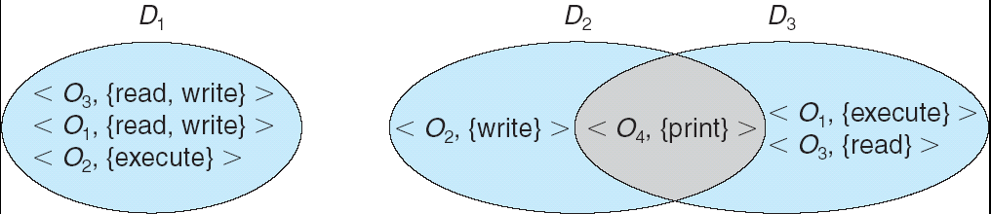
A Theoretical Construct
Like Turing machines in computational theory or relational calculus in databases
Gives us a framework for comparing models
Access-right = <object-name, rights-set>
where rights-set is a subset of all valid operations that can be performed on the object.
Domain = set objects and their associated of access-rights

Slide 5
Domain Structure
Association between process and domain
  Fixed
    If wish to adhere to need-to-know principle
      Must be able to change domain content
  Dynamic
    Implies: able to switch domains
Processes
Change access rights on the fly
-or-
Switch domains

Slide 6

Domain Implementation (UNIX)
System consists of 2 domain classes:
  User
  Supervisor
Domain = user-id
Can’t easily change access privileges on the fly…
Unix: dynamic
Processes able to change domains

Slide 7
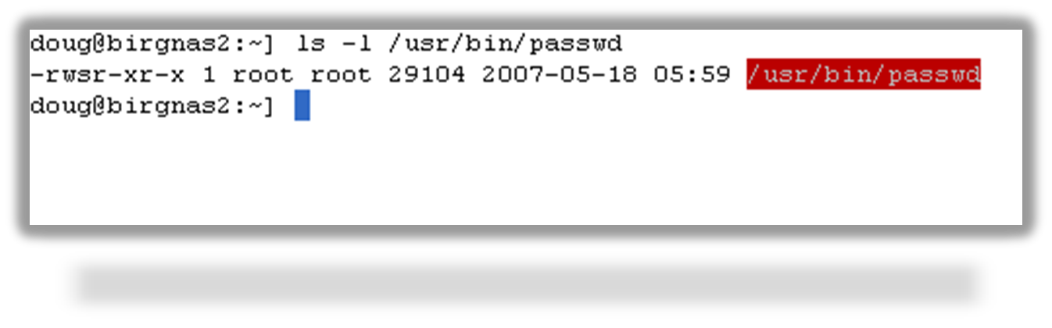
Domain switching in Unix
Domain switch accomplished via file system.
  Each file has associated with it a domain bit (setuid bit).
  When file is executed and setuid = on, then user-id is set to owner of the file being executed. When execution completes user-id is reset.
Example: set password
  Must change an entry in “passwd” file
  Could perform through system call
    Very limiting, must alter the kernel
    What if a user wanted to give limited access

Slide 8
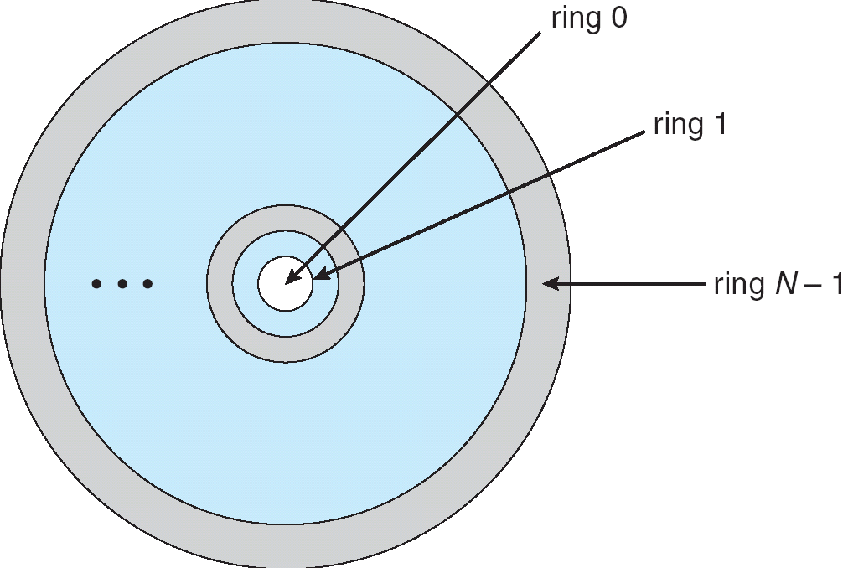
Domain Implementation (MULTICS)
Let D_{i} and D_{j} be any two domain rings.
If j < I ⇒ D_{i} ⊆ D_{j}

Slide 9
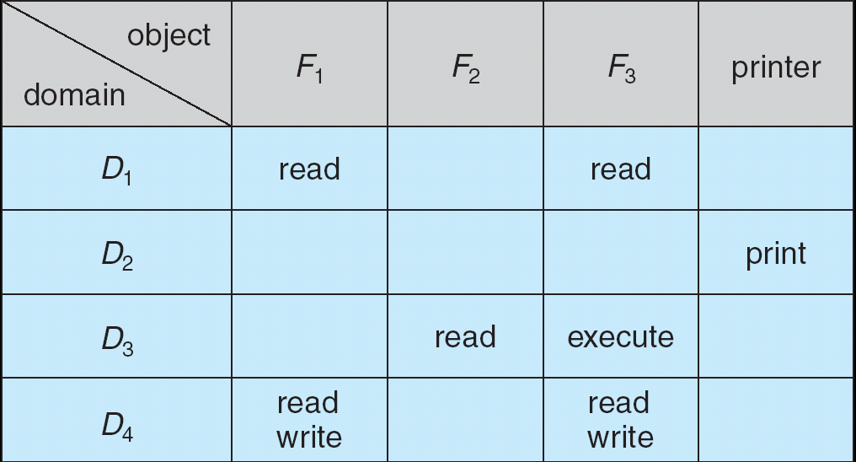
Access Matrix
Representation of theoretical construct
In Unix, rows=users, columns=resources (files, etc.)

Slide 10
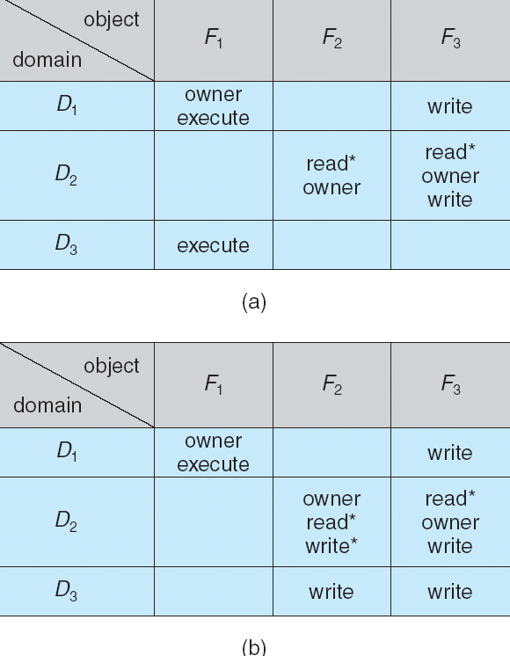
Dynamic Protection
Operations to add, delete access rights.
Special access rights:
  owner of O_{i}
  copy op from O_{i} to O_{j}
  control – D_{i} can modify D_{j} access rights (row control)
  transfer – switch from domain D_{i} to D_{j}

Slide 11
Where to keep the list
If keep permissions with object
  Access control list (ACL)
  Columns of access matrix
If keep with the user (or in a database indexed by user)
  Capability list
  Rows of access matrix
ACL dominant
Still a huge debate
ACL vs. Capabilities

Slide 12
Revocation of Access Rights
If mean remove rights for all users to access a given object…
  Access List – Delete access rights from access list.
    Simple
    Immediate
  Capability List – Scheme required to locate capability in the system before capability can be revoked.
    Less easy, would search all user’s lists
    Methods for overcoming
      Reacquisition: periodically delete all rights from domains
      Back-pointers
      Indirection
      Keys (domain has key, objects have locks)
        Master key
        Several keys with different privileges
User n capabilities
Print to printer x
r,w,x,own home dir
r,x /usr/bin
Notes:
Doug notes
Basically, list is with domain, not object
Seems cultish, a lot of anger
AL has taken over
But still lots of research and publications
It has been said that they are equivalent
Distinguish between capability and or other accessible data
I think an example of a capability might be “print”
Book says most OS’s use combo of two, and likens permissions on file as access list and entry in open file table as a capability
Mach is supposedly capability list
From wiki
Although most operating systems implement a facility which resembles capabilities, they typically do not provide enough support to allow for the exchange of capabilities among possibly mutually untrusting entities to be the primary means of granting and distributing access rights throughout the system. A capability-based system, in contrast, is designed with that goal in mind.
Also said that does not have a path to a file, but rather each user must have an “un-forgeable reference” and simply having the reference gives them access.

Slide 13
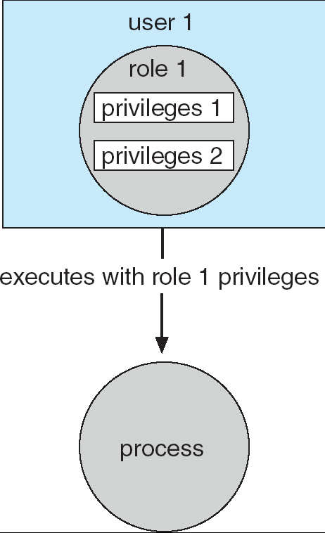
Role-Based Access Control
RBAC
  Solaris 10 and systems that utilize directory services (Novel, Windows NT, Linux)
    Users assigned roles granting access to privileges and programs
    Can be temporary
In charge of certain resources

Slide 14
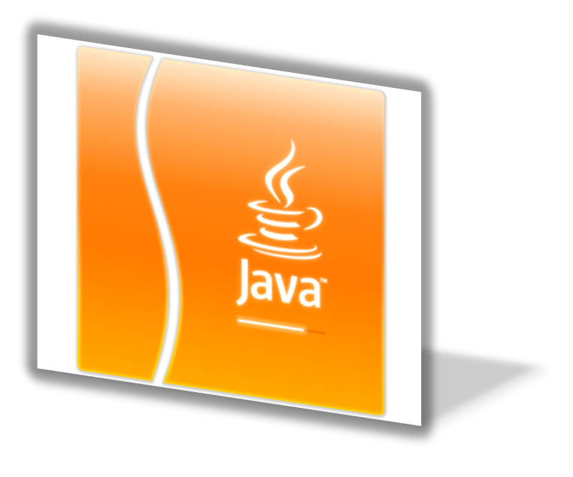
Language-Based Protection
Compiler-based enforcement
  Only allow compilation by “trusted” compiler
  Write programs for dissemination with built-in safe-guards
  Weaknesses?
Example: Java
  Handled by Java Virtual Machine (JVM)
  Especially useful in Java Applets
    Disk access off by default
    Performs loads un-trusted methods downloaded from web
    A class can only perform a privileged operation if it is in a protection domain
      All privileged ops must be performed in a privileged block
      Determined through stack inspection

Slide 15
End of Chapter 14

