Slide 1
Chapter 15: Security

Slide 2

Security vs. Protection
Protection all about protecting authorized users from one another
Security is all about external threats
Either could be accidental or malicious
  Easier to protect against accidental than malicious misuse

Slide 3
Categories
Breach of confidentiality
  Passwords, account numbers, credit card information
Breach of integrity
  Website vandalized
Breach of availability
  Destruction or corruption of data (virus that formats hard drive)
Theft of service
  Hijack a machine and use to serve up pirated movies and music
Denial of service
  Packet storm prevents any other traffic

Slide 4
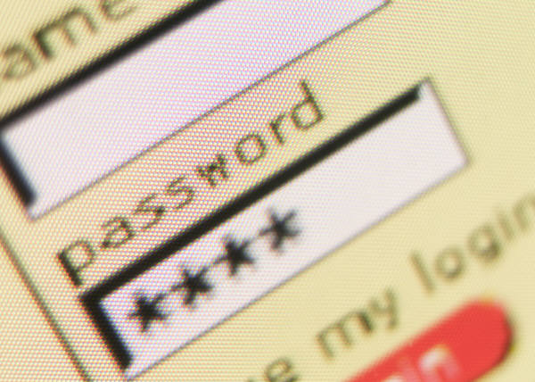
Methods
Masquerading (breach authentication)
  Password stealing

Slide 5
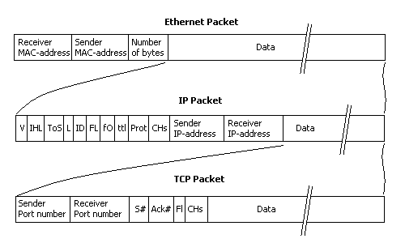
Session hijacking or replaying
TCP often packages communications into sessions
Session IDs can be determined from cookies, URLs, or intercepting packets
Use of the session ID allows an attacker to operate with the same permissions as the stolen session
Requires the use of a protocol analyzer. With today’s high use of switches, often done in wireless environments.

Slide 6
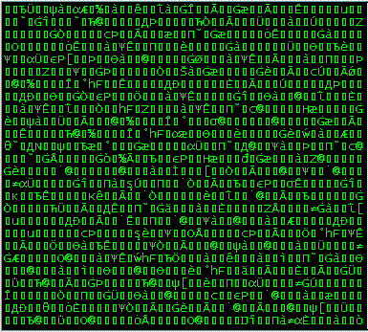
Cryptography as a Security Tool
If encrypt all traffic then can’t intercept passwords or session IDs
If sender and receiver know a private key can encrypt and decrypt securely
Very safe but very inconvenient
Must securely hand-off the key

Slide 7
Public Keys
Encryption hit the big-time with the advent of public keys
4 keys
  Each user has a private and a public key
They exchange their public keys
When user A encrypts a message for user B the message is encrypted with user A’s
User A
The “key” is that both of user B’s keys are generated together. If you encrypt a message with user B’s public key, it requires that user’s private key to decrypt it.
Just knowing the public key does not allow discovery of the private key or decryption of the message.
Encrypt using User B’s public key
Decrypt using User B’s private key
User B

Slide 8

Asymmetric Encryption
Public key encryption is known as asymmetric encryption
Traditional, private key, encryption is symmetric
Public key is slower—often used just long enough to exchange a private key
  Asymmetric ⇒ based on mathematical function, slow
  Symmetric ⇒ based on simple transform, fast
Exchanging Keys

Slide 9
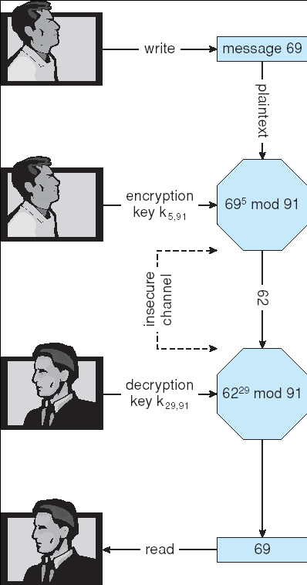
RSA Asymmetric Cryptography
RSA named after the inventors
  Rivest, Shamir, and Adleman
Algorithm
  Choose two distinct prime numbers p and q.
  Compute n = pq.
  Compute the totient: φ(n) = (p-1)(q-1)
  Choose an integer e such that 1 < e < φ(n), and e and φ(n) share no divisors other than 1 (i.e. e and φ(n) are coprime).
  Determine d (using modular arithmetic) which satisfies the congruence relation de mod(φ(n))=1
  The public key consists of the modulus n and the exponent e.
  The private key consists of the modulus n exponent d

Slide 10
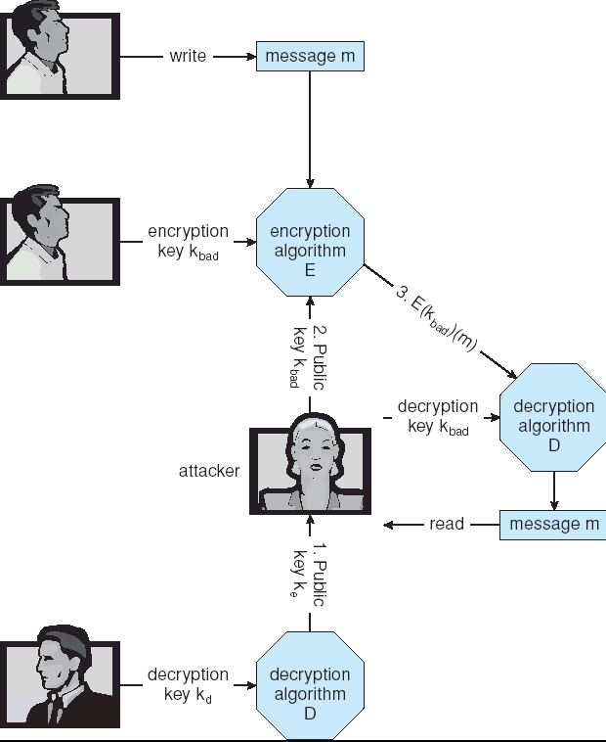
Man-in-the-middle attack
Attacker intercepts public key exchange
Similar to session hijacking

Slide 11
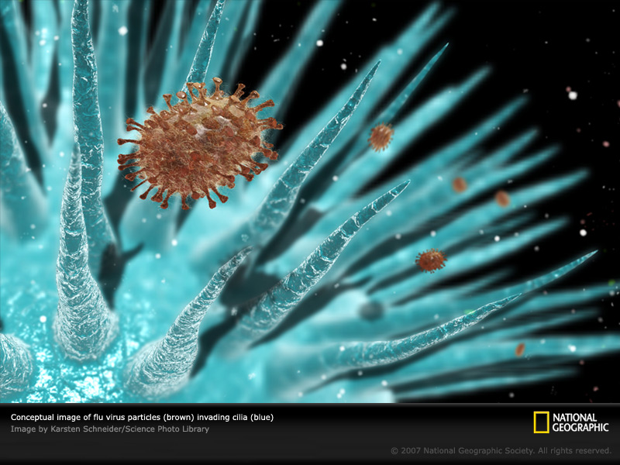
Viruses
Some are simply malicious
Some are designed to gather valuable information
  Passwords, account numbers, etc.
All have in common
  Circumvent security
  Spread (like a virus)

Slide 12
Viruses
Many categories of viruses, literally many thousands of viruses
  File: appends to file. Prog jumps to virus and back
  Boot: infection of boot sector
  Macro: high-level extension to application
  Source code: seeks and modifies source code
  Polymorphic: changes each time it is installed
  Encrypted: virus is encrypted to help hide
  Stealth: modifies parts of system that could be used to detect it
  Tunneling: hidden in interrupt handler or driver
  Multipartite: infects multiple parts of a system
  Armored: coded to be difficult to understand

Slide 13
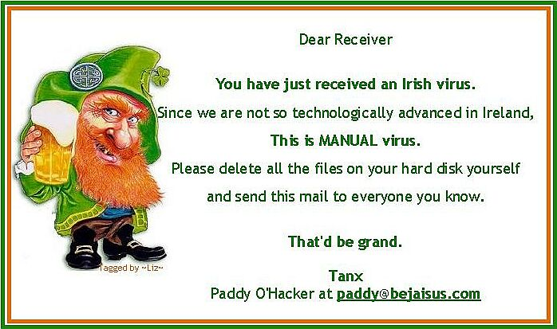
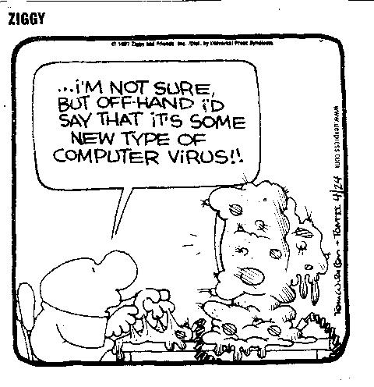
Viruses
Trojan Horse
  Hides in programs that users actually want
Trap Door
  Left by application developers so they can get back in later
Logic Bomb
  Program that initiates a security incident under certain circumstances
  Example: employee writes a program that will wipe a system if laid off
Stack and Buffer Overflow
  Exploits a bug in a program (overflow either the stack or memory buffers)

Slide 14
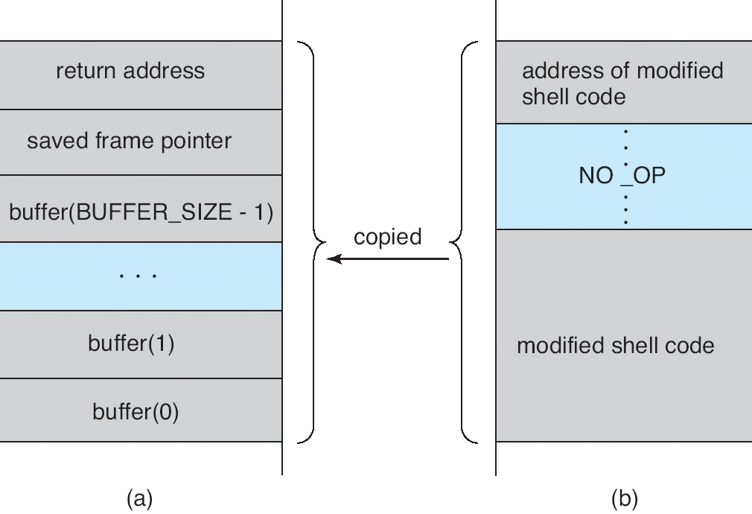
Hypothetical Stack Frame
Before attack
After attack

Slide 15

System and Network Threats
Worms
  use spawn mechanism; standalone program
Port scanning
  Automated attempt to connect to a range of ports on one or a range of IP addresses
  Used to exploit known security holes (like buffer overr

Slide 16
Authentication – Digital Signature
If encrypt a “signature” with private key
Then can decrypt with public key
If receiver is able to decrypt the signature using the public key then it must have been encrypted by the same private key that is associated with the public key
Works in both directions
If can decrypt with public key then must have been encrypted by the owner of the private key

Slide 17

Digital Certificates
Proof of who or what owns a public key
Public key digitally signed by a trusted party
Trusted party receives proof of identification from entity and certifies that public key belongs to entity
Certificate authority are trusted party – their public keys included with web browser distributions
  They vouch for other authorities via digitally signing their keys, and so on
Trusted Authority

Slide 18
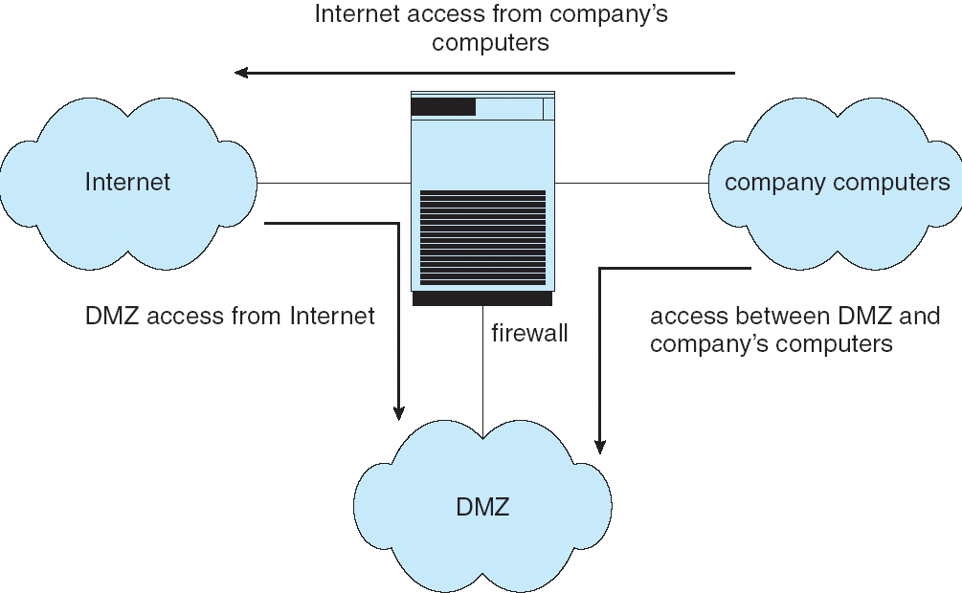
Firewalling to Protect Systems and Networks
Prevents things like port scanning
Connections must be initiated from inside except through approved ports (ssh, http, etc.)

Slide 19
End of Chapter 15

