Slide 1
EI232 CIRCUITS AND ELECTRONICS
LECTURE NOTES
Ma Dianguang
Fall 2013

Slide 2
CHAPTER 10
FIRST-ORDER TRANSIENTS IN LINEAR ELECTRICAL NETWORKS

Slide 3
10.0 INTRODUCTION

Slide 4
10.0 INTRODUCTION

Slide 5
10.0 INTRODUCTION

Slide 6
10.0 INTRODUCTION

Slide 7
10.1 ANALYSIS OF RC CIRCUITS

Slide 8
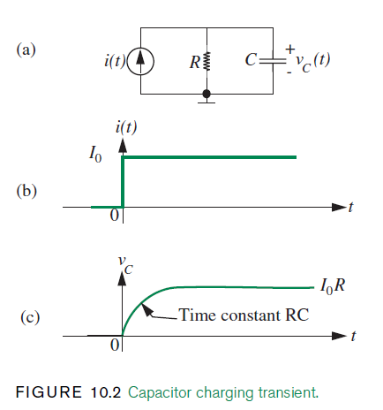
10.1 ANALYSIS OF RC CIRCUITS

Slide 9
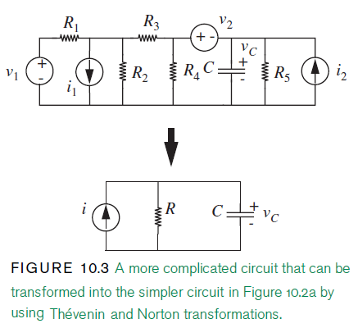
10.1 ANALYSIS OF RC CIRCUITS

Slide 10
10.1 ANALYSIS OF RC CIRCUITS

Slide 11
10.1 ANALYSIS OF RC CIRCUITS

Slide 12
10.1 ANALYSIS OF RC CIRCUITS

Slide 13
10.1 ANALYSIS OF RC CIRCUITS

Slide 14
10.1 ANALYSIS OF RC CIRCUITS

Slide 15
10.1 ANALYSIS OF RC CIRCUITS

Slide 16
10.1 ANALYSIS OF RC CIRCUITS

Slide 17
10.1 ANALYSIS OF RC CIRCUITS

Slide 18
10.1 ANALYSIS OF RC CIRCUITS

Slide 19
10.1 ANALYSIS OF RC CIRCUITS

Slide 20
10.1 ANALYSIS OF RC CIRCUITS

Slide 21
10.1 ANALYSIS OF RC CIRCUITS

Slide 22
10.1 ANALYSIS OF RC CIRCUITS

Slide 23
10.1 ANALYSIS OF RC CIRCUITS

Slide 24
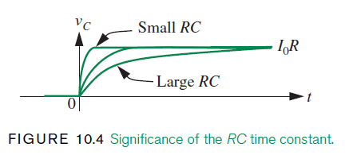
10.1 ANALYSIS OF RC CIRCUITS

Slide 25
10.1 ANALYSIS OF RC CIRCUITS

Slide 26
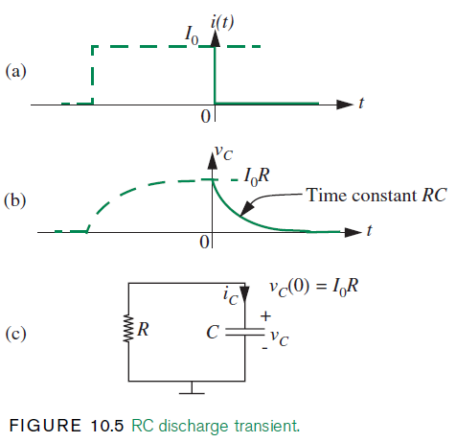
10.1 ANALYSIS OF RC CIRCUITS

Slide 27
10.1 ANALYSIS OF RC CIRCUITS

Slide 28
10.1 ANALYSIS OF RC CIRCUITS

Slide 29
10.1 ANALYSIS OF RC CIRCUITS

Slide 30
10.1 ANALYSIS OF RC CIRCUITS

Slide 31
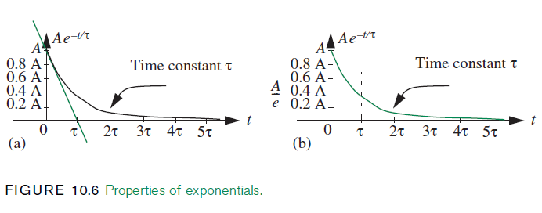
10.1 ANALYSIS OF RC CIRCUITS

Slide 32
10.1 ANALYSIS OF RC CIRCUITS

Slide 33
10.1 ANALYSIS OF RC CIRCUITS

Slide 34
10.1 ANALYSIS OF RC CIRCUITS

Slide 35
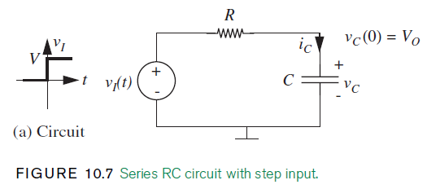
10.1 ANALYSIS OF RC CIRCUITS

Slide 36
10.1 ANALYSIS OF RC CIRCUITS

Slide 37
10.1 ANALYSIS OF RC CIRCUITS

Slide 38
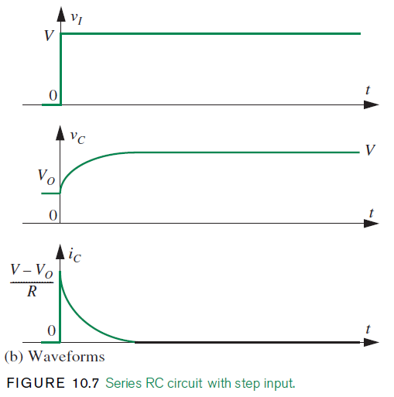
10.1 ANALYSIS OF RC CIRCUITS

Slide 39
10.1 ANALYSIS OF RC CIRCUITS

Slide 40
10.1 ANALYSIS OF RC CIRCUITS

Slide 41
10.1 ANALYSIS OF RC CIRCUITS

Slide 42
10.1 ANALYSIS OF RC CIRCUITS

Slide 43
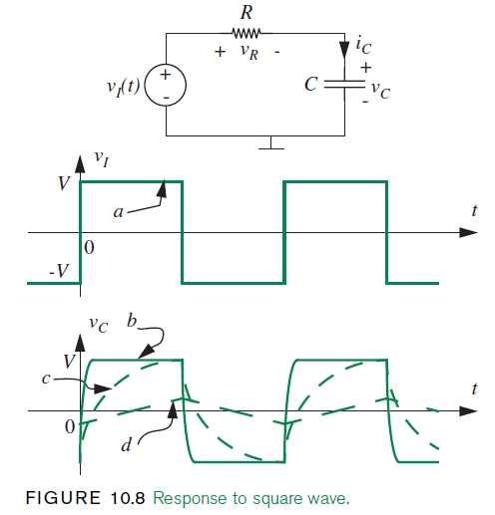
10.1 ANALYSIS OF RC CIRCUITS

Slide 44
10.1 ANALYSIS OF RC CIRCUITS

Slide 45
10.1 ANALYSIS OF RC CIRCUITS

Slide 46
10.1 ANALYSIS OF RC CIRCUITS

Slide 47
10.2 ANALYSIS OF RL CIRCUITS

Slide 48
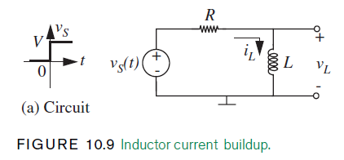
10.2 ANALYSIS OF RL CIRCUITS

Slide 49
10.2 ANALYSIS OF RL CIRCUITS

Slide 50
10.2 ANALYSIS OF RL CIRCUITS

Slide 51
10.2 ANALYSIS OF RL CIRCUITS

Slide 52
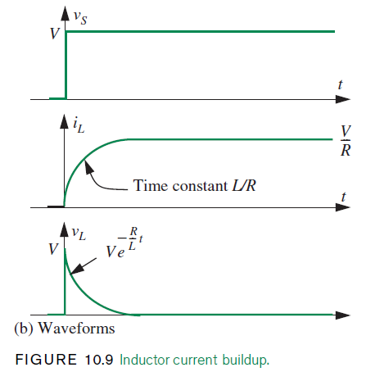
10.2 ANALYSIS OF RL CIRCUITS

Slide 53
10.2 ANALYSIS OF RL CIRCUITS

Slide 54
10.3 INTUITIVE ANALYSIS

Slide 55
10.3 INTUITIVE ANALYSIS

Slide 56
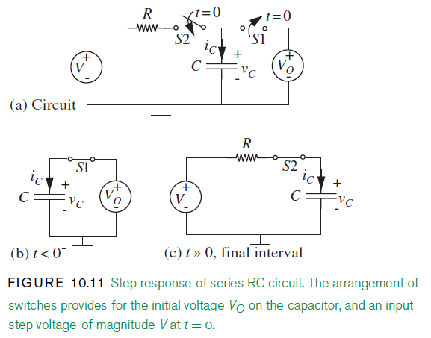
10.3 INTUITIVE ANALYSIS

Slide 57
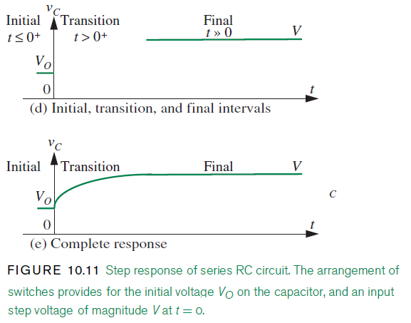
10.3 INTUITIVE ANALYSIS

Slide 58
10.3 INTUITIVE ANALYSIS

Slide 59
10.3 INTUITIVE ANALYSIS

Slide 60
10.3 INTUITIVE ANALYSIS

Slide 61
10.3 INTUITIVE ANALYSIS

Slide 62
10.3 INTUITIVE ANALYSIS

Slide 63
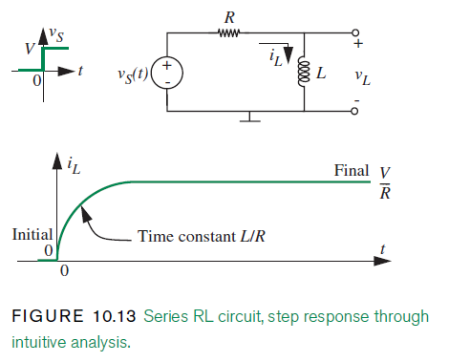
10.3 INTUITIVE ANALYSIS

Slide 64
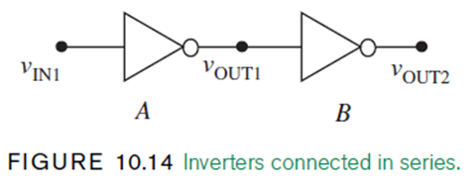
10.4 PROPAGATION DELAY AND THE DIGITAL ABSTRACTION

Slide 65
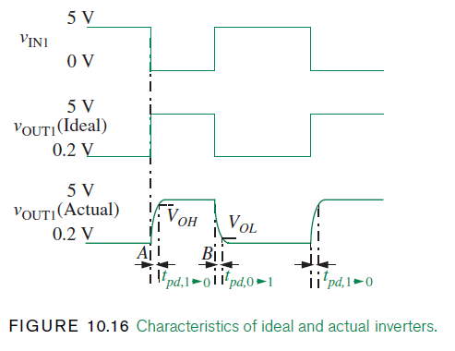
10.4 PROPAGATION DELAY AND THE DIGITAL ABSTRACTION

Slide 66
10.4 PROPAGATION DELAY AND THE DIGITAL ABSTRACTION

Slide 67
10.4 PROPAGATION DELAY AND THE DIGITAL ABSTRACTION

Slide 68
10.4 PROPAGATION DELAY AND THE DIGITAL ABSTRACTION

Slide 69
10.4 PROPAGATION DELAY AND THE DIGITAL ABSTRACTION

Slide 70
10.4 PROPAGATION DELAY AND THE DIGITAL ABSTRACTION

Slide 71
10.4 PROPAGATION DELAY AND THE DIGITAL ABSTRACTION

Slide 72
10.4 PROPAGATION DELAY AND THE DIGITAL ABSTRACTION

Slide 73
10.4 PROPAGATION DELAY AND THE DIGITAL ABSTRACTION

Slide 74
10.4 PROPAGATION DELAY AND THE DIGITAL ABSTRACTION

Slide 75
10.4 PROPAGATION DELAY AND THE DIGITAL ABSTRACTION

Slide 76
10.4 PROPAGATION DELAY AND THE DIGITAL ABSTRACTION

Slide 77
10.4 PROPAGATION DELAY AND THE DIGITAL ABSTRACTION

Slide 78
10.4 PROPAGATION DELAY AND THE DIGITAL ABSTRACTION

Slide 79
10.4 PROPAGATION DELAY AND THE DIGITAL ABSTRACTION

Slide 80
10.4 PROPAGATION DELAY AND THE DIGITAL ABSTRACTION

Slide 81
10.4 PROPAGATION DELAY AND THE DIGITAL ABSTRACTION

Slide 82
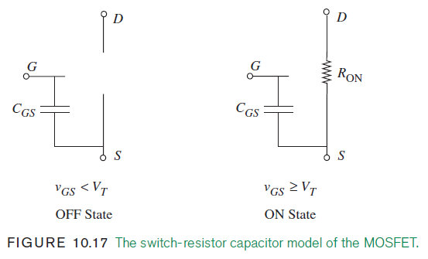
10.4 PROPAGATION DELAY AND THE DIGITAL ABSTRACTION

Slide 83
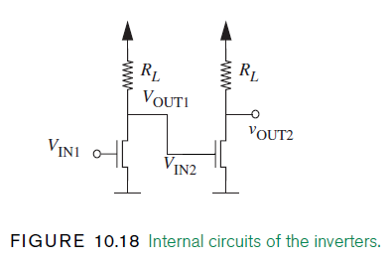
10.4 PROPAGATION DELAY AND THE DIGITAL ABSTRACTION

Slide 84
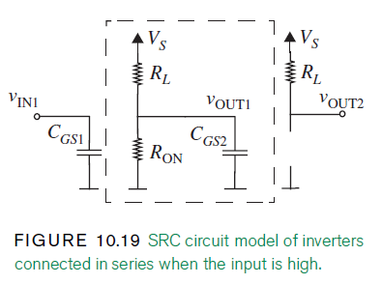
10.4 PROPAGATION DELAY AND THE DIGITAL ABSTRACTION

Slide 85
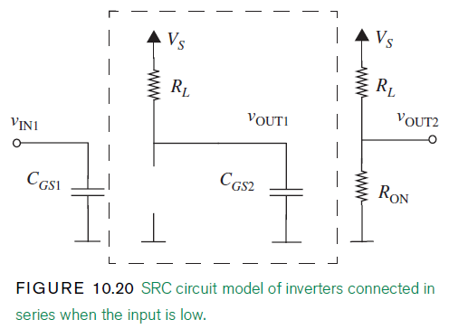
10.4 PROPAGATION DELAY AND THE DIGITAL ABSTRACTION

Slide 86
10.4 PROPAGATION DELAY AND THE DIGITAL ABSTRACTION

Slide 87
10.4 PROPAGATION DELAY AND THE DIGITAL ABSTRACTION

Slide 88
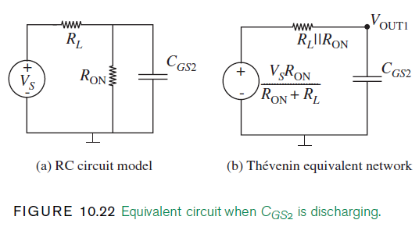
10.4 PROPAGATION DELAY AND THE DIGITAL ABSTRACTION

Slide 89
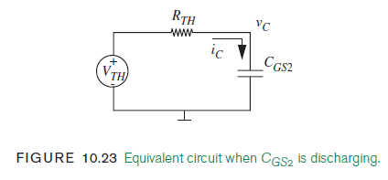
10.4 PROPAGATION DELAY AND THE DIGITAL ABSTRACTION

Slide 90
10.4 PROPAGATION DELAY AND THE DIGITAL ABSTRACTION

Slide 91
10.4 PROPAGATION DELAY AND THE DIGITAL ABSTRACTION

Slide 92
10.4 PROPAGATION DELAY AND THE DIGITAL ABSTRACTION

Slide 93
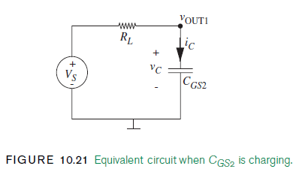
10.4 PROPAGATION DELAY AND THE DIGITAL ABSTRACTION

Slide 94
10.4 PROPAGATION DELAY AND THE DIGITAL ABSTRACTION

Slide 95
10.4 PROPAGATION DELAY AND THE DIGITAL ABSTRACTION

Slide 96
10.4 PROPAGATION DELAY AND THE DIGITAL ABSTRACTION

Slide 97
10.4 PROPAGATION DELAY AND THE DIGITAL ABSTRACTION

Slide 98
10.5 STATE AND STATE VARIABLES

Slide 99
10.5 STATE AND STATE VARIABLES

Slide 100
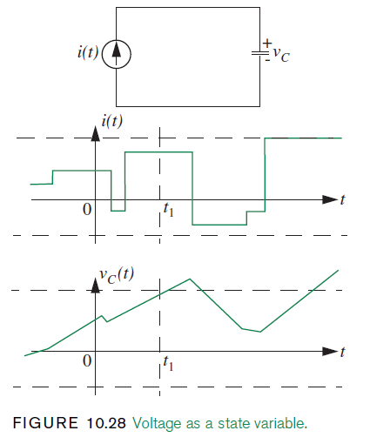
10.5 STATE AND STATE VARIABLES

Slide 101
10.5 STATE AND STATE VARIABLES

Slide 102
10.5 STATE AND STATE VARIABLES

Slide 103
10.5 STATE AND STATE VARIABLES

Slide 104
10.5 STATE AND STATE VARIABLES

Slide 105
10.5 STATE AND STATE VARIABLES

Slide 106
10.5 STATE AND STATE VARIABLES

Slide 107
10.5 STATE AND STATE VARIABLES

Slide 108
10.5 STATE AND STATE VARIABLES

Slide 109
10.5 STATE AND STATE VARIABLES

Slide 110
10.5 STATE AND STATE VARIABLES

Slide 111
10.5 STATE AND STATE VARIABLES

Slide 112
10.5 STATE AND STATE VARIABLES

Slide 113
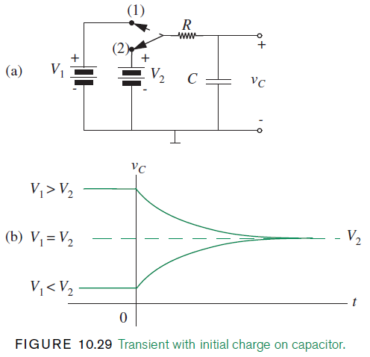
10.5 STATE AND STATE VARIABLES

Slide 114
10.5 STATE AND STATE VARIABLES

Slide 115
10.5 STATE AND STATE VARIABLES

Slide 116
10.5 STATE AND STATE VARIABLES

Slide 117
10.5 STATE AND STATE VARIABLES

Slide 118
10.5 STATE AND STATE VARIABLES

Slide 119
10.5 STATE AND STATE VARIABLES

Slide 120
10.5 STATE AND STATE VARIABLES

Slide 121
10.6 ADDITIONAL EXAMPLES

Slide 122
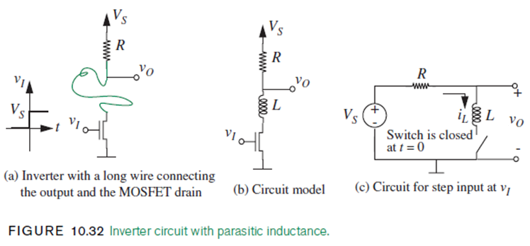
10.6 ADDITIONAL EXAMPLES

Slide 123
10.6 ADDITIONAL EXAMPLES

Slide 124
10.6 ADDITIONAL EXAMPLES

Slide 125
10.6 ADDITIONAL EXAMPLES

Slide 126
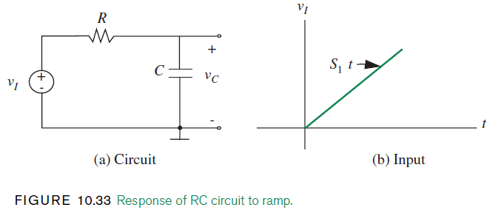
10.6 ADDITIONAL EXAMPLES

Slide 127
10.6 ADDITIONAL EXAMPLES

Slide 128
10.6 ADDITIONAL EXAMPLES

Slide 129
10.6 ADDITIONAL EXAMPLES

Slide 130
10.6 ADDITIONAL EXAMPLES

Slide 131
10.6 ADDITIONAL EXAMPLES

Slide 132
10.6 ADDITIONAL EXAMPLES

Slide 133
10.6 ADDITIONAL EXAMPLES

Slide 134
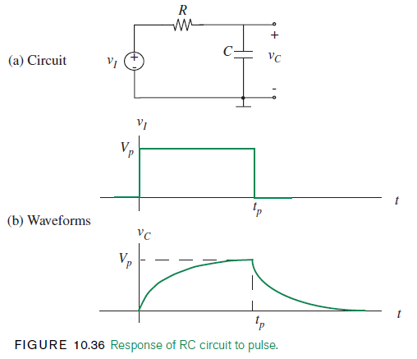
10.6 ADDITIONAL EXAMPLES

Slide 135
10.6 ADDITIONAL EXAMPLES

Slide 136
10.6 ADDITIONAL EXAMPLES

Slide 137
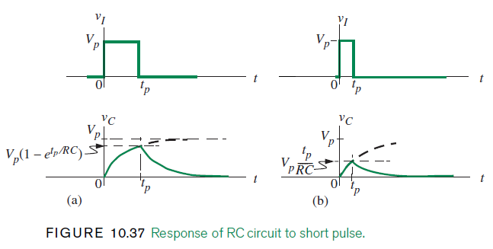
10.6 ADDITIONAL EXAMPLES

Slide 138
10.6 ADDITIONAL EXAMPLES

Slide 139
10.6 ADDITIONAL EXAMPLES

Slide 140
10.6 ADDITIONAL EXAMPLES

Slide 141
10.6 ADDITIONAL EXAMPLES

Slide 142
10.6 ADDITIONAL EXAMPLES

Slide 143
10.6 ADDITIONAL EXAMPLES

Slide 144
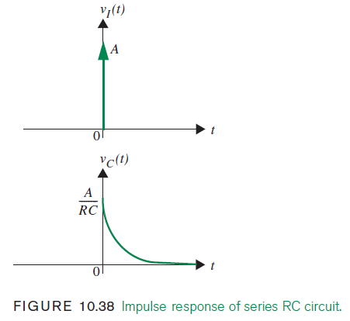
10.6 ADDITIONAL EXAMPLES

Slide 145
10.6 ADDITIONAL EXAMPLES

Slide 146
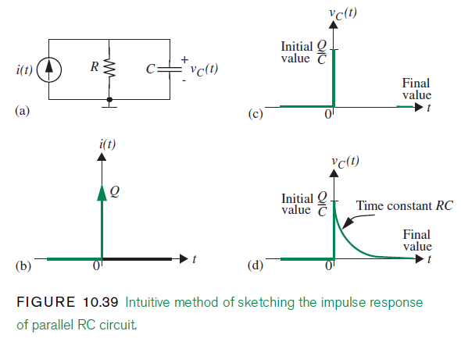
10.6 ADDITIONAL EXAMPLES

Slide 147
10.6 ADDITIONAL EXAMPLES

Slide 148
10.6 ADDITIONAL EXAMPLES

Slide 149
10.6 ADDITIONAL EXAMPLES

Slide 150
10.6 ADDITIONAL EXAMPLES

Slide 151
10.6 ADDITIONAL EXAMPLES

Slide 152
10.6 ADDITIONAL EXAMPLES

Slide 153
10.6 ADDITIONAL EXAMPLES

Slide 154
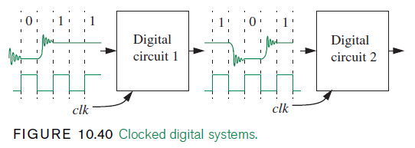
10.6 ADDITIONAL EXAMPLES

Slide 155
10.6 ADDITIONAL EXAMPLES

Slide 156
10.6 ADDITIONAL EXAMPLES

Slide 157
10.6 ADDITIONAL EXAMPLES

Slide 158
10.6 ADDITIONAL EXAMPLES

Slide 159
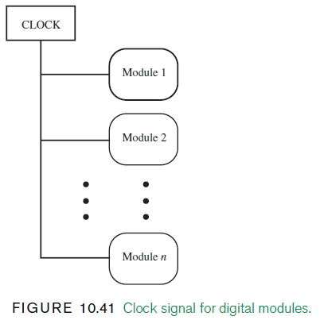
10.6 ADDITIONAL EXAMPLES

Slide 160
10.6 ADDITIONAL EXAMPLES

Slide 161
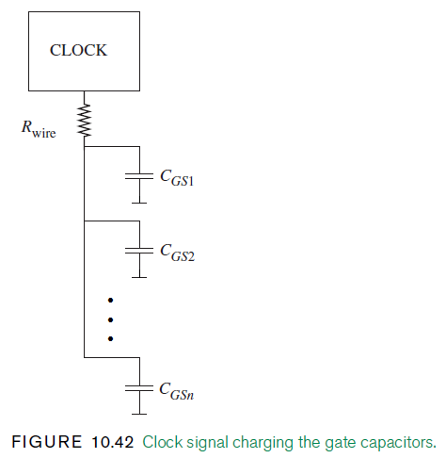
10.6 ADDITIONAL EXAMPLES

Slide 162
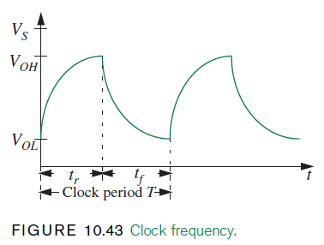
10.6 ADDITIONAL EXAMPLES

Slide 163
10.6 ADDITIONAL EXAMPLES

Slide 164
10.6 ADDITIONAL EXAMPLES

Slide 165
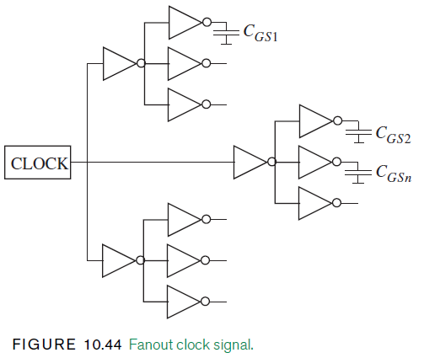
10.6 ADDITIONAL EXAMPLES

Slide 166
10.6 ADDITIONAL EXAMPLES

Slide 167
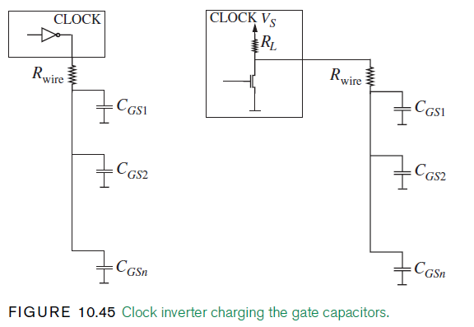
10.6 ADDITIONAL EXAMPLES

Slide 168
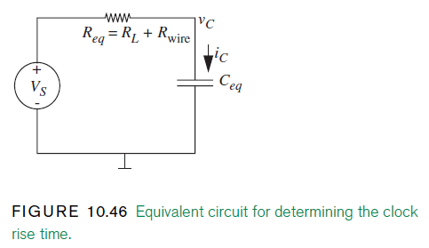
10.6 ADDITIONAL EXAMPLES

Slide 169
10.6 ADDITIONAL EXAMPLES

Slide 170
10.6 ADDITIONAL EXAMPLES

Slide 171
10.6 ADDITIONAL EXAMPLES

Slide 172
10.6 ADDITIONAL EXAMPLES

Slide 173
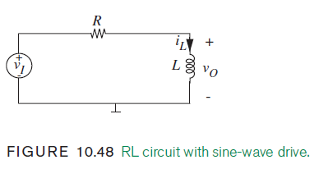
10.6 ADDITIONAL EXAMPLES

Slide 174
10.6 ADDITIONAL EXAMPLES

Slide 175
10.6 ADDITIONAL EXAMPLES

Slide 176
10.6 ADDITIONAL EXAMPLES

Slide 177
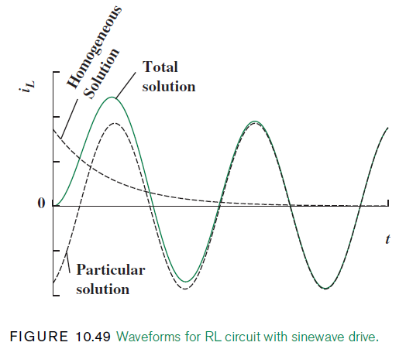
10.6 ADDITIONAL EXAMPLES

Slide 178
10.7 DIGITAL MEMORY

Slide 179
10.7 DIGITAL MEMORY

Slide 180
10.7 DIGITAL MEMORY

Slide 181
10.7 DIGITAL MEMORY

Slide 182
10.7 DIGITAL MEMORY

Slide 183
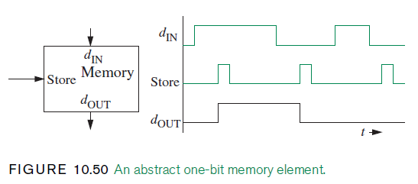
10.7 DIGITAL MEMORY

Slide 184
10.7 DIGITAL MEMORY

Slide 185
10.7 DIGITAL MEMORY

Slide 186
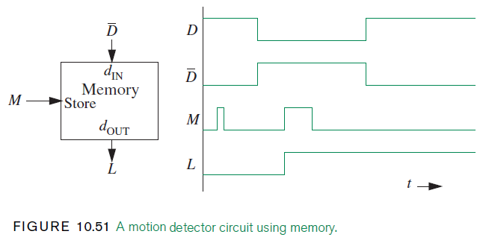
10.7 DIGITAL MEMORY

Slide 187
10.7 DIGITAL MEMORY

Slide 188
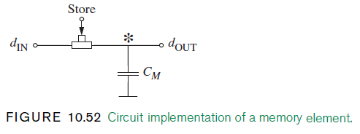
10.7 DIGITAL MEMORY

Slide 189
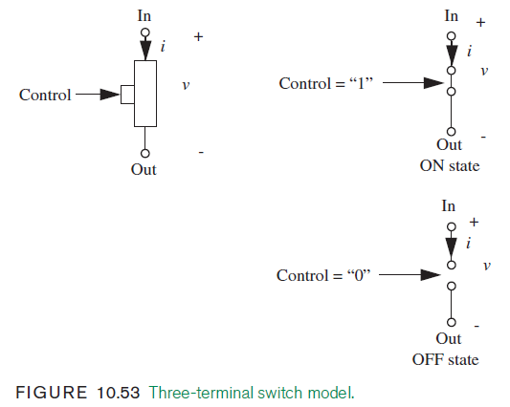
10.7 DIGITAL MEMORY

Slide 190
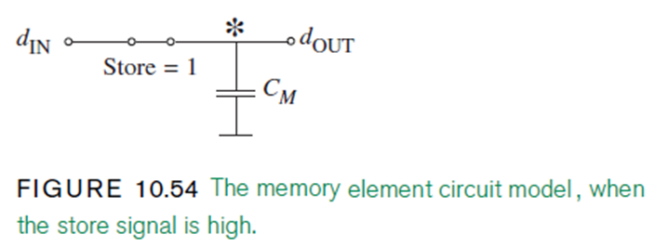
10.7 DIGITAL MEMORY

Slide 191
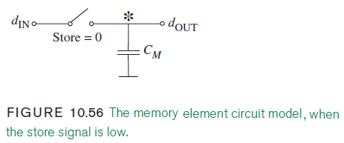
10.7 DIGITAL MEMORY

Slide 192
10.7 DIGITAL MEMORY

Slide 193
10.7 DIGITAL MEMORY

Slide 194
10.7 DIGITAL MEMORY

Slide 195
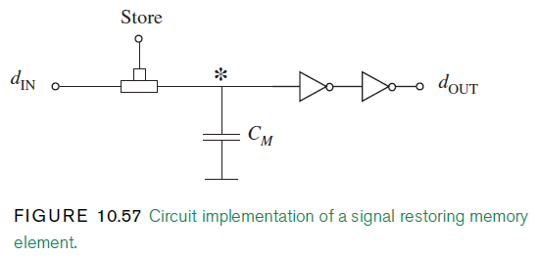
10.7 DIGITAL MEMORY

Slide 196
10.7 DIGITAL MEMORY

Slide 197
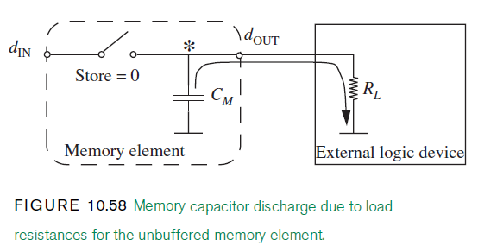
10.7 DIGITAL MEMORY

Slide 198
10.7 DIGITAL MEMORY

Slide 199
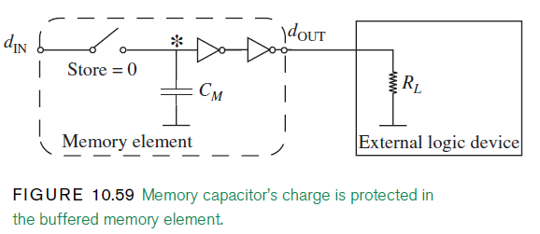
10.7 DIGITAL MEMORY

Slide 200
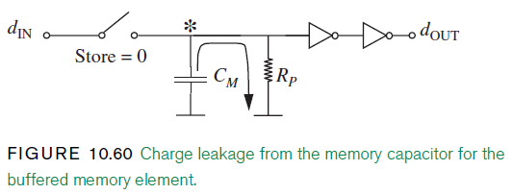
10.7 DIGITAL MEMORY

Slide 201
10.7 DIGITAL MEMORY

Slide 202
10.7 DIGITAL MEMORY

Slide 203
10.7 DIGITAL MEMORY

Slide 204
10.7 DIGITAL MEMORY

Slide 205
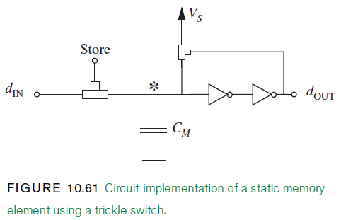
10.7 DIGITAL MEMORY

Slide 206
10.7 DIGITAL MEMORY

Slide 207
THE END

