Slide 1
EI232 CIRCUITS AND ELECTRONICS
LECTURE NOTES
Ma Dianguang
Fall 2013

Slide 2
CHAPTER 8
THE SMALL-SIGNAL MODEL

Slide 3
8.1 OVERVIEW OF THE NONLINEAR MOSFET AMPLIFIER

Slide 4
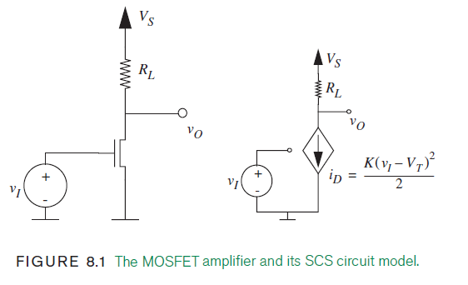
8.1 OVERVIEW OF THE NONLINEAR MOSFET AMPLIFIER

Slide 5
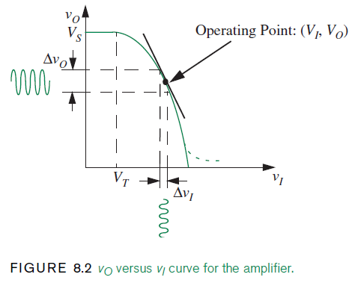
8.1 OVERVIEW OF THE NONLINEAR MOSFET AMPLIFIER

Slide 6
8.2 THE SMALL-SIGNAL MODEL

Slide 7
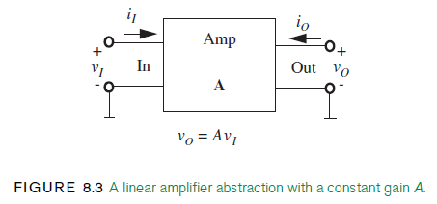
8.2 THE SMALL-SIGNAL MODEL

Slide 8
8.2 THE SMALL-SIGNAL MODEL

Slide 9
8.2 THE SMALL-SIGNAL MODEL

Slide 10
8.2 THE SMALL-SIGNAL MODEL

Slide 11
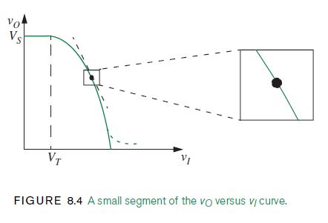
8.2 THE SMALL-SIGNAL MODEL

Slide 12
8.2 THE SMALL-SIGNAL MODEL

Slide 13
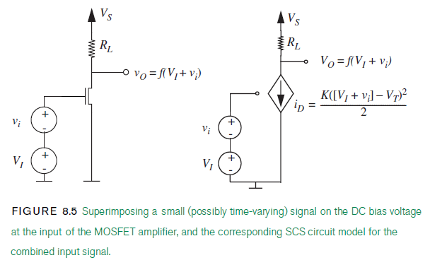
8.2 THE SMALL-SIGNAL MODEL

Slide 14
8.2 THE SMALL-SIGNAL MODEL

Slide 15
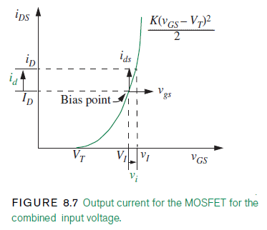
8.2 THE SMALL-SIGNAL MODEL

Slide 16
8.2 THE SMALL-SIGNAL MODEL

Slide 17
8.2 THE SMALL-SIGNAL MODEL

Slide 18
8.2 THE SMALL-SIGNAL MODEL

Slide 19
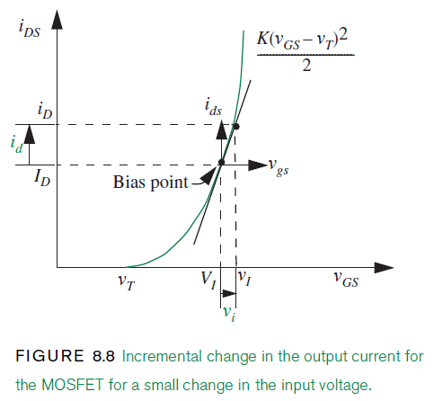
8.2 THE SMALL-SIGNAL MODEL

Slide 20
8.2 THE SMALL-SIGNAL MODEL

Slide 21
8.2 THE SMALL-SIGNAL MODEL

Slide 22
8.2 THE SMALL-SIGNAL MODEL

Slide 23
8.2 THE SMALL-SIGNAL MODEL

Slide 24
8.2 THE SMALL-SIGNAL MODEL

Slide 25
8.2 THE SMALL-SIGNAL MODEL

Slide 26
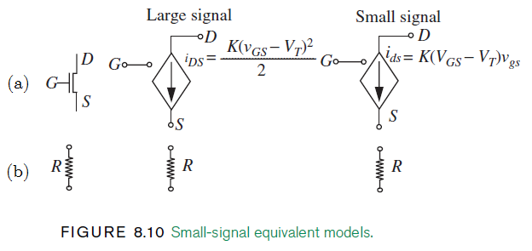
8.2 THE SMALL-SIGNAL MODEL

Slide 27
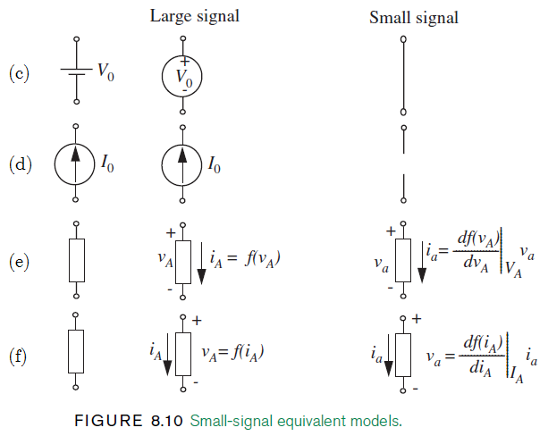
8.2 THE SMALL-SIGNAL MODEL

Slide 28
8.2 THE SMALL-SIGNAL MODEL

Slide 29
8.2 THE SMALL-SIGNAL MODEL

Slide 30
8.2 THE SMALL-SIGNAL MODEL

Slide 31
8.2 THE SMALL-SIGNAL MODEL

Slide 32
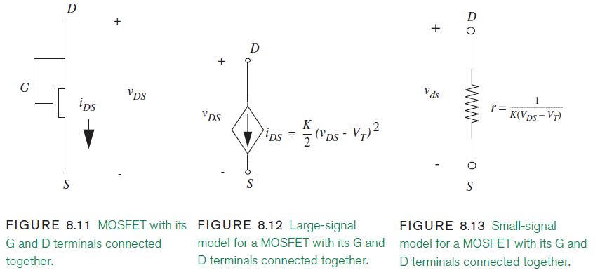
8.2 THE SMALL-SIGNAL MODEL

Slide 33
8.2 THE SMALL-SIGNAL MODEL

Slide 34
8.2 THE SMALL-SIGNAL MODEL

Slide 35
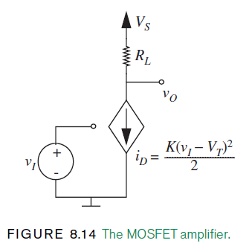
8.2 THE SMALL-SIGNAL MODEL

Slide 36
8.2 THE SMALL-SIGNAL MODEL

Slide 37
8.2 THE SMALL-SIGNAL MODEL

Slide 38
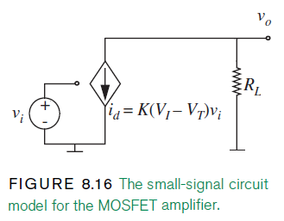
8.2 THE SMALL-SIGNAL MODEL

Slide 39
8.2 THE SMALL-SIGNAL MODEL

Slide 40
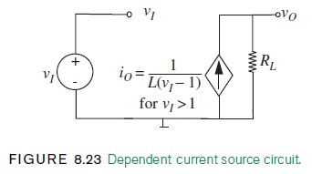
8.2 THE SMALL-SIGNAL MODEL

Slide 41
8.2 THE SMALL-SIGNAL MODEL

Slide 42
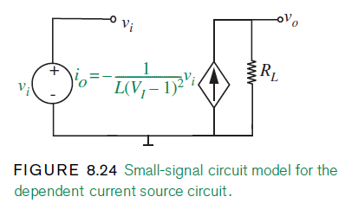
8.2 THE SMALL-SIGNAL MODEL

Slide 43
8.2 THE SMALL-SIGNAL MODEL

Slide 44
8.2 THE SMALL-SIGNAL MODEL

Slide 45
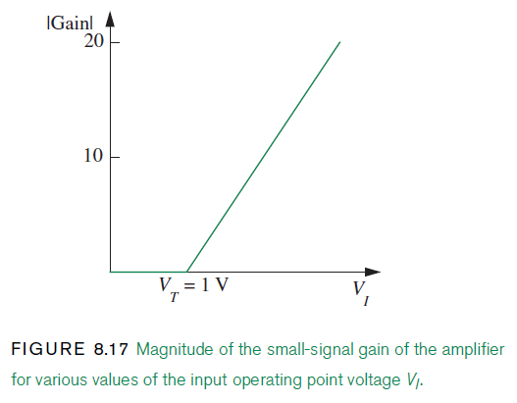
8.2 THE SMALL-SIGNAL MODEL

Slide 46
8.2 THE SMALL-SIGNAL MODEL

Slide 47
8.2 THE SMALL-SIGNAL MODEL

Slide 48
8.2 THE SMALL-SIGNAL MODEL

Slide 49
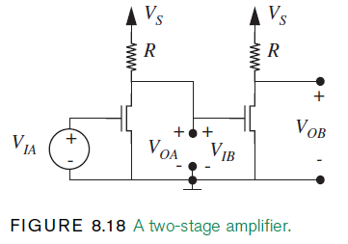
8.2 THE SMALL-SIGNAL MODEL

Slide 50
8.2 THE SMALL-SIGNAL MODEL

Slide 51
8.2 THE SMALL-SIGNAL MODEL

Slide 52
8.2 THE SMALL-SIGNAL MODEL

Slide 53
8.2 THE SMALL-SIGNAL MODEL

Slide 54
8.2 THE SMALL-SIGNAL MODEL

Slide 55
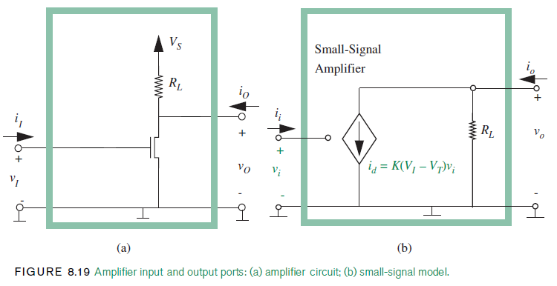
8.2 THE SMALL-SIGNAL MODEL

Slide 56
8.2 THE SMALL-SIGNAL MODEL

Slide 57
8.2 THE SMALL-SIGNAL MODEL

Slide 58
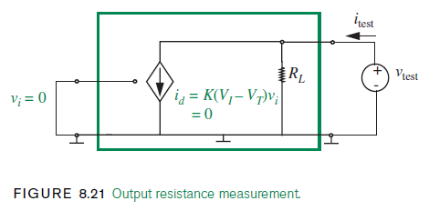
8.2 THE SMALL-SIGNAL MODEL

Slide 59
8.2 THE SMALL-SIGNAL MODEL

Slide 60
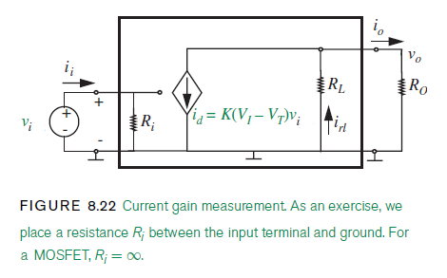
8.2 THE SMALL-SIGNAL MODEL

Slide 61
8.2 THE SMALL-SIGNAL MODEL

Slide 62
8.2 THE SMALL-SIGNAL MODEL

Slide 63
8.2 THE SMALL-SIGNAL MODEL

Slide 64
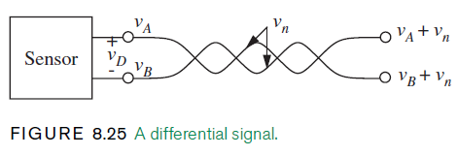
8.2 THE SMALL-SIGNAL MODEL

Slide 65
8.2 THE SMALL-SIGNAL MODEL

Slide 66
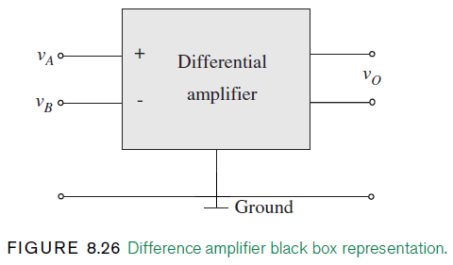
8.2 THE SMALL-SIGNAL MODEL

Slide 67
8.2 THE SMALL-SIGNAL MODEL

Slide 68
8.2 THE SMALL-SIGNAL MODEL

Slide 69
8.2 THE SMALL-SIGNAL MODEL

Slide 70
8.2 THE SMALL-SIGNAL MODEL

Slide 71
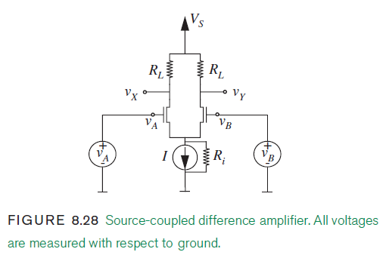
8.2 THE SMALL-SIGNAL MODEL

Slide 72
8.2 THE SMALL-SIGNAL MODEL

Slide 73
8.2 THE SMALL-SIGNAL MODEL

Slide 74
8.2 THE SMALL-SIGNAL MODEL

Slide 75
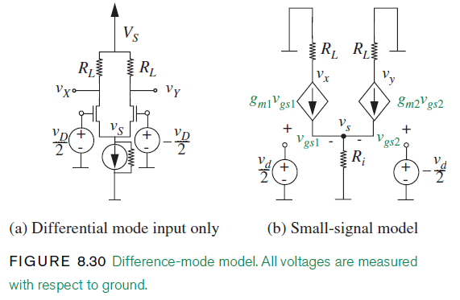
8.2 THE SMALL-SIGNAL MODEL

Slide 76
8.2 THE SMALL-SIGNAL MODEL

Slide 77
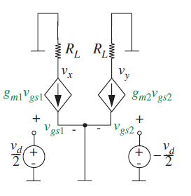
8.2 THE SMALL-SIGNAL MODEL

Slide 78
8.2 THE SMALL-SIGNAL MODEL

Slide 79
8.2 THE SMALL-SIGNAL MODEL

Slide 80
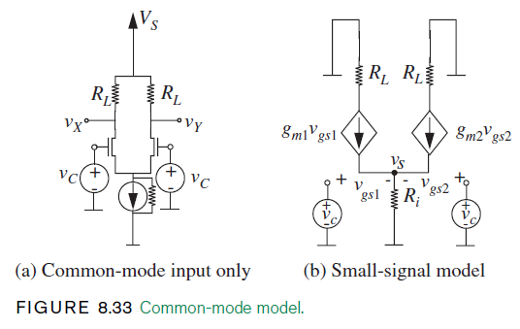
8.2 THE SMALL-SIGNAL MODEL

Slide 81
8.2 THE SMALL-SIGNAL MODEL

Slide 82
8.2 THE SMALL-SIGNAL MODEL

Slide 83
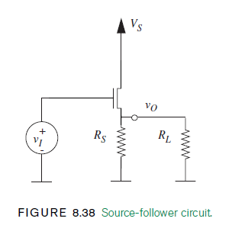
8.2 THE SMALL-SIGNAL MODEL

Slide 84
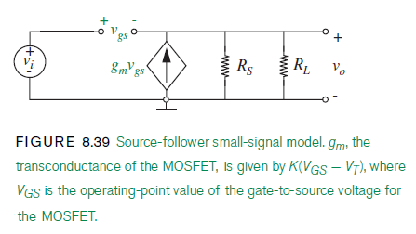
8.2 THE SMALL-SIGNAL MODEL

Slide 85
8.2 THE SMALL-SIGNAL MODEL

Slide 86
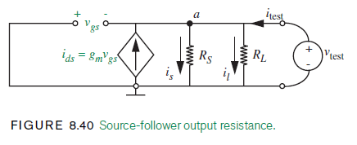
8.2 THE SMALL-SIGNAL MODEL

Slide 87
8.2 THE SMALL-SIGNAL MODEL

Slide 88
8.2 THE SMALL-SIGNAL MODEL

Slide 89
8.2 THE SMALL-SIGNAL MODEL

Slide 90
8.2 THE SMALL-SIGNAL MODEL

Slide 91
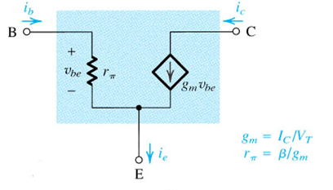
8.2 THE SMALL-SIGNAL MODEL

Slide 92
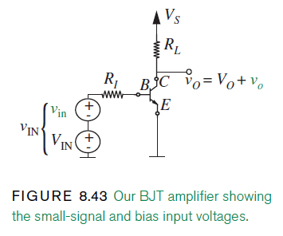
8.2 THE SMALL-SIGNAL MODEL

Slide 93
8.2 THE SMALL-SIGNAL MODEL

Slide 94
8.2 THE SMALL-SIGNAL MODEL

Slide 95
8.2 THE SMALL-SIGNAL MODEL

Slide 96
THE END

