Slide 1
tbl_user
userId =>int
userName =>varchar
password =>varchar
active => bit
employeeId =>int
roleId =>int
createdBy => int (userId)
createdDate =>datetime
tbl_role
roleId=>int
roleName=>varchar
active=>bit
remark=> bit
createdBy => int (userId)
createdDate =>datetime
tbl_employee
employeeId=>int
employeeImage=>varchar
employeeName=>varchar
fatherName=> varchar
dateOfBirth=>date
nrcNo => varchar
joinDate=>date
departmentId=>int
designationId => int
education => varchar
gender => varchar
maritalStatus=> varchar
address =>varchar
createdBy => int (userId)
createdDate =>datetime
tbl_designation
designationId=>int
designation=>varchar
active => bit
remark=>varchar
createdBy => int (userId)
createdDate =>datetime
tbl_department
departmentId=>int
department=>varchar
active => bit
remark=>varchar
createdBy => int (userId)
createdDate =>datetime

Slide 2


Slide 3
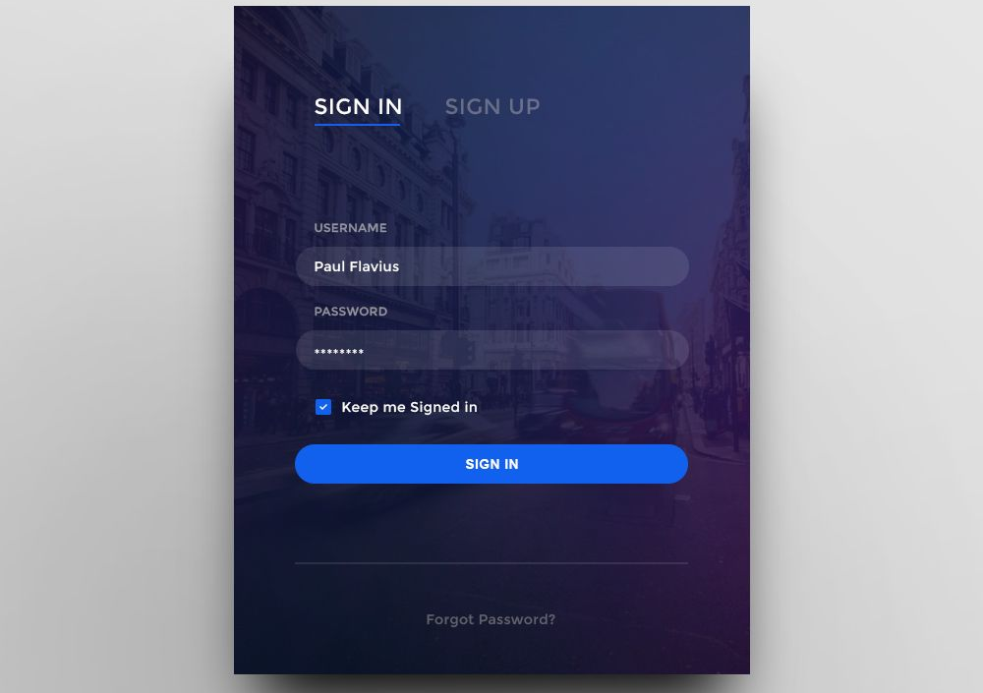
Login

Slide 4
Sidebar menu items
Main Menu
Setup
Dashboard
Transactions
View Transactions
Report
Admin Panel
Setting
Setup
Create Login
Roles
Employees
Designations
Departments

