Slide 1
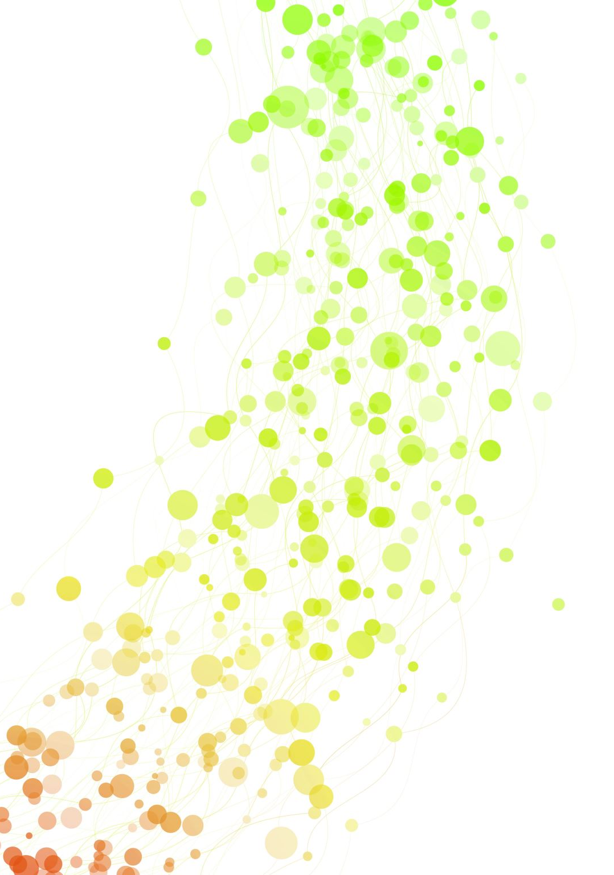
Nashville City Cemetery
By The Numbers

Slide 2
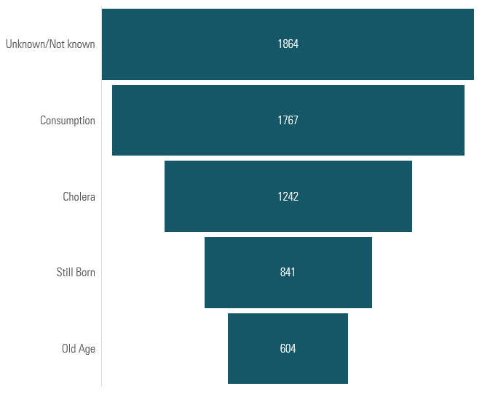
Top 10 Causes of Death

Slide 3
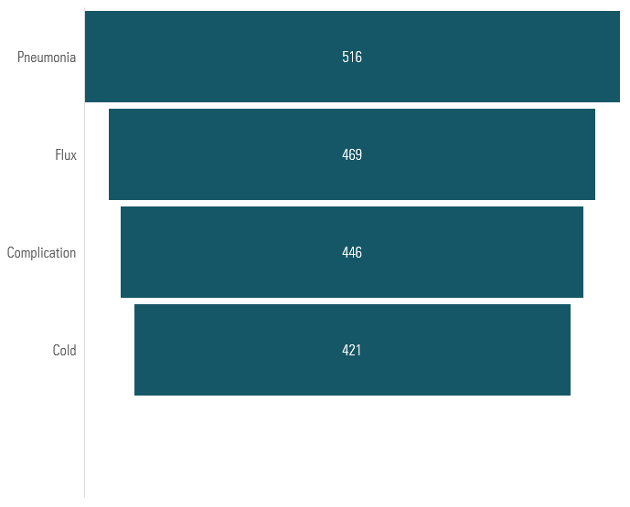
Top 10 Causes Of Death

Slide 4
What do these numbers mean?
“Unknown” = Cause of death wasn’t recorded at all.
“Not Known” = Same idea; slightly different wording
I combined the two in the dataset.
Poor medical knowledge and limited diagnostics attributed to much of the unknown-not known data. Although medicine advanced during and after the civil war many physicians lacked the knowledge, tools and technology to accurately diagnose.
Incomplete or informal records also played a big role. Those impoverished, enslaved individuals/those under Black Codes and Jim Crow attributed greatly. Infant mortality with investigation must also be considered.

Slide 5
What do these numbers Mean?
Social and cultural factors were also at play along with Stigma.
For causes of death considered “shameful” at the time (e.g., venereal diseases), families or officials might have intentionally left the cause blank or entered “Unknown” to avoid scandal.
The inability to accurately track Epidemics. In times of outbreaks such as HIV/AIDS, there were simply too many deaths for officials to determine individual causes. Some deaths might just be marked “Unknown” in the rush or because they couldn't readily identify.

Slide 6
Years With THE Most Burials
Notes:
Question #2

Slide 7
Spikes In Death By Months
September 1866 stands out as a massive spike at 441 deaths. This is likely tied to a cholera outbreak, hit Nashville hard in 1866.
July 1850 was also a deadly month with 370 deaths. This aligns with one of the first recorded cholera epidemics that we have using this data. It swept Nashville the summer of 1850. That was a hot summer month, and we know that Cholera is water-born.
July 1864 & July 1865 were during the height of the Civil War. The 154 deaths coincide with battles, disease outbreaks in army camps, and poor sanitary conditions.

Slide 8
Male To Female Deaths
Slightly more males than females are buried in the dataset.
Male deaths: 10,108 (51.2%)
Female deaths: 9,372 (47.5%)
This was most likely due to males fighting in the civil war, as well infectious/ venereal diseases and risky labor such as building sky scrappers.

Slide 9
Death By Age Over Time
Infant/child deaths (0–10) were much higher before the 1900s.
Ages 60+ (especially ages 71–90) increased significantly between the 1930’s- 1960’s.
Very old age (91–100+) remained rare but slowly grew by the 1970s.
The middle-age groups (41–60) just remained stable through the years.

Slide 10

the most common last names of people buried in this cemetery
Smith 129
Brown 113
Johnson 98
Jones 85
Williams 71

Slide 11
Most Famous Person Buried In This Cemetery
President James K. Polk (11th President of the U.S.)
Died In 1849

Slide 12
Other Notable Burials
Elias Polk who was enslaved by former President Polk but who went onto become one of the first African American Democratic Political Activists. He is interesting because of his path after emancipation. The democratic party was known for white supremacy in the 1800’s. Polk’s alignment to them is seen as a contradiction during that time period.

Slide 13
Last Infant Burial of 1864
The infant was nameless and there is no cause of death listed. This goes back to the first findings regarding “unknown / not known”.
The child’s father was Jack Curren, a free man of color.
Died December 29,1864

Slide 14
The Systemic Erasure of a People
enslaved people in 1860 — over 30% of the total population. Davidson County had nearly 14,800 enslaved people.
Slaveholders recorded births and deaths of enslaved people primarily as economic data, not as matters of identity or humanity.
Black Codes made Births and deaths of Black Nashvillians were seldom officially documented — reinforcing “Unknown” and informal entries
During Jim Crow Segregation laws expanded into cemeteries, hospitals, and registries, isolating Black lives and deaths
This data tells us that “Between enslavement, restrictive Black Codes, and entrenched Jim Crow segregation, Black Nashvillians were often erased from public records — including burial records. What we see as ‘Unknown’ in the data represents real human lives systematically omitted from history.”

Slide 15
Children of the Shadows Museum/ Memorial
installation of empty cradles or shoes, symbolizing the thousands of Black children lost to preventable disease, systemic racism and poverty.
Elias Polk Statue or Bust exhibit or install
“Say Their Names” Memorial Wall. Visitors can add names of Black ancestors lost to history, creating a living memorial.
Black Death Under Jim Crow exhibit.
Enslaved and Erased exhibit.

