Slide 1
Opioid Oversight and Community Impact
Representing community groups advocating for prescription opioid oversight
Goal: Identify overdose trends, spending correlations, and socioeconomic factors
Recommend data-informed actions for oversight and prevention

Slide 2



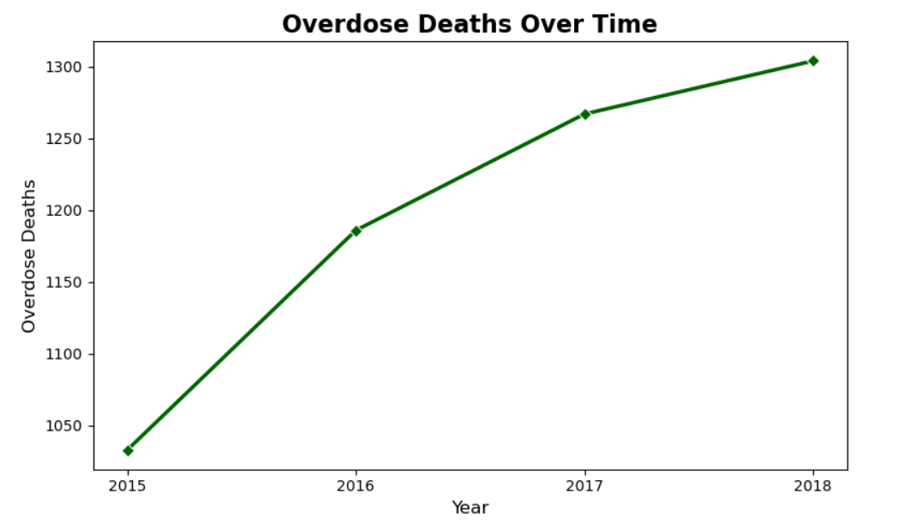
Overdose Death Trends
Overdose deaths increased about 25% from 2015–2018.
The steepest rise occurred between 2015–2016, adding roughly 140 deaths.
Growth slowed after 2017 but remains upward — highlighting sustained risk.

Slide 3
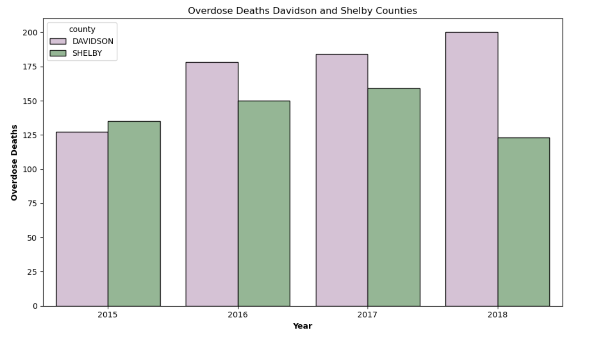
Top Counties by Overdose Deaths
Davidson County overdose deaths rose approximately 57% from 2015 to 2018.
Shelby County peaked in 2017 but declined in 2018.
Davidson remains the state’s highest-burden county for overdoses.

Slide 4
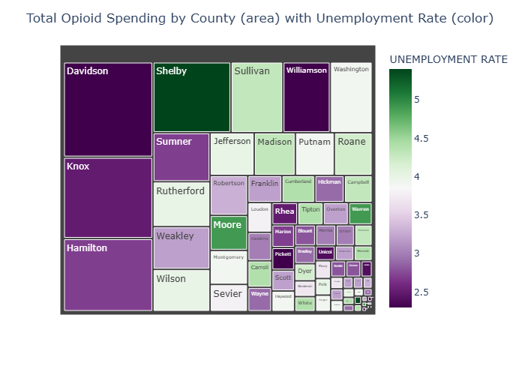
Relationship Between Opioid Spending and Unemployment Rate

Slide 5
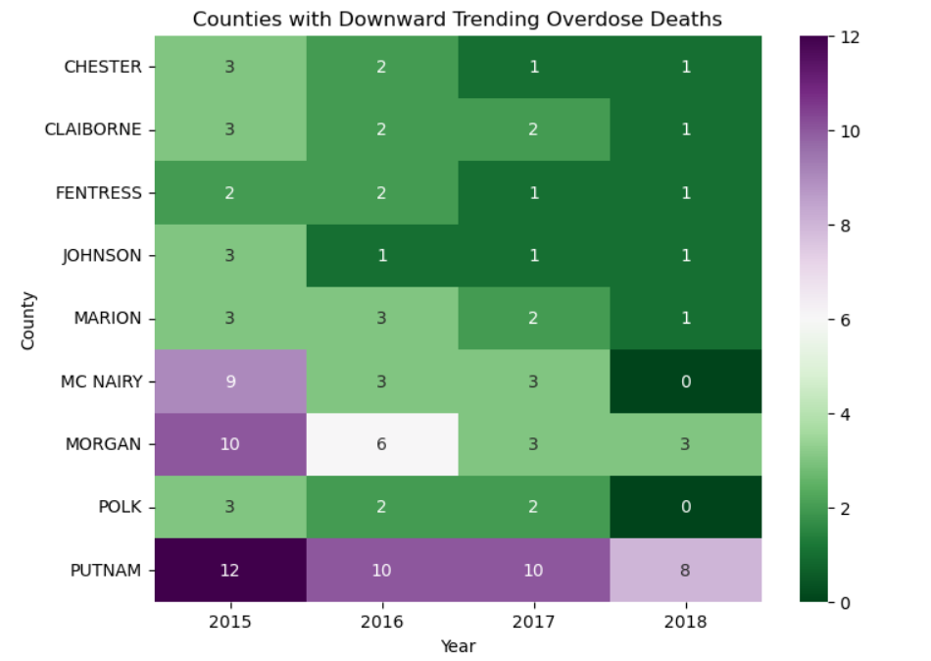
Counties with Downward Trend of Deaths
Several smaller counties – McNairy, Morgan, Putnam, Chester, Claiborne — show declines from 2015 to 2018.
The most consistent improvement occurred in Putnam, Morgan, and McNairy.

Slide 6
Economic Hardship and Overdose Rates
Unemployment does not show a strong statewide correlation with overdose deaths.
Some overlap exists in southwest counties, linking hardship and drug use risk.
Link to Map

