Slide 1

🚌
WeGo Nashville
We analyzed 338,000+ bus crossings
so you don't have to.
Bus Performance Analysis
Team: Axel Rose
You're welcome, Nashville. 🎸
NewForce Cohort 12 • 2026

Slide 2



The Big Picture: Are We On Time?
79.7%
17.4%
2.9%
On Time
Late
Early

Slide 3
Does Direction Matter? (Spoiler: Yes.)
FROM Downtown
TO Downtown
75.0% on time
75.6% on time
22.1% late • 3.1% early
10.8% late • 2.5% early
🚌💨 (running FROM downtown gets messy)
🎯 Heading into downtown = more punctual

Slide 4

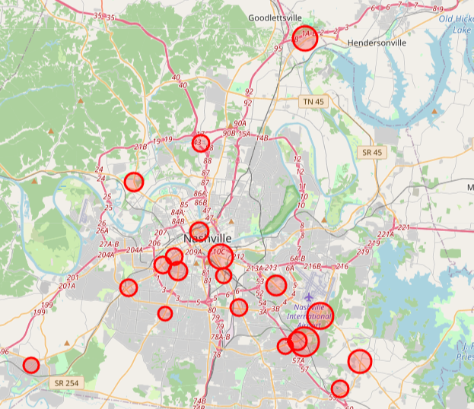
Where Does Nashville Bus Service Struggle?
Key Findings
🔴 Downtown core
Worst late clusters
🔴 Murfreesboro Pike
South corridor hotspot
🟡 Goodlettsville
Surprising outlier way up north
🟢 Route edges
Better performance
at outer stops

Slide 5
Rush Hour: The Great Bus Villain
😩 4–5pm: ~28% of buses are late
Afternoon rush is the enemy of schedules
😌 Sunday is the GOAT: only 11.4% late
Fewer people, fewer problems

Slide 6


The Driver Effect: It's Real, Y'all
219
Drivers Analyzed
18%
Average Late Rate
🏆 Best driver: only 0.6% late
Somebody's getting a gold star sticker
😬 Worst driver: 54.4% late
Half the time. Every time. Bless their heart.

Slide 7
Headway: The Bunching Problem
Headway = time between buses at the same stop.
Bunching = buses clump together. Gapping = huge gaps between buses.
Acceptable range: 50%–150% of scheduled headway.

Slide 8
The Domino Effect: First Stop → Everything Else
🚨 Start 6+ minutes late?
You'll probably stay late.
Buses that start very late average -5.9 min downstream — nearly at the threshold.
⏱️ Drivers who take their full layover time
produce more stable headways downstream.
The schedule isn't magic — drivers using their buffer time is.

Slide 9
✅ 79.7% on-time overall — better than it sounds!
🌆 Downtown & rush hour are the biggest trouble spots
So, What Did
We Learn?
🚌 FROM downtown is rougher than heading in (22% vs 11% late)
tl;dr — Nashville buses are
pretty solid, but rush hour
and downtown are tough.
😴 Sunday is the best day to ride — only 11.4% late
🧑‍✈️ Drivers matter a lot — 0.6% to 54% late range!
🎸 Nashville's still got rhythm.
🎛️ Layover time = headway stability — use the buffer!

