Slide 1



Docker
从 零 开 始
给 刘 师 傅 好 好 的 上 一 课 。
冯 泽 明
2021-10-10

Slide 2


目录
1、Docker是什么?
2、Docker的历史。
contents
3、为什么使用 Docker？
4、Docker的HelloWorld。

Slide 3

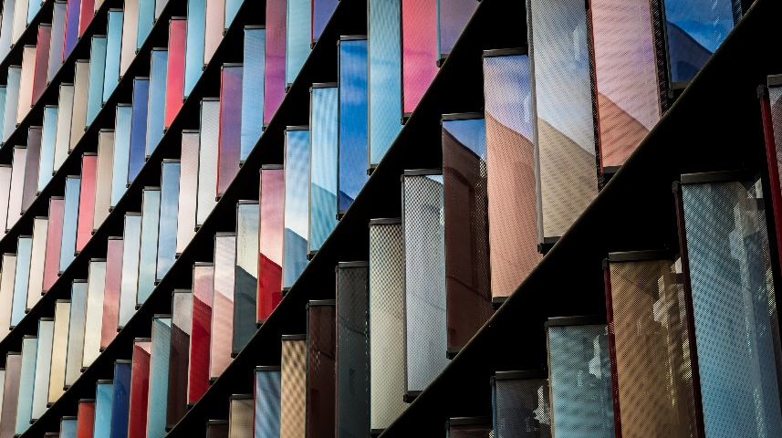

PART 1
Docker is a platform that allows you to “build, ship, and run any app, anywhere.” It has come a long way in an incredibly short time and is now considered a standard way of solving one of the costliest aspects of software: deployment.
Docker是一个平台，允许“build, ship, and run any app, anywhere”。它在极短的时间内走了很长一段路，现在被认为是用于解决软件部署问题的标准方法，而部署是软件最昂贵的方面之一。
Docker是什么？

Slide 4
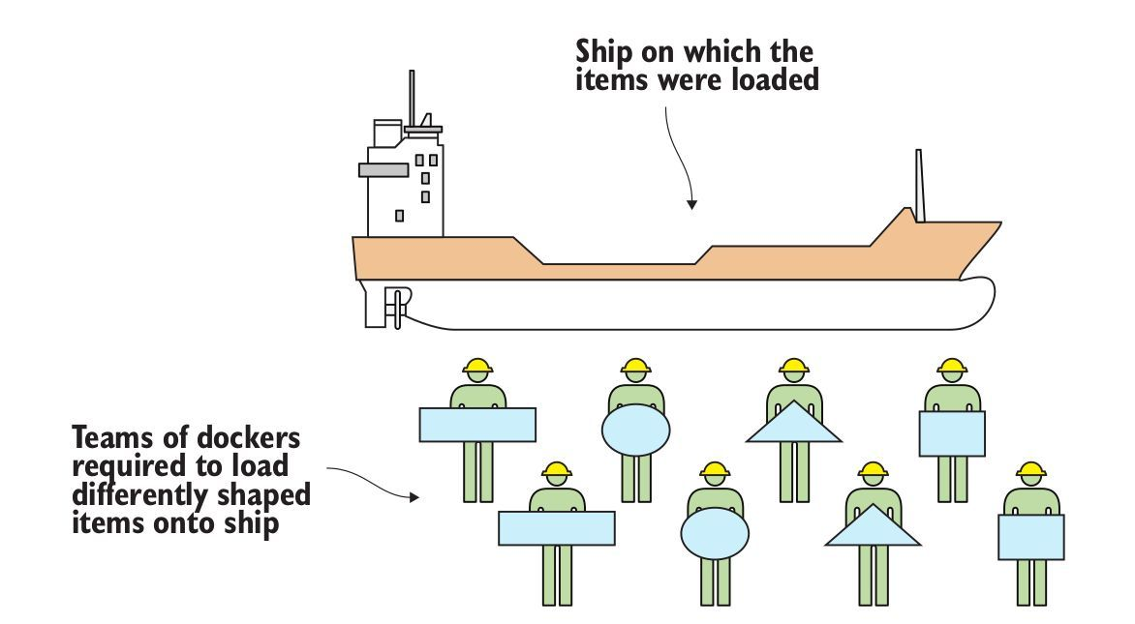
此处打个比方
来自书籍 《Docker In Practice” chapter 1.1.1 What is Docker? 》
在有Docker之前：
不同团队的码头工人被要求装载不同形状的物体到船上去。
Notes:
要了解Docker是什么，从隐喻开始比使用技术解释更容易，而Docker本身是一个强大的隐喻：Docker的本意是码头工人。码头工人是这样的劳动者：当船只停靠在港口时，码头工人将商品移入和移出船只。箱子和物品的大小和形状各不相同，经验丰富的码头工人因其能够以经济有效的方式手工将货物装入船舶而受到重视。雇人搬东西并不便宜，但别无选择。

Slide 5
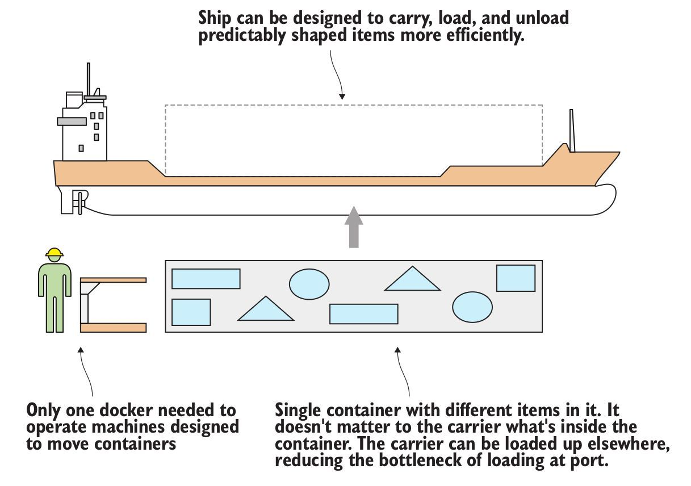
此处打个比方
来自书籍 《Docker In Practice” chapter 1.1.1 What is Docker? 》
在有Docker之后：
船被设计为更有效的装载和卸载预设形状的物品
物品放在相同的容器中且不关心容器里面是什么
载体可以装载到其他地方，减少了港口装载的瓶颈
仅需一个码头工人来操作设计用来移动容器的机器
Notes:
对于工作在软件方面的人来说，这应该是熟悉的。花费了大量时间和智力，将隐喻奇怪形状的软件变成了不同大小的异形船，其中包含其他形状奇特的软件，因此它们可以出售给其他地方的用户或企业。

Slide 6
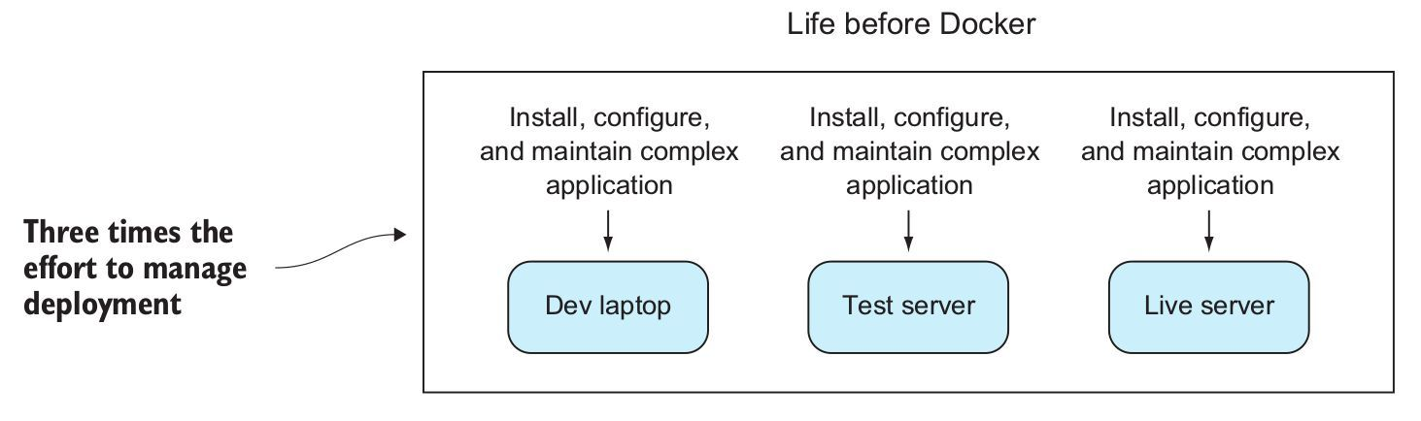
开始使用Docker之前
Notes:
在Docker之前，将软件部署到不同的环境需要付出巨大的努力。即使您不是手动运行脚本来在不同的计算机上配置软件（并且很多人仍然这样做），您仍然需要与配置管理工具搏斗，这些工具可以在日益快速发展而缺乏资源的环境上管理状态。即使将这些工作封装在VM中，也花费了大量时间来管理这些VM的部署，等待它们启动，以及管理它们创建的资源使用开销。

Slide 7
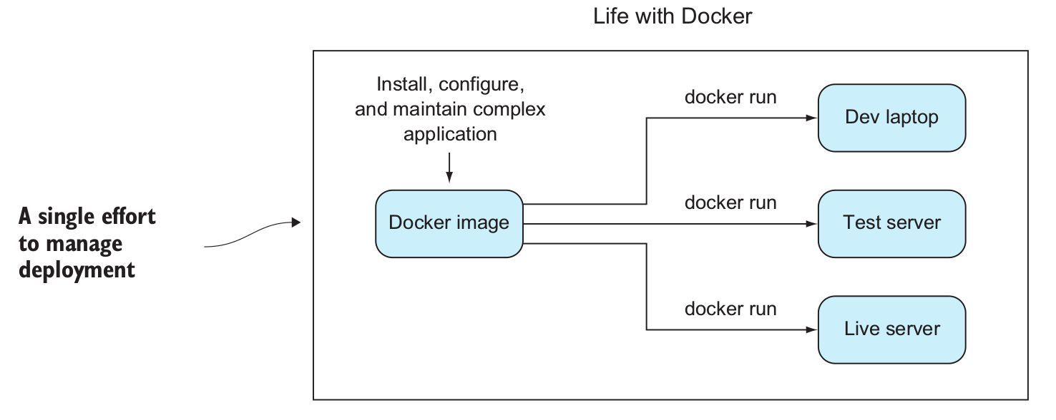
开始使用Docker之后
Notes:
有了Docker，配置工作与资源管理分离，从而使得部署工作非常简单：运行docker run，环境镜像被拉下并准备运行，消耗更少的资源，不干扰其他环境。
无需担心容器是否将被运送到RedHat机器，Ubuntu机器或Cent OS VM映像; 只要它上面有Docker，就可以了。

Slide 8
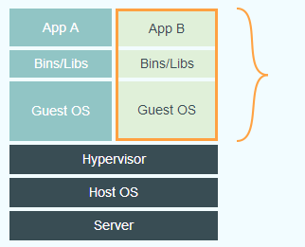
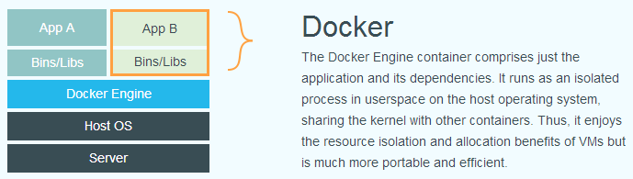
不同于传统的虚拟化
传统虚拟化
体积臃肿庞大，包含程序、库与操作系统
虚拟出一套硬件并在其上运行操作系统
Docker
只包含程序与库
直接运行与宿主内核
Notes:
传统虚拟机技术是虚拟出一套硬件后，在其上运行一个完整操作系统，在该系统上再运行所需应用进程；而容器内的应用进程直接运行于宿主的内核，容器内没有自己的内核，而且也没有进行硬件虚拟。因此容器要比传统虚拟机更为轻便。

Slide 9

PART 2
Docker的历史。

Slide 10
PART 3
为什么使用 Docker？

Slide 11
PART 4
Docker的HelloWorld。

Slide 12
THE TITLE TEXT HERE
The sun is bright, the trees are green and the animals live happily.） Mufasa: Look, Simba, everything the light touches is our kingdom. Simba: Wow! Mufasa: A king's time as ruler rises and falls like the sun. One day, Simba, the sun will set on my time here and rise with you as the new king. Simba: And this all be mine? Mufasa: Everything! Simba: Everything the light touches! What about that shadowy place? Mufase: That's beyond our borders, you must never go there, Simba. Simba: But I thought a king can do whatever he wants.
TEXT
TEXT
TEXT
TEXT HERE

Slide 13

TEXT HERE
he sun is bright, the trees are green and the animals live happily.）
TEXT HERE
TEXT HERE
the trees are green and the animals live happily
the trees are green and the animals live happily
The sun is bright, the trees are green and the animals live happily.） Mufasa: Look, Simba, everything the light touches is our kingdom. Simba: Wow! Mufasa: A king's time as ruler rises and falls like the sun. One day, Simba, the sun will set on my time here and rise with you as the new king. Simba: And this all be mine? Mufasa: Everything! Simba: Everything the light touches! What about that shadowy place? Mufase: That's beyond our borders, you must never go there, Simba. Simba: But I thought a king can do whatever he wants. Mufasa: Oh, there's more to being a king than getting your way all the time.

Slide 14


Enjoy your life TEXT HERE
TEXT
HERE
The sun is bright, the trees are green and the animals live happily.） Mufasa: Look, Simba, everything the light touches is our kingdom. Simba: Wow! Mufasa: A king's time as ruler rises and falls like the sun. One day, Simba, the sun will set on my time here and rise with you as the new king. Simba: And this all be mine? Mufasa: Everything! Simba: Everything the light touches! What about that shadowy place?
Enjoy your life TEXT HERE
TEXT
HERE
The sun is bright, the trees are green and the animals live happily.） Mufasa: Look, Simba, everything the light touches is our kingdom. Simba: Wow! Mufasa: A king's time as ruler rises and falls like the sun. One day, Simba, the sun will set on my time here and rise with you as the new king. Simba: And this all be mine? Mufasa: Everything! Simba: Everything the light touches! What about that shadowy place?

Slide 15

TEXT HERE
01
The sun is bright, the trees are green and the animals live happily.） Mufasa: Look, Simba, everything the light touches is our kingdom.
TEXT HERE
02
The sun is bright, the trees are green and the animals live happily.） Mufasa: Look, Simba, everything the light touches is our kingdom.
TEXT
HERE
TEXT HERE
03
The sun is bright, the trees are green and the animals live happily.） Mufasa: Look, Simba, everything the light touches is our kingdom.
TEXT HERE
04
The sun is bright, the trees are green and the animals live happily.） Mufasa: Look, Simba, everything the light touches is our kingdom.

Slide 16
PART 2
The sun is bright, the trees are green and the animals live happily.） Mufasa: Look, Simba, everything the light touches is our kingdom. Simba: Wow! Mufasa: A king's time as ruler rises and falls like the sun. One day, Simba, the sun will set on my time here and rise with you as the new king. Simba: And this all be mine? Mufasa: Everything! Simba: Everything the light touches! What about that shadowy place?
Enjoy your life
TEXT HERE

Slide 17
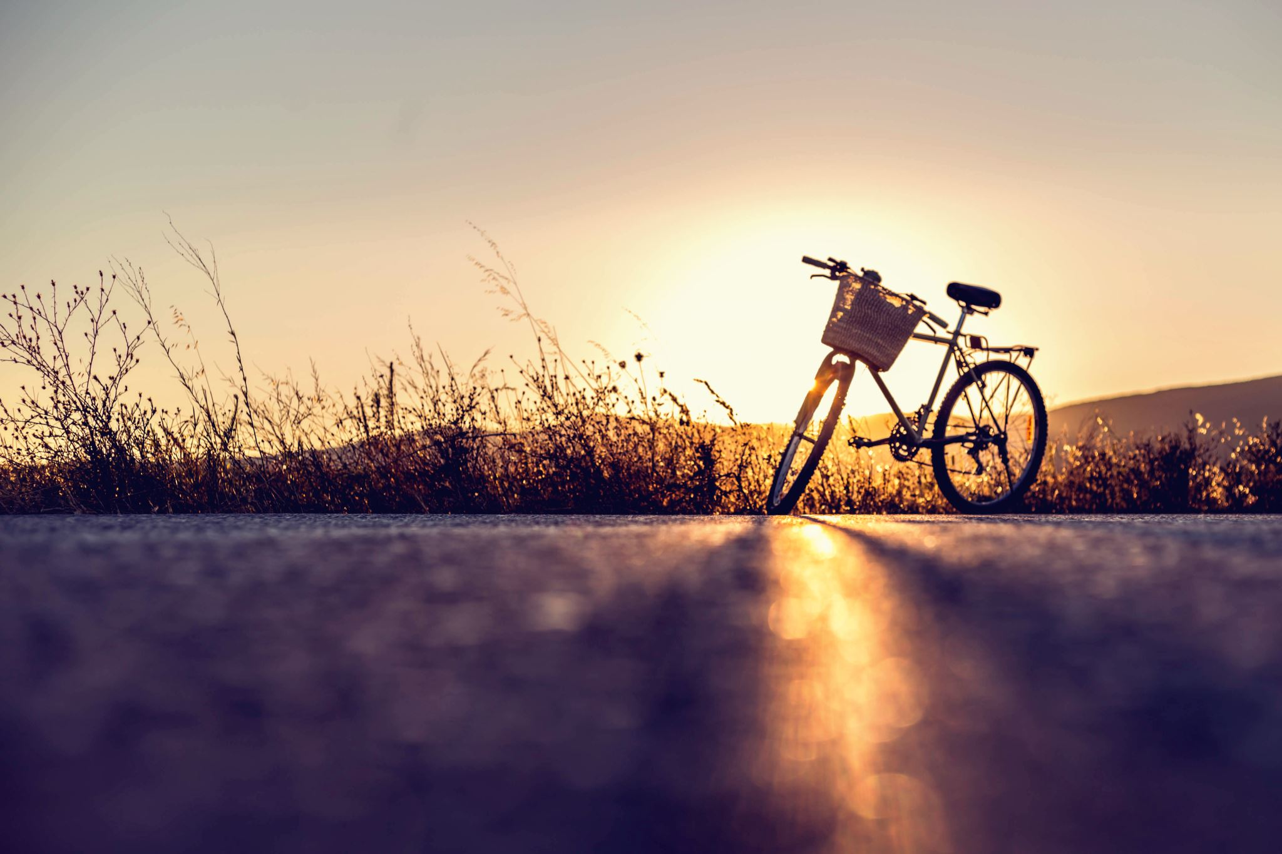


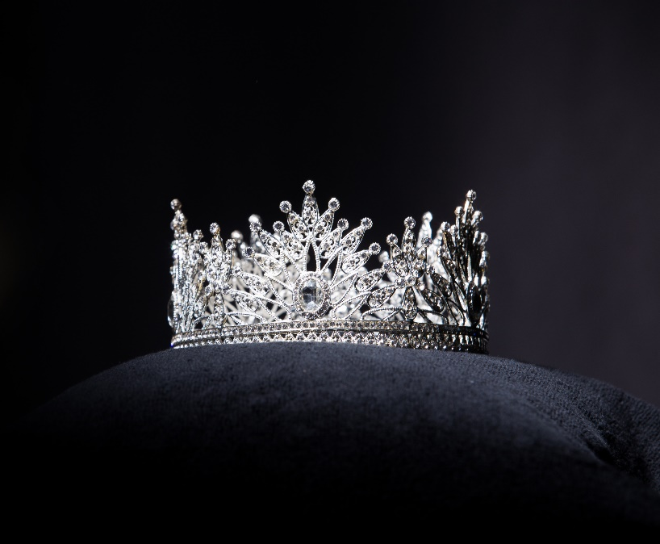
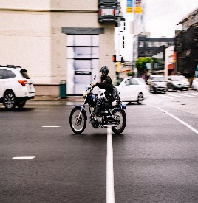
TEXT HERE
TEXT HERE

Slide 18
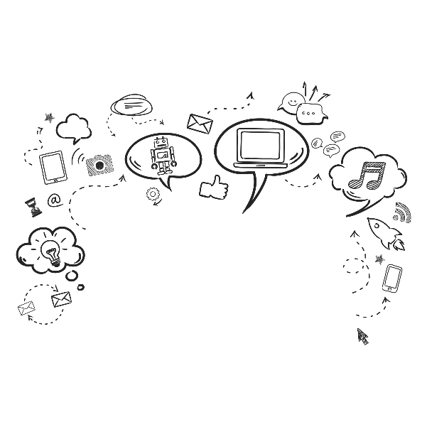
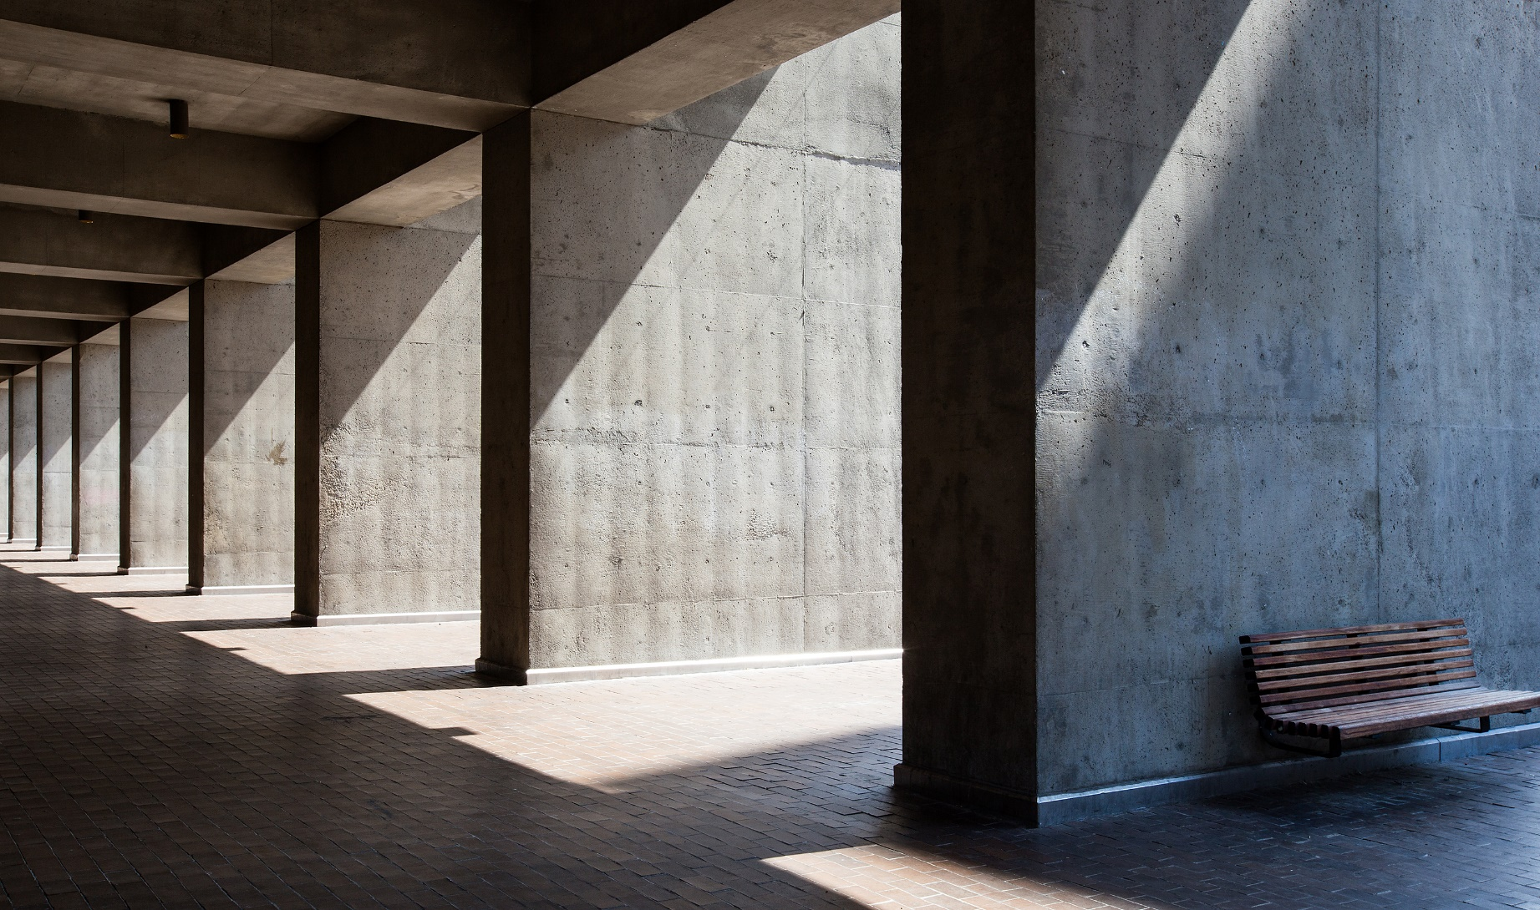
Enjoy your life TEXT HERE
The sun is bright, the trees are green and the animals live happily.） Mufasa: Look, Simba, everything the light touches is our kingdom. Simba: Wow! Mufasa: A king's time as ruler rises and falls like the sun. One day, Simba, the sun will set on my time here and rise with you as the new king. Simba: And this all be mine? Mufasa: Everything! Simba: Everything the light touches! What about that shadowy place?

Slide 19
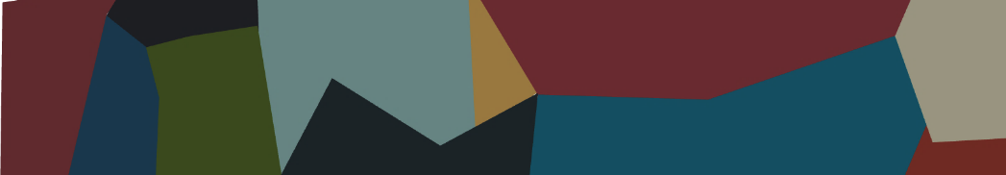
Thanks for watching

