Slide 1

Java 8+

Slide 2
Topics
Lambda Expressions

Slide 3
Lambda Expressions

Slide 4
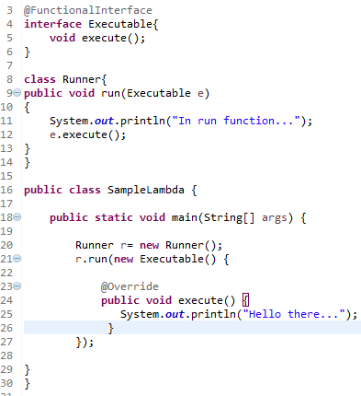
Traditional way – Anonymous Classes

Slide 5
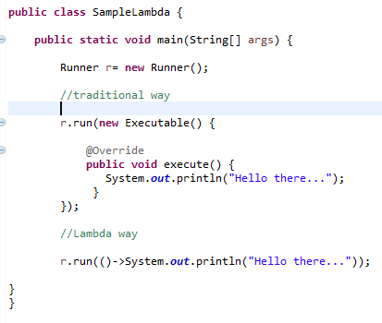
Basic Lambda Expression

Slide 6
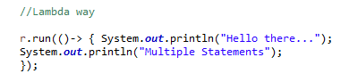
Multiple Statements

Slide 7
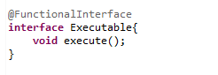
Functional Interface

Slide 8
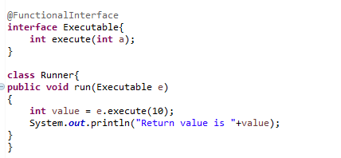
Return Values & Parameters

Slide 9
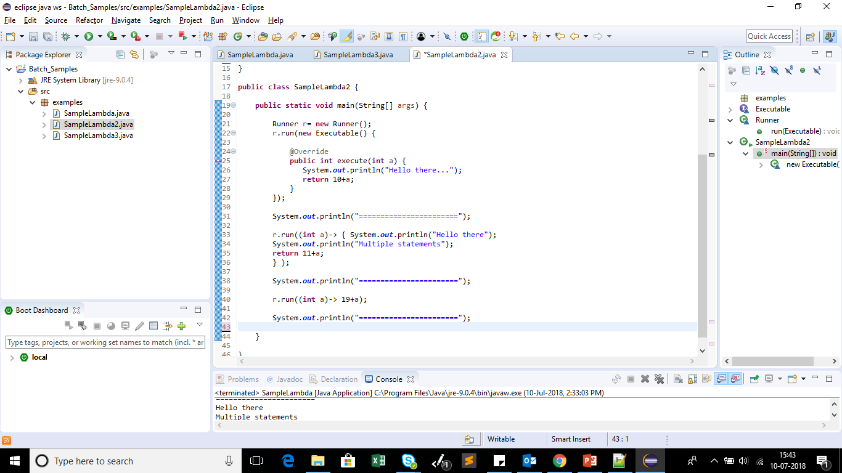
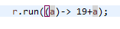
Return Values & Parameters

Slide 10
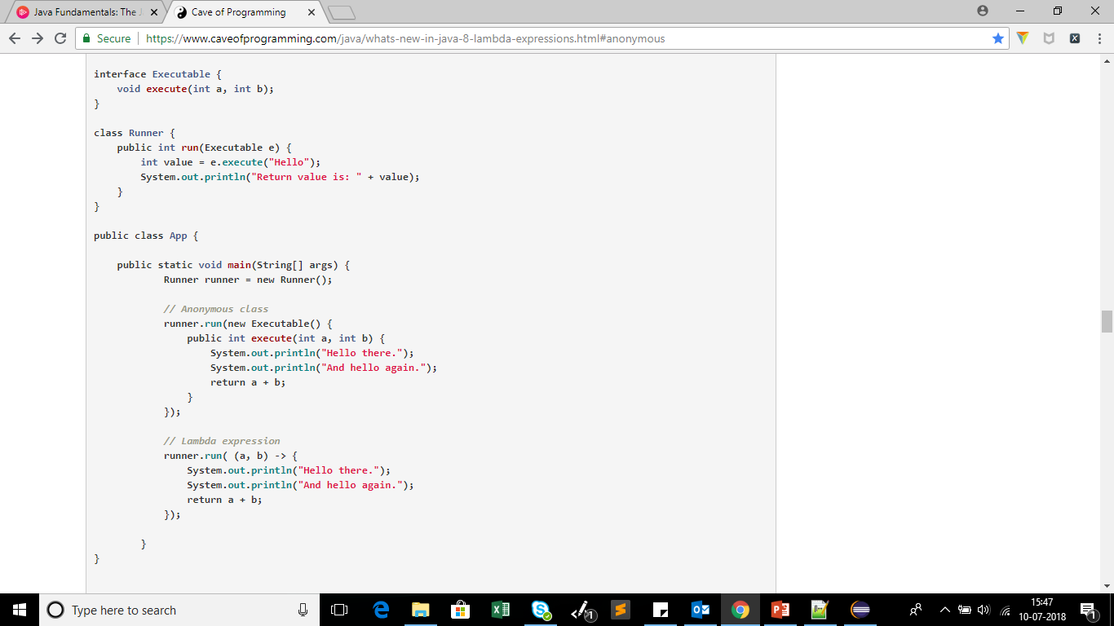
Lambda Expression Multiple Parameters

Slide 11
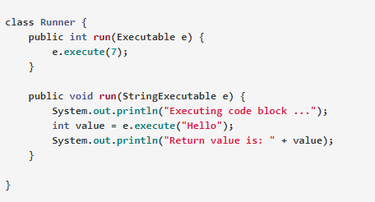
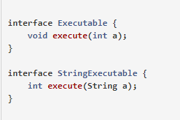
Parameter Ambiguity

Slide 12
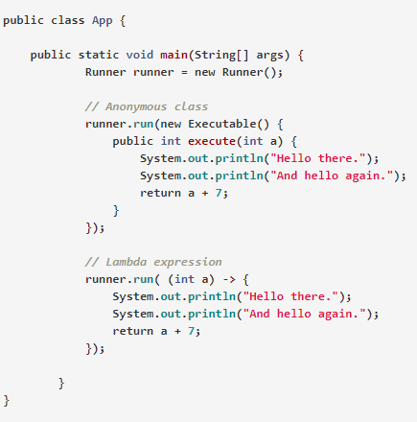
Parameter Ambiguity

Slide 13
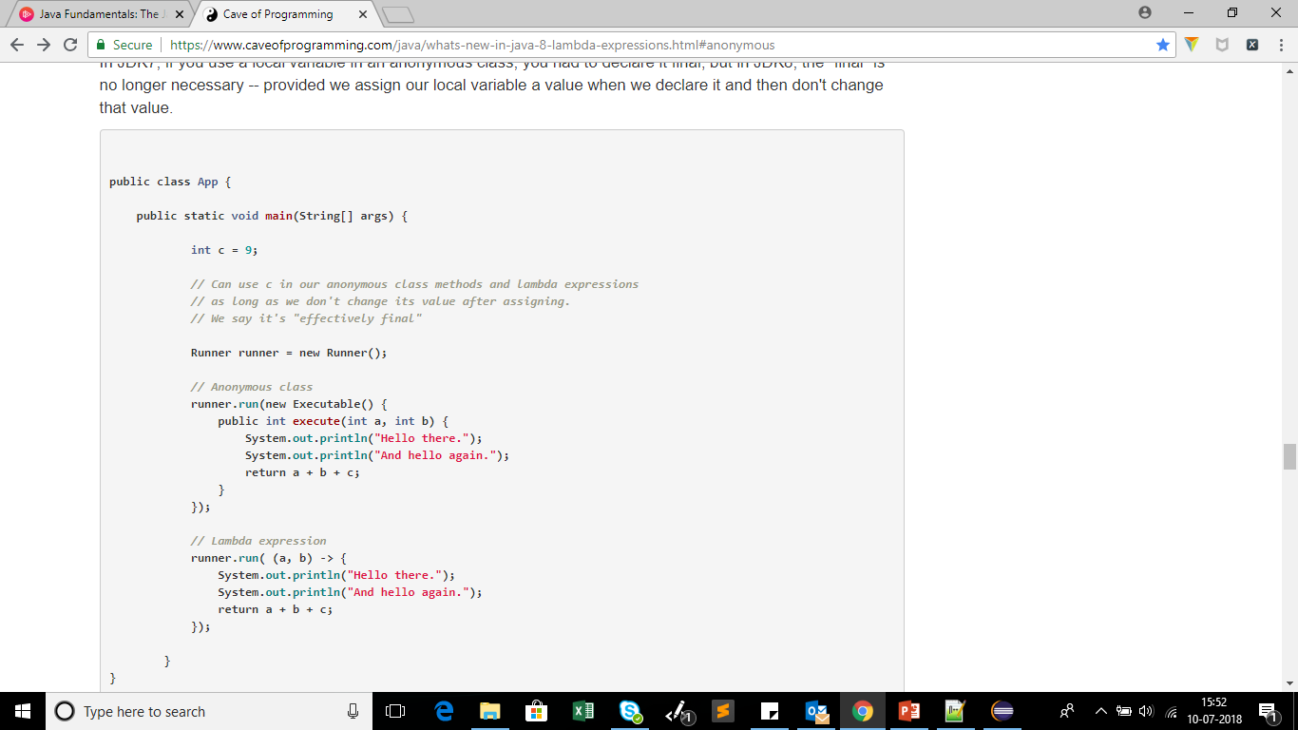
Lambda Expression - Scope

Slide 14
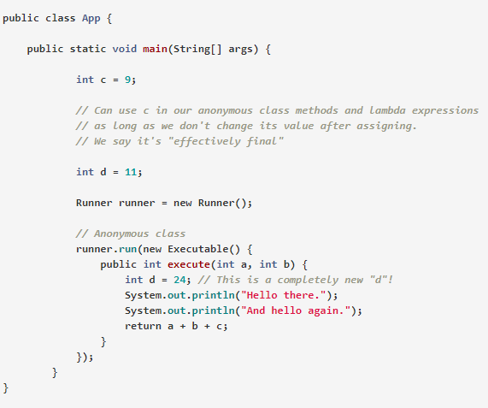
Lambda Expression - Scope

Slide 15
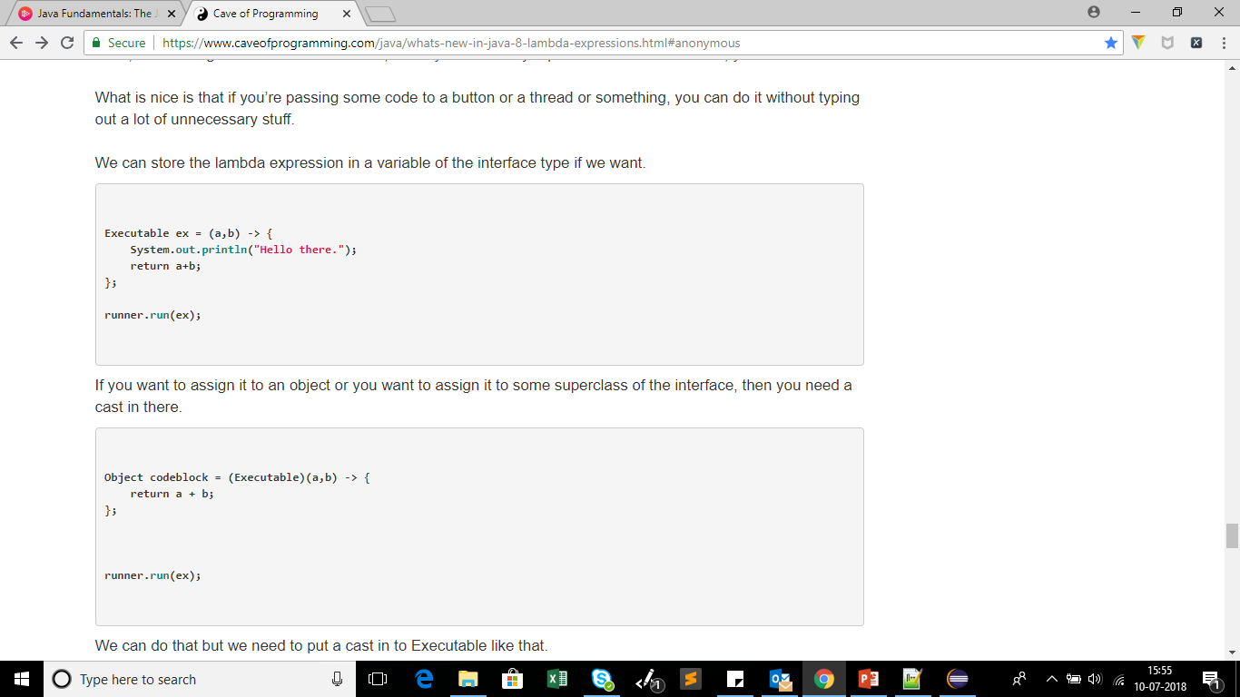
Lambda Expression – As Objects

Slide 16
Thank You
Our Locations: China | Costa Rica | India | Mauritius | Philippines | Poland | Singapore | U.K. | U.S.A.

