Slide 1


SDLC
Neetu Srivastava

Slide 2
Prerequisite
There are no specific prerequisites for this SDLC tutorial and any software professional can go through this tutorial to get a bigger picture of how the high-quality software applications and products are designed
A good understanding of programming or testing or project management will give an added advantage and help to gain maximum from this tutorial
Faster Time-to-Market
Digital Transformation
Securing Brand and Customer Trust
Enhancing Operational Efficiency

Slide 3
Training Output
By the end of this tutorial, the readers will develop a comprehensive understanding of SDLC and its related concepts and will be able to select and follow the right model for any given Software project.
Faster Time-to-Market
Digital Transformation
Securing Brand and Customer Trust
Enhancing Operational Efficiency

Slide 4
Introduction
SDLC stands for Software Development Life Cycle also called as Software Development Process
SDLC is a process that consists of a series of planned activities to develop or alter the Software Products
The SDLC aims to produce a high-quality software that meets or exceeds customer expectations, reaches completion within times and cost estimates
It consists of a detailed plan describing how to develop, maintain, replace and alter or enhance specific software
The life cycle defines a methodology for improving the quality of software and the overall development process
Faster Time-to-Market
Digital Transformation
Securing Brand and Customer Trust
Enhancing Operational Efficiency

Slide 5
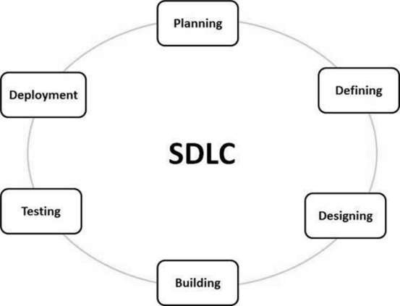
Introduction
The following figure is a graphical representation of the various stages of a typical SDLC.
Faster Time-to-Market
Digital Transformation
Securing Brand and Customer Trust
Enhancing Operational Efficiency

Slide 6
Stage 1: Planning and Requirement Analysis
Requirement analysis is the most important and fundamental stage in SDLC
It is performed by the senior members of the team with inputs from the customer, the sales department, market surveys and domain experts in the industry
This information is then used to plan the basic project approach and to conduct product feasibility study in the economical, operational and technical areas
Planning for the quality assurance requirements and identification of the risks associated with the project is also done in the planning stage
The outcome of the technical feasibility study is to define the various technical approaches that can be followed to implement the project successfully with minimum risks.
Faster Time-to-Market
Digital Transformation
Securing Brand and Customer Trust
Enhancing Operational Efficiency

Slide 7
Stage 2: Defining Requirements
Once the requirement analysis is done the next step is to clearly define and document the product requirements and get them approved from the customer or the market analysts
This is done through a SRS (Software Requirement Specification) document which consists of all the product requirements to be designed and developed during the project life cycle
Faster Time-to-Market
Digital Transformation
Securing Brand and Customer Trust
Enhancing Operational Efficiency

Slide 8
Stage 3: Designing the Product Architecture
SRS is the reference for product architects to come out with the best architecture for the product to be developed
Based on the requirements specified in SRS, usually more than one design approach for the product architecture is proposed and documented in a DDS - Design Document Specification.
This DDS is reviewed by all the important stakeholders and based on various parameters as risk assessment, product robustness, design modularity, budget and time constraints, the best design approach is selected for the product
The internal design of all the modules of the proposed architecture should be clearly defined with the minutest of the details in DDS.
Faster Time-to-Market
Digital Transformation
Securing Brand and Customer Trust
Enhancing Operational Efficiency

Slide 9
Stage 4: Building or Developing the Product
In this stage of SDLC the actual development starts and the product is built
The programming code is generated as per DDS during this stage
If the design is performed in a detailed and organized manner, code generation can be accomplished without much hassle
Developers must follow the coding guidelines defined by their organization and programming tools like compilers, interpreters, debuggers, etc. are used to generate the code
Different high level programming languages such as C, C++, Pascal, Java and PHP are used for coding. The programming language is chosen with respect to the type of software being developed
Faster Time-to-Market
Digital Transformation
Securing Brand and Customer Trust
Enhancing Operational Efficiency

Slide 10
Stage 5: Testing the Product
This stage is usually a subset of all the stages as in the modern SDLC models, the testing activities are mostly involved in all the stages of SDLC
However, this stage refers to the testing only stage of the product where product defects are reported, tracked, fixed and retested, until the product reaches the quality standards defined in the SRS
Faster Time-to-Market
Digital Transformation
Securing Brand and Customer Trust
Enhancing Operational Efficiency

Slide 11
Stage 6: Deployment in the Market and Maintenance
Once the product is tested and ready to be deployed it is released formally in the appropriate market
Sometimes product deployment happens in stages as per the business strategy of that organization
The product may first be released in a limited segment and tested in the real business environment (UAT- User acceptance testing)
Then based on the feedback, the product may be released as it is or with suggested enhancements in the targeting market segment
After the product is released in the market, its maintenance is done for the existing customer base
Faster Time-to-Market
Digital Transformation
Securing Brand and Customer Trust
Enhancing Operational Efficiency

Slide 12
SDLC Models
There are various software development life cycle models defined and designed which are followed during the software development process. These models are also referred as Software Development Process Models". Each process model follows a Series of steps unique to its type to ensure success in the process of software development.
Following are the most important and popular SDLC models followed in the industry:
Waterfall Model
Iterative Model
Spiral Model
V-Model
Big Bang Model
Agile Model
RAD Model
Prototyping Models
Faster Time-to-Market
Digital Transformation
Securing Brand and Customer Trust
Enhancing Operational Efficiency

Slide 13
SDLC – Waterfall Model
The Waterfall model is the earliest Process Model that was used widely for software development to ensure success of the project.
It is also referred to as a linear-sequential life cycle model i.e. the software development process in a linear sequential flow.
In a waterfall model, each phase must be completed before the next phase can begin
In a waterfall model, the phases do not overlap
In a Waterfall model, typically, the outcome of one phase acts as the input for the next phase sequentially.
Faster Time-to-Market
Digital Transformation
Securing Brand and Customer Trust
Enhancing Operational Efficiency

Slide 14
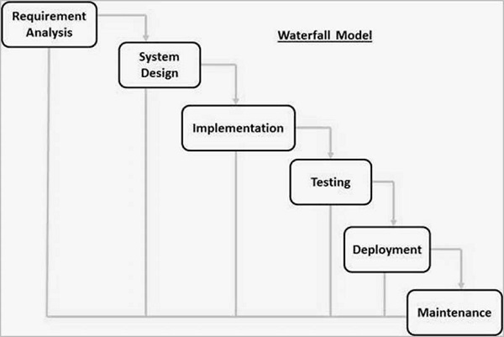
SDLC – Waterfall Model
The following picture is a representation of the different phases of the Waterfall Model:
Faster Time-to-Market
Digital Transformation
Securing Brand and Customer Trust
Enhancing Operational Efficiency

Slide 15
SDLC – Waterfall Model Phases
Requirement Gathering and analysis − All possible requirements of the system to be developed are captured in this phase and documented in a requirement specification document.
System Design − The requirement specifications from first phase are studied in this phase and the system design is prepared. This system design helps in specifying hardware and system requirements and helps in defining the overall system architecture.
Implementation − With inputs from the system design, the system is first developed in small programs called units, which are integrated in the next phase. Each unit is developed and tested for its functionality, which is referred to as Unit Testing.
Integration and Testing − All the units developed in the implementation phase are integrated into a system after testing of each unit. Post integration the entire system is tested for any faults and failures.
Deployment of system − Once the functional and non-functional testing is done; the product is deployed in the customer environment or released into the market.
Maintenance − There are some issues which come up in the client environment. To fix those issues, patches are released. Also to enhance the product some better versions are released. Maintenance is done to deliver these changes in the customer environment.
All these phases are cascaded to each other in which progress is seen as flowing steadily downwards like a waterfall through the phases. The next phase is started only after the defined set of goals are achieved for previous phase and it is signed off, so the name "Waterfall Model". In this model, phases do not overlap.
Faster Time-to-Market
Digital Transformation
Securing Brand and Customer Trust
Enhancing Operational Efficiency

Slide 16
Waterfall Model
Following are the suitable scenarios to use Waterfall Model:
Requirements are well defined, clearly documented and fixed
Product definition is stable
Technology is not dynamic and is well understood by the project team
There are no ambiguous or undefined requirements
The project is short
The disadvantage is that the model is not flexible to changes and just in case there is a requirement change, which is very common in today’s dynamic world, it becomes very expensive to make the change.
Faster Time-to-Market
Digital Transformation
Securing Brand and Customer Trust
Enhancing Operational Efficiency

Slide 17
Iterative Model
An iterative life cycle model does not attempt to start with a full specification of requirements. Instead, starts with a simple implementation of a small set of the software requirements
It is then reviewed to identify further requirements and the process is then repeated, producing a new version of the software at the end of each iteration of the model.
At each iteration, design modifications are made and new functional capabilities are added
The basic idea behind this method is to develop a system through repeated cycles (iterative) and in smaller portions at a time (incremental).
It iteratively enhances the evolving versions until the complete system is implemented and ready to be deployed
Faster Time-to-Market
Digital Transformation
Securing Brand and Customer Trust
Enhancing Operational Efficiency

Slide 18
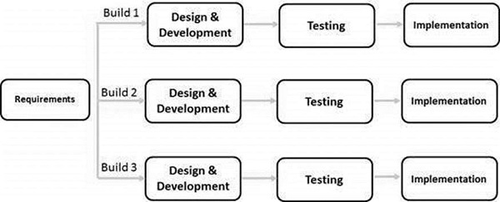
Iterative Model
The following illustration is a representation of the Iterative and Incremental model −
Faster Time-to-Market
Digital Transformation
Securing Brand and Customer Trust
Enhancing Operational Efficiency
The fllowi

Slide 19
Iterative Model
In this incremental model, the whole requirement is divided into various builds
During each iteration, the development module goes through the requirements, design, implementation and testing phases
Each subsequent release of the module adds function to the previous release. The process continues till the complete system is ready as per the requirement
The key to a successful use of an iterative software development lifecycle is rigorous validation of requirements, and verification & testing of each version of the software against those requirements within each cycle of the model. As the software evolves through successive cycles, tests must be repeated and extended to verify each version of the software
Faster Time-to-Market
Digital Transformation
Securing Brand and Customer Trust
Enhancing Operational Efficiency

Slide 20
Iterative Model
This model is most often used in the following scenarios −
Requirements of the complete system are clearly defined and understood.
Major requirements must be defined; however, some functionalities or requested enhancements may evolve with time.
A new technology is being used and is being learnt by the development team while working on the project.
Resources with needed skill sets are not available and are planned to be used on contract basis for specific iterations.
There are some high-risk features and goals which may change in the future.
The disadvantages of the Iterative and Incremental SDLC Model are as follows −
More resources may be required.
Although cost of change is lesser, but it is not very suitable for changing requirements.
More management attention is required.
System architecture or design issues may arise because not all requirements are gathered in the beginning of the entire life cycle.
Not suitable for smaller projects.
End of project may not be known which is a risk.
Highly skilled resources are required for risk analysis.
Faster Time-to-Market
Digital Transformation
Securing Brand and Customer Trust
Enhancing Operational Efficiency

Slide 21
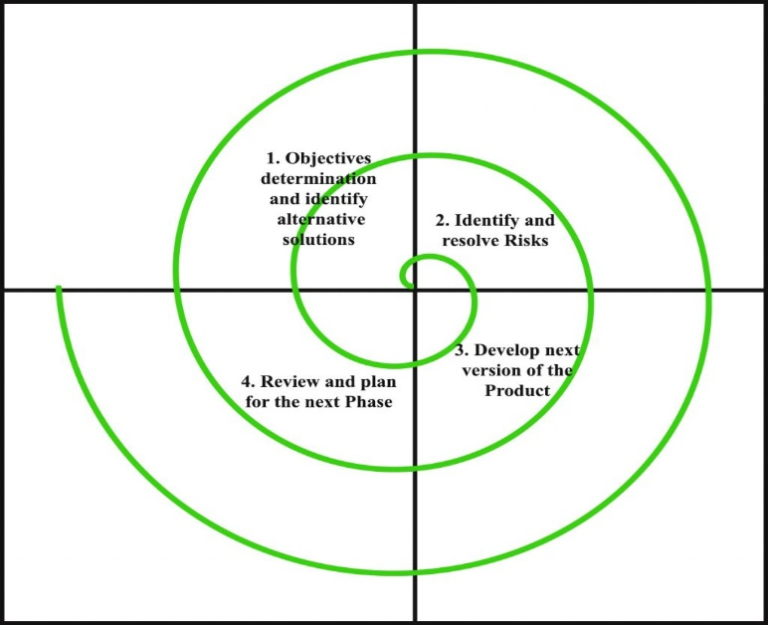
Spiral Model
This Spiral model is a combination of iterative development process model and sequential linear development model i.e. the waterfall model with a very high emphasis on risk analysis. It allows incremental releases of the product through each iteration around the spiral.
In its diagrammatic representation, it looks like a spiral with many loops. The exact number of loops of the spiral is unknown and can vary from project to project. Each loop of the spiral is called a Phase of the software development process.
Faster Time-to-Market
Digital Transformation
Securing Brand and Customer Trust
Enhancing Operational Efficiency

Slide 22
Spiral Model
Each phase of Spiral Model is divided into four quadrants as shown in the above figure. The functions of these four quadrants are discussed below-
Objectives determination and identify alternative solutions: Requirements are gathered from the customers and the objectives are identified, elaborated and analyzed at the start of every phase. Then alternative solutions possible for the phase are proposed in this quadrant.
Identify and resolve Risks: During the second quadrant all the possible solutions are evaluated to select the best possible solution. Then the risks associated with that solution is identified and the risks are resolved using the best possible strategy. At the end of this quadrant, Prototype is built for the best possible solution.
Develop next version of the Product: During the third quadrant, the identified features are developed and verified through testing. At the end of the third quadrant, the next version of the software is available.
Review and plan for the next Phase: In the fourth quadrant, the Customers evaluate the so far developed version of the software. In the end, planning for the next phase is started.
Faster Time-to-Market
Digital Transformation
Securing Brand and Customer Trust
Enhancing Operational Efficiency

Slide 23
Spiral Model
The following pointers explain the typical uses of a Spiral Model:
When there is a budget constraint and risk evaluation is important.
For medium to high-risk projects.
Customer is not sure of their requirements which is usually the case.
Requirements are complex and need evaluation to get clarity.
New product line which should be released in phases to get enough customer feedback.
Significant changes are expected in the product during the development cycle.
Below are some of the main disadvantages of the spiral model:
The Spiral Model is much more complex than other SDLC models.
Spiral Model is not suitable for small projects as it is expensive.
The successful completion of the project is very much dependent on Risk Analysis. Without very highly experienced expertise, it is going to be a failure to develop a project using this model.
As the number of phases is unknown at the start of the project, so time estimation is very difficult.
Faster Time-to-Market
Digital Transformation
Securing Brand and Customer Trust
Enhancing Operational Efficiency

Slide 24
V -Model
V -Model
The V-model is SDLC model where execution of processes happens in a sequential manner in V-shape. It is also known as Verification and Validation model.
V -Model is an extension of the waterfall model and is based on association of a testing phase for each corresponding development stage. This means that for every single phase in the development cycle there is a directly associated testing phase. This is a highly disciplined model and next phase starts only after completion of the previous phase.
V-Model design
Under V-Model, the corresponding testing phase of the development phase is planned in parallel. So there are Verification phases on one side of the ‘V’ and Validation phases on the other side. Coding phase joins the two sides of the V-Model.
Faster Time-to-Market
Digital Transformation
Securing Brand and Customer Trust
Enhancing Operational Efficiency

Slide 25
V Model
Faster Time-to-Market
Digital Transformation
Securing Brand and Customer Trust
Enhancing Operational Efficiency

Slide 26
V Model
V- Model application is almost same as waterfall model, as both the models are of sequential type. Requirements have to be very clear before the project starts, because it is usually expensive to go back and make changes. This model is used in the medical development field, as it is strictly disciplined domain.
Following are the suitable scenarios to use V-Model:
Requirements are well defined, clearly documented and fixed
Product definition is stable
Technology is not dynamic and is well understood by the project team
There are no ambiguous or undefined requirements
The project is short
The disadvantage is that the model is not flexible to changes and just in case there is a requirement change, which is very common in today’s dynamic world, it becomes very expensive to make the change.
Faster Time-to-Market
Digital Transformation
Securing Brand and Customer Trust
Enhancing Operational Efficiency

Slide 27
Big Bang Model
Big Bang Model does not follow a process/procedure
It comprises of focusing all the possible resources in the software development and coding, with very little or no planning
Even the customer is not sure about what exactly he wants and the requirements are implemented on the fly without much analysis
The requirements are understood and implemented as they come
The output is the software developed which may or may not be as per customer requirement.
Faster Time-to-Market
Digital Transformation
Securing Brand and Customer Trust
Enhancing Operational Efficiency

Slide 28
Big Bang Model
The advantages of the Big Bang Model are as follows −
This is a very simple model
Little or no planning required
Easy to manage
Very few resources required
Gives flexibility to developers
It is a good learning aid for new comers or students
The disadvantages of the Big Bang Model are as follows −
Very High risk and uncertainty
Not a good model for complex and object-oriented projects
Poor model for long and ongoing projects
Can turn out to be very expensive if requirements are misunderstood
Faster Time-to-Market
Digital Transformation
Securing Brand and Customer Trust
Enhancing Operational Efficiency

Slide 29
Software Prototyping
Software prototyping is becoming very popular as a software development model, as it enables to understand customer requirements at an early stage of development. It helps get valuable feedback from the customer and helps software designers and developers understand about what exactly is expected from the product under development.
Prototype is a working model of software with some limited functionality. The prototype does not always hold the exact logic used in the actual software application and is an extra effort to be considered under effort estimation.
Prototyping is used to allow the users evaluate developer proposals and try them out before implementation. It also helps understand the requirements which are user specific and may not have been considered by the developer during product design.
Faster Time-to-Market
Digital Transformation
Securing Brand and Customer Trust
Enhancing Operational Efficiency

Slide 30
Conclusion
Conclusion:
Waterfall and V model are traditional SDLC models and are of sequential type. Sequential means that the next phase can start only after the completion of first phase. Such models are suitable for projects with very clear product requirements and where the requirements will not change dynamically during the course of project completion.
Iterative and Spiral models are more accommodative in terms of change and are suitable for projects where the requirements are not so well defined, or the market requirements change quite frequently.
Big Bang model is a random approach to Software development and is suitable for small or academic projects.
Agile is the most popular model used in the industry. Agile introduces the concept of fast delivery to customers using prototype approach. Agile divides the project into small iterations with specific deliverable features. Customer interaction is the backbone of Agile methodology, and open communication with minimum documentation are the typical features of Agile development environment.
RAD (Rapid Application Development) and Software Prototype are modern techniques to understand the requirements in a better way early in the project cycle. These techniques work on the concept of providing a working model to the customer and stockholders to give the look and feel and collect the feedback. This feedback is used in an organized manner to improve the product.
Faster Time-to-Market
Digital Transformation
Securing Brand and Customer Trust
Enhancing Operational Efficiency

Slide 31
Case Study
Example: let as take a Example of making a website of 7 pages for any shop.this is a small website which is developed using waterfall model and it require less time to developed
1) Requirement Gathering and analysis : All the client requirements about the website is gathered and prepare a SRS document. Requirements like their is one registration page, one login page,user profile page, products view page, product buy, add to cart , Billing. All the requirements are clear,documented and well understood.
2) System Design : what type of programming language php,java or .net or what type of database is used to develop the website is planned in this phase.
3) Implementation : Once the programming language is finalized the coding is begin in the Implementation phase and small units are prepare like all the pages are coding one by one.
Faster Time-to-Market
Digital Transformation
Securing Brand and Customer Trust
Enhancing Operational Efficiency

Slide 32
Case Study
4) Testing: All the pages are integrated or linking with each other and performing system testing to check the functionality of the website it is according to the customer requirement or not.
5) Deployment:Once the website is completed it is deployed in the customer system for the acceptance.
6) Maintenance: If any issue is come after deploying the website then patches are released to resolve those issues.
Faster Time-to-Market
Digital Transformation
Securing Brand and Customer Trust
Enhancing Operational Efficiency

Slide 33
Case Study
Example: Let as take a Example for making a website for shopping mall which contains many shops. Making a website for a shopping mall is not a easy task because it require lots of time. It is also not possible to gather all the requirements of all the shops at once . So developing a Website for a mall the waterfall model is not appropriate.
Scenario:
In waterfall model all the phases are completed before the next phase start. Output of one phase is become an input for the next phase. Once the development is start, it is difficult to go back to previous phase.In Water fall model If their is any confusion in the requirement or any fault is occurred , then development will starting from the first phase.
If the requirements are finalised and during the design phase it became clear that part of the requirements are wrong, then the process of development is start from the first phase of waterfall model which is requirement gathering phase.
Faster Time-to-Market
Digital Transformation
Securing Brand and Customer Trust
Enhancing Operational Efficiency

Slide 34
Thank You
Our Locations: China | Costa Rica | India | Mauritius | Philippines | Poland | Singapore | U.K. | U.S.A.

