Slide 1
Devops
Software (DEV)elopement and Network (OP)erations
Brad Jones – CSC111 – 5/26/2017

Slide 2
What is DevOps?
“DevOps is the practice of operations and development engineers participating together in the entire service lifecycle, from design through the development process to production support.”
“DevOps means a lot of different things to different people because the discussion around it covers a lot of ground. People talk about DevOps being “developer and operations collaboration,” or it’s “treating your code as infrastructure,” or it’s “using automation,” or “using kanban,” or “a toolchain approach,” or “culture,” or a variety of seemingly loosely related items.”

Slide 3

OK, but what does that mean?
“DevOps means a lot of different things to different people because the discussion around it covers a lot of ground. People talk about DevOps being “developer and operations collaboration,” or it’s “treating your code as infrastructure,” or it’s “using automation,” or “using kanban,” or “a toolchain approach,” or “culture,” or a variety of seemingly loosely related items.”
-Ernest Mueller, Aug 2, 2010

Slide 4
Devops earning potential

Slide 5
Docker is one of many tools available to administer cloud SaaS networks
Here was the first bullet point list I could find! It took about 25 minutes. A brief explanation of the steps needed to forward your local ports to a virtual machine located inside a Docker container. Ill be setting up a homelab over the summer, studying for the Linux + certification test
boot2docker ssh -L 0.0.0.0:3306:127.0.0.1:3306
Explanation:
“boot2docker ssh” – initiates the SSH connection from your Mac to the Boot2Docker VM
“-L” – forwards a local port to the other side of the SSH connection
“0.0.0.0:3306” – binds locally to all available IP addresses on port 3306
“127.0.0.1:3306” – forwards all traffic to the VM’s local host to port 3306
Once this is set up, remote hosts can connect to your Mac IP on port 3306, and the traffic will be terminated inside the VM on port 3306.

Slide 6
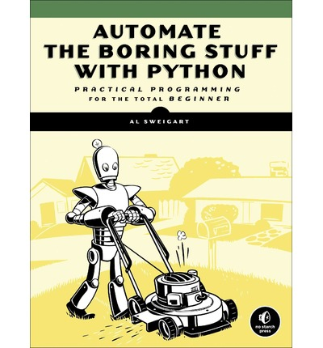
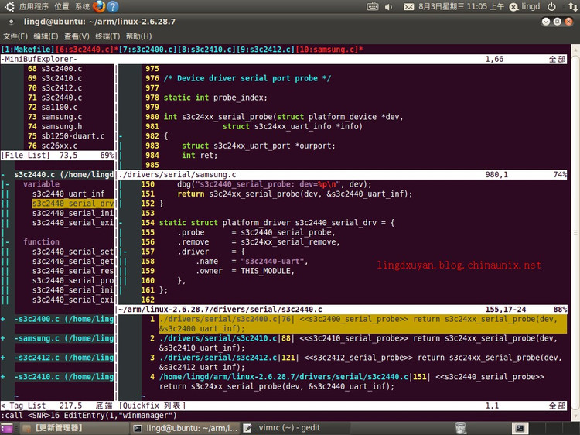
I will also be studying Python scripting with the VIM text-editor
DevOps is a long term career goal, but you must walk before you run. I plan on doing some Web Dev while completing my AAS in programming and networking. With my AAS I will look for Jr. Sysadmin positions and applyi for NSC’s BAS in App Dev program.

