Slide 1




DeepSeek presents:
DeepSeekTravels
Produce a safe packing list for an upcoming trip
(An AI assistant built by an AI assistant)
Travel safe, don’t forget anything

Slide 2


Scenario
Going on a trip, unsure what to take with me.
Problem
As a traveller, I am struggling to plan what to pack with me for an upcoming trip.
I do not know what the weather is like, and in general struggle to plan what items I need for various upcoming activities. I am also struggling to plan how many items I need to sustain me for the trip duration.
Solution
Build a travel assistant that can help to produce a context-rich packing list, taking various things into consideration, such as destination details, weather conditions, luggage allowance, visas, attractions, etc.

Slide 3

Goal
Build an AI assistant that generates an optimized travel packing list and optional booking suggestions, taking into account user constraints (e.g., backpack capacity), trip parameters (destination, time of day, dates, trip length), weather, attraction plans, and regulatory requirements (airport security, visas, documents).
Success Criteria
As a traveller, I can use DeepSeek UI so that it can produce a packing list for my trip.
As a traveller, I can specify destination, dates, trip length, planned activities and time-of-day usage so the assistant tailors my packing list.
As a traveller, I can set constraints like backpack capacity, airline baggage limits, weight targets, or liquid restrictions to get a feasible list.
As a traveller, the assistant proactively asks for my carry capacity, max weight I can comfortably carry, and any limitations (mobility, health, liquid restrictions) and tailors recommendations accordingly.
The response of the assistant should add safety warnings for the countries I’m planning to visit, if they are considered high risk. It should also find visa requirements for any country, given my nationality.

Slide 4

Solution Overview
What it does?
Inputs
Outputs
Generates a packing list based on user inputs about the trip, weather and attractions in these locations + visa and regs
Origin
Destination
Departure date
Travellers details (number, age, nationality)
Trip length
Activities
Luggage/baggage limits
Health/mobility/other constraints
Budget
Packing list with context in mind
Out of scope
Upload a photo of my backpack to estimate volume and check if the packing list fits. Linking constraints like visa rules, backpack capacity, airline baggage limits, weight targets, or liquid restrictions to proper storage or API endpoints rather than fixtures/mock data.

Slide 5


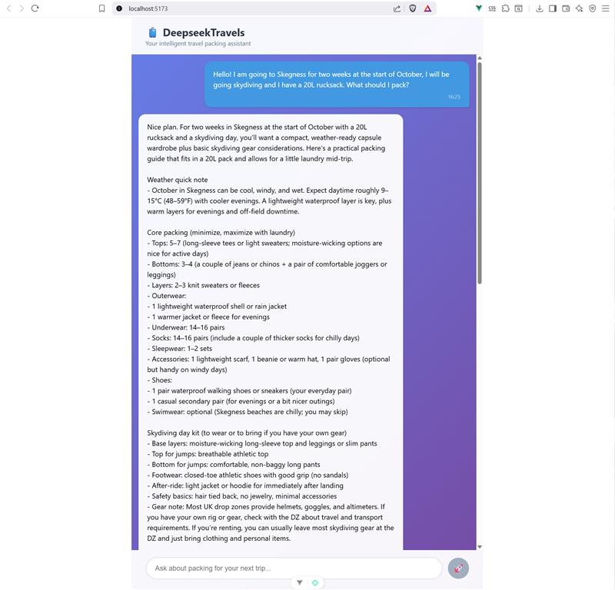
Demo

