Slide 1

Bluff or Buff v1.2

Slide 2
goal of the project
Bluff or buff v1.2
Text-based console poker game
Player competes against an AI opponent
Three different levels of playing
Texas Hold’em rules
Fully working betting system

Slide 3
Core Components
Bluff or buff v1.2
1. Main.java: Entry point that initializes the game
2. GameController: Manages overall game flow and player interactions
3. RoundManager: Handles individual poker rounds and betting phases
4. PokerAI: AI decision-making engine
5. MonteCarloSimulator: Statistical simulation for AI strategy
6. HandEvaluator: Determines poker hand rankings

Slide 4
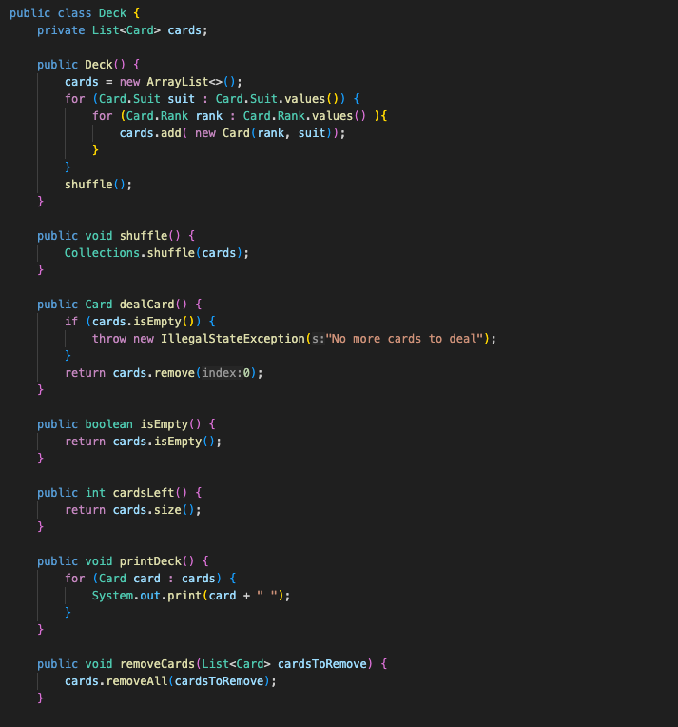
Encapsulation
Notes:
Encapsulation: Classes like Player and Deck encapsulate their data and provide controlled access through methods like getChips() and dealCard().

Slide 5
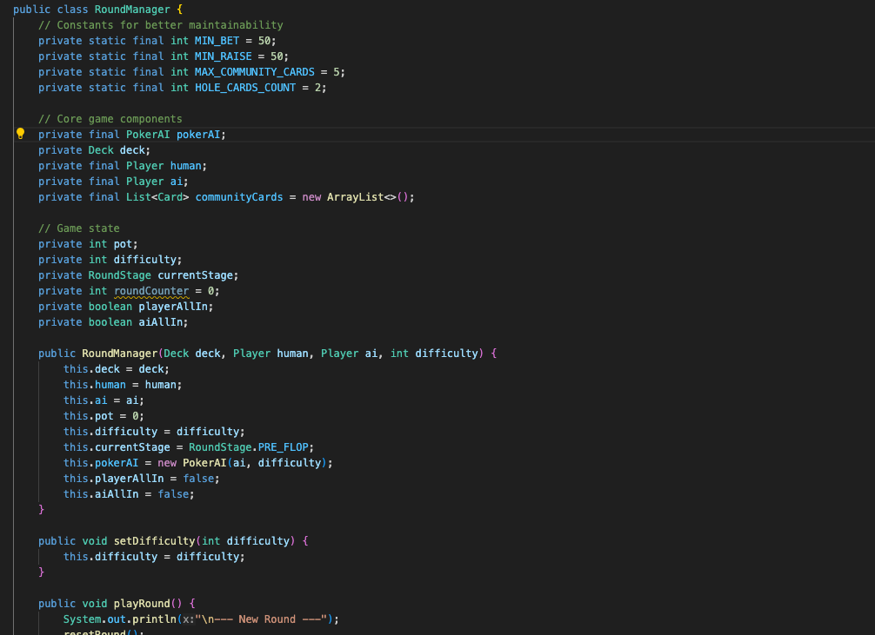
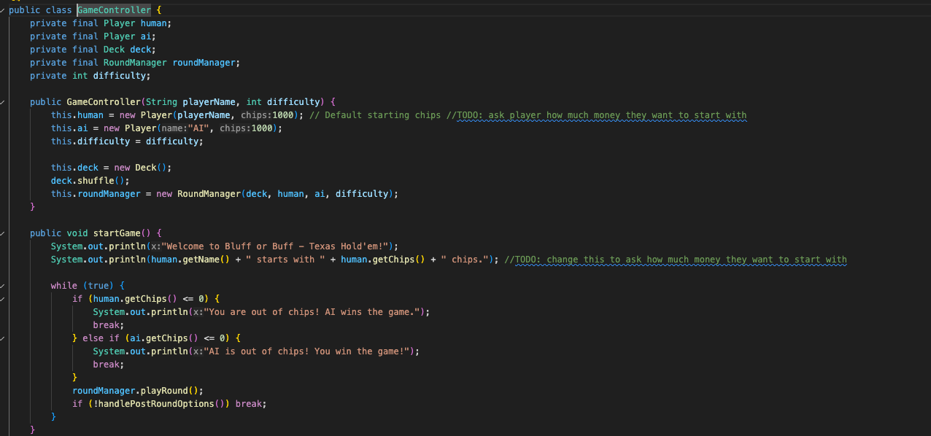
Abstraction
Notes:
How Abstraction Works Here:
Hiding Details:
The GameController does not need to know how cards are shuffled, dealt, or how the winner is determined. These details are encapsulated in the RoundManager.
Simplified Interface:
The GameController interacts with RoundManager through high-level methods like startRound(), manageBetting(), and determineWinner(). It doesn't deal with the internal logic of these operations.
Separation of Concerns:
The RoundManager focuses solely on the poker round logic, while the GameController handles the overall game flow and player interactions.
This abstraction makes the code more modular, easier to maintain, and allows for changes in the poker logic without affecting the GameController.

Slide 6
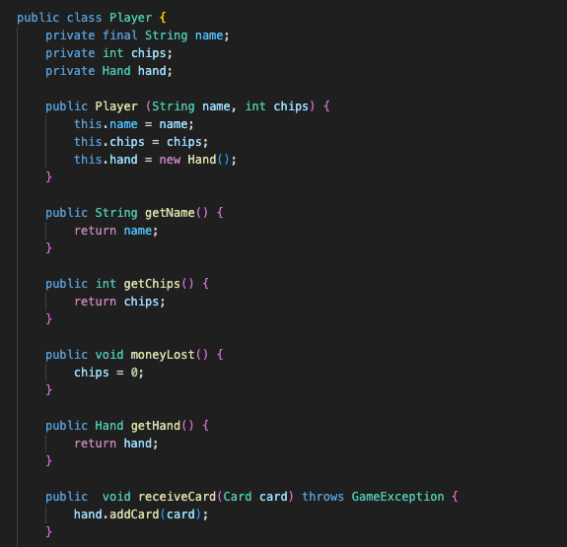
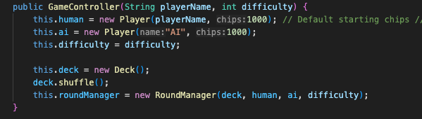
Inheritance
Notes:
Inheritance: While inheritance is not heavily used, the project has placeholders for extending functionality, such as AIPlayer and HumanPlayer classes.

Slide 7
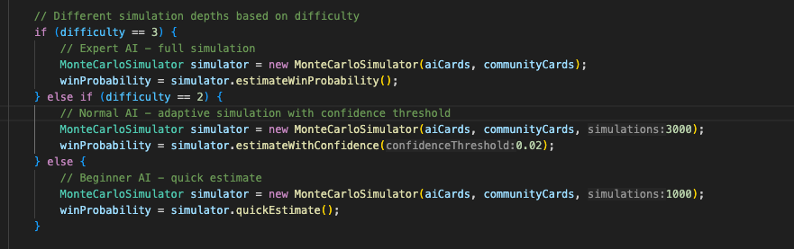
Polymorphism
Notes:
How Polymorphism is Demonstrated
Enum Polymorphism:
The BettingAction enum uses polymorphism by overriding the performAction() method for each constant. This allows each action to have its own behavior.
Method Polymorphism:
The getAIDecision() method in PokerAI demonstrates polymorphism by delegating the decision-making to the DecisionStrategy interface. Different implementations of DecisionStrategy (e.g., AggressiveStrategy, ConservativeStrategy) provide different behaviors.
Dynamic Behavior:
The PokerAI class can dynamically switch strategies at runtime using the setStrategy() method, showcasing polymorphism in action.
This design makes the code flexible, extensible, and easy to maintain.

Slide 8
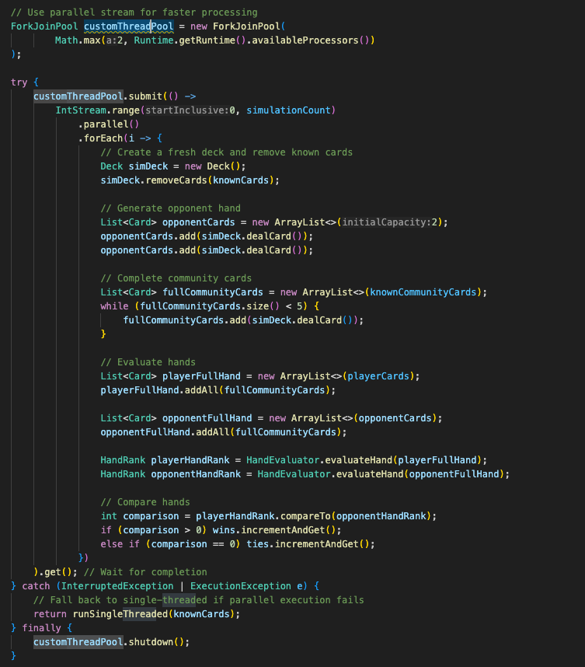
Multi threading
Notes:
In the context of the `MonteCarloSimulator`, **multi-threading** is used to run multiple simulations in parallel, leveraging the available CPU cores to improve performance. Here's how it works:
---
### **How Multi-Threading Works in `MonteCarloSimulator`**
1. **ForkJoinPool for Parallelism**:
- The `MonteCarloSimulator` uses a `ForkJoinPool` to manage threads for parallel execution.
- A custom thread pool is created with a size based on the number of available CPU cores (`Runtime.getRuntime().availableProcessors()`).
```java
ForkJoinPool customThreadPool = new ForkJoinPool(
Math.max(2, Runtime.getRuntime().availableProcessors())
);
```
2. **Parallel Stream for Simulations**:
- The `IntStream.range(0, simulationCount).parallel()` creates a parallel stream, which splits the simulation tasks into smaller chunks and distributes them across multiple threads.
- Each thread runs a subset of the simulations independently.
```java
customThreadPool.submit(() ->
IntStream.range(0, simulationCount)
.parallel()
.forEach(i -> {
// Simulation logic for each iteration
})
).get(); // Wait for all threads to complete
```
3. **Thread-Safe Counters**:
- `AtomicInteger` is used for the `wins` and `ties` counters to ensure thread-safe updates. This prevents race conditions when multiple threads increment these counters simultaneously.
```java
AtomicInteger wins = new AtomicInteger(0);
AtomicInteger ties = new AtomicInteger(0);
```
4. **Independent Simulations**:
- Each thread performs the following steps independently:
- Creates a fresh deck of cards.
- Removes known cards (player's cards and community cards).
- Simulates the opponent's hand and completes the community cards.
- Evaluates the player's and opponent's hands.
- Updates the `wins` or `ties` counters based on the comparison.
5. **Synchronization and Completion**:
- The `ForkJoinPool.submit()` method ensures that all threads complete their tasks before proceeding.
- The `.get()` method waits for all threads to finish execution.
```java
customThreadPool.submit(() -> ...).get();
```
6. **Shutdown**:
- After all simulations are complete, the thread pool is shut down to release resources.
```java
customThreadPool.shutdown();
```
---
### **Why Multi-Threading is Used**
- **Performance**: Running simulations in parallel significantly reduces the time required to compute win probabilities, especially for large numbers of simulations.
- **CPU Utilization**: Multi-threading allows the program to utilize multiple CPU cores, making it more efficient.
- **Scalability**: The approach scales well with the number of available cores, making it suitable for modern multi-core processors.
---
### **Code Snippet Highlight**
Here’s the multi-threading logic from the `MonteCarloSimulator`:
```java
ForkJoinPool customThreadPool = new ForkJoinPool(
Math.max(2, Runtime.getRuntime().availableProcessors())
);
try {
customThreadPool.submit(() ->
IntStream.range(0, simulationCount)
.parallel()
.forEach(i -> {
// Create a fresh deck and remove known cards
Deck simDeck = new Deck();
simDeck.removeCards(knownCards);
// Generate opponent hand
List<Card> opponentCards = new ArrayList<>(2);
opponentCards.add(simDeck.dealCard());
opponentCards.add(simDeck.dealCard());
// Complete community cards
List<Card> fullCommunityCards = new ArrayList<>(knownCommunityCards);
while (fullCommunityCards.size() < 5) {
fullCommunityCards.add(simDeck.dealCard());
}
// Evaluate hands
List<Card> playerFullHand = new ArrayList<>(playerCards);
playerFullHand.addAll(fullCommunityCards);
List<Card> opponentFullHand = new ArrayList<>(opponentCards);
opponentFullHand.addAll(fullCommunityCards);
HandRank playerHandRank = HandEvaluator.evaluateHand(playerFullHand);
HandRank opponentHandRank = HandEvaluator.evaluateHand(opponentFullHand);
// Compare hands
int comparison = playerHandRank.compareTo(opponentHandRank);
if (comparison > 0) wins.incrementAndGet();
else if (comparison == 0) ties.incrementAndGet();
})
).get(); // Wait for completion
} catch (InterruptedException | ExecutionException e) {
// Handle exceptions
} finally {
customThreadPool.shutdown();
}
```
---
### **Key Components of Multi-Threading**
1. **ForkJoinPool**:
- Manages the threads and distributes tasks across them.
- Allows for efficient parallel execution.
2. **Parallel Streams**:
- Splits the simulation tasks into smaller chunks and processes them in parallel.
3. **Thread-Safe Counters**:
- `AtomicInteger` ensures that updates to shared counters (`wins` and `ties`) are thread-safe.
4. **Synchronization**:
- The `.get()` method ensures that the main thread waits for all simulation threads to complete before proceeding.
---
### **Benefits of Multi-Threading in `MonteCarloSimulator`**
- **Faster Simulations**: By running simulations in parallel, the program can handle large numbers of iterations in a fraction of the time required for single-threaded execution.
- **Efficient Resource Utilization**: Multi-threading ensures that all available CPU cores are utilized effectively.
- **Scalability**: The approach can handle larger simulations as the number of CPU cores increases.
This design makes the `MonteCarloSimulator` highly efficient and suitable for computationally intensive tasks like poker simulations.

Slide 9
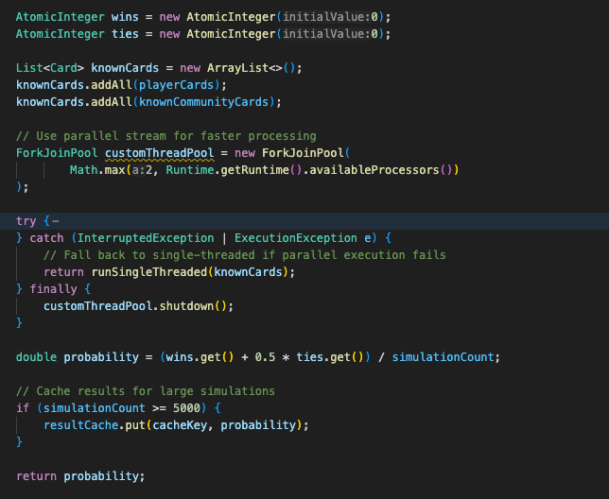
Caching
Notes:
The `MonteCarloSimulator` uses a `ConcurrentHashMap` to cache simulation results, which helps improve performance by avoiding redundant computations for the same game state. Here's how it works:
---
### **How Caching Works in `MonteCarloSimulator`**
1. **Cache Initialization**:
- A static `ConcurrentHashMap` named `resultCache` is used to store simulation results.
- The key is a unique string generated from the player's cards and known community cards (`cacheKey`), and the value is the computed win probability.
2. **Generating a Cache Key**:
- The `generateCacheKey()` method creates a unique key by concatenating the string representations of the player's cards and known community cards.
- This ensures that the same game state always maps to the same key.
```
3. **Checking the Cache**:
- Before running a simulation, the `estimateWinProbability()` method checks if the result for the current game state (`cacheKey`) is already in the cache.
- If the result is found, it is returned immediately, avoiding the need for a costly simulation.
```
4. **Storing Results in the Cache**:
- After computing the win probability, the result is stored in the cache for future use.
- This is done only for large simulations (e.g., `simulationCount >= 5000`) to avoid excessive memory usage for smaller simulations.
---
### **Why Use a `ConcurrentHashMap`?**
- **Thread-Safe**: Since the simulations use parallel processing (`ForkJoinPool`), multiple threads may access the cache simultaneously. A `ConcurrentHashMap` ensures thread-safe operations without requiring external synchronization.
- **Performance**: The `ConcurrentHashMap` is optimized for concurrent reads and writes, making it suitable for high-performance applications like this one.
---
### **Benefits of Caching**
1. **Avoid Redundant Computations**:
- If the same game state is encountered multiple times, the cached result is reused, saving time and computational resources.
2. **Improved Performance**:
- For large simulations, caching significantly reduces the time required to compute win probabilities, especially in scenarios where the same state is evaluated repeatedly.
3. **Scalability**:
- The use of `ConcurrentHashMap` ensures that the caching mechanism scales well with multi-threaded simulations.
---
### **Example Flow**
1. **First Simulation**:
- The `estimateWinProbability()` method generates a `cacheKey` for the current game state.
- Since the key is not in the cache, the simulation runs, and the result is stored in the cache.
2. **Subsequent Simulations**:
- When the same game state is encountered again, the method retrieves the result from the cache instead of running the simulation again.
---
´
---
### **Conclusion**
The caching mechanism in `MonteCarloSimulator` is a smart optimization that leverages a `ConcurrentHashMap` to store and reuse simulation results. This reduces redundant computations, improves performance, and ensures thread safety in a multi-threaded environment.

Slide 10
The issues
Buggy AI interactions
Broken betting logic and chip management
Unplayable due to persistent all-in flags
Messy codebase with dead code
Very bad code quality/performance

