Slide 1
Final project ---- By Zeyu Wang

Slide 2
List
1. My question-1page
2. My data-3pages
3. What’s the problem and how to deal with them?-6pages
4. Data is ready.-6pages
5. Get the result-3pages
6. TensorFlow to predict the future GDP in 5 years.-3pages

Slide 3
What’s my question?
1. My question
CO2 emissions, Commercial service exports, Commercial service imports, Communications computer exports, Communications computer imports and Current health expenditure per capita
GDP
Relationship between GDP and some other indicators

Slide 4
2.My data
Where is my data from?
INF
Report for Selected Countries and Subjects (imf.org)
The World Bank Data
Developer Information – World Bank Data Help Desk

Slide 5
How to start?
2.My data
Getting data

Slide 6
2.My data
INF----Using Web Crawler
The World Bank Data---WebApi

Slide 7
The problem
3. What’s the problem and how to deal with them?
INF is dynamic webpages
The data will be loaded by JS
Can’t get data by the general method.

Slide 8
How to fix it?
3. What’s the problem and how to deal with them?
Using pyqt5 to imitate the Browser to get the data.

Slide 9
A problem in pyqt5.
3. What’s the problem and how to deal with them?
Pyqt4→pyqt5
Many code on the internet have problem.
Problem in environment

Slide 10
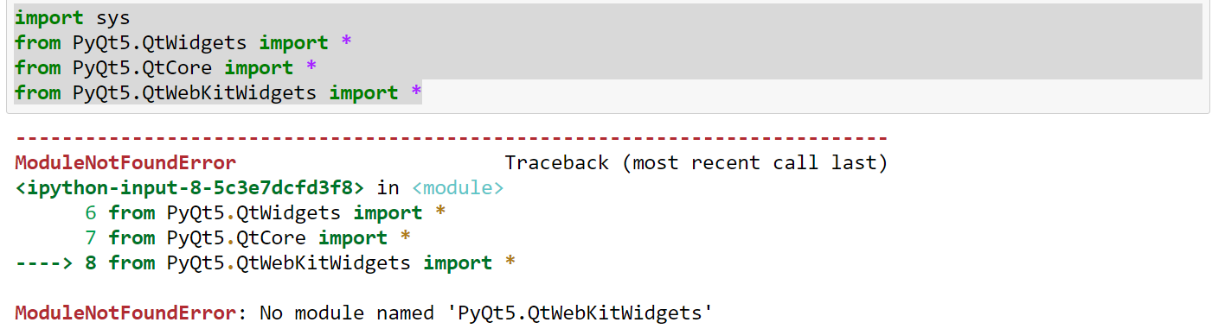
3. What’s the problem and how to deal with them?

Slide 11
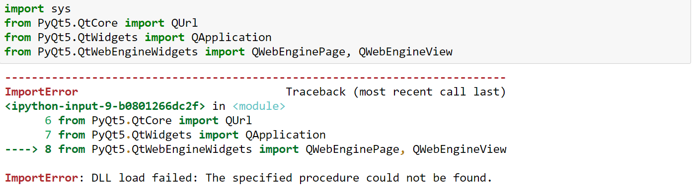
3. What’s the problem and how to deal with them?

Slide 12
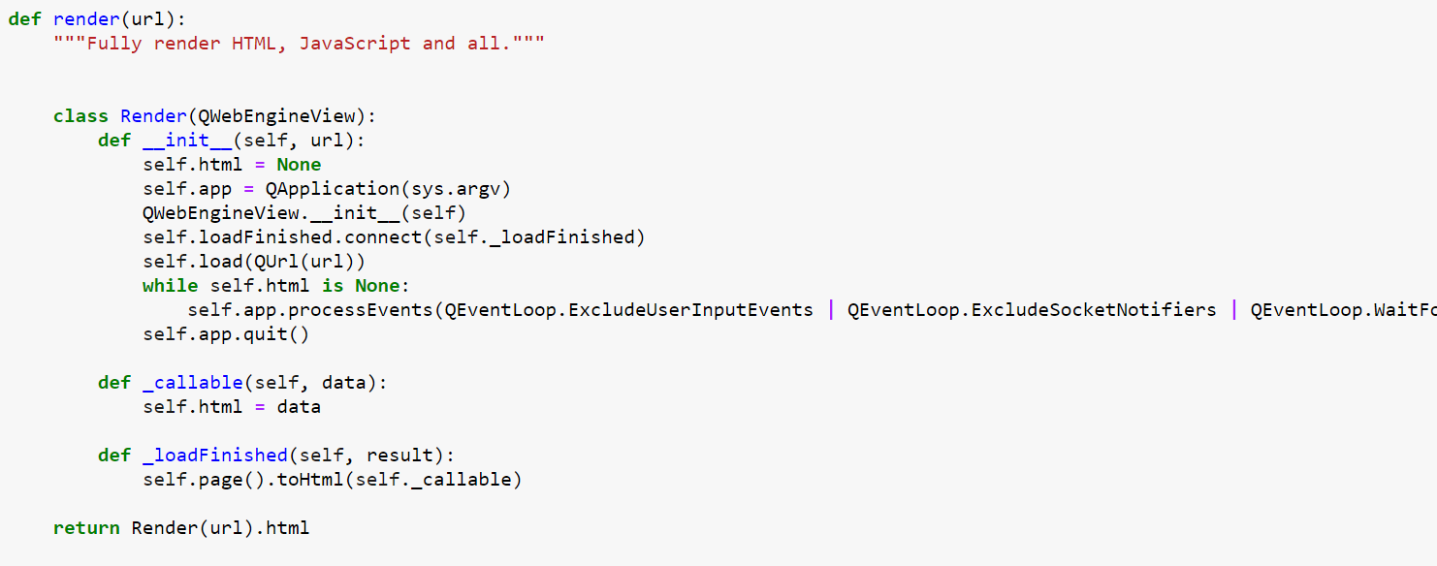
3. What’s the problem and how to deal with them?

Slide 13
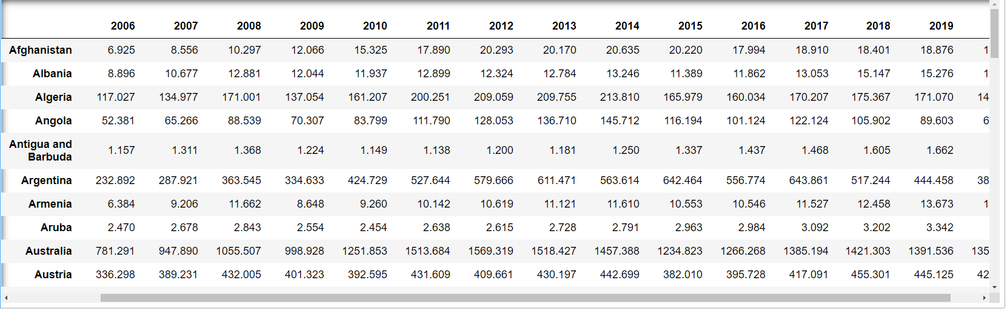
GDP DATA→MongoDB
4. Data is ready.

Slide 14
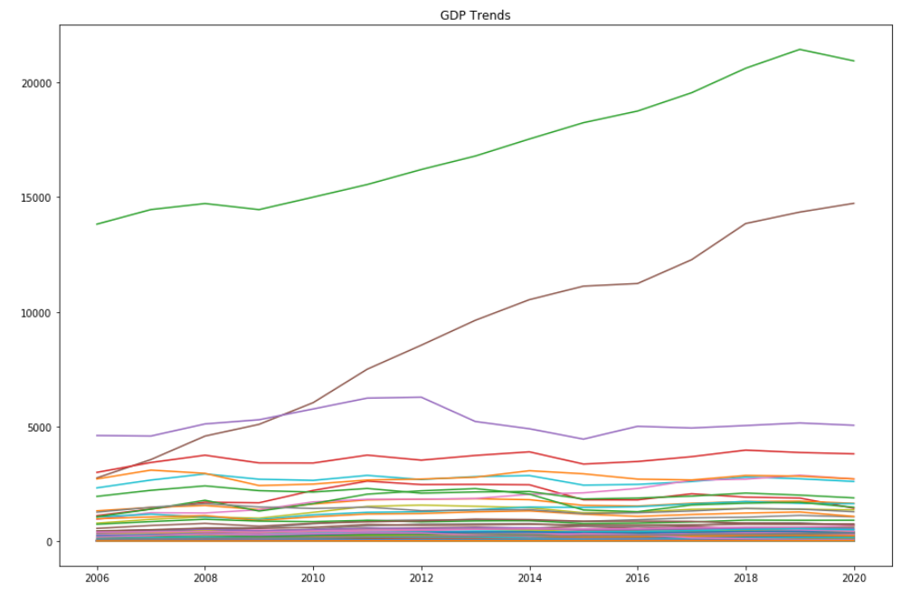
Choose countries
4. Data is ready.
1.USA
2.China
3.Tuvalu
variance

Slide 15
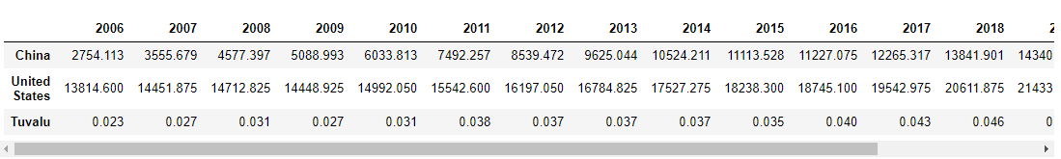
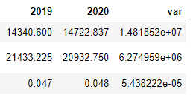
Choose countries
4. Data is ready.

Slide 16
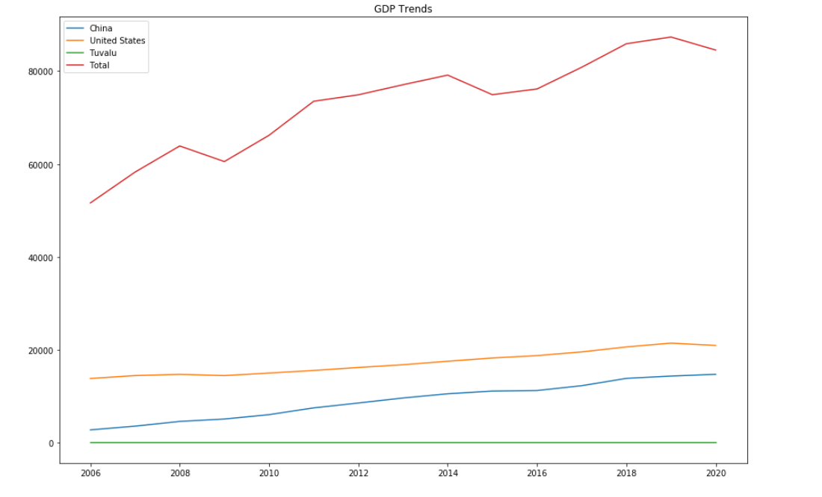
Choose countries
4. Data is ready.

Slide 17
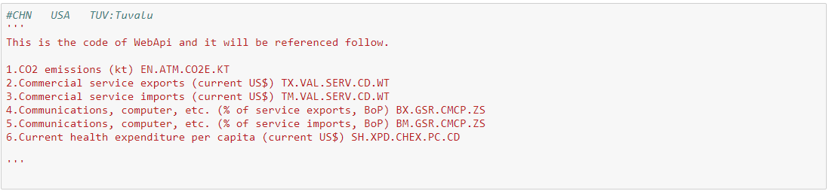
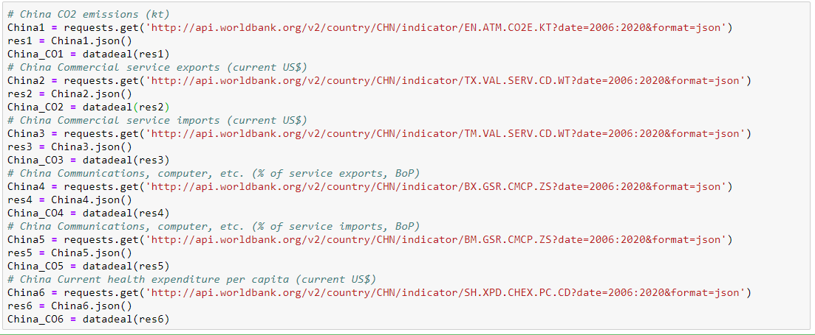
WebAPI
4. Data is ready.

Slide 18
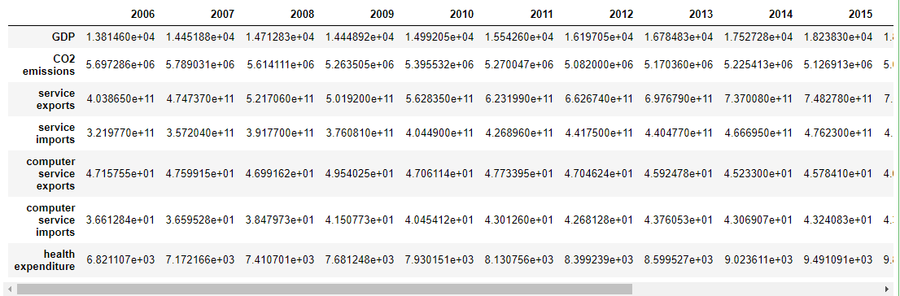
One of the indicators
4. Data is ready.

Slide 19
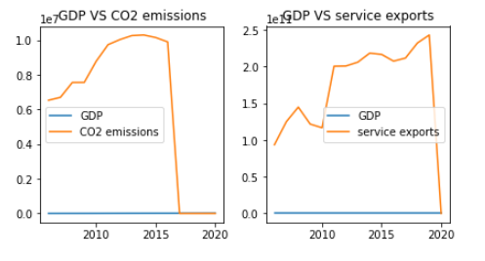
One of the indicators
5. Get the result

Slide 20
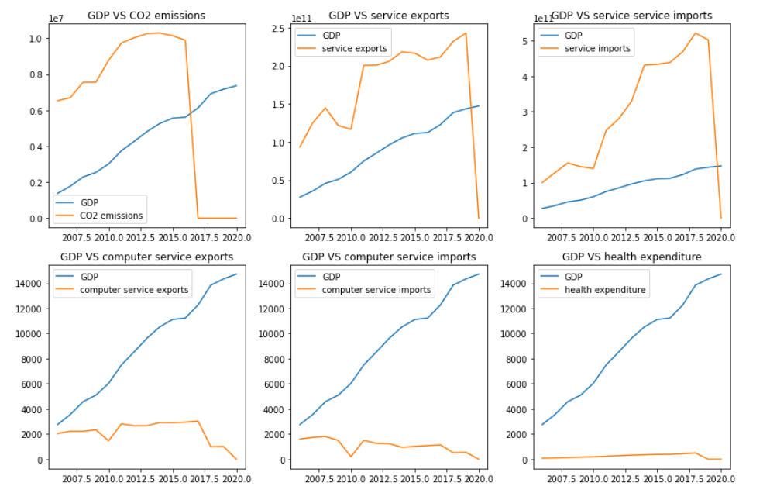
One of the results
5. Get the result

Slide 21
Conclusions:
5. Get the result

Slide 22
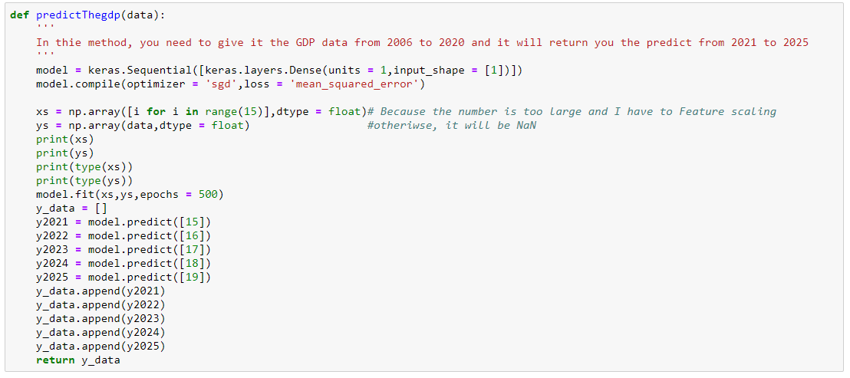
Use Tensorflow to predict the future GDP:
6. TensorFlow to predict the future GDP in 5 years.

Slide 23
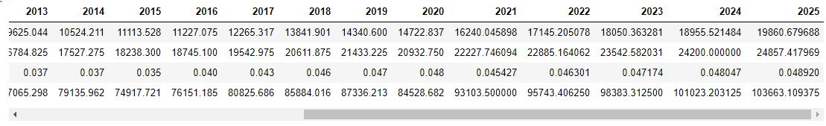
Use tensorflow to predict the future GDP:
6. TensorFlow to predict the future GDP in 5 years.

Slide 24
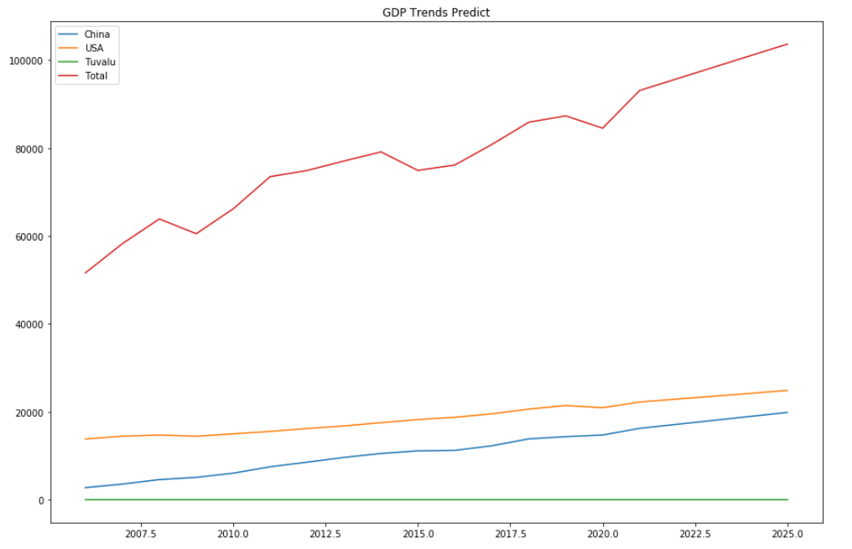
Use tensorflow to predict the future GDP:
6. TensorFlow to predict the future GDP in 5 years.

Slide 25
Thanks for your listerning!

