Slide 1
M V C

Slide 2
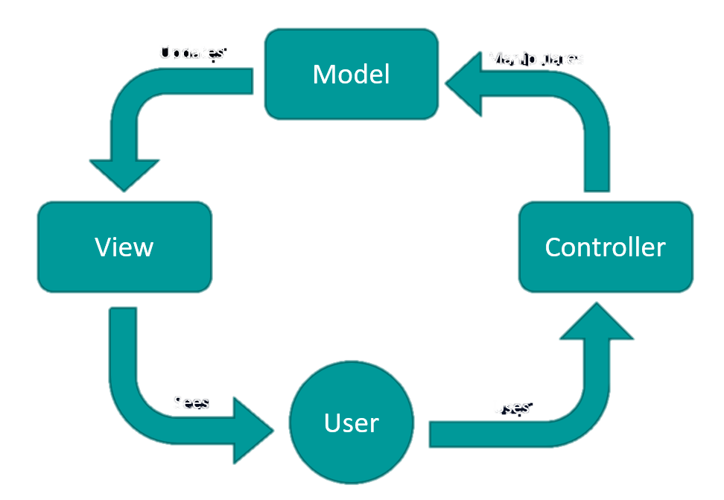
Introduction
A software architectural pattern that specifies three development aspects of an application.

Slide 3
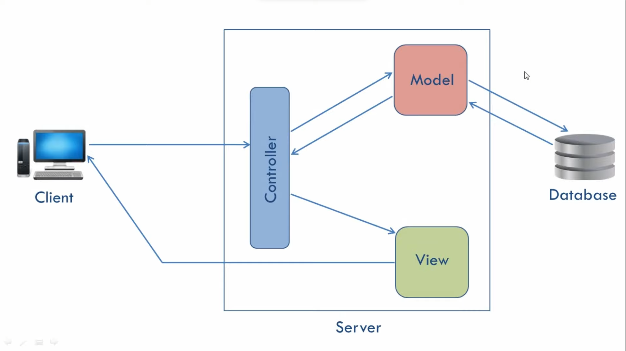
ARCHITECTURE

Slide 4
View
View
What user sees on the screen
Or, the presentation of the application.
Model change changes the view.

Slide 5
Model
Knows all about the data
Represents application data and business rules
Does not care for the reprentation of data

Slide 6
View
View
Controller
Like bridge between model and view
Intercepts request from view and pass it to the model for action.
After action by model, pass view to the user

Slide 7
Advantages
Easily modifiable
Faster development process
Easy planning and maintenance
Organizes large-size web applications

Slide 8
Disadvantages
Can be hard to understand due to the complexity and updates
The complexity in code navigation (with all updates, the structure becomes more complex)

Slide 9
M V C
Thank you

