Slide 1



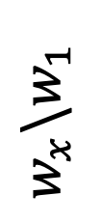
Input
Vanilla
$$w_{x}\backslash w_{1}$$

Slide 2



Input
Vanilla
$$w_{x}\backslash w_{1}$$

Slide 3
Input
Vanilla
$$w_{x}\backslash w_{1}$$

Slide 4



Input
Vanilla
$$w_{x}\backslash w_{1}$$

Slide 5



Input
Vanilla
$$w_{x}\backslash w_{1}$$

Slide 6



Input
Vanilla
$$w_{x}\backslash w_{1}$$

Slide 7









Input
Vanilla
TRM
Oracle

Slide 8







Input
Vanilla
MLDG
Oracle

Slide 9


Input
Vanilla
MLDG
Oracle

Slide 10




Input
Vanilla
MLDG
Oracle

