Slide 1
Tessellation

Slide 2
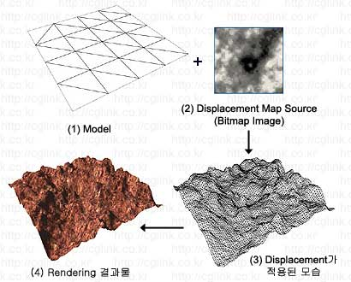

Tessellation이란?
폴리곤을 잘게 쪼개어 새로운 폴리곤을 만드는 것.

Slide 3
Tessellation를 사용하는 이유?
다이나믹 LOD
물리엔진, 애니메이션 연산시 비용 감소
메모리 절약
http://blog.naver.com/bilm/110085166047

Slide 4
파이프 라인
Vertex Shader
Hull Shader
Tessellator
Domain Shader

Slide 5
Primitive Type
D3D11_PRIMITIVE_TOPOLOGY_1_CONTROL_POINT_PATCHLIST ~
D3D11_PRIMITIVE_TOPOLOGY_32_CONTROL_POINT_PATCHLIST

Slide 6
Shader Code
Vertex Shader
Struct VS_IN
{
float3 Position : POSITION;
}
VS_IN VS_Main(VS_IN Input)
{
return Input;
}

Slide 7
Shader Code
Hull Shader - Constant Hull Shader
struct ConstantHS_Out { float edges[3] : SV_TessFactor //변
float inside : SV_InsideTessFactor; //안쪽 };
ConstantHS_Out Constant_HS_Main(InputPatch<VS_OUT_Tess, 3> InPatches, uint uPatchID : SV_PrimitiveID) { ConstantHS_Out Output = (ConstantHS_Out)0;
Output.edges[0] = TessellationFactor; //몇번 쪼갤지 설정 최대 64개 Output.edges[1] = TessellationFactor; Output.edges[2] = TessellationFactor;
Output.inside = TessellationFactor;
return Output; }

Slide 8
Shader Code
Hull Shader - Control Point Hull Shader
[domain("tri")] //어떻게 쪼갤 것인가.? “isoline”, “tri”, “qurd”의 인자 값이 들어감.
[partitioning("integer")] //어떻게 나눌 것인가 “intrger”, “fractional_even”, “fractional_odd”, “pow2”의 인자값이 들어감
[outputtopology("triangle_cw")] //그리는 방식
[outputcontrolpoints(3)] //내보낼 컨트롤 포인트 갯수
[patchconstantfunc("Constant_HS_Main")] //상수 쉐이더 이름
HS_OUT HS_Main(InputPatch<VS_OUT_Tess, 3> InPatches, uint uControlPointID : SV_OutputControlPointID, uint uPatchID : SV_PrimitiveID)
{
HS_OUT Output = (HS_OUT)0;
Output.Pos = InPatches[uControlPointID].Pos;
return Output;
}

Slide 9
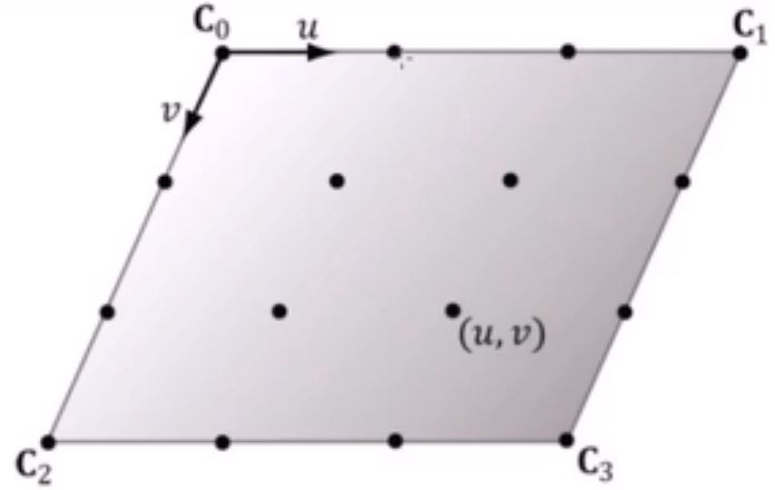
Tessellator 결과

Slide 10
Shader Code
Domain Shader - tri
struct DS_OUT { float4 Pos : SV_POSITION; };
[domain("tri")] DS_OUT DS_Main(ConstantHS_Out Input, float3 BaryCentricCoord : SV_DomainLocation, const OutputPatch<HS_OUT, 3> Patches) { DS_OUT Output = (DS_OUT)0;
float3 Pos = BaryCentricCoord.x * Patches[0].Pos + BaryCentricCoord.y * Patches[1].Pos + BaryCentricCoord.z * Patches[2].Pos;
Output.Pos = mul(float4(Pos, 1), matWorld); Output.Pos = mul(Output.Pos, matView); Output.Pos = mul(Output.Pos, matProj);
return Output; }

Slide 11
Shader Code
Domain Shader - quad
struct DS_OUT { float4 Pos : SV_POSITION; };
[domain("quad")] DS_OUT DS_Main(ConstantHS_Out Input, float2 UV : SV_DomainLocation, const OutputPatch<HS_OUT, 4> Patches) { DS_OUT Output = (DS_OUT)0;
float3 v1 = lerp(Patches[0].Pos, Patches[1].Pos, UV.x);
float3 v2 = lerp(Patches[2].Pos, Patches[3].Pos, UV.x);
float3 Pos = lerp(v1, v2, UV.y);
Output.Pos = mul(float4(Pos, 1), matWorld); Output.Pos = mul(Output.Pos, matView); Output.Pos = mul(Output.Pos, matProj);
return Output; }

Slide 12
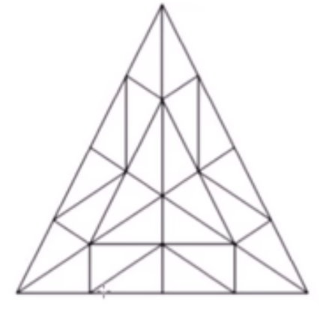
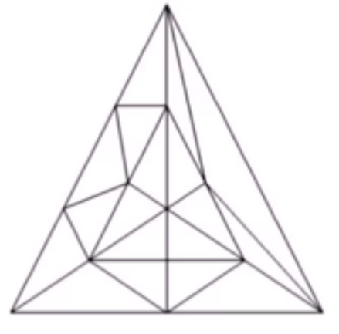
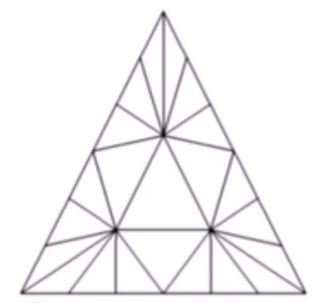
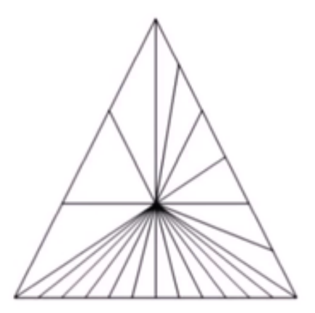
최종 결과
[domain("tri")]
Output.edges[0] = 4;
Output.edges[1] = 4; Output.edges[2] = 4;
Output.inside = 4;
Output.edges[0] = 1;
Output.edges[1] = 2; Output.edges[2] = 3;
Output.inside = 4;
Output.edges[0] = 6;
Output.edges[1] = 6; Output.edges[2] = 6;
Output.inside = 3;
Output.edges[0] = 6;
Output.edges[1] = 12; Output.edges[2] = 3;
Output.inside = 1;

Slide 13
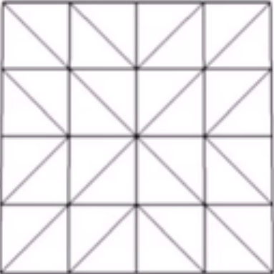
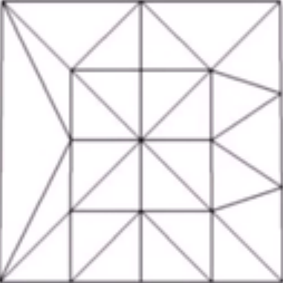
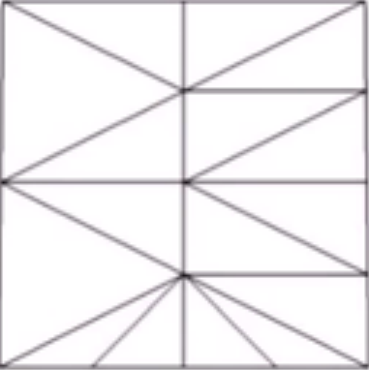
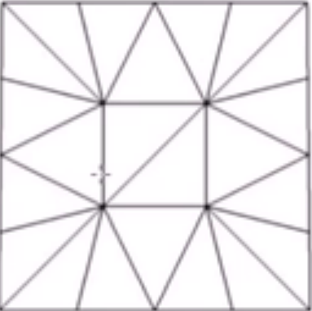
최종 결과
[domain("qurd")]
Output.edges[0] = 4;
Output.edges[1] = 4; Output.edges[2] = 4;
Output.edges[3] = 4;
Output.inside[0] = 4;
Output.inside[1] = 4;
Output.edges[0] = 1;
Output.edges[1] = 2; Output.edges[2] = 3;
Output.edges[3] = 4;
Output.inside[0] = 4;
Output.inside[1] = 4;
Output.edges[0] = 2;
Output.edges[1] = 2; Output.edges[2] = 4;
Output.edges[3] = 4;
Output.inside[0] = 2;
Output.inside[1] = 4;
Output.edges[0] = 4;
Output.edges[1] = 4; Output.edges[2] = 4;
Output.edges[3] = 4;
Output.inside[0] = 3;
Output.inside[1] = 3;

Slide 14
감사합니다.

