Slide 1
COCOS2D - X
※if you can use another, it is strongly recommanded use that.

Slide 2
Cocos2d ?
https://namu.wiki/w/Cocos2d
http://www.hanbit.co.kr/media/openbook/cocos2d-x/02.html
But i want ‘UNITY’ or ‘UNREAL’.........
http://dabin.playgm.co.kr/55
http://makerj.tistory.com/156
https://m.blog.naver.com/PostView.nhn?blogId=proonan29&logNo=220462359778&proxyReferer=https%3A%2F%2Fwww.google.co.kr%2F

Slide 3
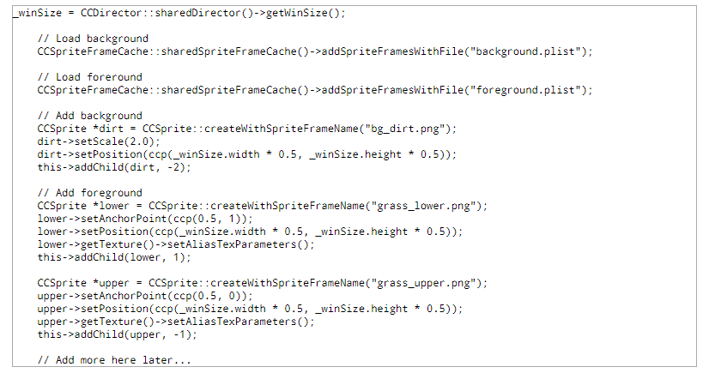
Resource
http://genieker.tistory.com/35

Slide 4
Base System.
http://www.tutorialbook.co.kr/entry/Cocos2dX-%EA%B8%B0%EC%B4%88-0-%EA%B8%B0%EB%B3%B8-%ED%94%84%EB%A1%9C%EC%A0%9D%ED%8A%B8-%EA%B5%AC%EC%A1%B0-%ED%99%95%EC%9D%B8%ED%95%98%EA%B8%B0
https://yunhos.wordpress.com/category/cocos2dx/
Coordinate system & anchor point
http://genieker.tistory.com/10
Zorder
http://cocos2dx.tistory.com/entry/cocos2dx-ZOrder

Slide 5
About Tag
http://genieker.tistory.com/13

