Slide 1
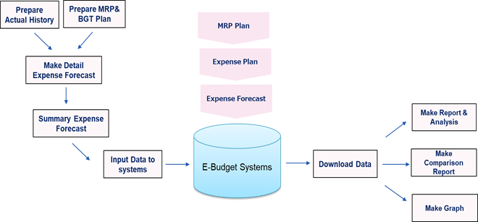
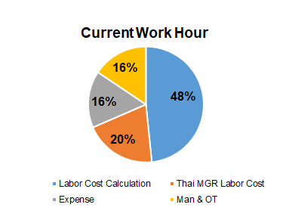
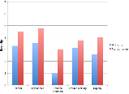

SF01 : [BCF/MBC] Expense Forecast ‘s Operation Improvement
Continue
Focus items : Change from manual calculation , summary , comparison to automatic system
Situation
KPI
Activity
1st Step :
Reduce Manual Operation of Resource preparation
Operation time improvement 41%
Common Platform Expense in each Division
Development web application
Interface actual expense from another system by upload or interface
Input Budget/Forecast on the system
Reports base on requirement
Break Down
Actual
(MOZART,K-MART,i-Semicon)
Improve 41%
(reduce 47 hours/Month)
Budget
Expense Forecast System
Forecast
Improvement Point
Reduce manual calculation time
Reduce risk of calculation mistake
PIC : Arthit C. , Vitawan , Porntip
Action | Apr | May | Jun | Jul | Aug | Sep | Oct | Nov | Dec | Jan | Feb | Mar
1. Operation discussion with ITF (ADM)
2. Systems Design
3. Development Program
4. Systems Test & UAT
5. Training
6. Go Live
Finish BGT screen for HC , OT and auto benefit calculation
Continue in FY20
Apr-20 Go Live

Slide 2
SF01 : =Current Operation for “ EXPENSE FCST ”=
Take Action improve in FY19 2H
Take Action improve in FY2020
In 192H we focus on : data input , data summary and comparison
**Current Time for 1 Cycle
Mid Range Plan
O-BGT Plan
Monthly Forecast
JOB
ADM (BCF)
Each Div.
MPC (MBC)
GA (HRF)
ADM (BCF)
Each Div.
MPC (MBC)
ADM (BCF)
MPC (MBC)
Each Div.
Labor Cost
25 Hours
63 Hours
MRP Data
MRP Data
Make Format
Data
Correct
Make Comparison Report
ADM Report 24 Hours
SDT Report 120 Hours
Make Monthly Forecast
Input Man ,OT Hour
243 Hours
No
Yes
Actual Data
BGT Data
10 Hours
Update Actual expense
Summary & Upload
Make Budget Plan
Input data
30 Hours
8 Hours
Production Plan
Actual Data
Gather All Data for Labor Cost
Labor Cost calculation
44 Hours
42 Hours
71 Hours
Summary & Upload
Production Plan
Summary & Upload
Summary Labor Cost
6 Hours
6 Hours
8 Hours
4 Hours
6 Hours
Thai MGR Labor Cost
Make Format
Input %Allocation
Input %Allocation
Labor Cost Allocation
Thai MGR Labor Cost
Make Format
Input %Allocation
12 Hours
8 Hours
Summary
120 Hours
E-Budget
Summary
8 Hours
Expense calculation
E-Budget
Expense
No
E-Budget
Data
Correct
Report :
MBC, ADM Div.
Input Data
Production Plan
12 Hours
Yes
Report :
MBC, ADM Div.
Cross Check
34 Hours
Make Comparison Report
Report :
MBC, ADM Div.
Expense Summary& Upload
Labor /Welfare/Depre. Allocation.
5 Hours
Labor /Welfare/Depre Allo.
4 Hours
Make Comparison Report
Make Comparison Report
Labor /Welfare/Depre Allocation
11 Hours
1. ADM (BCF) Report
Indirect/SDT Expense Report
25 Hours(Total all Cycle 60 Hours)
2. MBC Report
27 Hours
Expense Allocation
Expense Allocation
Expense Allocation
8 Hours
Cross Check Data
Man 2 Hours
Expense 1 Hours
1. ADM (BCF) Report
Indirect/SDT Expense Report
25 Hours(Total all Cycle 60 Hours)
2. MBC Report
27 Hours
Cross Check Data
Man 0.5 Hours
Expense 0.5 Hours
1. ADM (BCF) Report
Expense for PL 2 Hours
2. MBC Report
65 Hours
Fix MRP Expense
Fix BGT Expense
Fix BGT Expense

Slide 3
SF01 : =Overall Improvement Action=
After discussion with ITF, we estimate to improve , and plan to make an auto calculation.
Work Hour plan to improve -50% down.
Topic | Current Manual Operation |  | Action Improve
 | Operation | Time | Improvement | Time (After Improvement)
1. Labor Cost | Make Excel Format | 15 Hours per 1 cycle | Input to Database systems | 5 Hours per Cycle (Remain Create Biz Group Master)
 | Gather & Summary | 40 Hours per 1 cycle | Auto Calculation & Generation | 10 Hours per Cycle (Remain Cross check Data)
2. Thai MGR Labor Cost | Make Excel Format | 12 Hours per 1 cycle | Input to Database systems | 4 Hours per Cycle (Remain Create Biz Group Master)
 | Analysis & Comparison | 6 Hours per 1 cycle | Web Report upon User Requirement | 4 Hours per Cycle (Remain Time for Confirmation Meeting)
 | Gather & Summary | 6 Hours per 1 cycle | Auto Calculation & Generation | 3 Hour per Cycle (Remain Cross check data)
3. Expense (HC & OT & Expense) | Gather Data | 34 Hours per 1 cycle | Auto Calculation & Generation | 10 Hours per Cycle (Remain Cross check data)
 | Welfare/Depreciation Allocation | 11 Hours per 1 cycle | Auto Calculation & Generation | 4 Hours per Cycle (Remain Cross check data)
 | Get Detail Actual for control | 243 Hours per 1 cycle | Auto Interface Data from SAP | 143 Hours per Cycle (Remain Cross check & analysis)
Total |  | 367 Hours per 1 cycle |  | 183 Hours per cycle (Reduce 184 Hours or -50% Down)

Slide 4
SF01 : Expense Forecast System Overall Function
ADM (BCF)
Each Div.
MPC (MBC)
Login
Man & OT input screen
MRP Data
Maintain User ID
Labor Cost screen & calculation
Make Comparison Report
ADM Report 24 Hours
SDT Report 120 Hours
Open & Closing period
Welfare cost screen & calculation
Make Budget Plan
Input data
Maintain Cost Center
DP Allocation
44 Hours
6 Hours
Summary & Upload
Maintain Account Code
Energy Allocation
4 Hours
Thai MGR Labor Cost
Make Format
Input %Allocation
8 Hours
Maintain Exchange Rates
All Expense Screen
Summary
DB_Expense
Summary & Export for BC & MBC & Yojitsusan
Get Actual Screen
Labor /Welfare/Depre. Allocation.
5 Hours
Summary & Reports
Indirect Allocation
Expense Allocation
Cross Check Data
Man 2 Hours
Expense 1 Hours
Labor Cost screen & calculation (Ass.Mgr up TH)
Fix BGT Expense

Slide 5
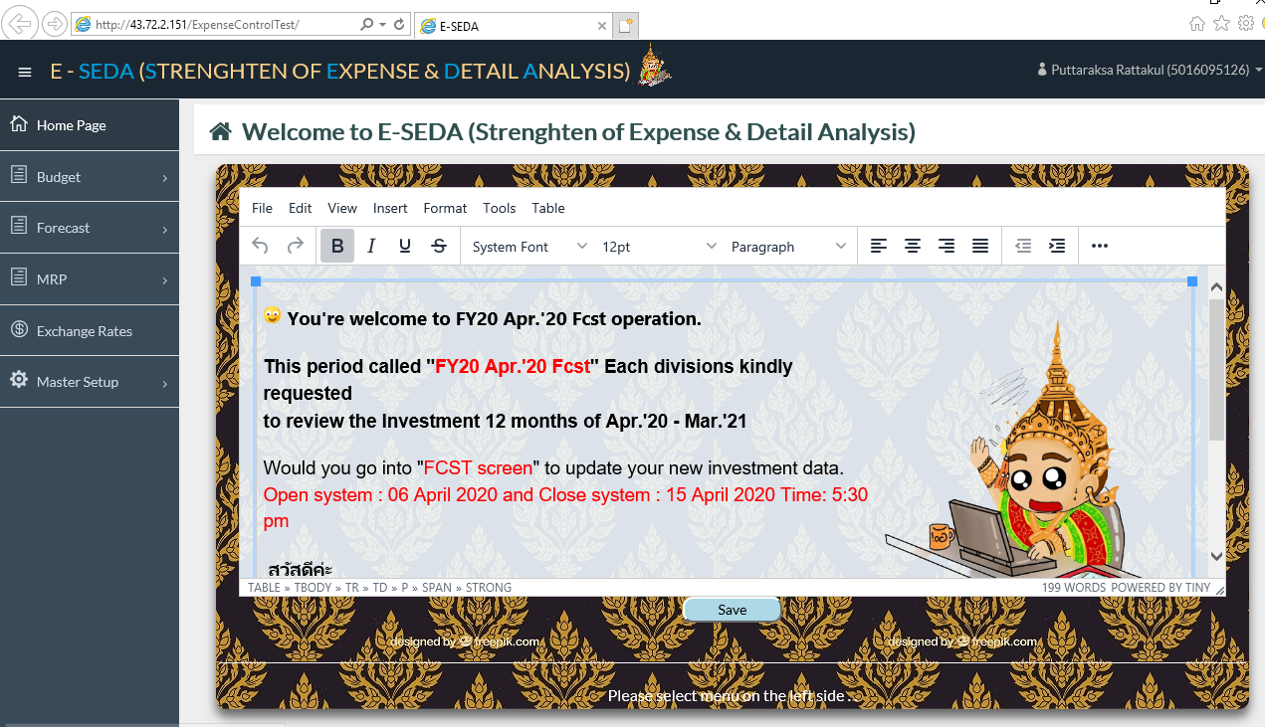
SF01 : UI Screen Design
Main Menu
CONTENT

Slide 6
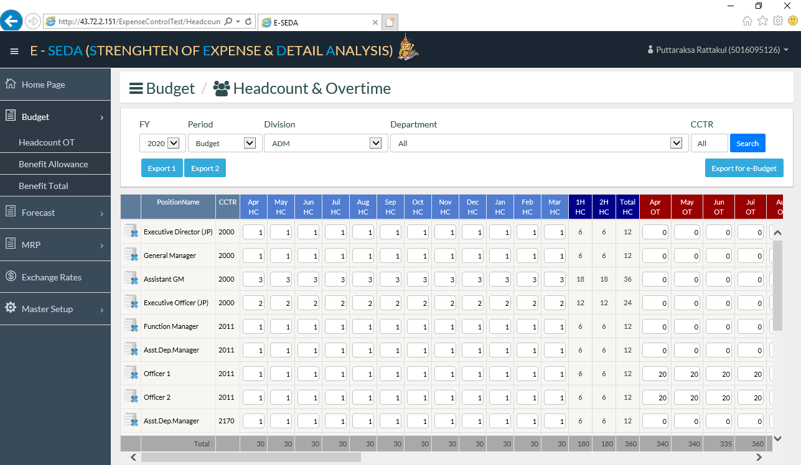
SF01 : UI Screen Design [HC & OT Input Screen]

Slide 7
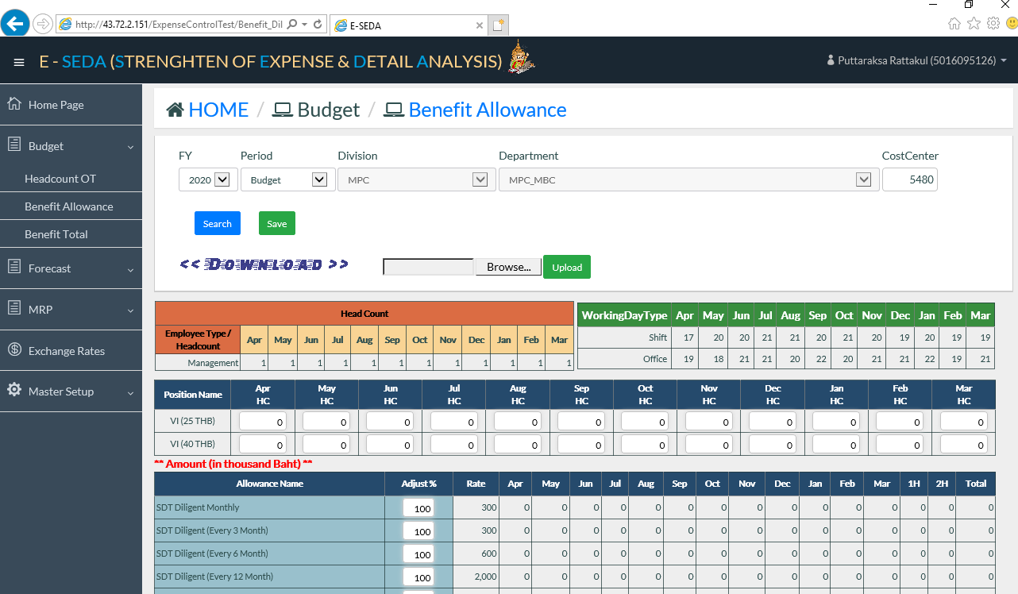
SF01 : UI Screen Design [Benefit Calculation Screen]

