Slide 1
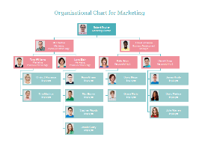
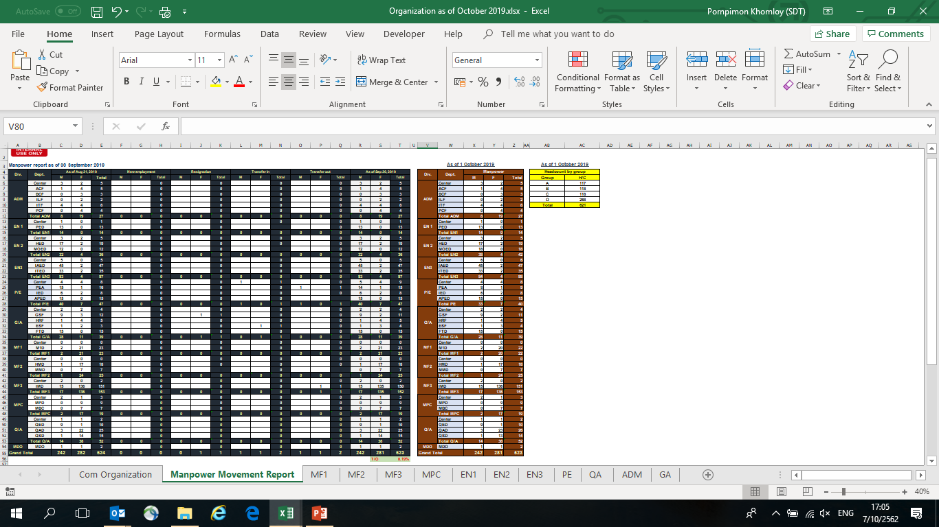
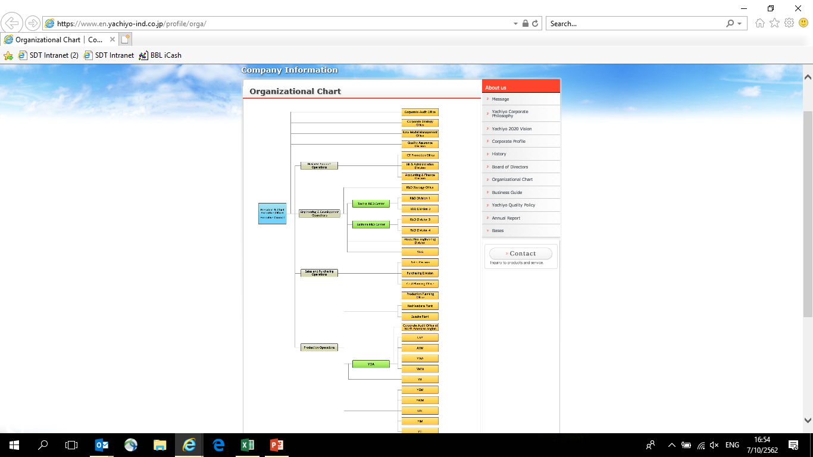
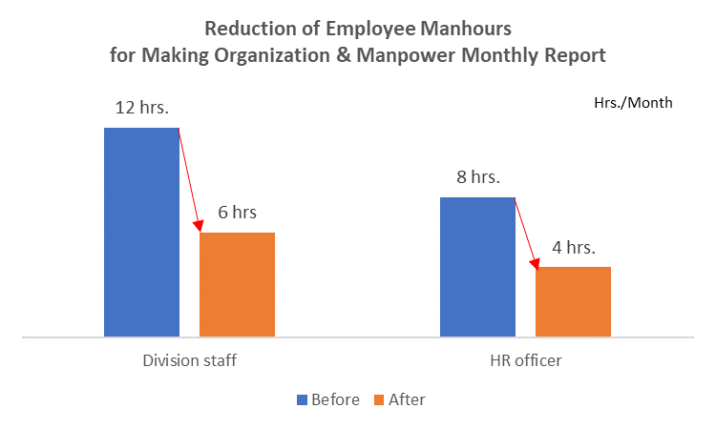

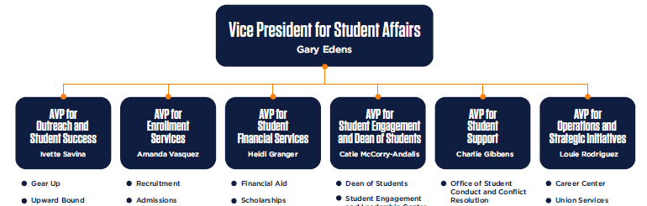
SF02 : [HRF] Organizations & Manpower Reports
Continue
Focus items : Reduce man hour to make Company Organize and manpower movement reports
Situation
KPI
Activity
Organization & Manpower monthly report
Reduce manhours of concerned persons for making report
Can reduce 50% manhours of staff from each division
Can reduce 50% manhours of HR Officer
100% accuracy of manpower report
Create System for each division input / update organization
Automatic organization chart form system
System Interface with HRMS via Upload / Download
Each division submit an updated organization & manpower via SharePoint
HR collect all files to make the company organization & manpower report
(Excel)
Check accuracy
(Manual check with excel)
Each division submit and update organization
Improvement points
Reduce manhours from making report
Reduce risk of report mistake
Current
Plan
2 hrs. x 6 Div. = 12 hrs. → 6 hrs.
HR = 8 hrs. → 4 hrs.
Organization Management
HRMS Organization
Movement
Reports
PIC : Arthit C. , Pimprapa
Action | Apr | May | Jun | Jul | Aug | Sep | Oct | Nov | Dec | Jan | Feb | Mar
Requirement Definition and PI Education
System Design
Development
System Test & UAT
Training
Go live
Keep Schedule
Finish Auto organization chart
Remain manpower movement report
Switch to develop POMS Goal setting

Slide 2


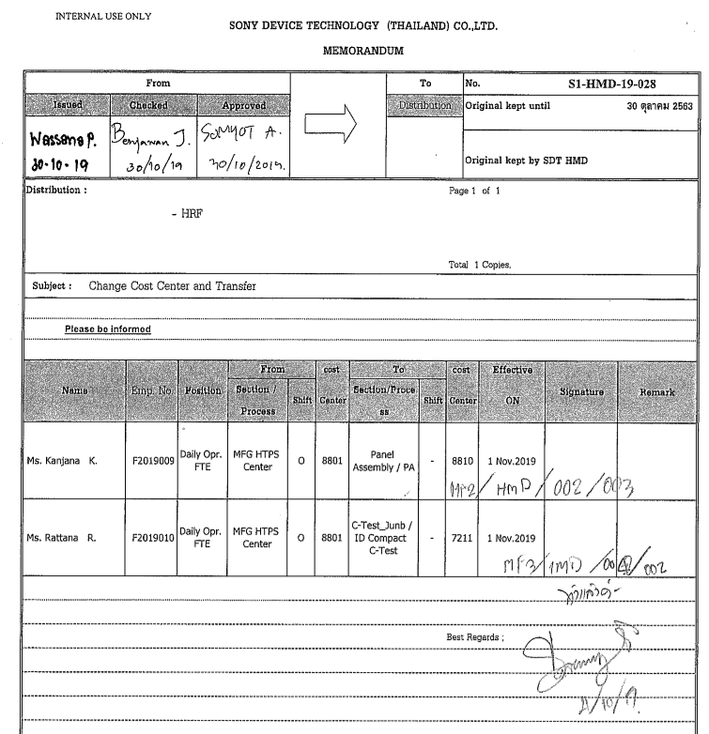
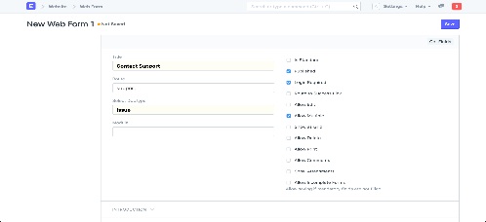

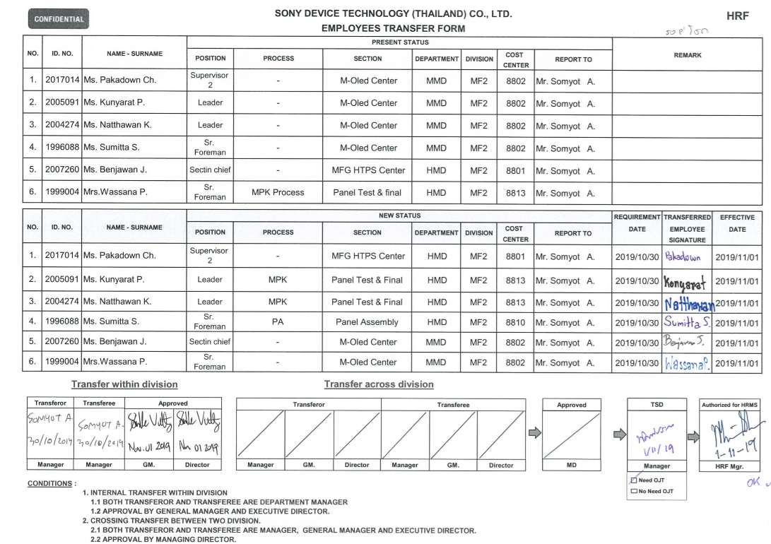

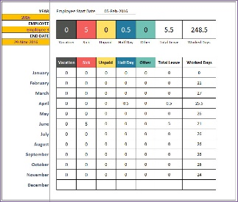


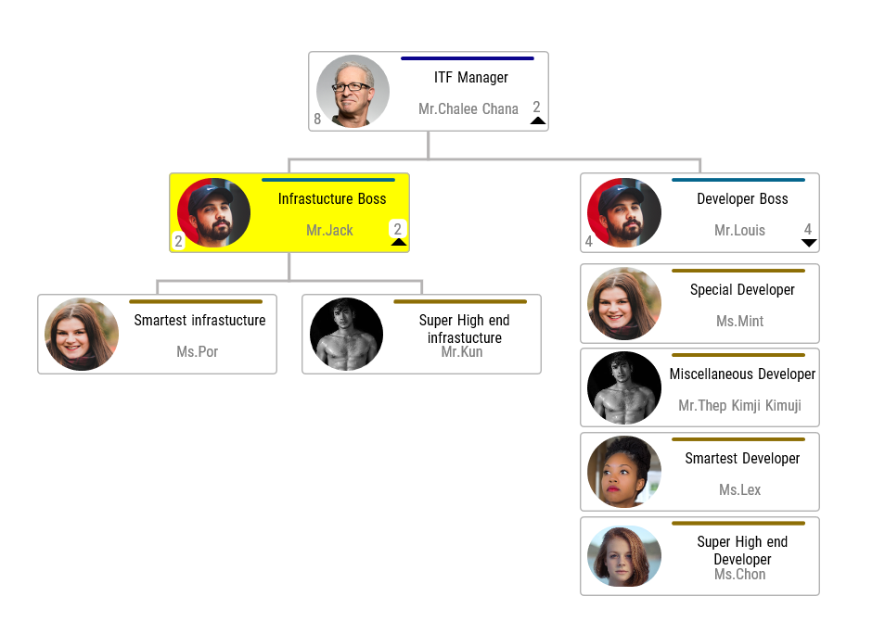
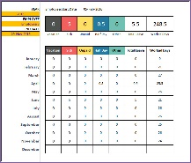
SF02 : [HRF] Organizations & Manpower Reports
As Is
To Be
Division Organize
Movement Request
Submit Movement
-Transfer
-Change Group
-Change Working Calendar
HRMS
Merge-Group-Mix data
Correct data & Comparation & Input on HRMS
Publish on Intranet Website
Movement Information
Update on HRMS
Approval
Input/Automatic update on HRMS
Make Manpower Reports
Make Organization Charts
Company & Division Organize
Manpower Reports
Every Process using Manual
Remain manual (Input Movement to HRMS)

Slide 3
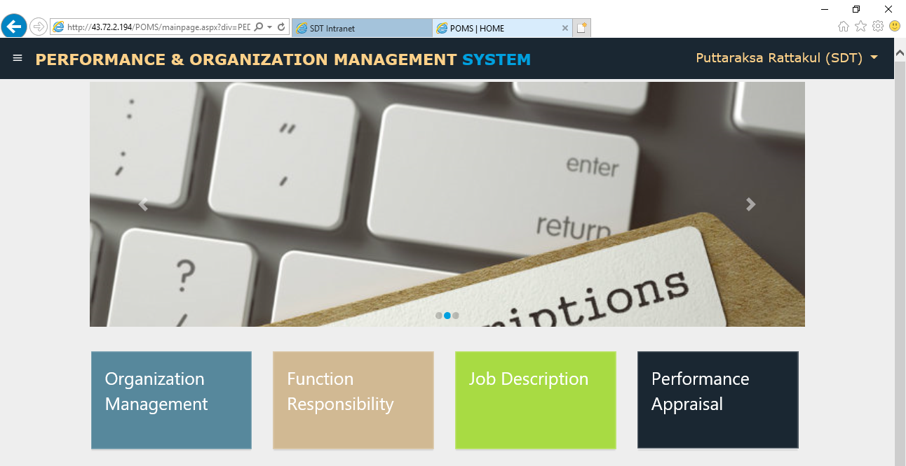
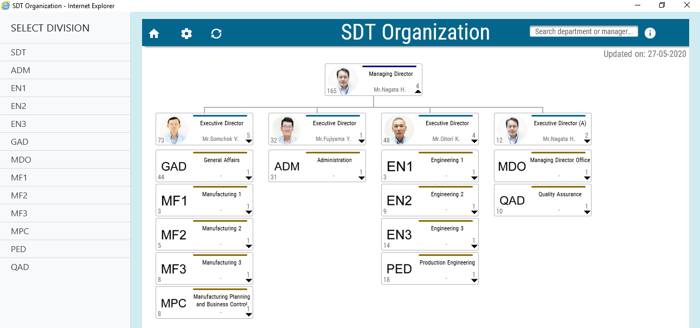
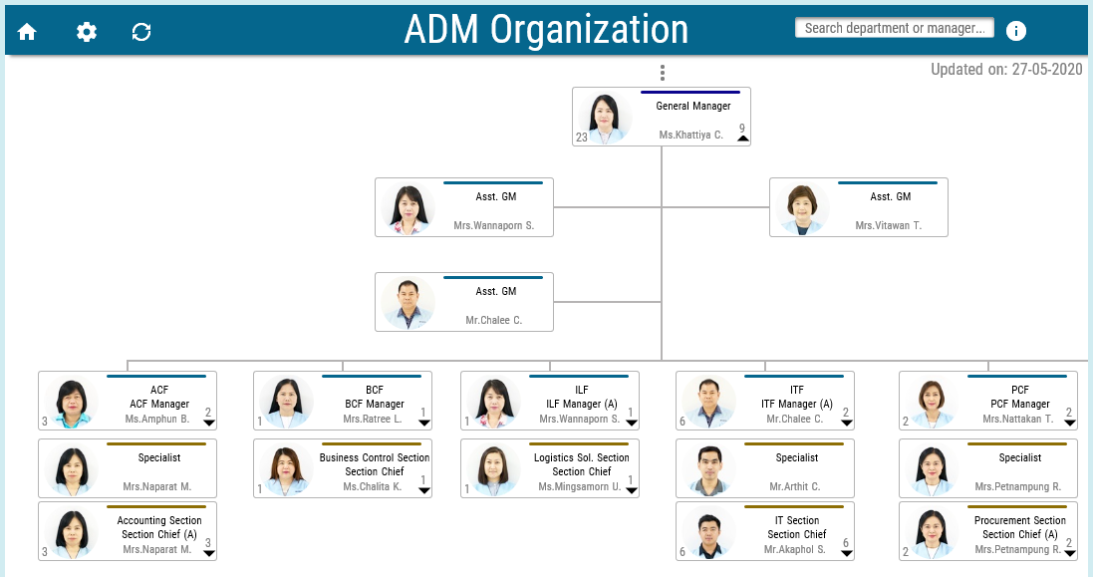
SF02 : [HRF] Organizations & Manpower Reports

