Slide 1
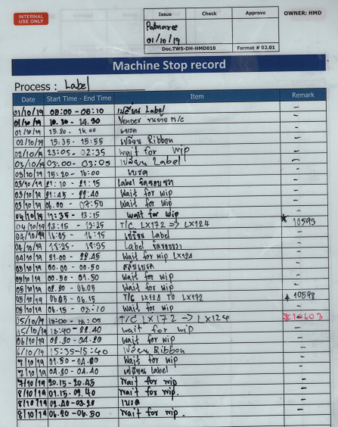


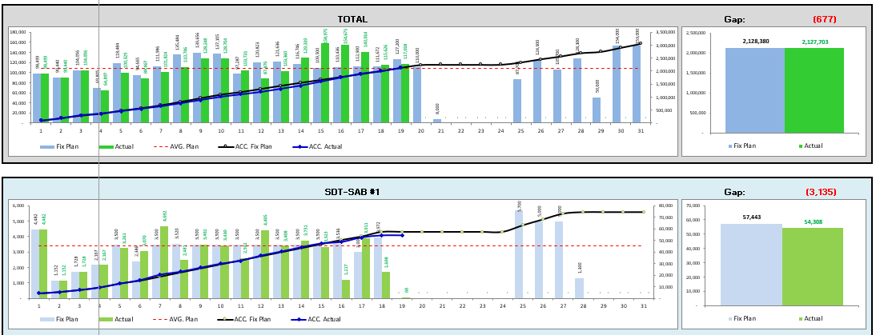
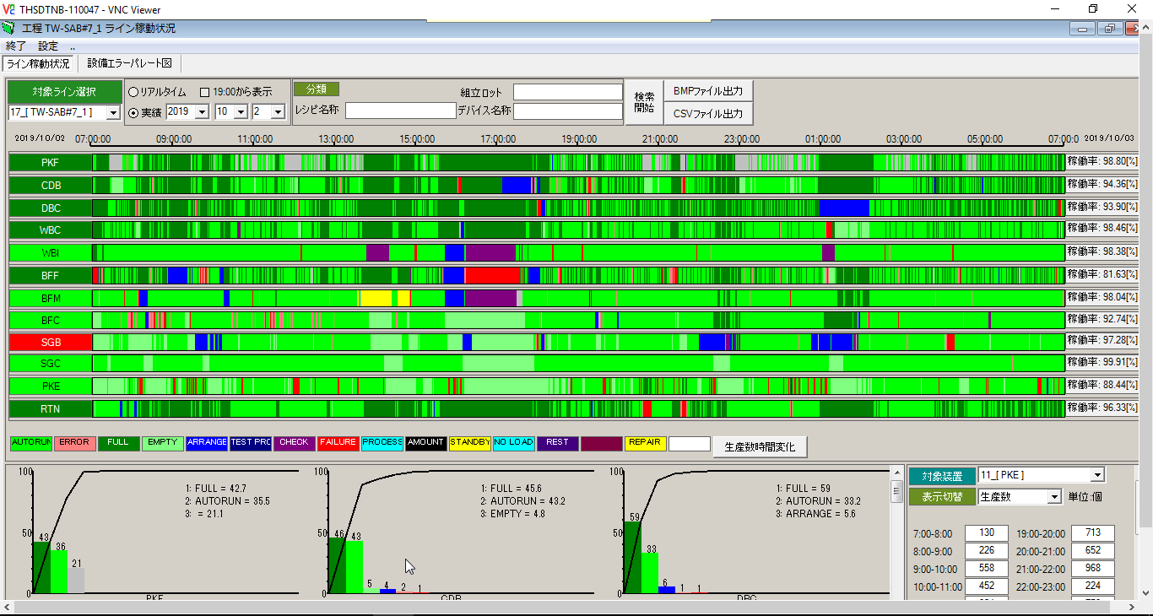
Closing
SF03 : [MF2/MF3] Machine Stop Record / Summary
Focus items: This system can reduce record time working hour and summary reports for analyze
Situation
KPI
Activity
Record Format
Discuss with SCK to make interface from Machine Online System
Develop application base on AXIS-MI tablet network for user can input on tablet
Make web summary reports
Record detail
in Laminate sheet
Reduce paper 240 sheet / month
Reduce record time 86hrs./ month
Recording Time
Machine output
Excel Record Format
Input detail in excel to make a report
E-Record
(Machine stop record)
Machine Efficiency
Machine output
Machine Efficiency
Machine Stop Record System
Make monthly report
Machine Online
PIC : Arthit C. , Rungkhun , Somyot
Action | Apr | May | Jun | Jul | Aug | Sep | Oct | Nov | Dec | Jan | Feb | Mar
1. Requirement (MF3, MF2)
2. System Design and Discussion with SCK
3. Development
4. System Test & UAT
5. Training
6. Go live
Get requirement from user
Discuss with SCK to make interface system
Development
UAT
Training

Slide 2

SF03 : [MF2/MF3] Machine Stop Record / Summary
Why we need the record? Every morning meeting we will conclude the yesterday output and list up the problem that effect to the output. Then we will take action to
Daily output VS plan
Machine monitor
MFG machine stop report
Yesterday output
VS plan
Plan
Actual
Actual
Plan
Plan
Loss time that make output not archive
Actual
MC#01
MC#02
MC#03
Action to recovery to archive plan
Wait for material
Machine not smooth
Wait for operator change material
Daily progress meeting

Slide 3
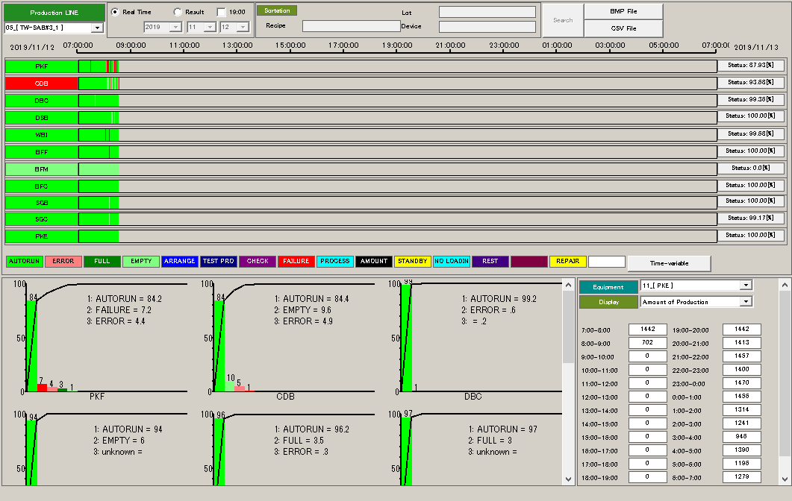

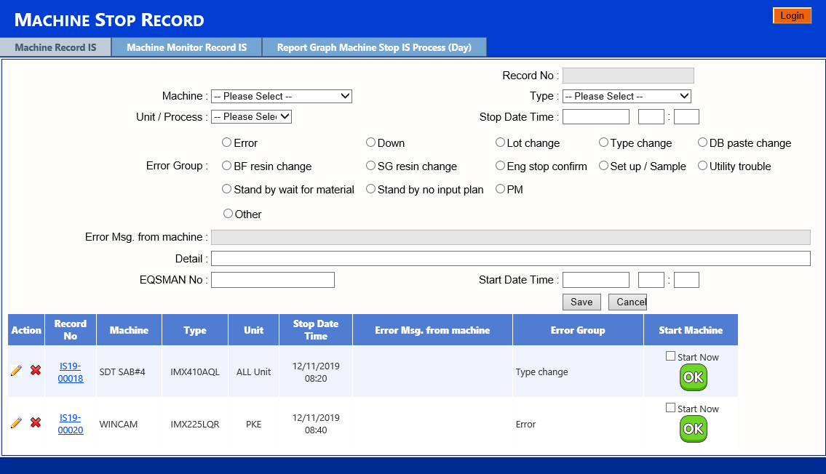





SF03 : System Architecture
Interface data from Current Machine Online System and develop new Web Application for input more information via Tablet
Machine online system
(Current)
Machine Stop Record
& Machine Efficiency
(new Web Application)
Input data via tablet
AXIS-MI Server
Auto Report
Machine Stop Summary
Machine Output & Efficiency
SONY NETWORK
PRIVATE NETWORK

Slide 4














SF03 : [MF2/MF3] Machine Stop Record / Summary
Machine monitor record items
VS
Manual record
Machine monitor record item |  | Manual record
 | Machine operate | No Record
 | Ready operate after push the product to next unit | No Record
 | Ready operate from previous unit | No Record
 | Machine Error (Fully Error detail) | Record data from machine display
 | Machine Error (Fully Error detail) | Record data from machine display
 | Arrange (No more detail) | Lot Change Material change
 | Check (No more detail) | PM Daily Check ENG use machine
Machine monitor record item |  | Manual record
 | Standby | Wait for WIP No production plan Wait for martial
 | Rest | No manpower support in brake time
 | Never-ruse | -
 | Never-ruse | -
 | Never-ruse | -
 | Never-ruse | -
 | Never-ruse | -

Slide 5




SF03 : [MF2/MF3] Machine Stop Record / Summary
Current Method
Writing
Typing

Slide 6
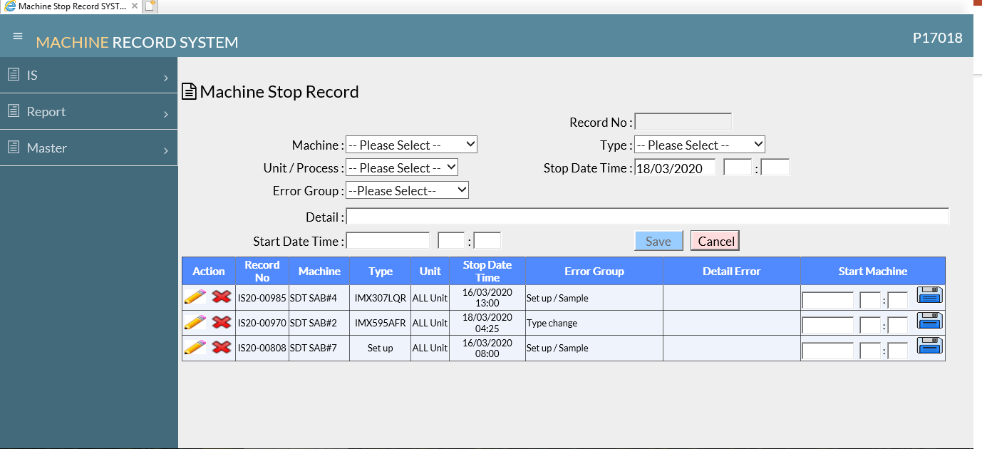
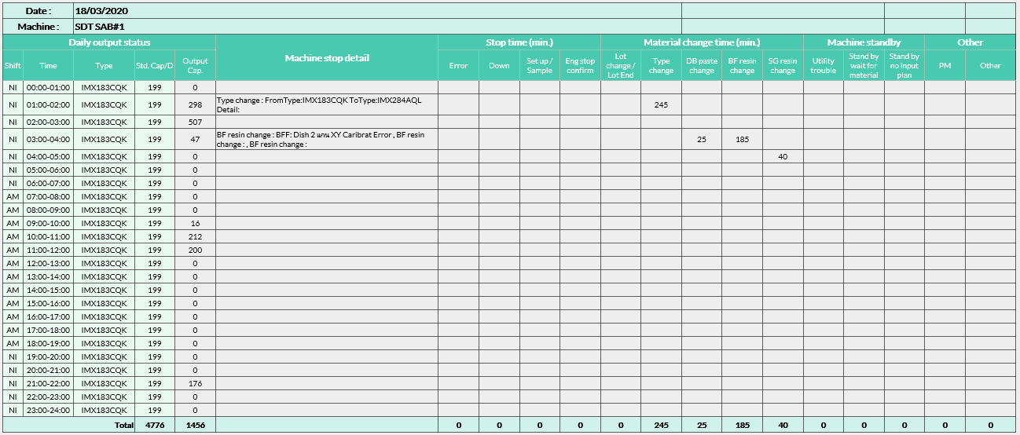

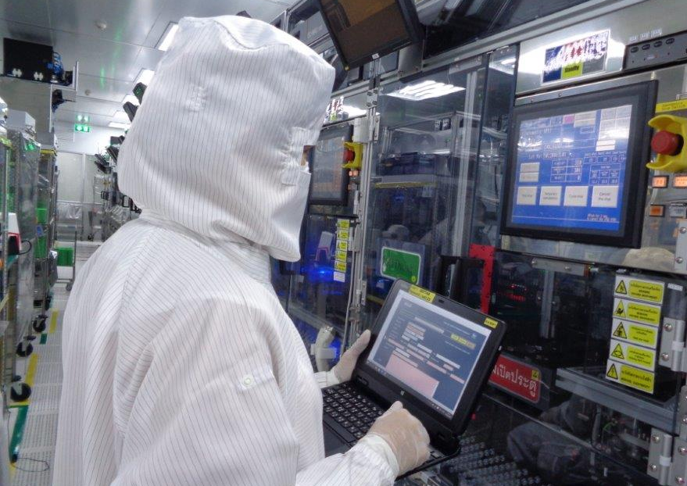
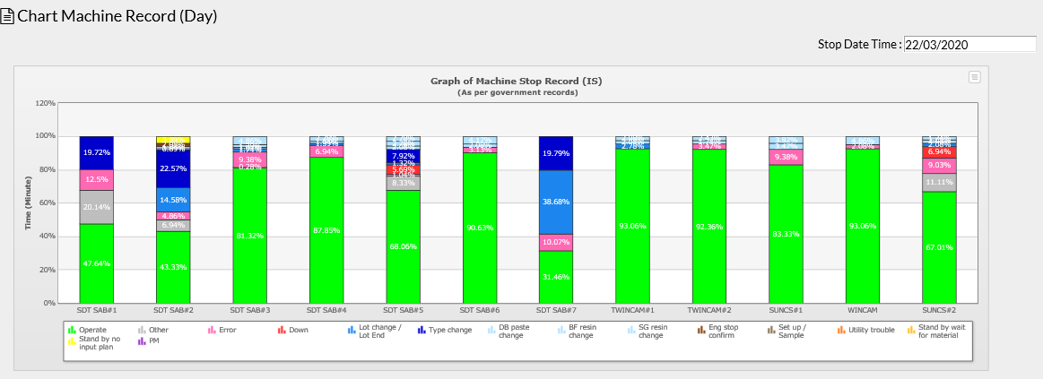
SF03 : [MF2/MF3] Machine Stop Record / Summary
Application
http://43.72.20.161/MachineStopRecord/
Machine number
Machine Unit
Product type
Error Group
Stop time
Summary by machine
More detail
Input time when machine can start
Input data by tablet
Step 1 : Stop time
Machine Efficiency
Input data to issue
Stop record
Step 2 : Stop time
Input time when machine can start

Slide 7
SF03 : [MF2/MF3] Machine Stop Record / Summary
Benefit
 | Indirect Benefit
1 | Reduce job to make report end of shift (input data to excel for all machine). So they have a time to focus other job such as prepare material, prepare information for next shift.
2 | Supervisor can monitor the machine stop issue by real time. (Different from old report that will be reported 1 time /shift by email.) So the operator is not interrupted during operation by telephone from supervisor for answering why machine stop.
Reduce record time 81%
285 hr/month
54 hr/month
Total 12 machines
Total 12 machines

