Slide 1
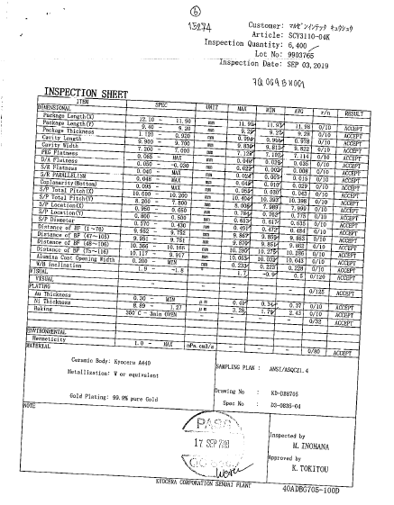
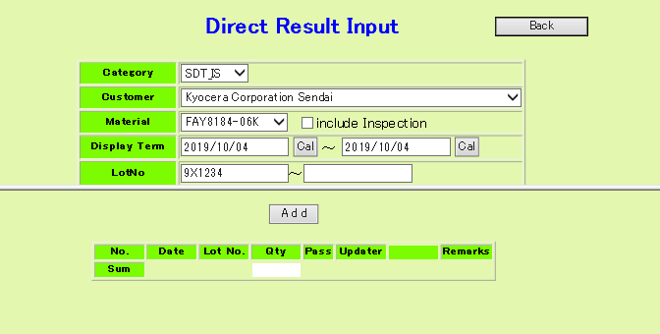

SF06 : [QSD Incoming] Material Inspection data checking lead-time reduction
Closing
Focus items : Change manual check in paper to auto check and record
Situation
KPI
Activity
Inspection data checking lead time Operator has to manual check inspection data every lot (~ 1300lot/ month)
Survey vendor data of each material
Grouping document
Set data base record item
Develop application from PDF to data base
Trial test
Set standard
Training to operator
Reduce 62.5%
-104Hrs
Item | Before | After
1. Vendor data checking by manual | 62.5 | 0.0
2. Stamp pass on vendor data | 20.8 | 0.0
3. Key inspection result data in data base | 20.8 | 0.0
4. Scan data | 10.4 | 10.4
5. Save vendor data in sharepoint | 10.4 | 10.4
6. Stamp pass on label box | 41.6 | 41.6
summary | 166.5 | 62.5
PDF → DB
DB utilization
Report sys.
Trace sys.
PDF Analyze
Incoming DB
Check inspection data by manual
Manual input in data base
In-charge : Nichapatr, Kritsada Application : Opas P.
Action | Apr | May | Jun | Jul | Aug | Sep | Oct | Nov | Dec | Jan | Feb | Mar
1. Survey vendor data of each material
2. Grouping document
3. Set data base record item
4. Develop application from PDF to data base
5. Trial test
6. Set standard and training
7. Implement
Already finished and implemented

Slide 2


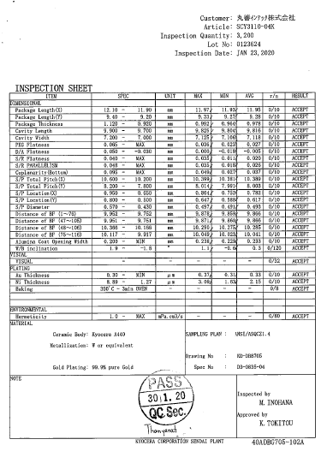

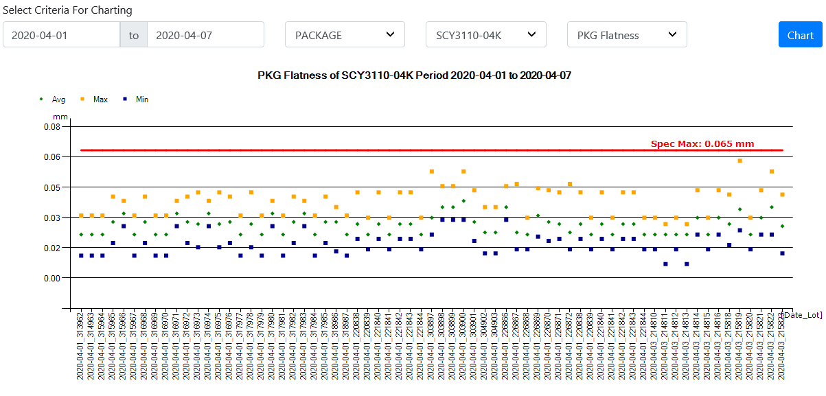


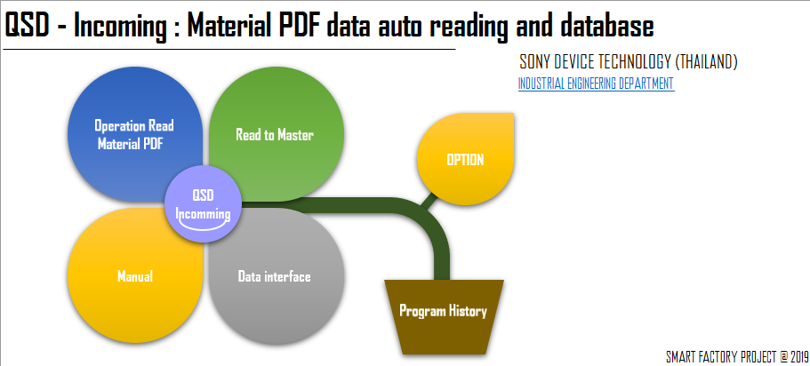


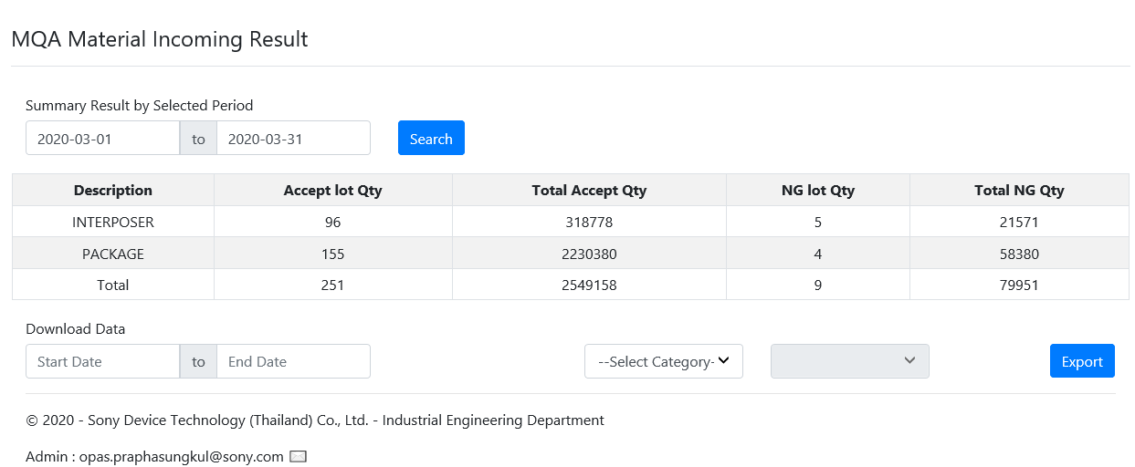
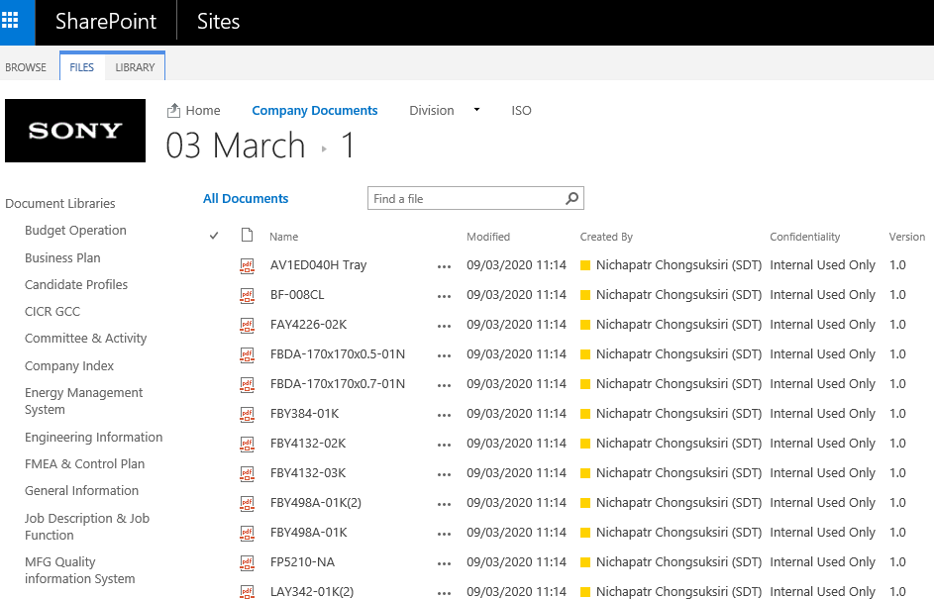






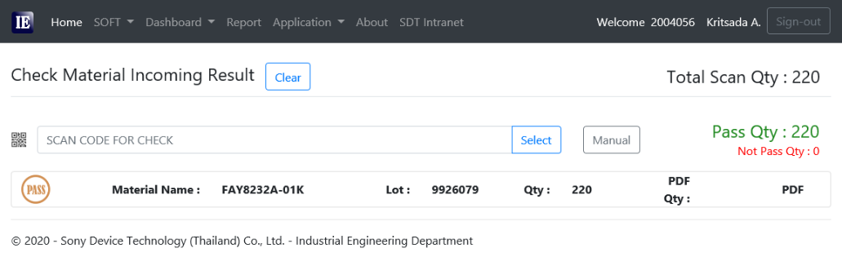





QSD-Incoming : Improvement summary
Before
10.7Min/Lot
After
4.5Min/Lot (2.6Min if implement all)
Receiving
Inspection data checking&record
History data
8Min/lot
1.8Min/lot
Master format
Chart trend
5.3Min
Material
Inspection
Data
0.4Min
Manual check
Text Enable.pdf
Picture.pdf
Data base
Inspection summary
1.3Min
O
X
Application
Inspection data (PAPER)
Key data
0.7Min
0.7Min
0.7Min
Result OK/NG
Save in sharepoint
0.7Min
“NG”
Alert mail
Scan the evidence
Material checking
2.7Min/lot
0.8Min/lot
Application
Received Material
Scan QR code
Matching datasheet & Material box & Check Q’ty
Stamp to receive
Stamp to receive
OR
PASS or NG
Wireless Scanner+PC notebook+cart
(5,900+30,000+5,000=49,000)
Receiving slip & inspection result
PDA
(60,000)

Slide 3
QSD-Incoming : Implementation
Temporally OCAP during trial period
2) Training to concern member
Start
Shift | Name | Date | Remark
Shift A | Waree | 11/3/2020 | Can create new format. Can operate the application.
Shift A | Kwannapa | 11/3/2020
Shift A | Dongjun | 11/3/2020
Shift B | Supitcha | 11/3/2020
Shift B | Thanyarat | 11/3/2020
Shift C | Siyapha | 11/3/2020
Shift C | Nittaya | 11/3/2020
Already trained to all member 7psn.
They can operate by the new method
Receive inspection data from Receiving
Upload file and run program
3) Implemented type list (in March’20)
Result
(Can run program?)
No
Create new format
and run?
Error
Yes
OK
Manual check data
Inspection result
“PASS”
No
Yes
Accept material
Inform Engineer to fix error or confirm data
First priority is 77%
Implement on received lot Q’ty
Completion of master format
End
Will optimize flow and revise WSD within Jun’20
(TWS-QSD013 Material Incoming Inspection)
Can’t apply all Lot&type due to take time to create master format (30min/type).
Already improve program (5min/type) and plan to finish create the master within Sep’20

Slide 4
QSD-Incoming : Project summary
Can reduce operation time
166.5Hr/M to 92.2Hr/M
or 45%
-62.5%
-45%
Unit : Hour/Month
Item | Improvement | Before | After (Plan) | After (Actual) | Reduction (Actual) | Remark
1. Vendor data checking by manual | Check&Judge by application | 62.5 | 0 | 20.3 | -68% | -Main is IP from Kyocera 77% (720/933) -Remaining 2.7%(26/933) for creating master data format. -20% (187/933) is picture .pdf, cannot be improved by this project.
2. Stamp pass on vendor data | Record data into data base by application | 20.8 | 0 | 4.7 | -77%
3. Key inspection result into data base | Auto upload to data base | 20.8 | 0 | 4.7 | -77%
4. Scan data | N/A | 10.4 | 10.4 | 10.4 | 0%
5. Save vendor data in sharepoint | N/A | 10.4 | 10.4 | 10.4 | 0% | Need to keep in share point for evidence
6. Stamp pass on label box | Auto matching Box-to-data by application | 41.6 | 41.6 | 41.6 | 0% | Can’t be implemented yet! need to invest scanner & Notebook (reduce 54% total reduction 58%)
Summary |  | 166.5 | 62.5 | 92.2 | -45%

Slide 5
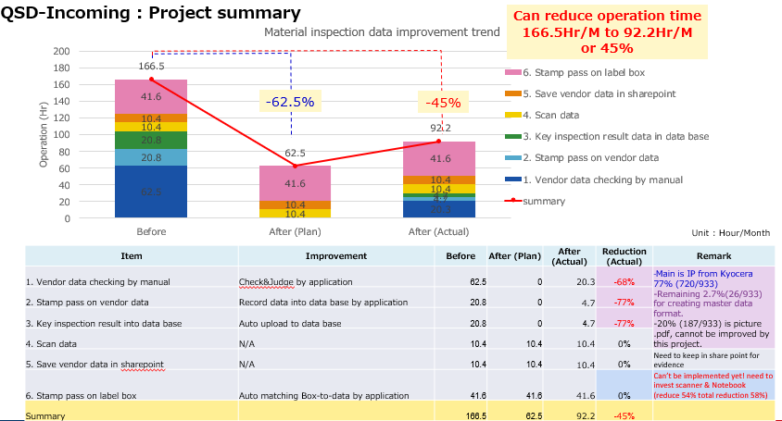
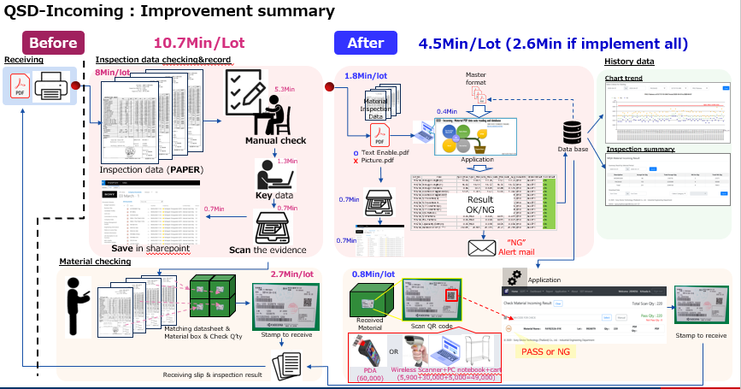
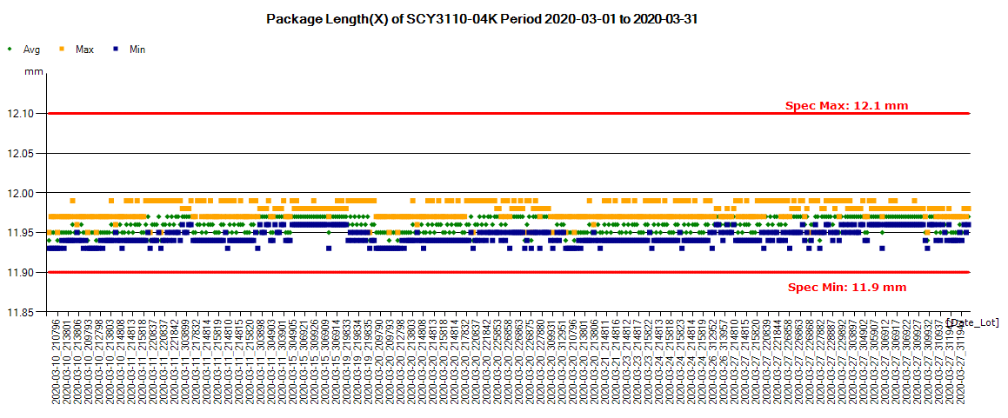
SF06 : [QSD Incoming] Material Inspection data checking lead-time reduction
Project Summary
Output & Benefit
Method & Tools
Read PDF (Text) to Database : Adobe Acrobat SDK
Programing 1. Data Formatting : VBA
2. Auto Email : VBA
3. Update to DB : SQL
4. Web report : ASP.net & VB.net
Can reduce operation time
166.5Hr/M to 92.2Hr/M
or 45%
Chart trend for each parameter

