Slide 1
GoogleItUp Presents

Slide 2
Smart Home Activity Detection System

Slide 3
AIM
To build a smart detection and spy system that detect the activities taking place in an empty household, and if suspicious activity is detected, then send a ping to the users.

Slide 4
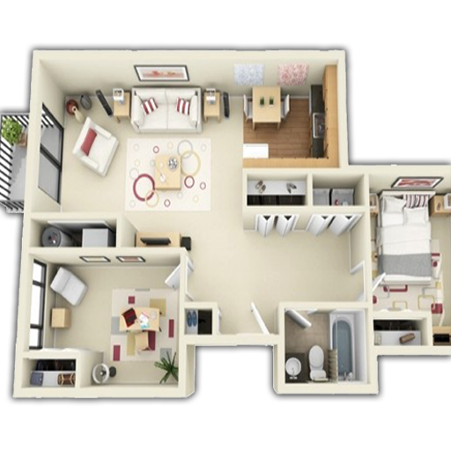
Awesome words

Slide 5
01
About this project

Slide 6
What we are working on
Functionality
Usability
Profitability

